Slide 1
Aortic Valve Stenosis
Jamil Borgi, MD
University of Washington Medical Center
11/2013
Revised: Alison F. Ward, MD
Emory University
9/2022

Slide 2
History
  70 year old female diagnosed with severe AS since 2015
  She has progressively worsening dyspnea and chest pain with activity over the past year
  PMH: HTN, HLD
  PSH: Excision of sclap melanoma
  Social Hx:
  Very active, lives alone, neg for smoking or drinking
  Meds:
  Amlodipine
  ASA
  HCTZ

Slide 3
Physical Exam
    NSR
    Physiologic S1, absent aortic component of S2, systolic ejection murmur
    Thrill is present, no heave
    Carotid pulsus parvus et tardus
    Lungs CTAB
    No ascites, no peripheral edema
    No previous scars on chest

Slide 4
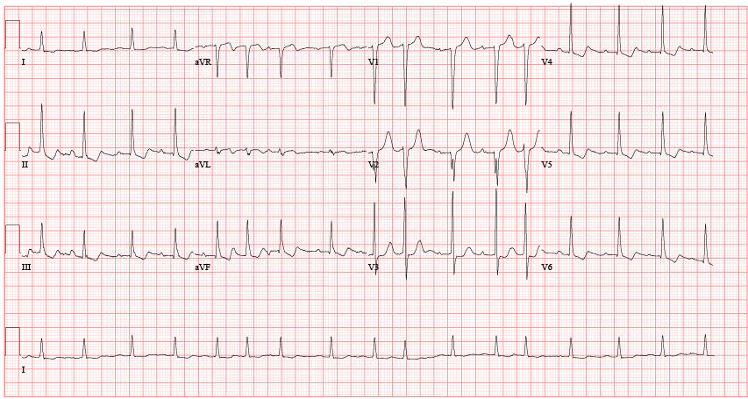
Electrocardiogram

Slide 5
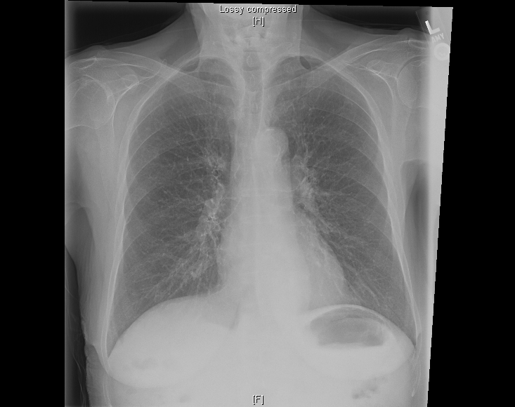
Chest X-Ray

Slide 6
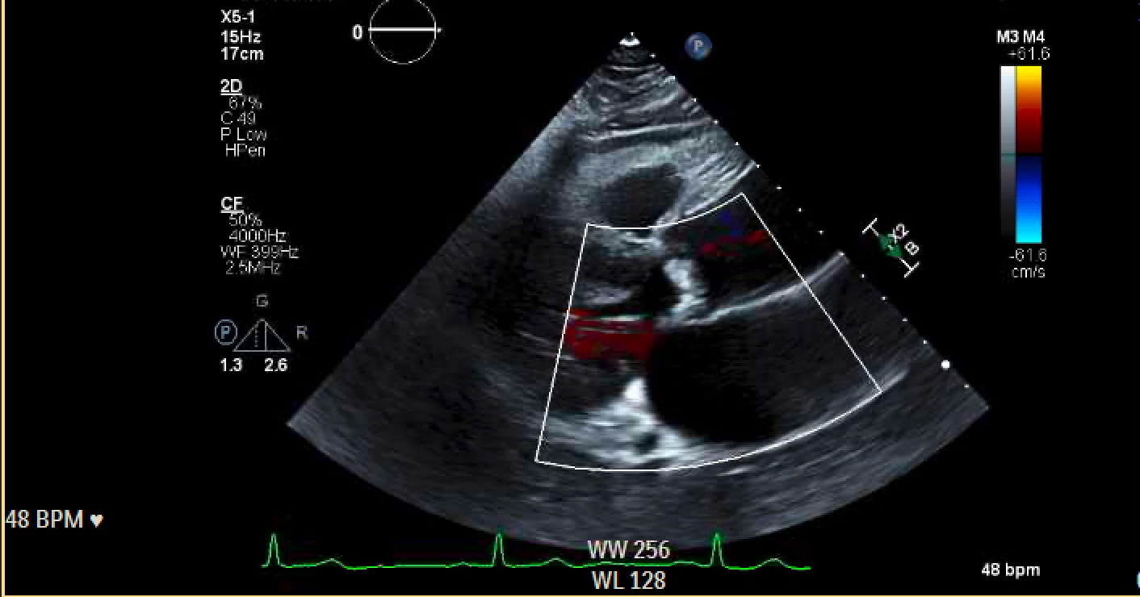
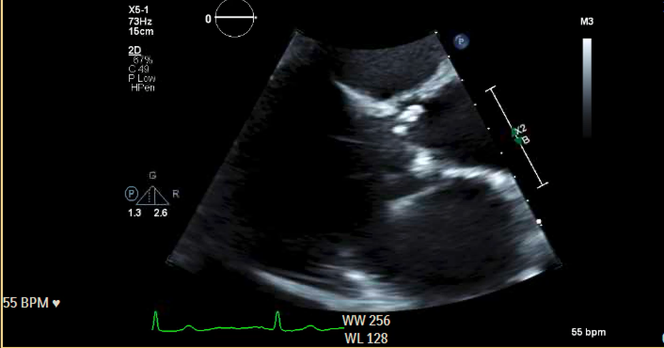
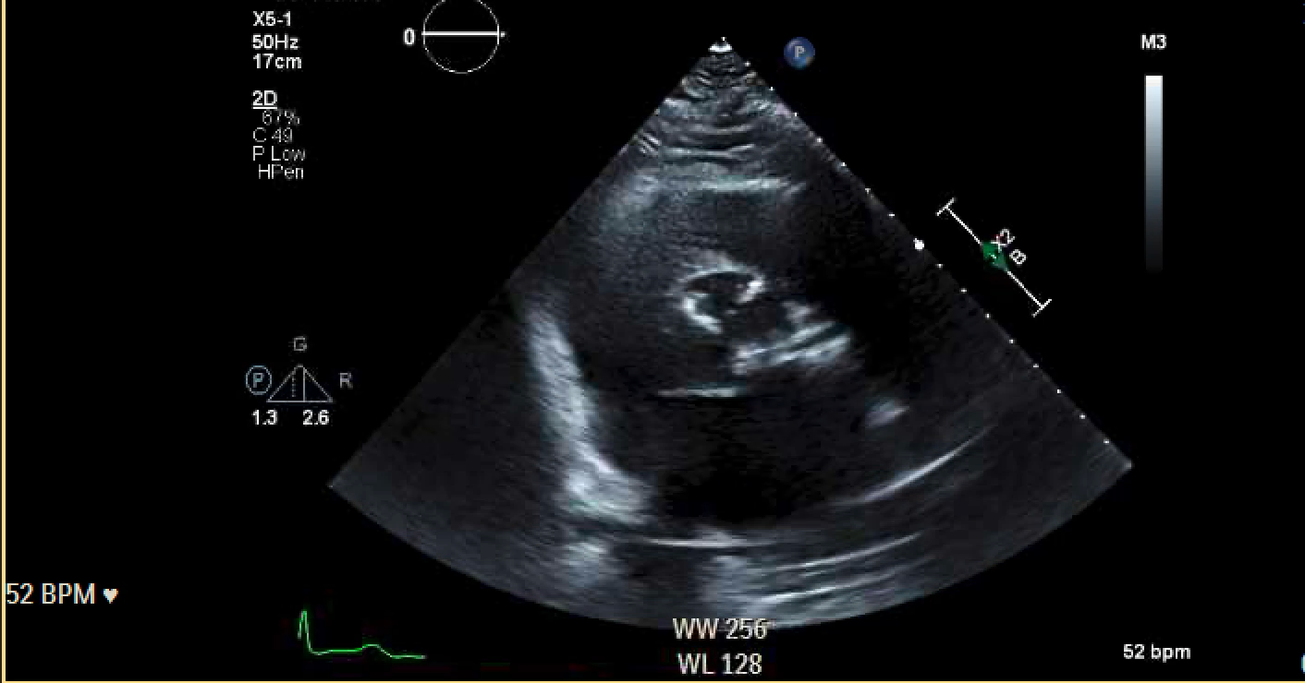
Echocardiogram

Slide 7
Echocardiogram Report
LV Ejection Fraction = 65-70%
No regional wall motion abnormalities
Grade II Diastolic Dysfunction
Severe aortic valve calcium deposition
The peak AV velocity is 4.5 M/sec
The peak/mean AV gradients are 79/50 mmHg
The calculated AV area is 0.49 cm²
The dimensionless index is 0.19
LVOT 1.8cm
Ao Root diameter 3.5cm

Slide 8
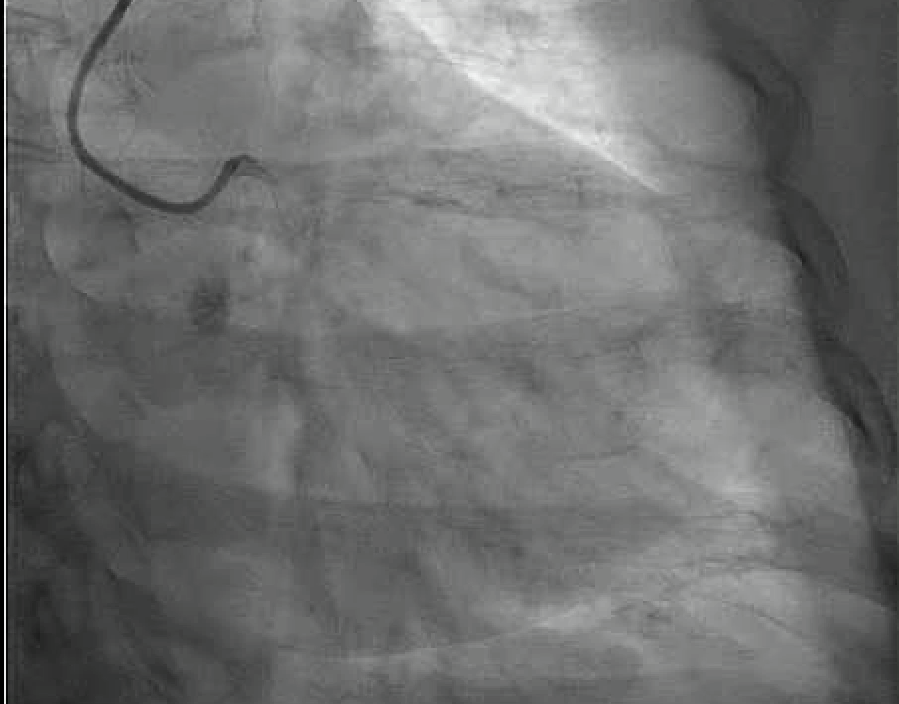
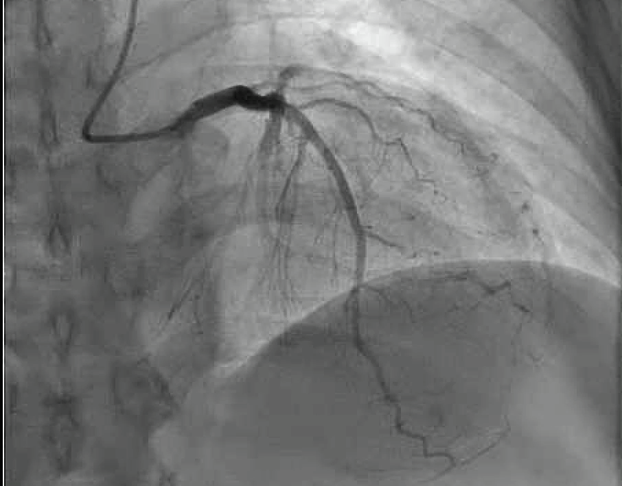
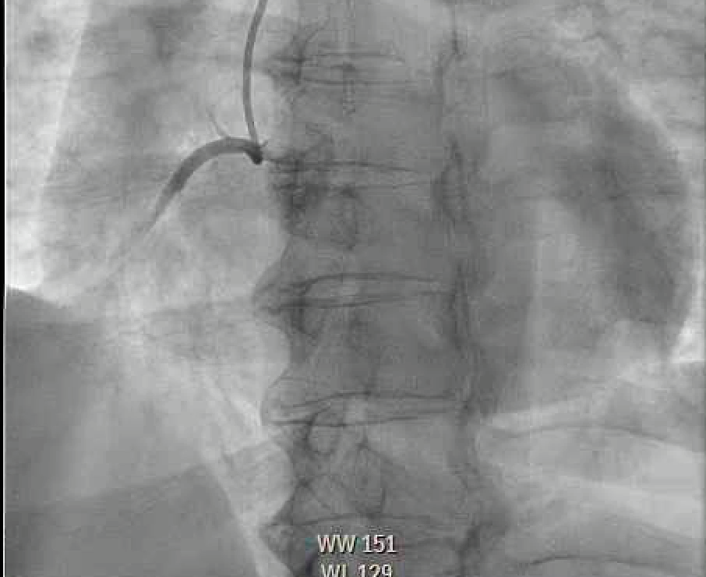
Left Heart Catheterization

Slide 9
Other Preoperative Studies
Chest/A/P CT: no aortic aneurysm, no significant aortic calcification, femoral arteries 5mm bilaterally
PFTs: FEV1 80% predicted, DLCO 70%
Carotid duplex: <50% stenosis bilaterally with antegrade flow in both vertebral arteries
Dental: dentures, no signs of oral infection
Urinalysis: negative for UTI

Slide 10
Outcome
Underwent SAVR
Valve: # 23 Edwards Magna Ease Pericardial bioprosthesis
Hospital course: Uneventful
  Discharged POD#5 to rehab
Postop visits: well healed sternotomy, back to active lifestyle

Slide 11
Discussion Points
Indications for aortic valve replacement
Anatomic variations of AS—tricuspid vs bicuspid, associated thoracic aortic aneurysm
Risk stratification: STS score / EURO score
Heart team decision—TAVR vs SAVR
Valve choices
Patient prosthesis mismatch
Need for root enlargement
Anesthetic priorities

Slide 14
Patient Prosthesis Mismatch (PPM)
iEOA
None-mild >0.85 cm² /m²
Mod 0.65 cm² /m² -0.85 cm² /m²
Severe <0.65 cm² /m²

Slide 16
Learning Points
Management of severe aortic stenosis should involve a heart team approach to determine optimal timing of intervention and selection of SAVR vs TAVR
Valve selection should determined factoring in age of patient, need for anticoagulation, valve durability, and optimal valve size
PPM should be avoided by implanting a valve with iEOA >0.85 cm² /m² or performing a root enlargement to allow implantation of large enough valve to avoid PPM

