Slide 1
Undifferentiated Pleomorphic Sarcoma of the Chest Wall
Author: Dale Han, MD / Yale University
Publication Date: April 2014
Last Revised: March 2025, Paul Schipper, MD / OHSU

Slide 2
History
72 year-old female with history of right breast cancer treated with lumpectomy and radiation. Eight years later, she develops a right anterolateral chest wall mass
PMH:
Right breast cancer, hypertension, pancreatitis
PSH:
Right breast lumpectomy, hysterectomy, umbilical hernia repair, bilateral tubal ligation
SH:
10 pack year smoking history. Quit 45 years ago

Slide 3
Exam and Labs
Pertinent Physical Exam
Lungs clear bilaterally
Heart rate regular
Right chest in lower right axilla with an approximately 5 cm hard fixed mass, no skin changes
Labs
Normal white cell count

Slide 4
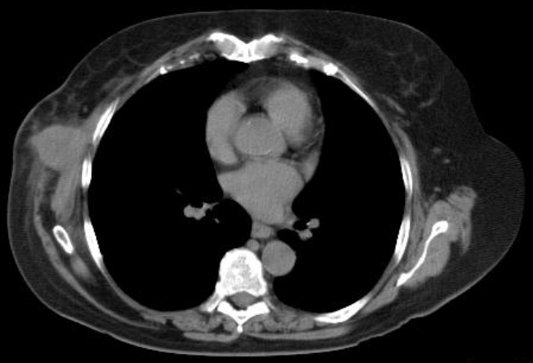
Chest CT
CT chest: 4.6 cm lobulated mass in right axilla next to 6th and 7th ribs, no pulmonary nodules

Slide 5
Additional studies
Brain MRI
PET Scan

Slide 6
Discussion Points for Conference
Differential Diagnosis?
Diagnostic Approaches ?
Core Needle Biopsy
Incisional Biopsy
Excisional Biopsy
Therapeutic Options ?
Radiation Therapy
Wide excision
Combined modalities
Stage?

Slide 7
Further work up
Core needle biopsy of mass: atypical spindle cells
Excisional biopsy performed resecting mass down to and including portion of serratus anterior muscle
Pathology: undifferentiated pleomorphic sarcoma
4.2 cm
Grade 2
Positive deep and caudal margins
MRI brain: negative for metastases
PET scan: negative for metastases

Slide 8
Surgery
Patient subsequently referred and evaluated for definitive management of right chest wall sarcoma
Right chest radical resection of excisional biopsy cavity with en bloc resection of right ribs 4, 5, 6, 7
Wedge resections of 2 right lower lobe pulmonary nodules found intra-operatively
Reconstruction of chest wall with mesh and latissimus dorsi flap

Slide 9
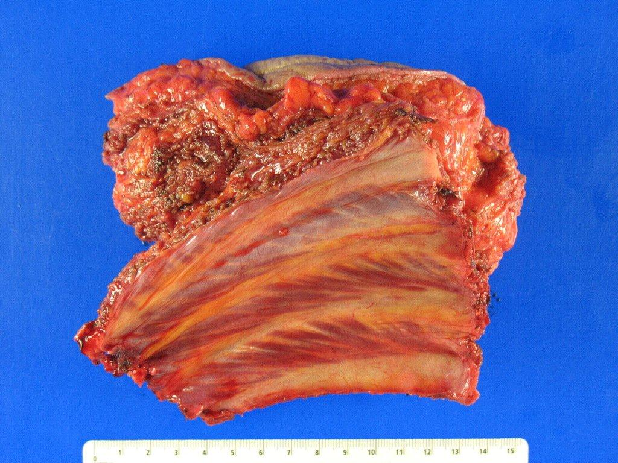
Surgery
Pathology: Residual cells with morphologic appearance similar to original sarcoma. Margins negative. Pulmonary wedge resections negative for malignancy.

Slide 10
Further Discussion points
Development of sarcoma in radiated tissue
Use of excisional biopsy versus upfront radical resection of chest wall
Extent of resection: en-bloc resection of ribs for positive deep margin after resection of serratus anterior muscle
Reconstruction of defect
Adjuvant therapy for chest wall sarcomas

Slide 11
Learning points
Undifferentiated pleomorphic sarcoma previously known as malignant fibrous histiocytoma
Attempt needle biopsy as opposed to excisional biopsy to minimize extent of final resection
Atypical spindle cells on needle biopsy should be assumed to be sarcoma in the appropriate clinical setting
Radical wide excision is treatment with resection of involved structures such as ribs and chest wall
Local recurrence common (20-45%)
Distant recurrence common (30-50%)
Adjuvant therapy has not been shown to definitively improve survival

