Slide 1
Thymic Neoplasm
Author: David Mauchley, M.D.
University of Colorado
May 2014
Last Revised: March 2025, Paul Schipper, MD, OHSU

Slide 2
Case #1
48 yo presents to your office with the following statement, “my primary care doctor said I have a benign thymoma and sent me to you to have it removed. If it is truly benign, why do I need surgery?”
How do you answer this question?

Slide 3
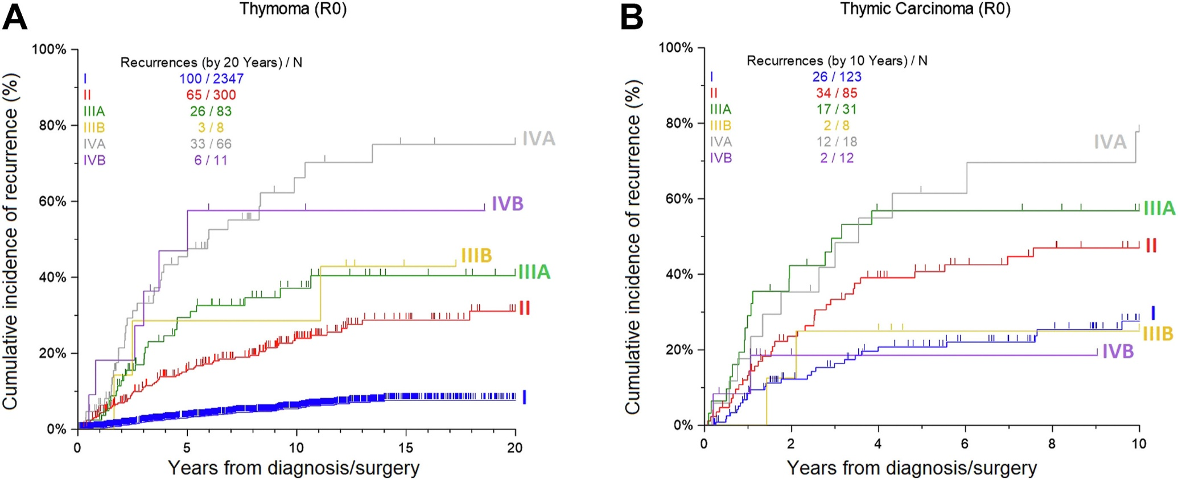
The diagnosis “benign thymoma” does not exist and was a misconception, possibly due to sometimes very slow growth. All thymomas have the possibility of spread, most often local or local-regional.

Slide 4
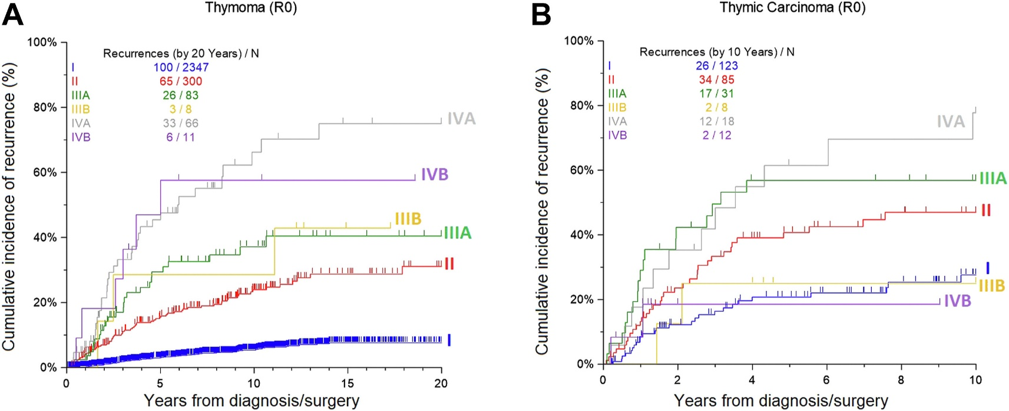
Masaoka Stage | 5-yr | 10-yr | % Recurrence
I | 100% | 84% | 4%
IIa | 98% | 70% | 14%
IIb
III | 89% | 55% | 26%
IVa | 71% | 38% | 46%
IVb | 53%

Slide 5
Histologic Classification
Cytologically Bland Thymomas (“benign” thymomas)
Cytologically bland cells, little to no atypia
Best prognosis
Majority of thymic tumors
Well-differentiated thymic carcinoma
Mostly bland but evidence of invasion
Thymic Carcinoma

Slide 6
Case #1
Once past the first question, you take a history. What symptoms would you expect her to have, assuming she does indeed have a thymic tumor?
She reports vague chest discomfort and an occasional cough that she thinks has gotten worse over the last several months. Otherwise asymptomatic. What might you ask about in her PMH?

Slide 7
Question #1
Next to Myasthenia Gravis, what is the second most common parathymic syndrome associated with the presence of a thymoma?
A. Pure red cell aplasia
B. Cytopenia
C. Systemic lupus erythematosus
D. Hypogammaglobulinemia
E. Polymyositis
4%
15%
1.2%
4.5%
4.5%
Second Malignancy=15%

Slide 8
Case #1
No parathymic syndromes in history. Physical Exam is unremarkable. What imaging studies would you want to see?
CT scan, of course

Slide 9
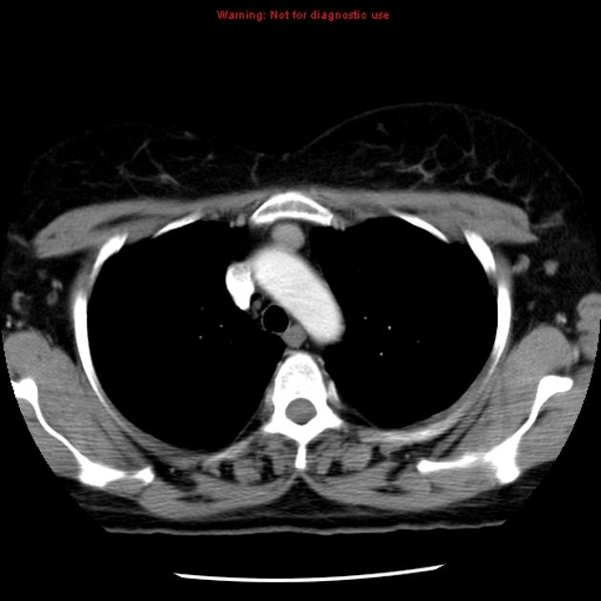
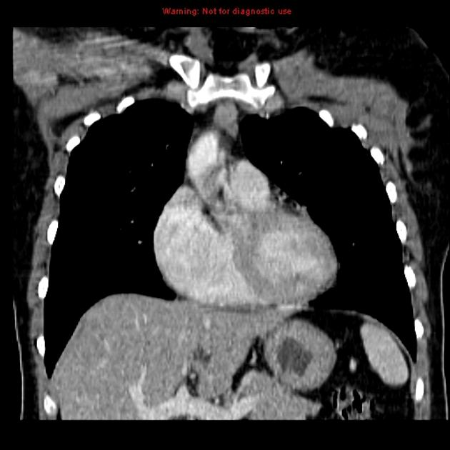
Case #1

Slide 10
Case #1
Any labs?
Do you want a biopsy?
What is the clinical stage of this tumor?

Slide 11
Staging
Thymic neoplasm have been staged with WHO system, Masaoka System, but no TNM system until…
Beginning with 8th Edition UICC-AJCC, when a TNM system was introduced.
As of Jan 2025, the 9th edition TNM staging is used to stage Thymic Epithelial Neoplasms/Tumors, which includes thymoma and thymic carcinoma. Neuroendocrine Tumors of the thymus are also staged with this system, although survival data is still sparse.

Slide 12
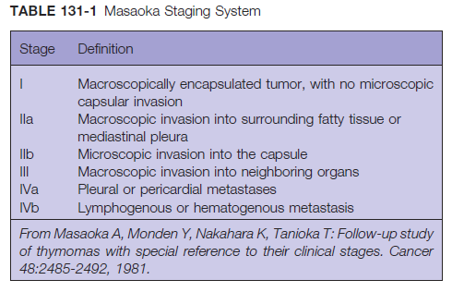
Masaoka Staging System (for historical use only!!!)

Slide 13
Survival by Masaoka
Masaoka Stage | 5-yr | 10-yr | % Recurrence
I | 100% | 84% | 4%
IIa | 98% | 70% | 14%
IIb
III | 89% | 55% | 26%
IVa | 71% | 38% | 46%
IVb | 53%
* 5-yr data: Kondo ATS 2003
* 10-yr data: Values represent averages of reported ranges

Slide 14
T Descriptor 9th Edition Thymic Epithelial Neoplasms(Thymoma and Thymic CA)
T | Description
T1 | Tumor limited to the thymus with or without encapsulation, or directly invades into the mediastinum alone or directly invades the mediastinal pleura but does not involve any other mediastinal structure.
T1a | 5 cm or less in its greatest dimension
T1b | larger than 5 cm in its greatest dimension
T2 | Tumor directly invades the pericardium (either partial or full-thickness), the lung, or the phrenic nerve
T3 | Tumor directly invades any of the following: (1) brachiocephalic vein, (2) superior vena cava, (3) chest wall, or (4) extrapericardial pulmonary arteries or veins
T4 | Tumor directly invades any of the following: (1) aorta (ascending, arch, or descending); (2) arch vessels; (3) intrapericardial pulmonary artery or veins; (4) myocardium; (5) trachea; or (6) esophagus.

Slide 15
Nodal and Metastasis Descriptors 9th Edition Thymic Epithelial Neoplasms(Thymoma and Thymic CA)
N and M | Description
N0 | No nodal involvement
N1 | Anterior (perithymic) nodes
N2 | Deep intrathoracic or cervical nodes (e.g., paratracheal, subcarinal, aortopulmonary window, hilar, jugular, and supraclavicular nodes)
M0 | No metastatic pleural, pericardial, or distant sites
M1a | Separate pleural or pericardial nodule(s)
M1b | Pulmonary intraparenchymal nodule or distant organ metastasis

Slide 16
9th edition TNM Staging Thymic Epithelial Neoplasms
Stage | T | N | M
I | T1a-b | N0 | M0
II | T2 | N0 | M0
IIIA | T3 | N0 | M0
IIIB | T4 | N0 | M0
IVA | T any | N1 | M0
 | T any | N0,N1 | M1a
IVB | T any | N2 | M0, M1a
 | T any | N any | M1b

Slide 17
Journal of Thoracic Oncology, Volume 18, Issue 12, 2023, Pages 1655-1671,

Slide 18
Case #1
How do you plan on treating this tumor?
The patient agrees to have surgery, but now that you’ve explained to her that the diagnosis of benign thymoma doesn’t exist, she wants to know if this tumor is likely to “do her in.” What do you tell her?

Slide 19
Question #2
Which of the following prognostic factors have consistently been shown to predict better survival in the treatment of thymic tumors?
A. Histologic type
B. Male sex
C. R₀ resection
D. Early stage
E. Presence of Myasthenia Gravis

Slide 20
Case #1
How do you plan on approaching this tumor surgically?
You do a thymectomy, she recovers well, path shows a cytologically bland thymoma with microscopic invasion into the tumor capsule (T1aN0M0, Stage Ia Thymoma)
5 years later, she returns to your office with the following CT scan

Slide 21
What do you do with this?

Slide 22
What is the stage?
This is a separate pleural nodule = M1a, Stage IVA.
Incorporating the original tumor, T1aN0M1a, Stage IVA
The pleural nodule is now driving the prognosis.

Slide 23
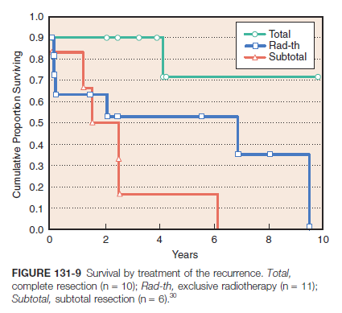
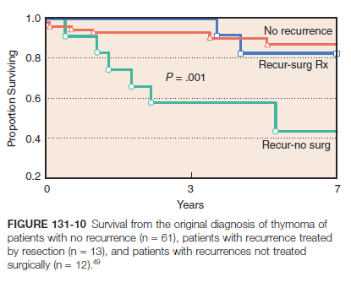
Treatment of Recurrence
If complete resection can be achieved, it is the best option

Slide 24
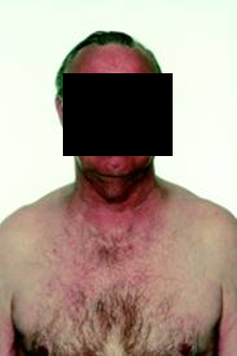
Case #2
45 yo M with well controlled MG presents with new onset and progressive facial flushing, particularly when he leans forward.

Slide 25
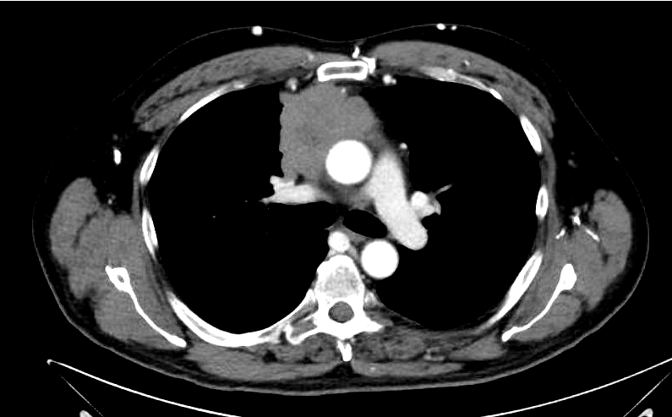

Slide 26
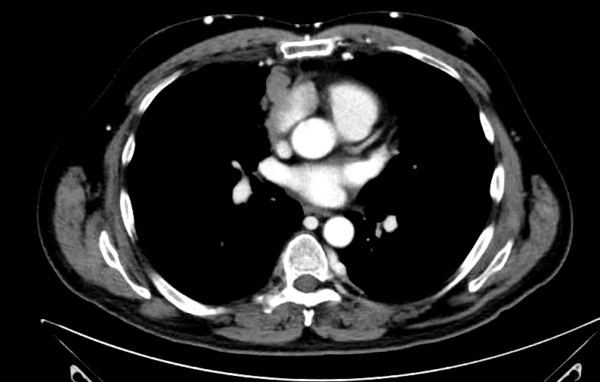

Slide 27
What is the facial flushing/discoloration?
Look at the tumor location
What does the tumor stenose/compress
The Superior Vena Cava is compressed
He has Superior Vena Cava syndrome from a compressive anterior mediastinal mass.

Slide 28
Case #2
Do you want a biopsy?
Biopsy shows lymphocyte rich thymoma
What would your initial management strategy be (remember predictors of survival)?
Neoadjuvent chemotherapy
Thymoma has very high response rate to chemo
Typically cisplatin, doxyrubicin, cyclophosphamide
Improves chance of R0 resection in stage III and IV tumors

Slide 29
Case #2
He completes neoadjuvant therapy and his flushing improves. Restaging CT scan shows regression of the tumor.
What incision are you going to make?
On exploration, you find that the tumor involves the R phrenic nerve and is inseparable from the ascending aorta
What now?

Slide 30
Role of Partial Resection
Data aren’t entirely convincing
Partial resection seems to have slight survival benefit over biopsy alone
Local recurrence is lower in R1 resection compared to R2 (adj radiotherapy)

Slide 31
Role of Partial Resection

Slide 32
Learning Points
Surgery is mainstay of therapy for thymic tumors
R₀ resection should be achieved if possible
Most important prognostic factors are stage and completeness of resection
There is no such thing as a benign thymoma
Biopsy of presumed thymoma is not detrimental

Slide 33
Learning points
Neoadj chemotherapy for advanced stage thymoma appears to improve survival and resectability
Adjuvant radiotherapy is indicated in patients with incomplete resection
Resection of recurrent thymoma should be done whenever possible

