Slide 1
Case Presentation:
Post operative management
VATS Right Upper Lobectomy
Updated by: Brian Mitzman, MD
University of Utah
Original Powerpoint by: Junaid Haroon, MD, Dr Rosemary Kelly, Chair,
University of Minnesota

Slide 2
Case History
73 yo RIGHT upper lobe nodule (14mm) on screening CT chest
PMHx: HTN, Peripheral Arterial Disease, Abdominal Aortic Aneurysm
PSHx: Knee surgery
Meds: Albuterol, Amlodipine, Lisinopril, Naproxen, Tamsulosin
Social: Veteran, current smoker, 75 pack year history, denies ETOH
Workup:
  CT chest: 14mm spiculated nodule
  PET/CT: SUV 6.5
  PFTs: FEV1: 76.9%, DLCO: 60%
  Biopsy: Squamous Cell

Slide 3
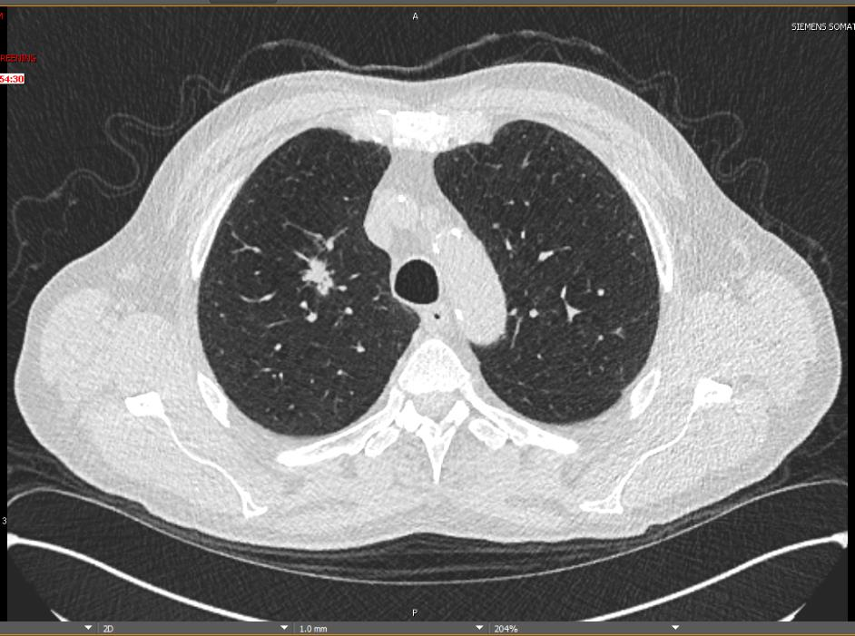
Pre-OP CT Chest

Slide 4
Procedure
VATS Right Upper Lobectomy, Mediastinal Lymphadenectomy
  Complete fissures
  No intraoperative complications

Slide 5
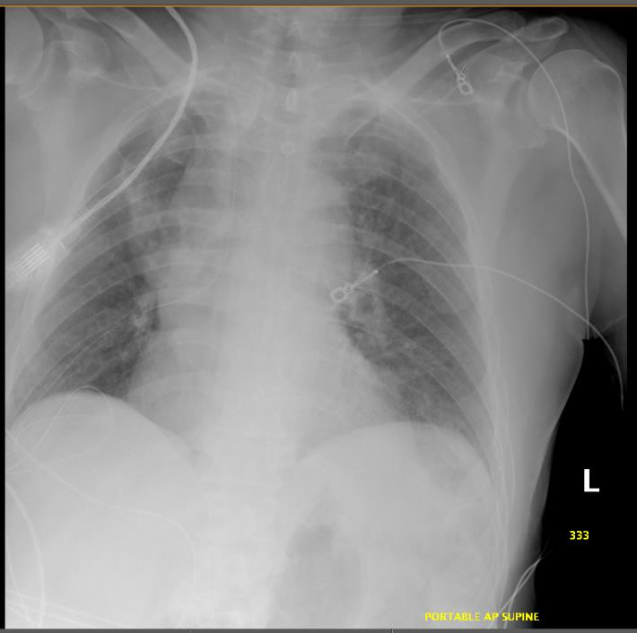
Immediate PostOp CXR

Slide 6
Hospital Course
POD 1: Clinically stable
  Afebrile
  Saturating 98% on room air
  In no distress
Routine CXR done, next slide

Slide 7
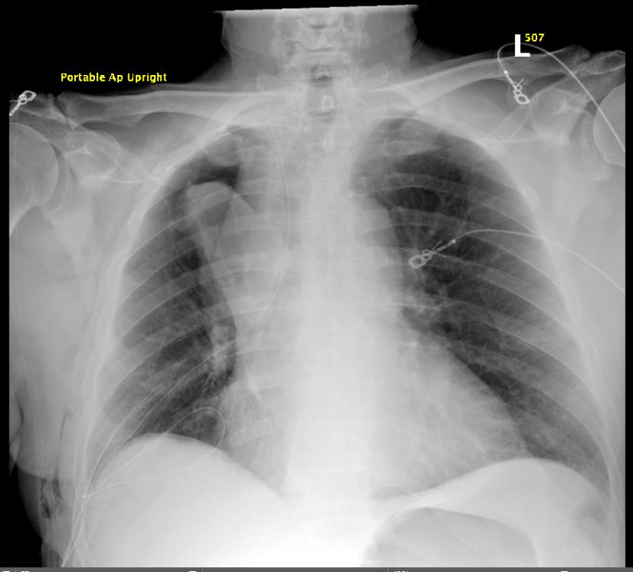
POD 1 CXR

Slide 8
Questions
1) What do you see on CXR?
2) Differential?
3) Next step in care?

Slide 9
POD 1 CXR

Slide 10
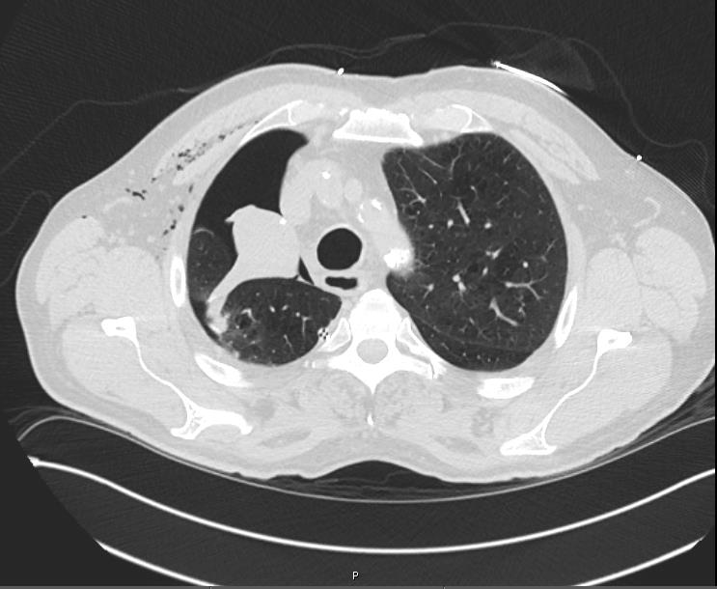
CT Chest

Slide 14
Bronchus intermedius

Slide 16
Blind ending airway

Slide 17
Lower lobe bronchus

Slide 18
1) What is your differential after CT Chest?
2) What other things would you want to look for on the CT Chest that may not be shown?
3) Plan?

Slide 19
Bronchoscopy
What are the usual bronchoscopic findings for middle lobe torsion?
How do you rule out torsion versus mucous plug?

Slide 20
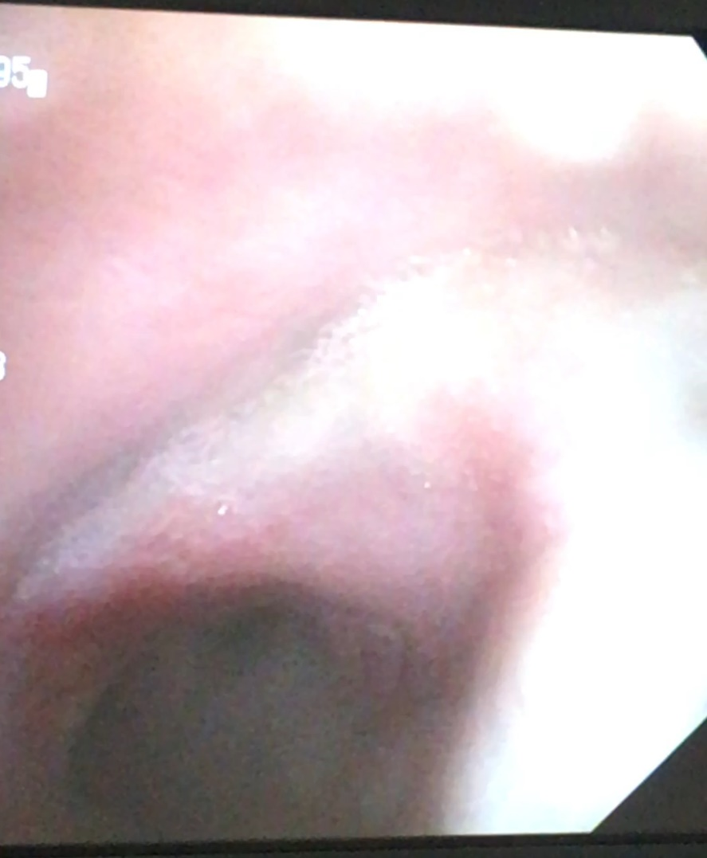
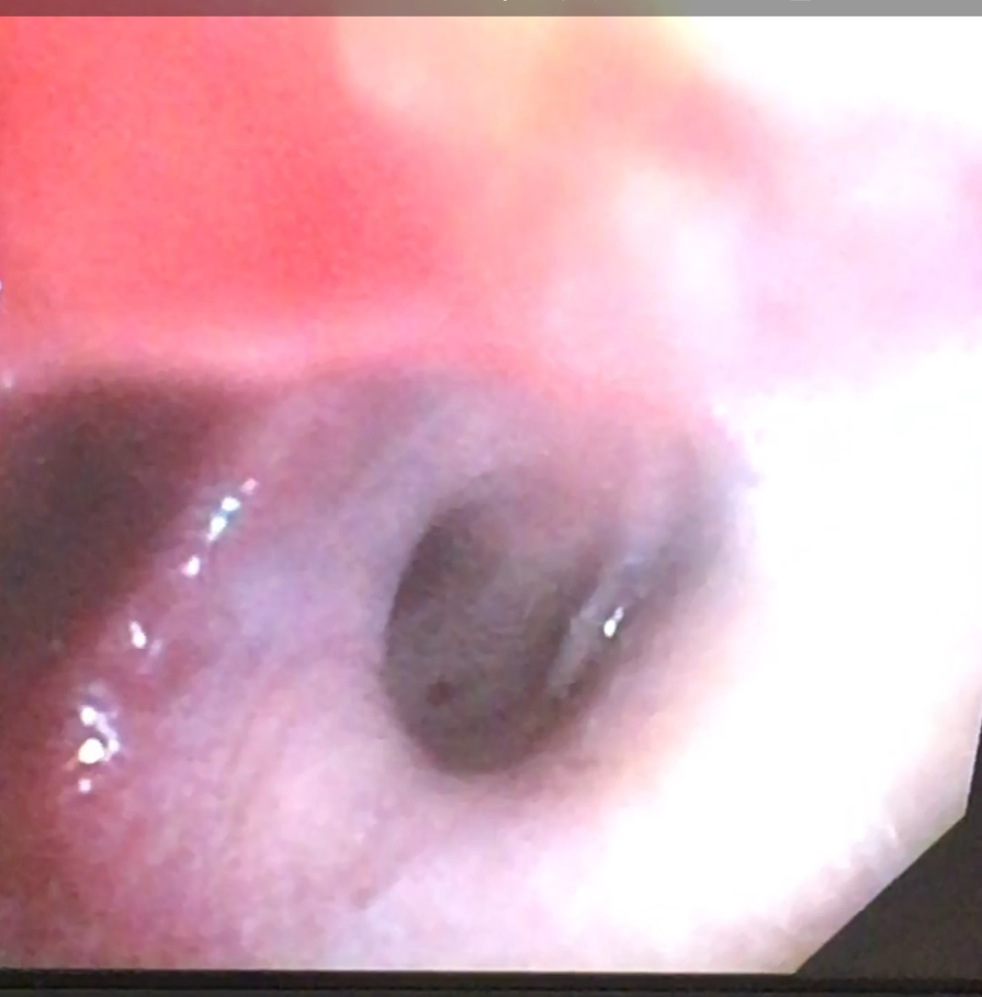
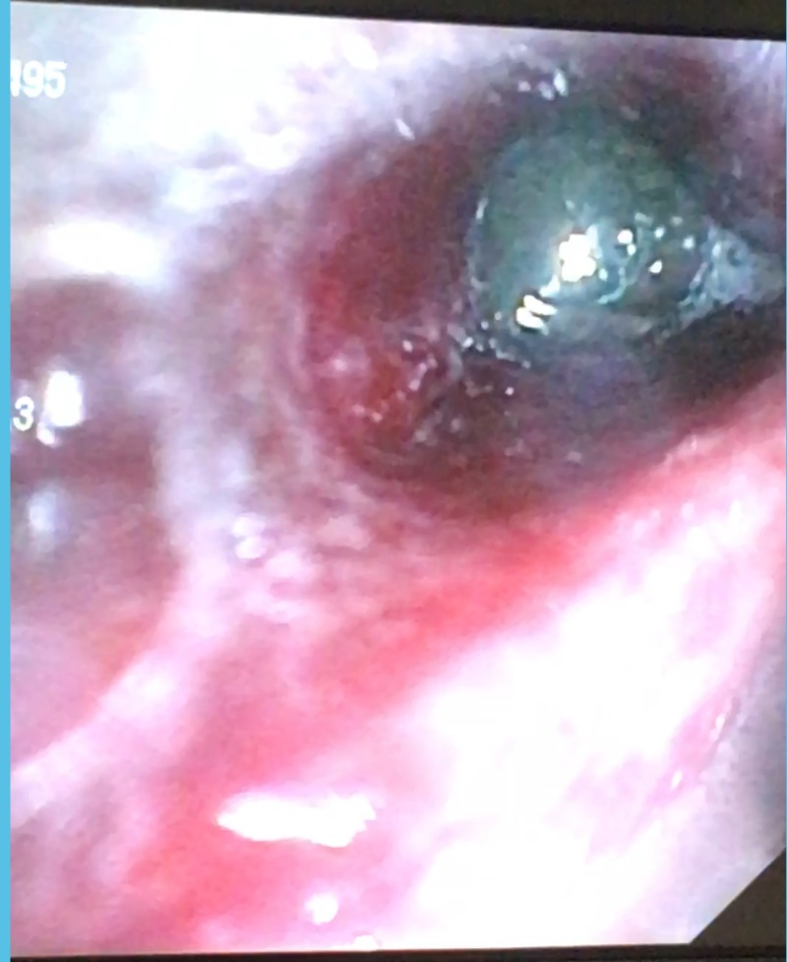
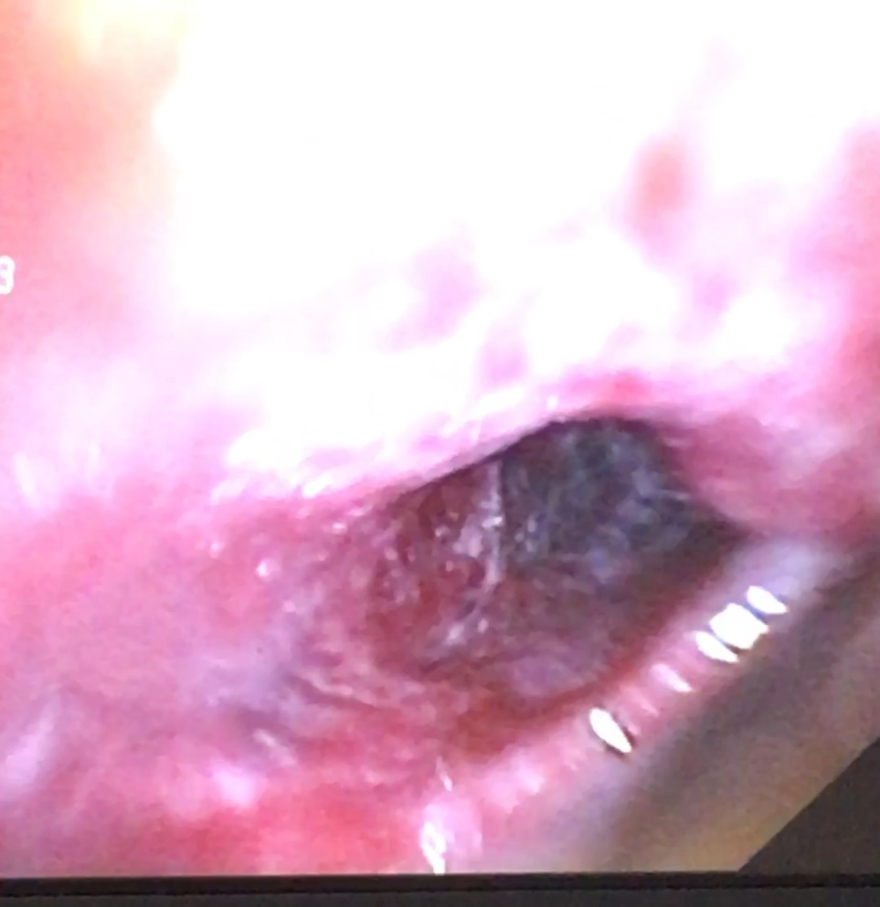
Bronchoscopy
Upper lobe staple line
Middle lobe bronchus with inflammation and congestion
Middle lobe bronchus with mucus plug

Slide 21
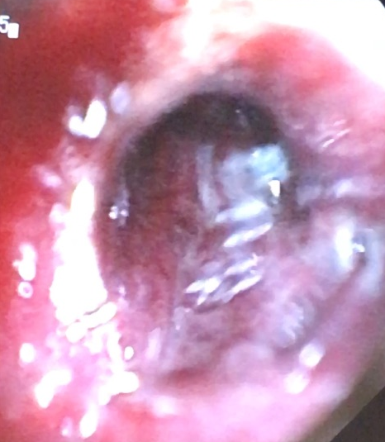
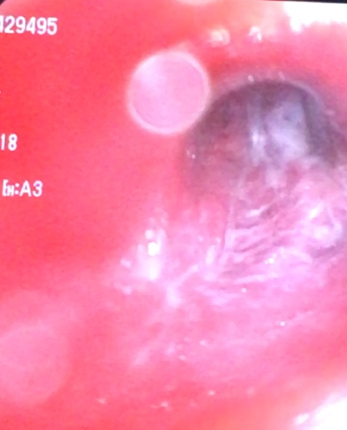
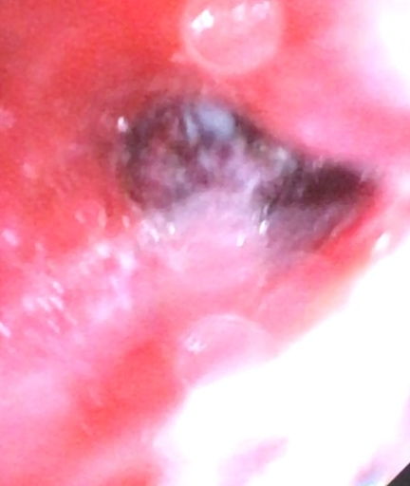
Bronchoscopic view of middle lobe bronchus, after removing mucus

Slide 22
Hospital Course
CT Chest:
  Mucus plugging with collapse of Right middle lobe
Bronchoscopy
  Rt upper lobe bronchial stump intact
  Rt middle lobe bronchus with mucus plugging
  Once mucus plug removed, bronchus appeared congested and inflamed
  Unable to pass scope into slit like opening of middle lobe bronchus

Slide 23
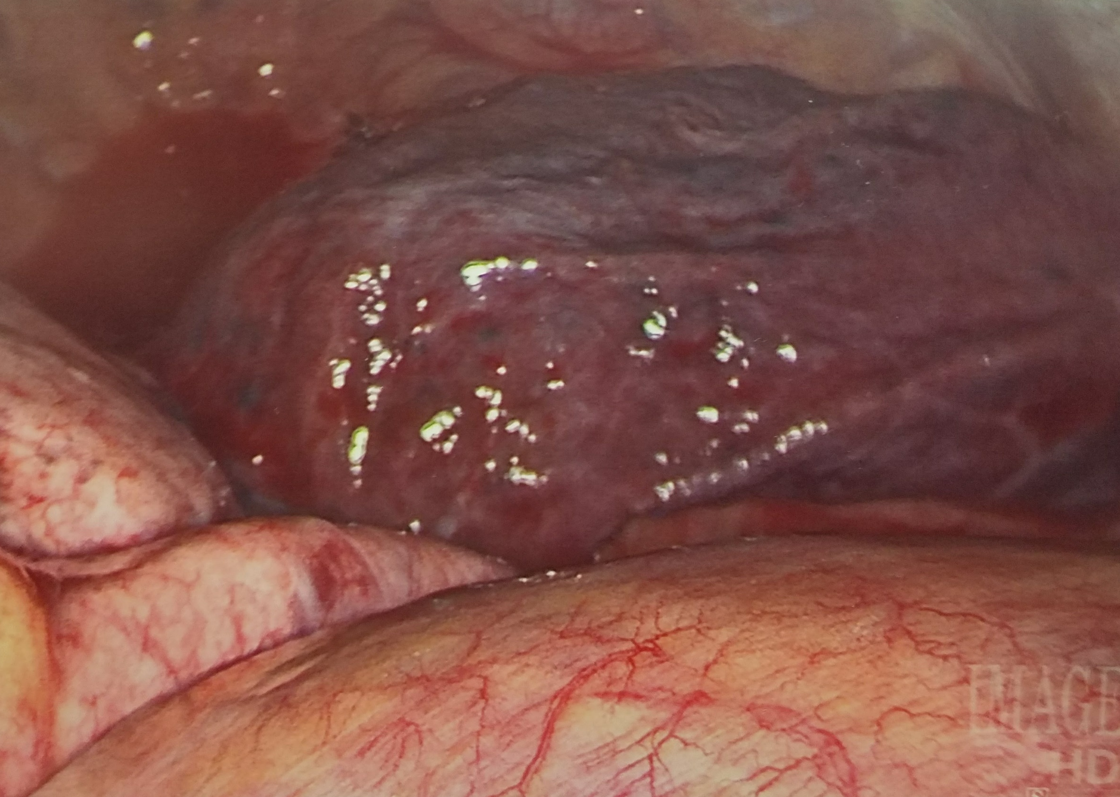
Hospital Course
Right Middle Lobe
Takeback to OR:
  RML torsion
  Right VATS, Right Middle Lobectomy
Pathology:
  RUL: Squamous cell carcinoma, pT1b pN0
  RML: Vascular congestion, focal alveolar hemorrhage
Right Lower Lobe

Slide 24
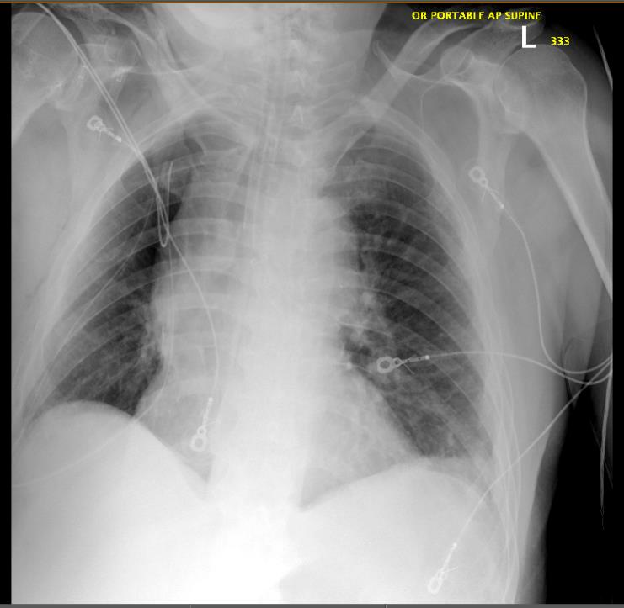
POD 1 CXR S/P Rt Middle Lobectomy

Slide 25
Key Points
Differential of CXR
  Post op pneumonia
  Mucus plugging
  Right middle lobe torsion
Differential of CT
  Shows RML collapse/consolidation
    Technical problem: 1) stapled RML airway, 2) inadvertently took RML nutrient blood supply/ischemia(right middle lobe PA +/- bronchial arteries), 3) RML torsion
    Non-Technical problem: 1) Atelectasis, 2) pneumonia, 3) RML mucus plugging
Plan
  Treat mucus plugging with bronch, pulmonary toilet. RML torsion is vascular emergency identified by airway occlusion/collapse, rare to save RML unless identified very quickly and untorsed. Best to prevent by providing broad base of attachment/fixation. If not viable on exploration, perform right middle lobectomy.

Slide 26
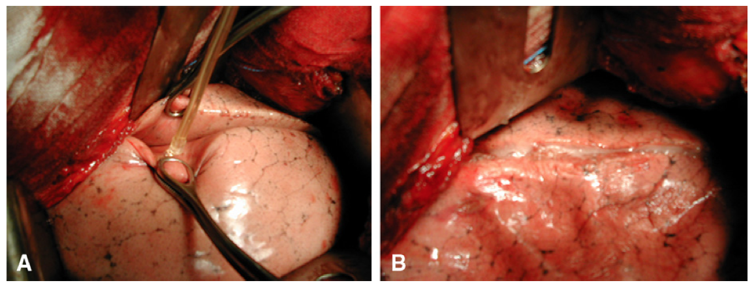
Prevention
If major fissure between middle and lower lobe is complete after an upper lobectomy:
Close observation during reinflation of lung
Middle Lobe Pexy - with suture, or by stapling parenchymal edge of middle lobe to lower lobe edge
Glue has been reported in the literature (Venuta F et al. JTCVS 2012;143:240-1)

