Slide 1
Thoracic Surgery General Management IV Complications
Brian Mitzman, MD
University of Utah

Slide 2
Learning Goals
The basic level concepts focused on:
General Knowledge
Diagnosis and Treatment of common complications

Slide 3
Discussion Questions
Most common complications after lobectomy?

Slide 4
Historical Data from STS Database
From: Subroto P, et al. Thoracoscopic lobectomy is associated with lower morbidity than open lobectomy:
a Propensity-matched analysis from the STS database. J Thorac Cardiovasc Surg 2010;139:366-78

Slide 5
Historical Data from STS Database
From: Subroto P, et al. Thoracoscopic lobectomy is associated with lower morbidity than open lobectomy:
a Propensity-matched analysis from the STS database. J Thorac Cardiovasc Surg 2010;139:366-78
Less common complications:

Slide 6
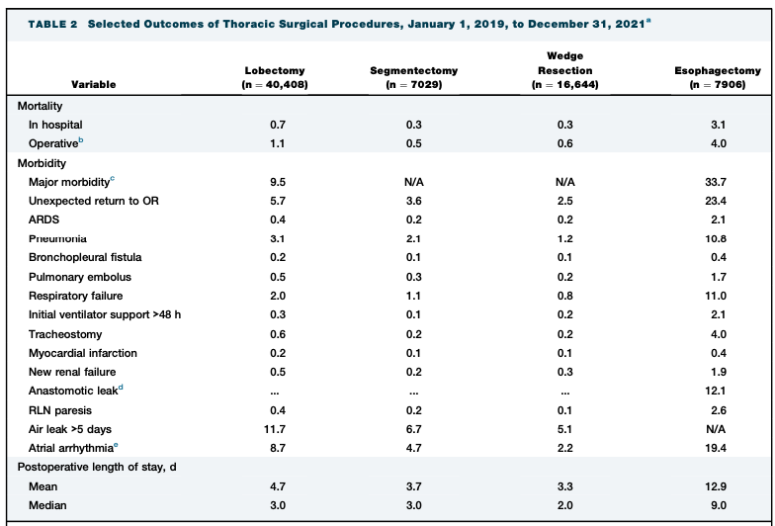
Data from STS GTSD 2022 Summary
Notes:
Servais et al. Ann Thorac Surg. 2023;115:43-50

Slide 7
Data from STS GTSD 2022 Summary
Lobectomy:
Overall Major Morbidity: 9.5%
Atrial Arrhythmia: 8.7%
Pneumonia: 3.1% MI: 0.2%
Length of Stay: Median 3.0 days
Prolonged Air Leak (>5 days):
Lobectomy: 11.7%
Segmentectomy: 6.7%
Wedge: 5.1%
Notes:
Servais et al. Ann Thorac Surg. 2023;115:43-50

Slide 8
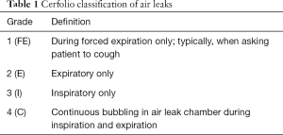
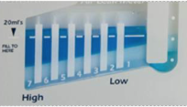
Case #1
74 y/o M with COPD (baseline FEV1 54%, DLCO 55%) undergoes uncomplicated robotic right upper lobectomy.
POD #1: Single chest tube to -20 suction. Air leak is E2-3 (expiratory bubbling into 2-3 chambers). CXR no pneumothorax.
What do you do, if anything?

Slide 9
Discussion
Topic for discussion:
Stay on suction versus waterseal?
Decrease suction from -20 to -10?
Intervene now? If so, how?
Observation? For how long?

Slide 10
Case #1
You opt to observe. It is now POD #5. Chest tube has been watersealed without pneumothorax, but air leak remains E1.
What now?

Slide 11
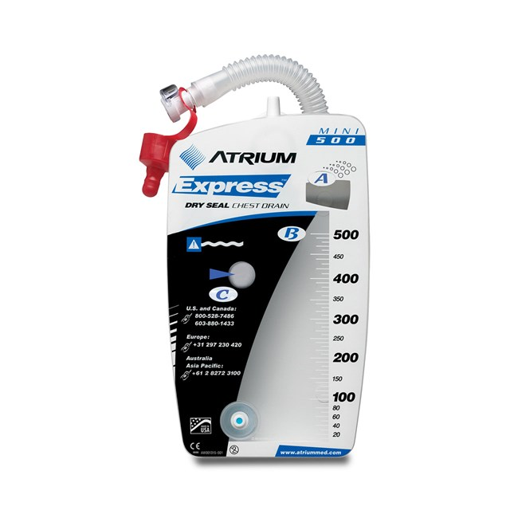
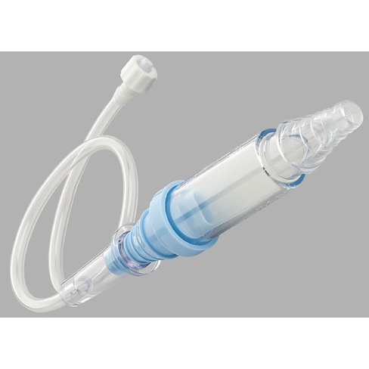
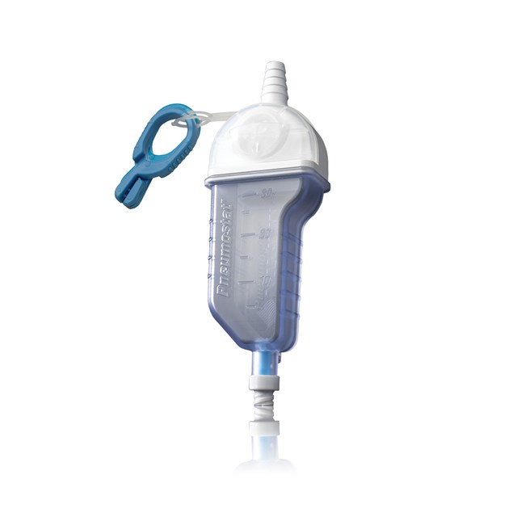
Treatment
Discharge home with portable device and give more time

Slide 12
Other options
Autologous Blood Patch
50-100cc of peripheral venous blood injected through chest tube
Tube/pleurevac then elevated to allow air to escape but blood to remain
Success rate reported 50-90%
Risk of empyema (0-9%)
Chemical Pleurodesis
Talc, doxycycline, iodine, other

Slide 13
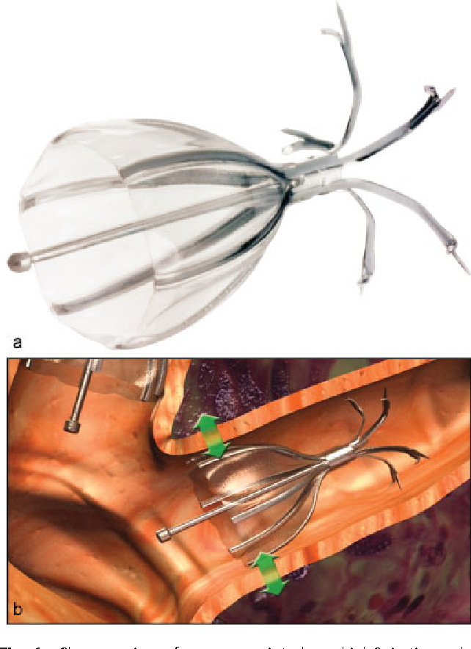
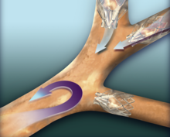
Other options
Endobronchial Valve

Slide 14
Case #2
71 y/o M undergoes robotic left lower lobectomy for a Stage Ib adenocarcinoma. The patient has no major cardiac history. His wife read that atrial fibrillation is a common complication and wants to know if she should worry.
What do you tell her?

Slide 15
Discussion
What are the risk factors for postoperative atrial fibrillation?
Is there a role for prophylactic medical treatment after lung surgery?
How do you treat acute onset a-fib in the postoperative lobectomy patient?

Slide 16
Prophylaxis:
Class I:
-Patients taking B-blockers preoperatively should continue treatment postoperatively (level B)
Class IIa:
-Cardizem prophylaxis is reasonable if not taking BB (level B)
-Amiodorone prophylaxis is reasonable (level B)
-Magnesium supplementation is reasonable to augment effects of other medications (level B)
Class IIb:
-New initiation of BB postoperatively for prophylaxis may be reasonable, but use is more limited by side effects than Cardizem (level B)
Class III:
Amiodorone not recommended for pneumonectomy patients due to toxicity (level B)
Digitalis should not be used for prophylaxis (Level A)
Flecainide is not recommended for prophylaxis (Level B)

Slide 17
Acute Treatment of Postoperative A-Fib:
Class I:
-Electrical cardioversion for patients who are hemodynamically unstable (level C)
-Hemodynamically stable but symptomatic should be chemically cardioverted. Electrical cardioversion if chemical fails (Level C)
-Hemodynamically stable with symptomatically acceptable AF should have trial of rate control lasting 24 hours (Level B)
Class IIa:
-If hemodynamically stable and lasting 24 hours or longer after rate control, reasonable to attempt chemical cardioversion (Level C)
Class IIb:
-Hemodynamically stable AF refractory to chemical cardioversion should be considered for electrical cardioversion (Level C)
Choice of Agent for Rate Control:
Class I:
-Selective B1 blocking agent recommended for initial rate control in absence of moderate-severe COPD or bronchospasm (level B)
-Diltiazem should be first line agent in presence of COPD or bronchospasm (Level B)
Class III:
-Digoxin as a single agent should not be used for rate control, but may be effective as combination with B1 or diltiazem (level A)

Slide 18
Learning Points
Atelectasis, atrial arrhythmia, air leak, pneumonia are common complications after lobectomy, even in modern era
Most air leaks stop spontaneously, and a trial at home with portable chest tube device is reasonable. Numerous methods for intervention are available if unsuccessful
Atrial fibrillation prophylaxis is not universally accepted, however guidelines exist to help provide direction

