Slide 1
Thoracic Surgery General Management III
Update by: Ammar Asban, MD Brian Mitzman, MD
University of Utah
Initial powerpoint by: Stephen Yang, MD
Johns Hopkins University
Case Presentations
Adult Cardiac Surgery
TSC TS 03
Milestone: 14

Slide 2
Learning Goals
The basic level concepts focused on:
Risk Assessment: Lung
The advanced level concepts focused on:
Postop Complications: Lung

Slide 3
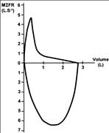
History
60 yo M presents with SOB on exertion. PFTs are performed. What does this P/V flow loop show?

Slide 4
Discussion

Slide 5
History
68 yo F presents for evaluation of a localized 2 cm NSCLC of the lingula.
Work up included:
ppoFEV1 30%
DLCO 40%
ECHO LVEF 50%, RVSP 30
MVO2 max 8 ml/kg/min
What should we offer this patient surgically, if anything?

Slide 6
History
68 yo F undergoes a RML/RLL bilobectomy.
You reinflate the remaining RUL, but worry there will be a significant pleural space left
What are some maneuvers to minimize the pleural space?

Slide 7
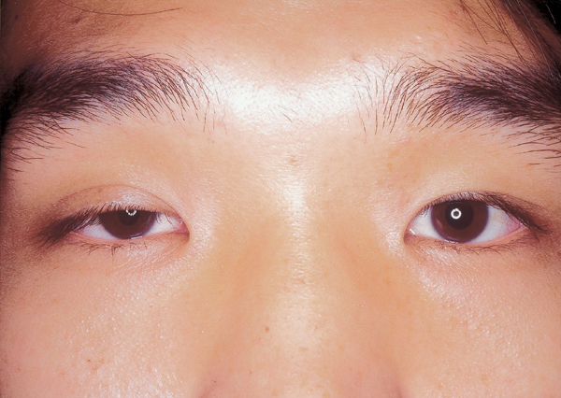
History
1 after RLL lobectomy for NSCLC, you look at the patient and see this? What is going on and what do you do?

Slide 8
History
A 72 yo undergoes a VATS RUL lobectomy with lymph node dissection having a positive R10 LN
On POD3, she is eating and walking with one chest tube
The chest tube drainage begins to increase to between 1000-1500 cc of opalescent fluid in 24 hours.
No organisms are identified in the fluid
Diagnosis?
Initial management should include?

Slide 9
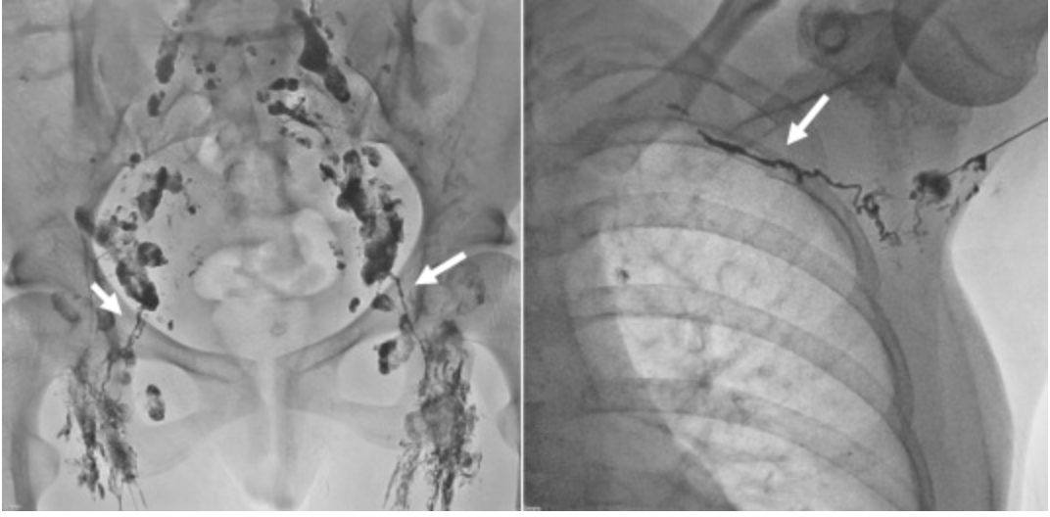
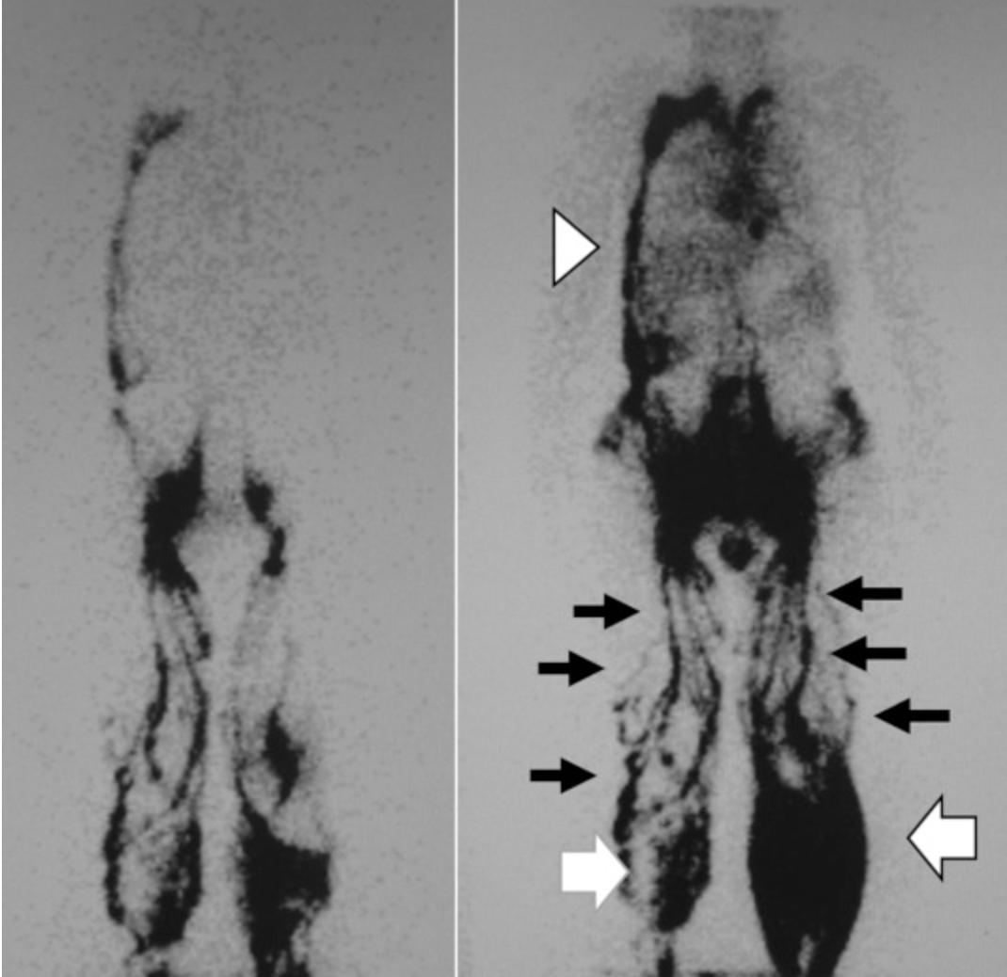
Management of chylothorax
In postoperative setting
Dietary control measures, fasting, low-fat diet and total parenteral nutrition
What will you do if there is evidence of mediastinal shift?
Adjunct therapy
Somatostatin, octreotide, and midodrine
How long would you monitor this patient and what type of intervention would you consider?
Pleurodesis
Thoracic duct embolization
Thoracic duct disruption
Thoracic duct ligation
Combination therapy
Therapeutic lymphangiography for traumatic chylothorax. Hara et al. Journal of Vascular Surgery: Venous and Lymphatic Disorders, Volume 6, Issue 2, March 2018, Pages 237-240

Slide 10
History
60 yo M construction worker with a 40-pack year smoking history was evaluated for resection of a carcinoma involving the bronchus intermedius
Preoperative pulmonary function tests showed FVC = 2.5L, FEV1 = 1.8 L, DLCO = 35% of predicted, room air Pa02 = 60 mmHg
What do his PFTs suggest and should he undergo resection?

Slide 11
History
A 55 yo underwent a difficult right pneumonectomy for advanced NSCLC requiring intrapericardial dissection vessel control.
Preop PFTs were excellent and he is generally healthy
POD2 he develops sudden SVT, hypotension and desaturation.
Initial management of his SVT is unsuccessful
CXR is shown. What next?

Slide 12
Case continue
3 days after right pneumonectomy patient noted to have a new LLL infiltration, cough, frothy sputum, and respiratory failure
What is your differential diagnosis?
How will you proceed to work this up?
What is the most common cause?
How would you manage this patient?
What operation would you offer this patient?

Slide 13
Case continue
6 weeks after right pneumonectomy patient comes to clinic with fever, new onset cough productive blood-tinged sputum. CXR shows air-fluid level in the right hemothorax
What is your work up?
What your differential diagnosis?
How would you manage this patient?

Slide 14
History
Your 71yo M patient is undergoing a routine RUL VATS lobectomy.
Prior to induction of anesthesia, a right subclavian catheter is placed for IV access.
During placement develops pulmonary wheezing, tachypnea, and tachycardia. Physical exam reveals a "mill wheel" churning murmur.
What is done next?

Slide 15
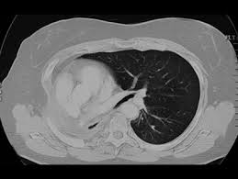
History
A 72 yo M is 1 year out following R pneumonectomy for T2N0 NSCLC Has been doing well except for progressive SOB since surgery Particularly worse since the last clinic visit 4 mo ago
CXR is shown
What next?

Slide 16
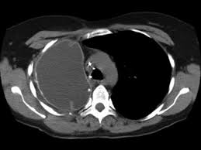
Discussion
Post-pneumonectomy Syndrome

Slide 17
History
65-year-old man underwent uneventful right pneumonectomy for lung cancer.
POD1, he experienced profound dyspnea when standing. His BP was 120/80 with a HR of 88 both standing and supine. His O2 sat was 92% on room air while in the supine position and was 80% in the standing position.
The patient has no significant cardiopulmonary history and his preoperative pulmonary function tests were excellent.
What is done next? What is the diagnosis?

Slide 18
Discussion
Platypnea-orthodeoxia

