Slide 1
Neoplasms of the Lung II
Author: Stephen C. Yang, MD / Johns Hopkins Medical Institutions
Created: July 2014
Last Revised: March 2025, Paul Schipper, MD / OHSU

Slide 2
Learning Goals
The basic level concepts focus on:
Stage I Staging, Including All Staging Tools
Stage I Survival and Recurrence Patterns
The advanced level concepts focus on:
Stage I Treatment and Multimodality

Slide 3
History
64-yo was found to have an apical RUL lung nodule on a screening CXR
Patient has no pulmonary symptoms
Former 30 py smoker, quit 10 years ago
PMH: hypertension, arthritis
No prior surgeries
ECOG PS0

Slide 4
Physical Exam
Gen: WNWD NAD, appears stated age
CV: RRR no m,g,r
CHEST: BS equal and clear
ABD: soft, flat non tender
EXT: no edema

Slide 5
Work Up
Labs WNL
Coags WNL
PFTs: FEV-1 = 1.84 L (87% predicted) FVC = 2.21 (81% predicted) DLCO = 14.5 (68% predicted)

Slide 6
CT Scan
3 cm mass apex of RUL. No hilar or mediastinal adenopathy. Upper cuts of abdomen normal

Slide 7
Differential Diagnosis?
Neoplasm
Infection
Congenital
Trauma
Other
Next steps?

Slide 8
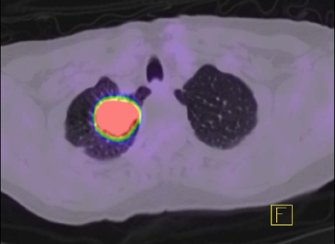
PET/CT Scan
Integrated scan showing hypermetabolic activity only in the lung mass. No uptake elsewhere.

Slide 9
Outcome
Underwent VATS RUL lobectomy
Uncomplicated postoperative course
Final path shows a 3.3 cm adenocarcinoma, lymph nodes in 4R, 7, 9R, and 10 R negative (3+1)
What stage is this?
Adjuvant therapy?
Surveillance?
5 year survival?

Slide 10
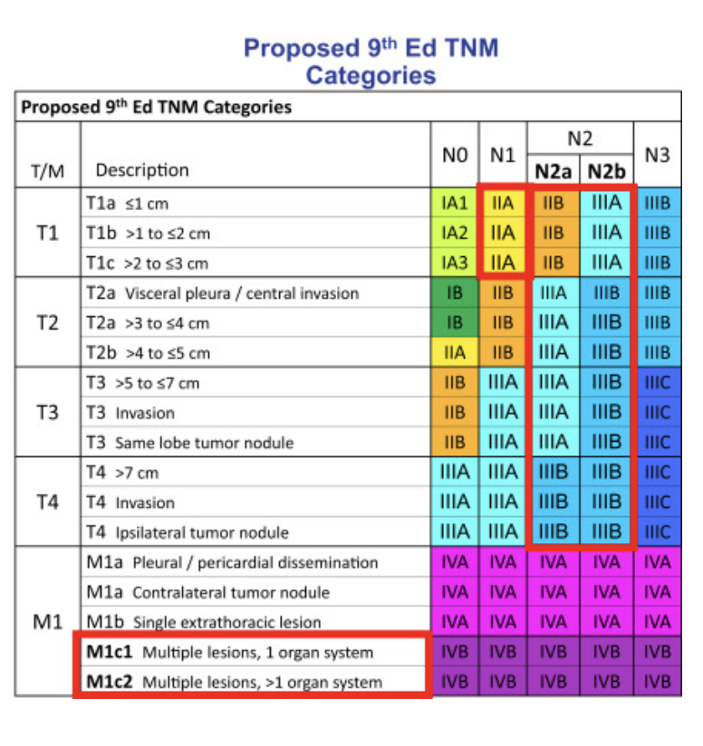
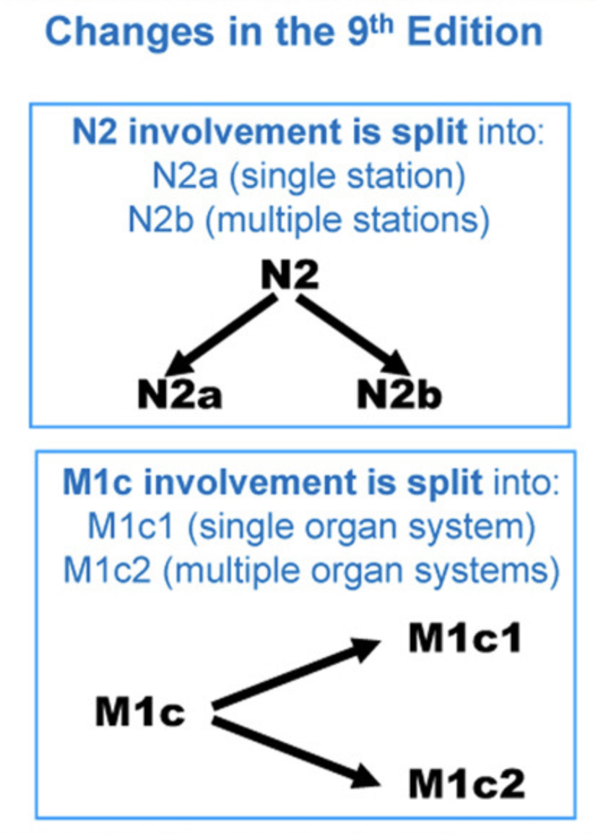
3.3 cm=T2a
T2aN0M0 = Stage IB
No adjuvant therapy offered other than clinical trial
Journal of Thoracic Oncology
Volume 19, Issue 7, July 2024, Pages 1007-1027

Slide 11
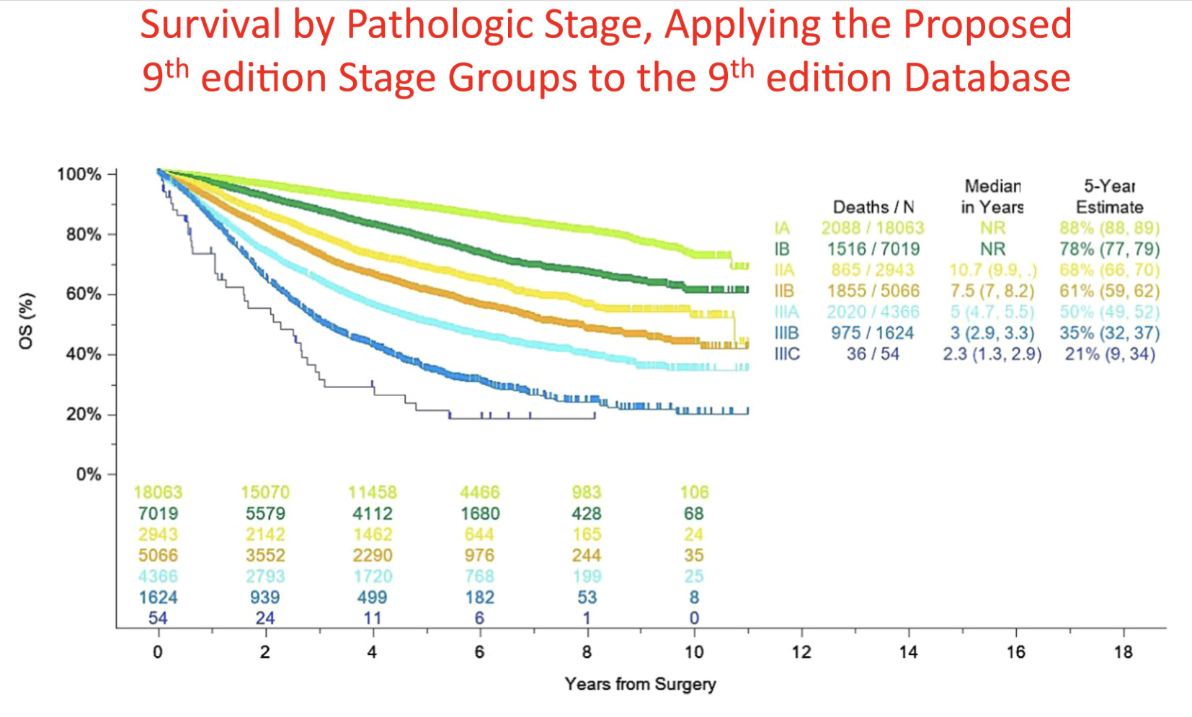
Journal of Thoracic Oncology
Volume 19, Issue 7, July 2024, Pages 1007-1027

Slide 12
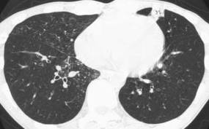
History
A 78 yo M presents with a 2 cm spiculated mass in the lingular tip found on w/u for dry cough
Former 30 py smoker, quit 20 years ago
PMH: rheumatoid arthritis, HTN, DM
No prior surgeries
ECOG PS0

Slide 13
Work Up
PE: Normal
Labs WNL
CXR and CT confirm the same 2 cm mass in the lingular tip.
There is a 1.5 cm AP window node, no other hilar or mediastinal adenopathy
PFTs: FEV-1 = 1.7 L (65% predicted) FVC = 2.1 (71% predicted) DLCO = 20.5 (88% predicted)
Next steps?

Slide 14
Discussion Points
Role of PET scanning? EBUS? Mediastinoscopy? Chamberlain Procedure? Needle aspiration?
Role of mediastinal lymph node dissection?
Lung sparing options?
What if left upper lobe rather than just lingula ?
What if lymph node positive on mediastinoscopy?
After final path report?

Slide 15
Outcome
PET showed avidity in the lung nodule only
EBUS stations L4, 7, and L10 negative
Mediastinoscopy negative
Left VATS lingulectomy, mediastinal LN dissection
What if AP window was positive intraop?
Final path T1N0 adenocarcinoma

Slide 16
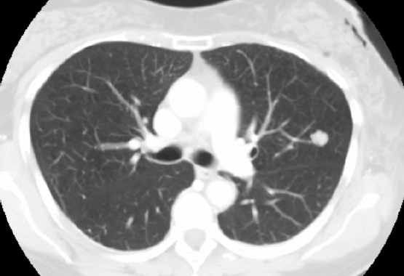
History
A 75 yo M is referred for a PET positive lung mass found on w/u for SOB
Former heavy smoker
PMH: CAD, PVD, HTN
No prior surgeries
ECOG PS0
PFTs: FEV1 40% predicted, DLCO 45% predicted
ECHO: LVEF 55%, PAS est 40 mmHg, mild TR
PET: avidity only in lung mass
What are options?

Slide 17
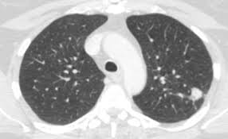
History
A 75 yo M is referred for a PET positive lung mass found on w/u for SOB
Former heavy smoker
PMH: CAD, PVD, HTN
No prior surgeries
ECOG PS0
PFTs: FEV1 40% predicted, DLCO 45% predicted
ECHO: LVEF 55%, PAS est 40 mmHg, mild TR
PET: avidity only in lung mass
What are options?

Slide 18
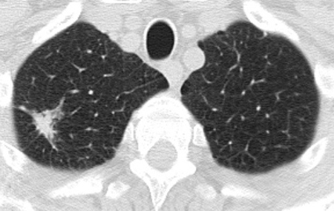
History
A 75 yo M is referred for a PET positive lung mass found on w/u for SOB
Former heavy smoker
PMH: CAD, PVD, HTN
No prior surgeries
ECOG PS0
PFTs: FEV1 40% predicted, DLCO 45% predicted
ECHO: LVEF 55%, PAS est 40 mmHg, mild TR
PET: avidity only in lung mass
What are options?

Slide 19
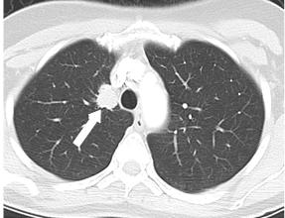
History
A 75 yo M is referred for a PET positive lung mass found on w/u for SOB
Former heavy smoker
PMH: CAD, PVD, HTN
No prior surgeries
ECOG PS0
PFTs: FEV1 40% predicted, DLCO 45% predicted
ECHO: LVEF 55%, PAS est 40 mmHg, mild TR
PET: avidity only in lung mass
What are options?

