Slide 1
Zenker's Diverticulum
Created: Stephanie G. Worrell, MD
University of Arizona
Last Revised: March 2025, Paul Schipper, OHSU

Slide 2
Case
82yo presents with food regurgitation and worsening dysphagia. Spouse comments that patient has terrible breath all the time.
PMH: CAD, PVD, HTN, COPD, GERD
Meds: Atorvastatin, HCTZ, Omeprazole, ASA
Former smoker, occasional EtOH
PE: BP 162/87 HR 84 O2 sat 99% RA
Halitosis, Abd soft NTND, Lungs clear to auscultation bilaterally, CV RRR

Slide 3
Discussion
What is in the differential diagnosis?
What key imaging or additional work up is needed?
What should be ruled out?

Slide 4
Imaging
EGD with cervical outpouching, no esophageal mucosal abnormalities and normal appearing stomach
Esophagram:

Slide 5
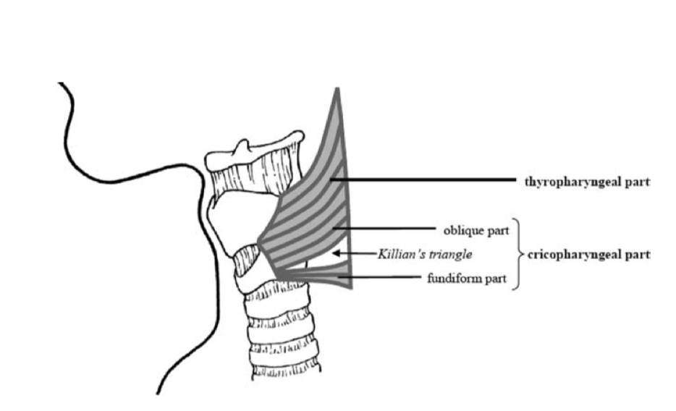
Anatomy
False diverticulum of the pulsion type
The hypopharyngeal pouch herniates more often to the left, and is rarely seen in the right side of the neck

Slide 6
Treatment Options
Transoral endoscopic approaches
Z-POEM, stapler, robotic approach
Transcervical myotomy with diverticulectomy or diverticulopexy

Slide 7
Discussion
Post-operative management
Drain?
Diet

