Slide 1
Paraesophageal hernia
Stephanie G. Worrell
University of Arizona

Slide 2
The problem
GERD is the most common foregut disease in the world and accounts for ~75% of all esophageal pathology
Progression of the disease occurs in 13% of patients over 5 years (while on acid suppressive meds)
Severe erosive esophagitis
Barrett’s esophagus

Slide 3
Patients at risk for progression:
family history of GERD
esophagitis on baseline endoscopy
failure of esophagitis to heal with acid suppression therapy
the need to escalate the dose of acid suppression therapy to achieve symptomatic relief
complete dependence on daily proton pump inhibitors (PPIs) to control symptoms

Slide 4
Background
Nissen has the most effective anti-reflux control
Identification of the proper surgical candidate leads to a successful outcome in nearly all patients
Dependent on appropriate technique
To decrease side effects
To decrease risk of slippage/recurrence
Nissen associated with reliable long-term outcomes
If concern about motility (i.e., IEM) or pre-operative dysphagia, a partial fundoplication may provide similar outcomes although some long-term data suggests inferiorly acid suppression

Slide 5
Identification of the proper surgical candidate
Comprehensive pre-operative work-up
Video esophagram
Upper gastrointestinal endoscopy
High resolution esophageal motility study
Esophageal pH monitoring (off PPI in patients without Barrett’s or LA Grade C/D erosive esophagitis)

Slide 6
Case
65yoF presents with a Type III hiatal hernia and occasional post prandial chest pain. She denies any dysphagia.
PMH: HTN, DM, Chronic anemia
PSH: none
Non smoker
PE: BP 123/84 HR 82 RR 17 O2 sat 98% RA BMI 32
Chest CTA bilaterally, CV RRR, Abd soft NTND

Slide 8
Discussion points
Complications of PEH
Cameron’s ulcers, volvulus (organoaxial vs mesenteroaxial), gastric outlet obstruction
Incidence of complications if left untreated 1% per year
Surgical Approach
Laparoscopic vs robotic vs transthoracic
Fundoplication
Nissen vs Toupet vs other partial
Adjuncts
Collis, mesh, diaphragm relaxation, gastropexy

Slide 9
Operation
Robotic paraesophageal hernia repair with Toupet fundoplication
Given the ineffective esophageal motility on HRM and no evidence of esophagitis/BE on EGD, a partial fundoplication was chosen
There was no evidence of a short esophagus with well >3cm of esophagus resting within the abdomen off tension following complete dissection of the paraesophageal hernia

Slide 10
Summary of surgical approaches
Fallon, B. P., & Reddy, R. M. (2021). Choosing the best approach for paraesophageal hiatal hernia repair: a narrative review. Video-Assisted Thoracic Surgery, 7, 7. https://doi.org/10.21037/vats-21-13

Slide 11
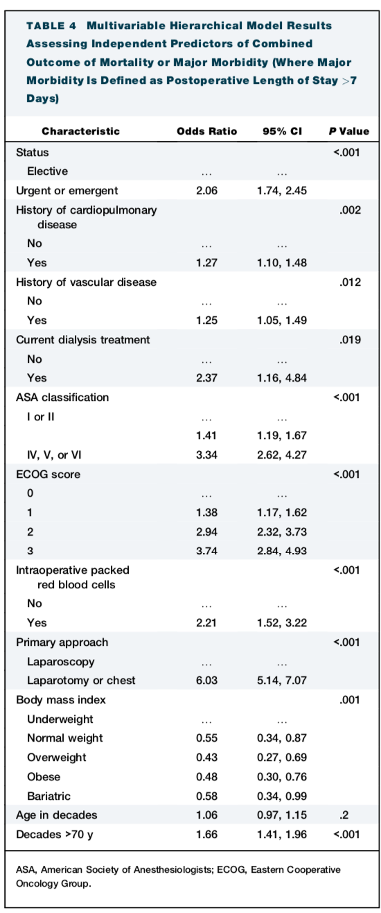
Surgical risk of PEH repair increased
Non elective PEH repair (OR 2.06)
Elderly, particularly >70yo (OR 1.66)
Patients with co-morbidities
Open approach (6.03)
The Impact of Age and Need for Emergent Surgery in Paraesophageal Hernia Repair Outcomes
Wong, Lye-Yeng et al. The Annals of Thoracic Surgery, Volume 116, Issue 1, 138 - 145

