Slide 1

Cardiac Complications after Lung Surgery
Update by: Ammar Asban, MD Brian Mitzman, MD
University of Utah
Initial Powerpoint by: Raghav Murthy MD, Derek Williams MD, David Graham MD, Brian Bethea MD
University of Texas Southwestern
Case Presentations
Adult Cardiac Surgery
TSC TS 03
Milestone: 14

Slide 2
Background
71 y/ o male, 6 month h/o
  Cough
  Increasing SOB / DOE
  No systemic symptoms
Past Medical History:
  COPD, HTN, early dementia
  10 ppk yr smoker
  3 alcoholic beverages/da

Slide 3
History and Exam
Labs:
  PFT’s :
    FVC 83% predicted
    FEV1 69% predicted
    DLCO 79% predicted
EKG: normal
ECHO: EF 60%
Bronchoscopy: LLL submucosal mass, cytology +ve adenocarcinoma

Slide 4
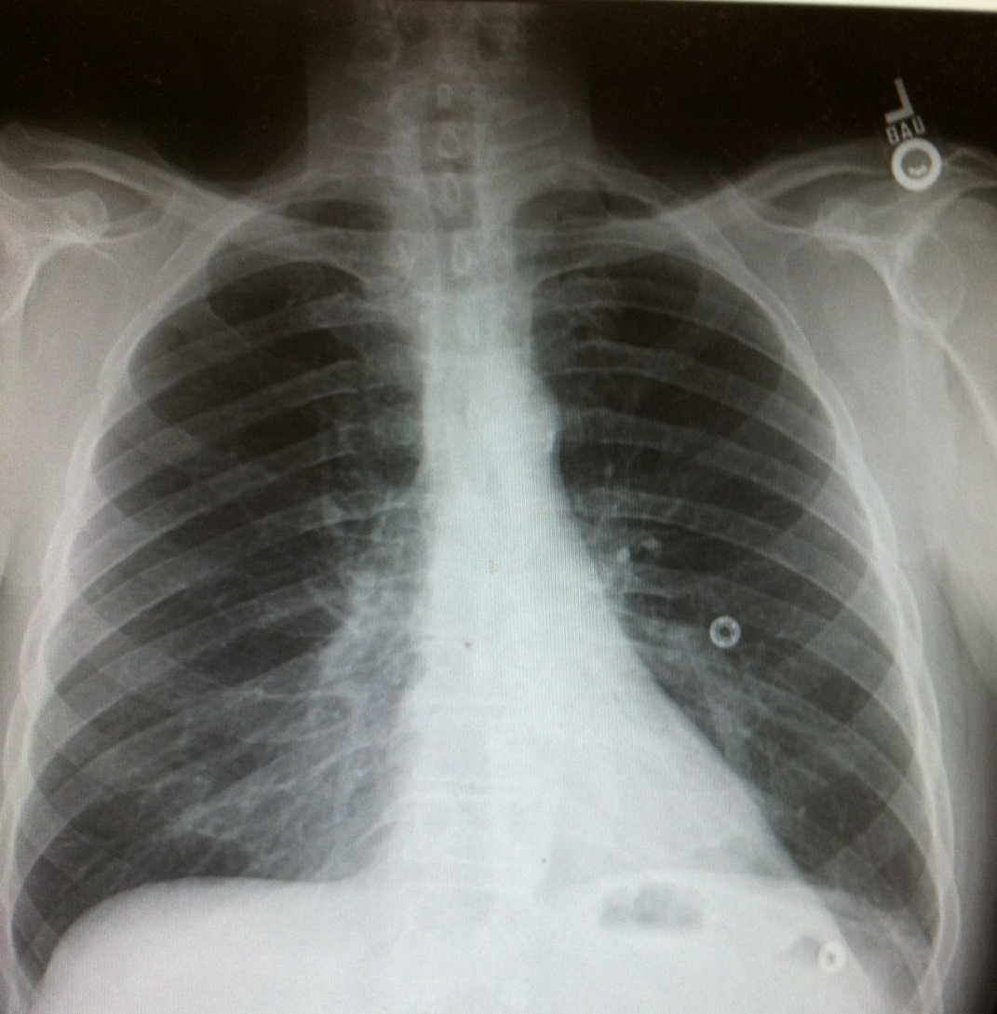
Chest X-ray

Slide 5
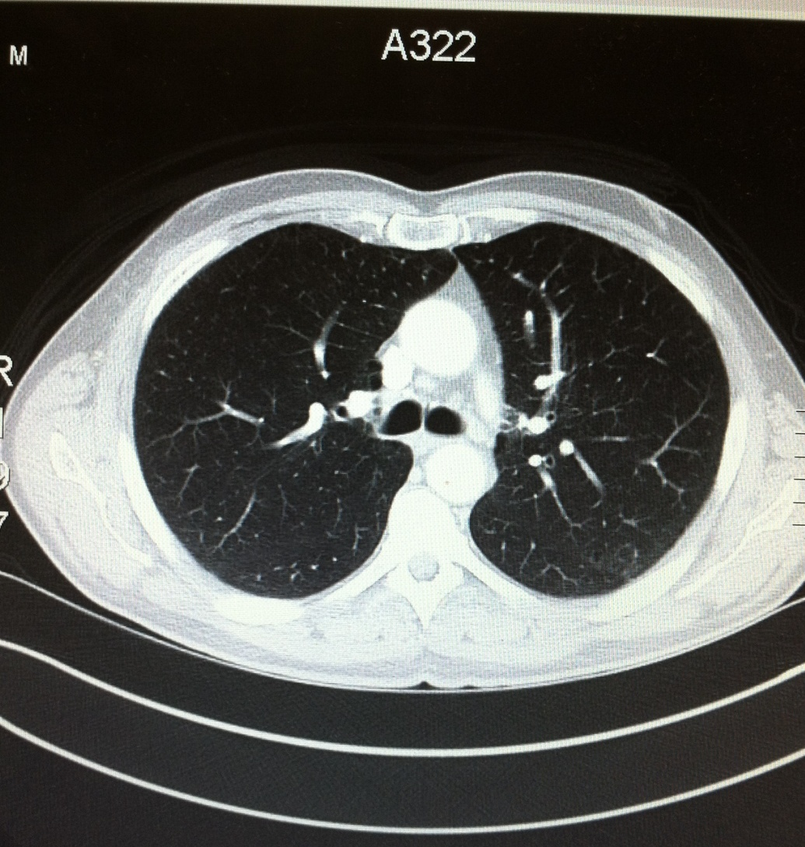
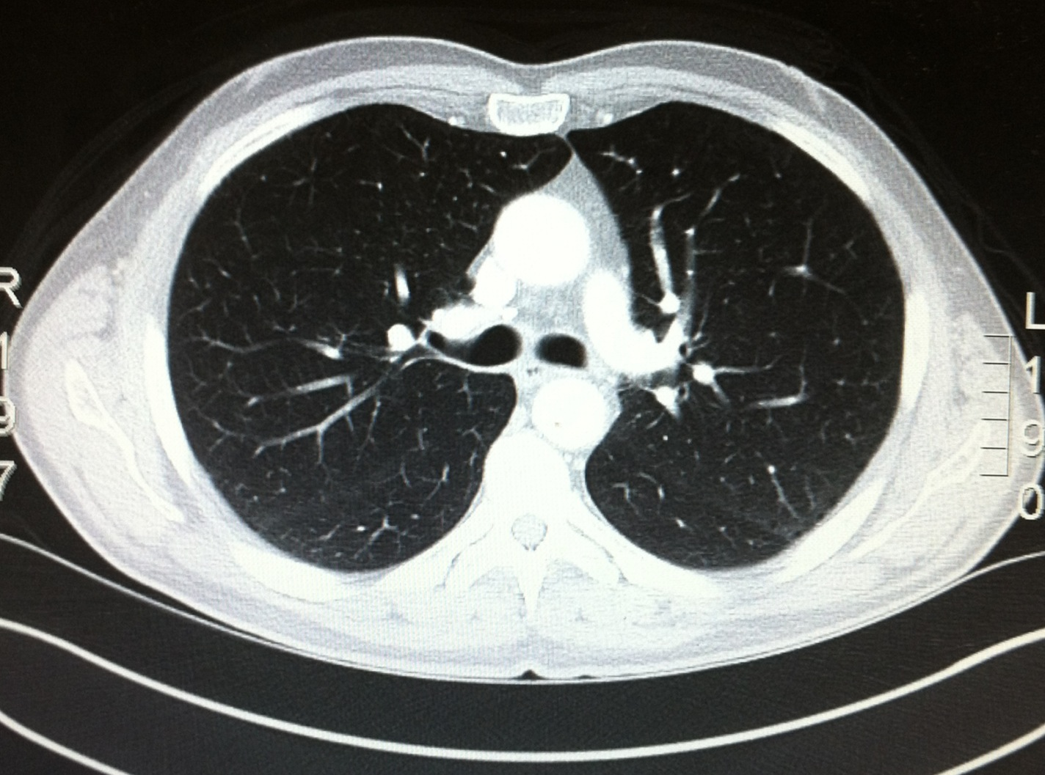
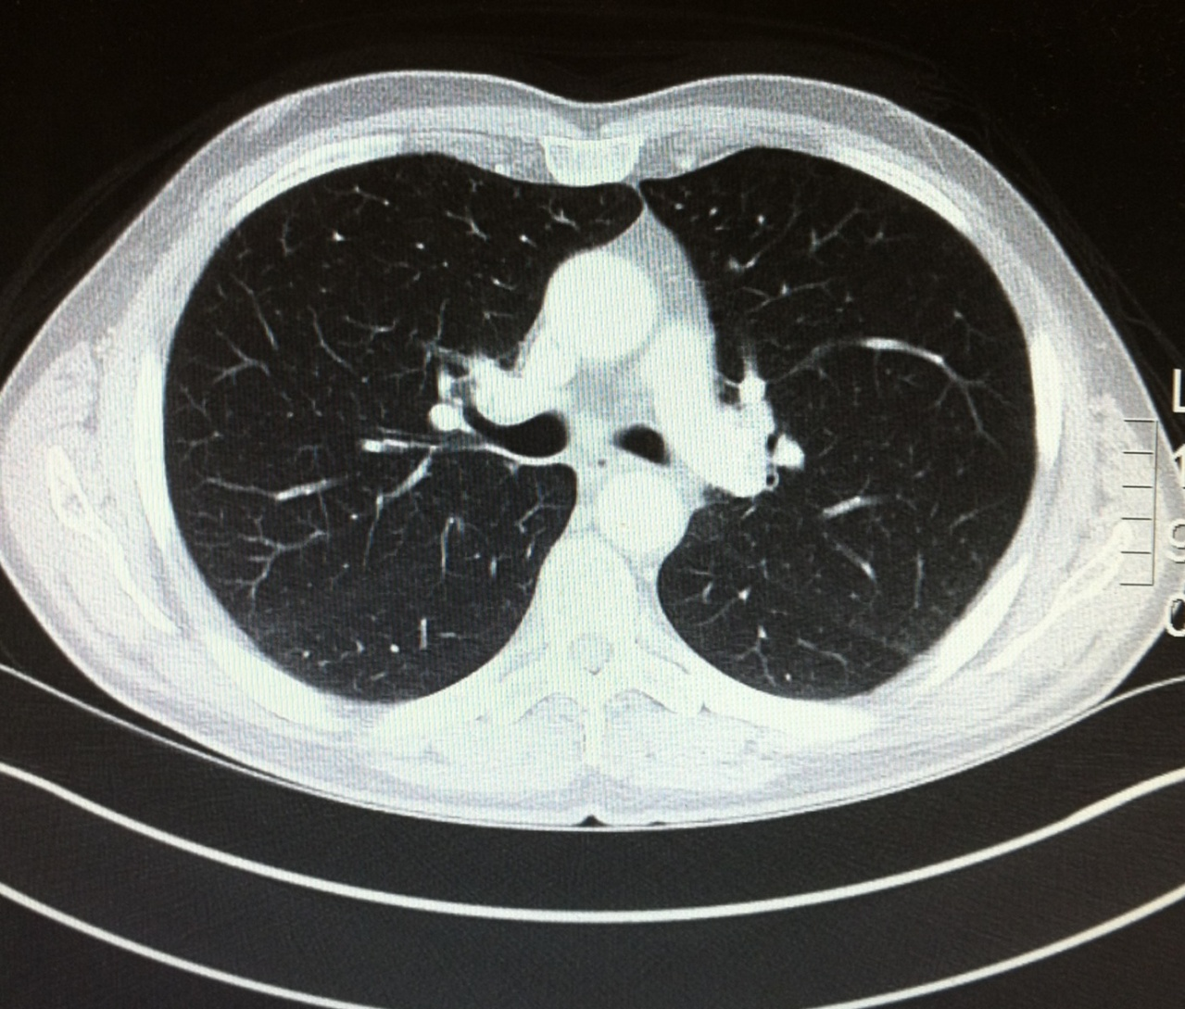
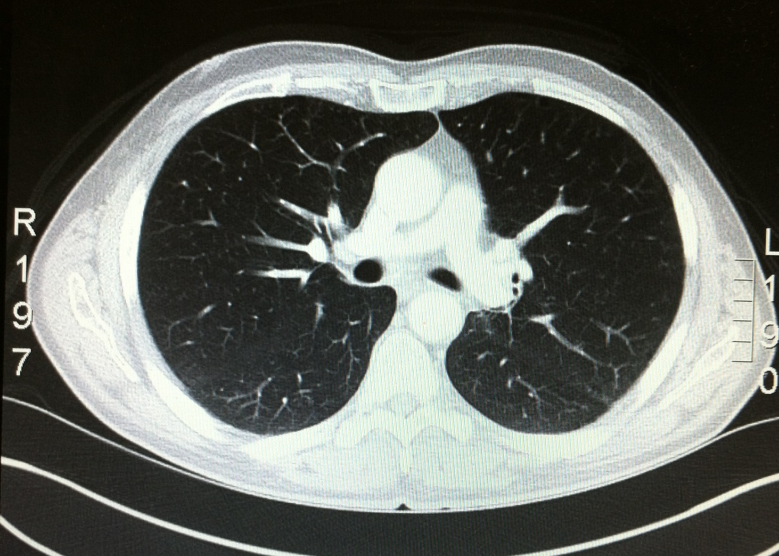
CT Scan

Slide 6
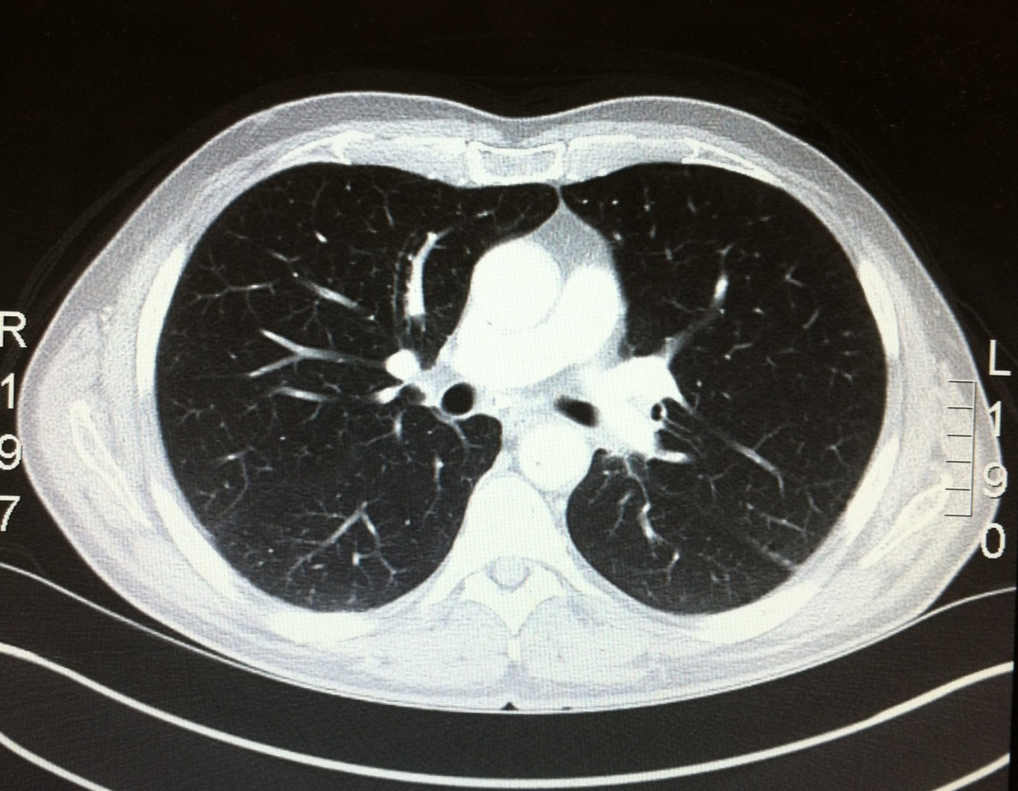
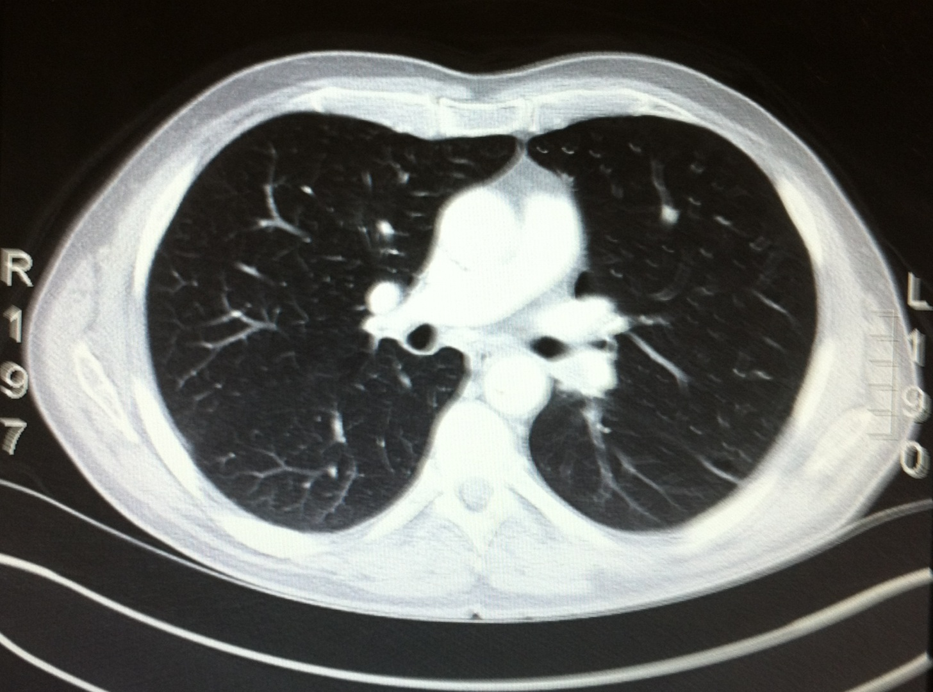
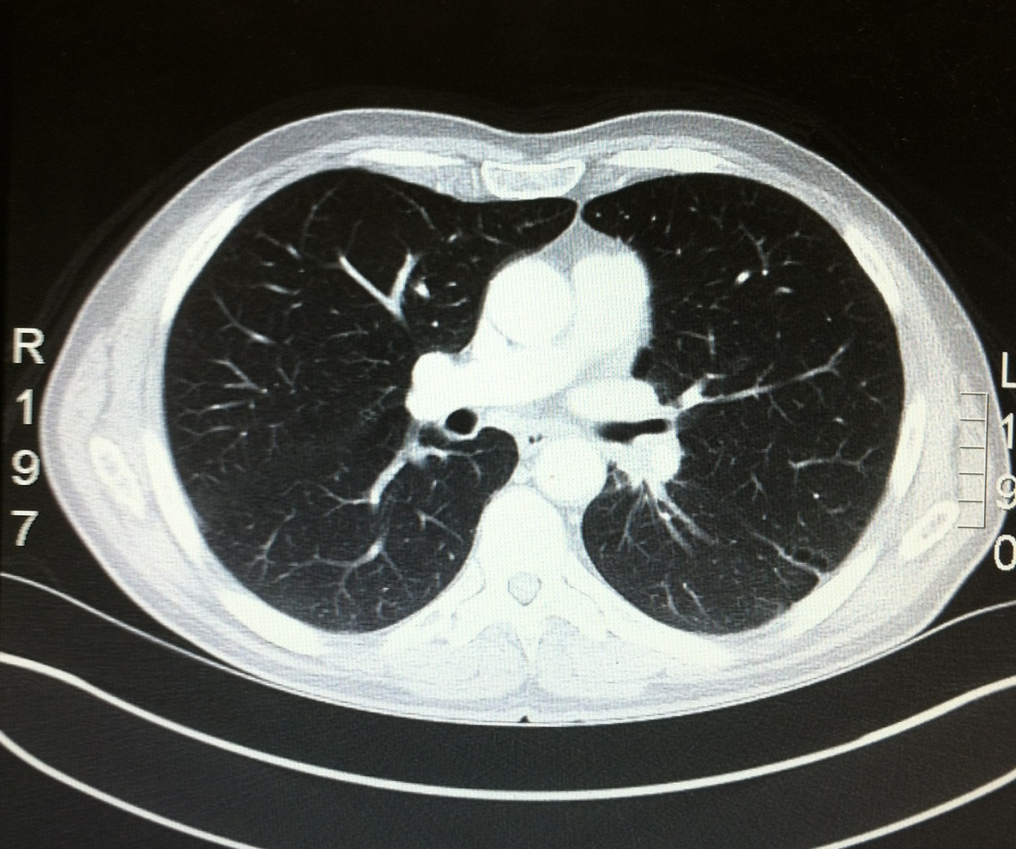
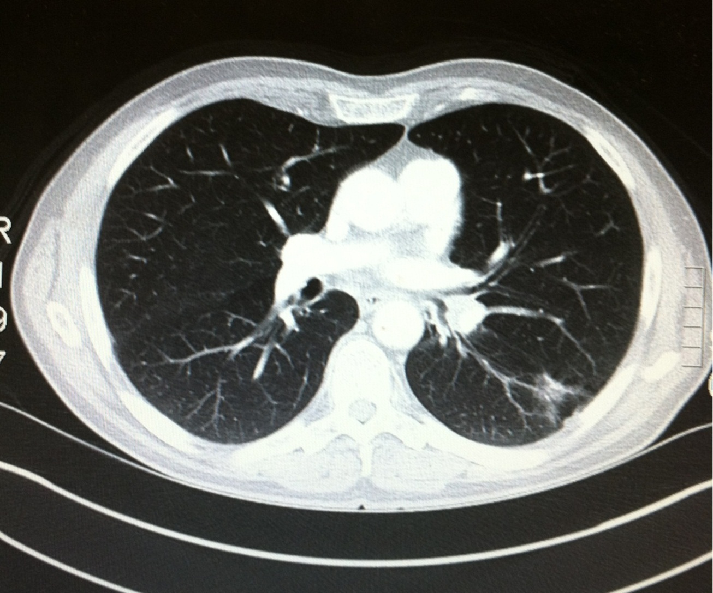
CT Scan

Slide 7
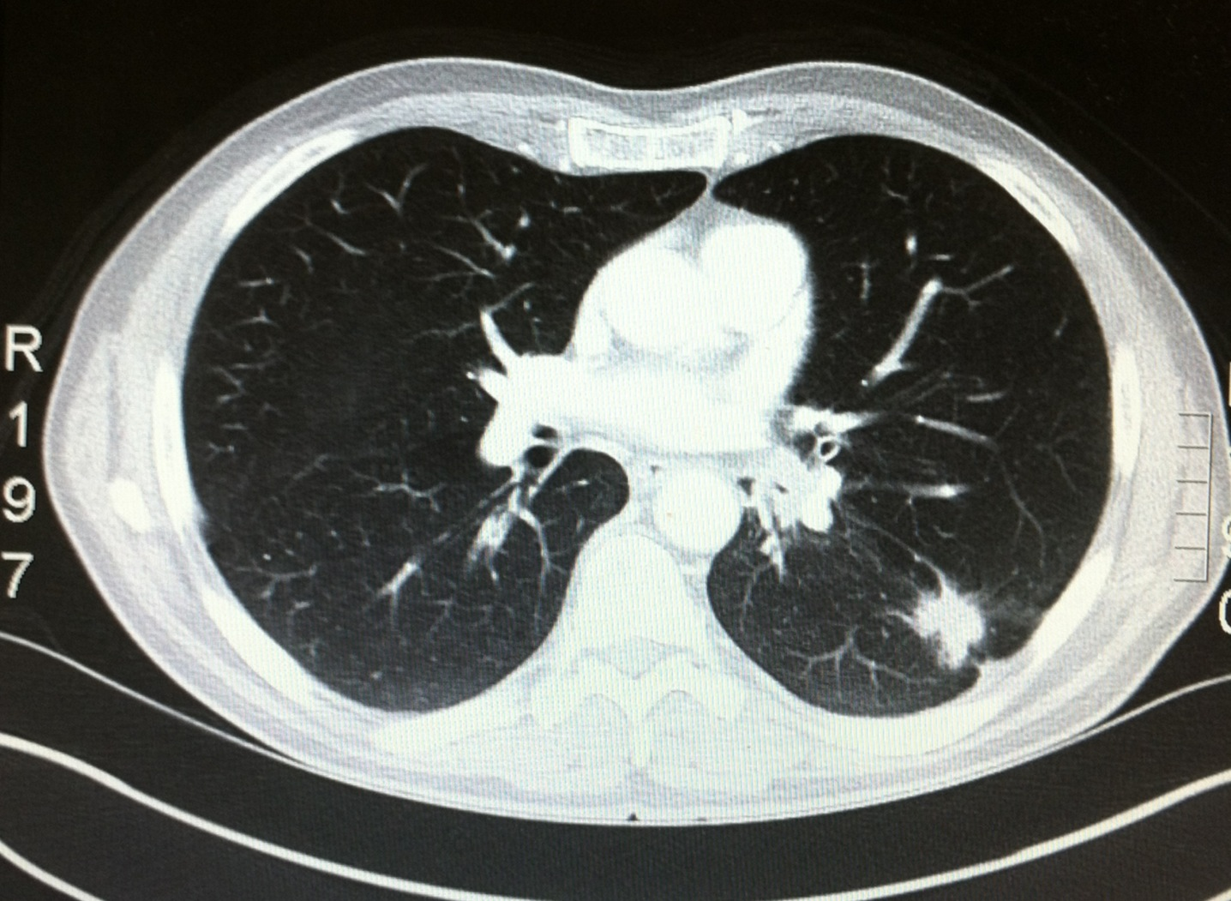
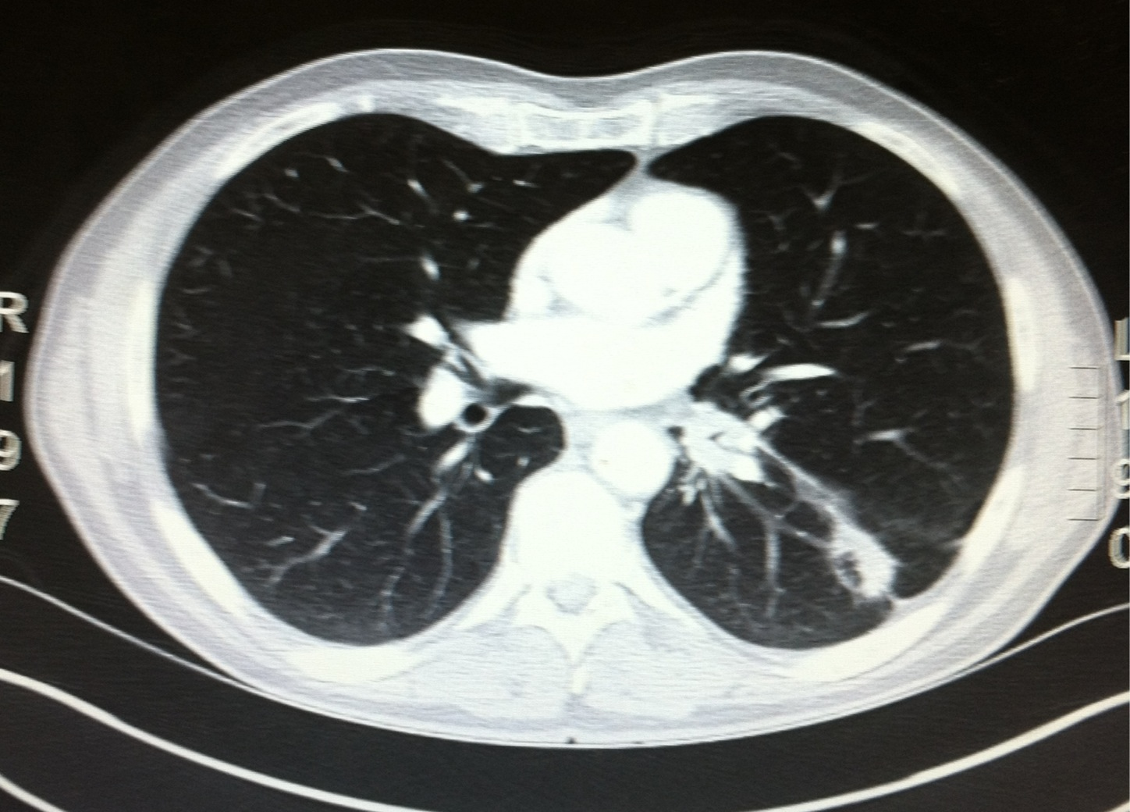
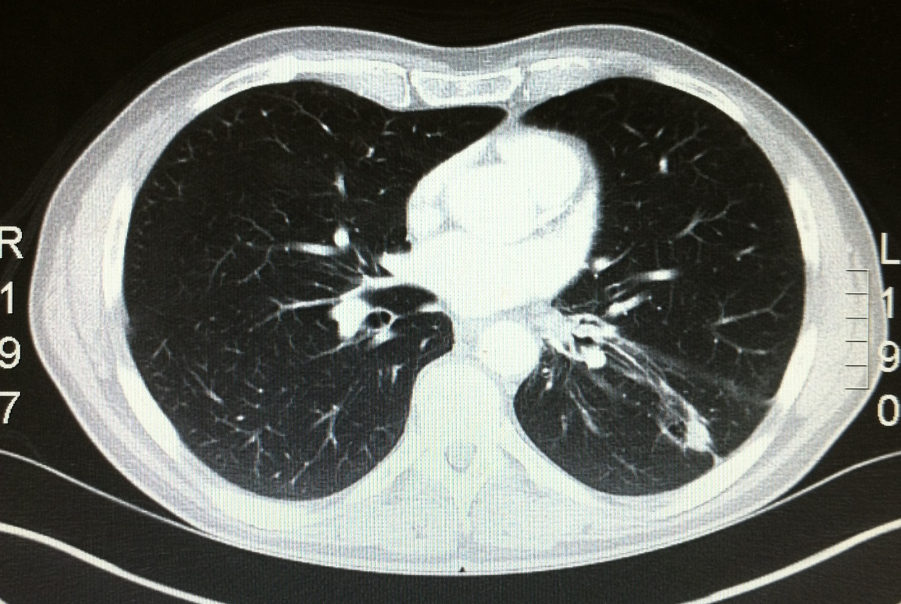
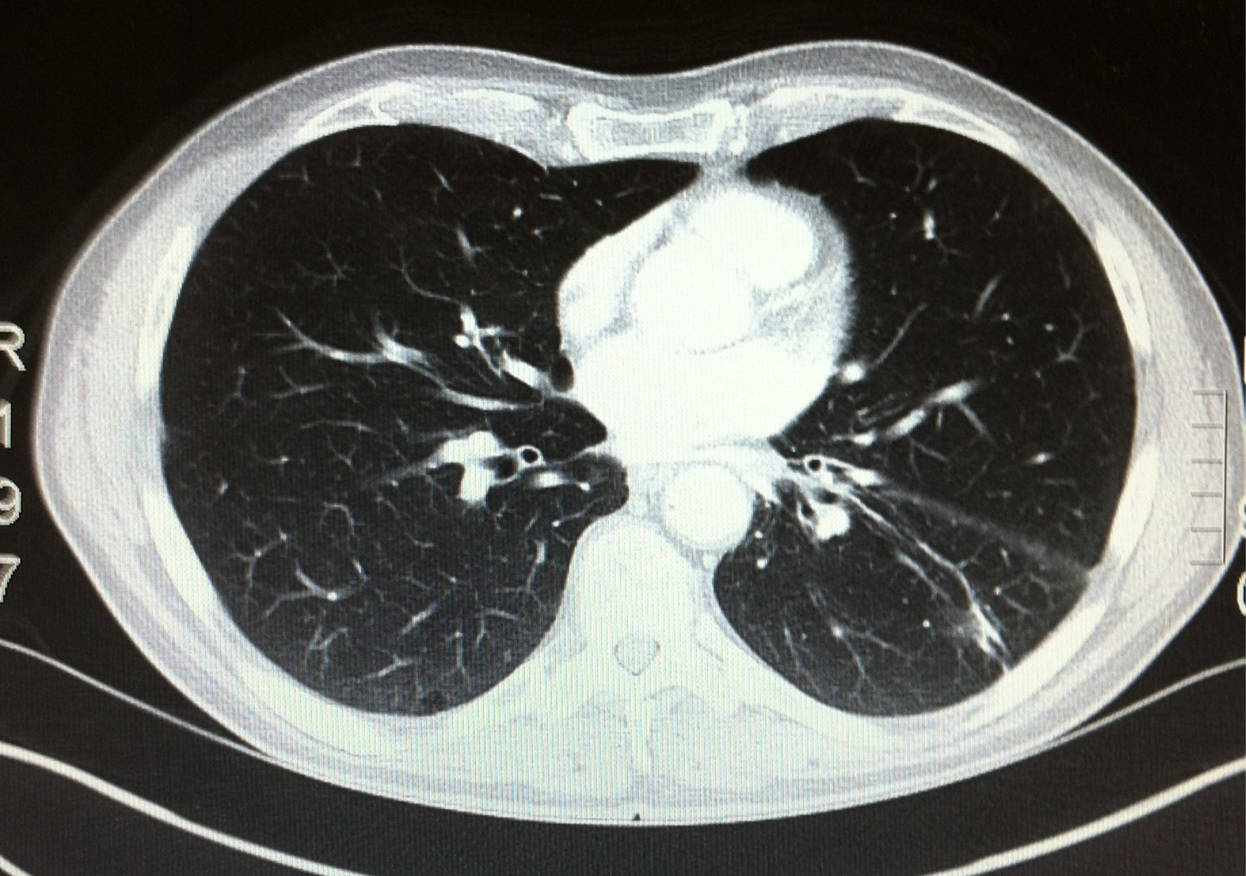
CT Scan

Slide 8
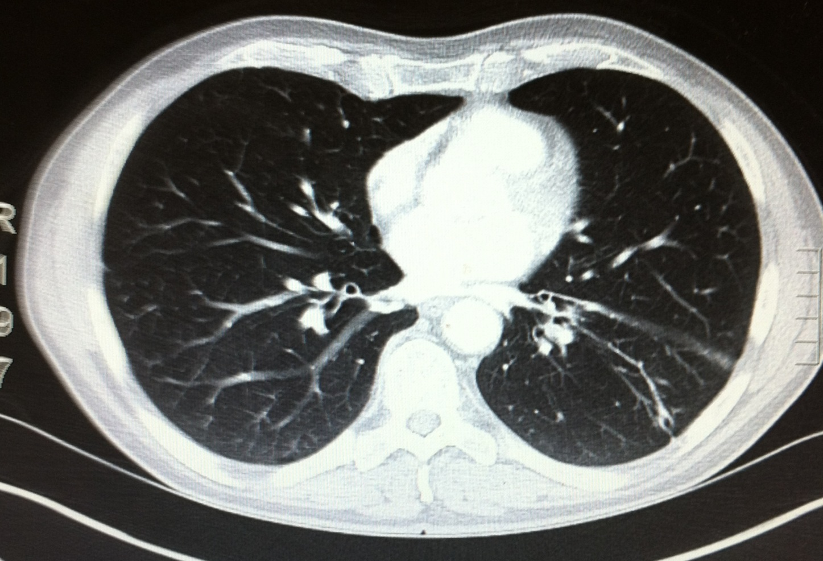
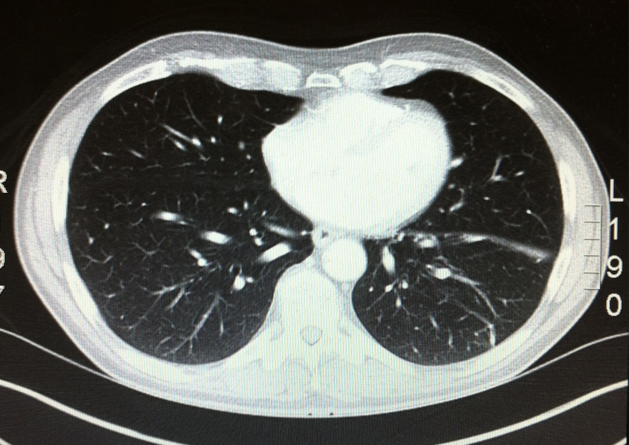
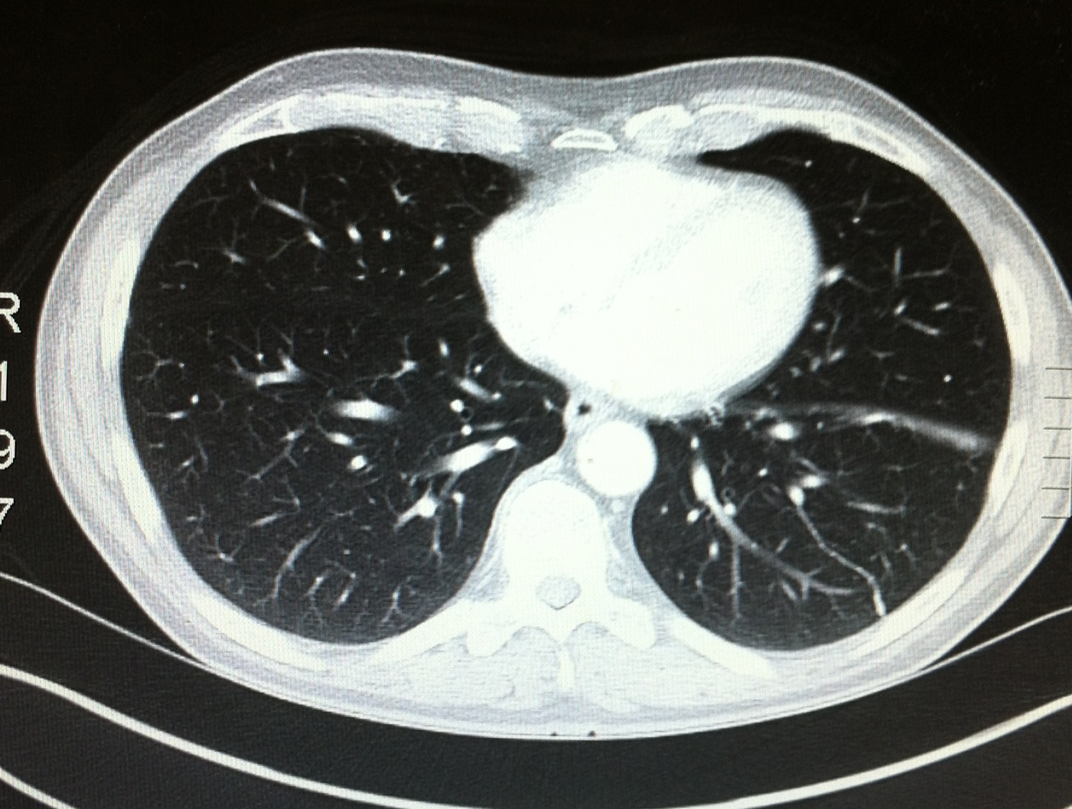
CT Scan

Slide 9
PFT – 5.5 SUV

Slide 10
Discussion Points for Conference
What stage is this neoplasm?
Which resections would this patient tolerate based on PFT’s
What is an appropriate cardiac work-up?
  Functional vs anatomic testing
List the general complications of pneumonectomy
List cardiac specific complications of pneumonectomy
  Simple vs complex complications
What is the mortality of a pneumonectomy versus a sleeve resection?
What is the long and short term post-op follow-up?

Slide 11
Operation
Pt had a mediastinoscopy January 13th. Level 4R, 7, 4L, 2R, and 2L were sampled and negative for malignancy
left pneumonectomy was performed February 3rd.
This case was performed before the era of neoadjuvant chemoimmunotherapy, and in the modern era with likely N1+ disease, Checkmate816 protocol should be strongly considered via multidisciplinary discussion

Slide 12
After completing the pneumonectomy and while the chest is still open, the patient has a PEA arrest
What do you do?

Slide 13
This Pt had CPR and Emergent Left Heart Cath
Found 80% RCA stenosis and placed a BMS.
Why Bare Metal?
What are the differences between Bare Metal and Drug Eluting?
What is the risk of stent occlusion?
What is the role of plavix, integrellin, ASA?

Slide 14
Immediately post stent placement
Pt has persistent hypotension
What do you do?
What is the differential?

Slide 15
Differential
Ongoing ischemia
  Missed lesion at cath/incomplete re-vascularization
  Early stent occlusion
  Coronary artery dissection
Hypovolemia
  Bleeding, vasodilated, oversedation
Cardiac Tamponade
Mediastinal shift post pneumonectomy

Slide 16
This pt had
PA Catheter showing tamponade
Echocardiogram showing blood around heart
What do you do?

Slide 17
Operation
Subxiphoid window
Converted to Sternotomy, 1 cm tear found at base of left atrium
Repaired
What bleeding can be repaired through the original left thoracotomy and what bleeding is better repaired through a median sternotomy?

Slide 18
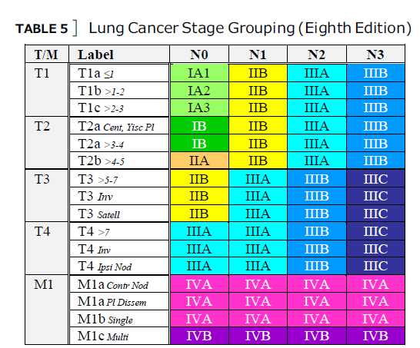
Pathology
The 8th edition of the AJCC staging system for non– small cell lung cancer
pT3N2M0 : Stage IIIB
3/11 LN + including level 7
Further therapy?
Chemotherapy
Radiation Therapy

Slide 19
Post operative course
Vasoactive meds weaned off by POD 7
L CT for intermittent drainage of hemothorax
POD 10: cholangitis
POD 14: extubated
POD 26: d/c to rehab

Slide 20
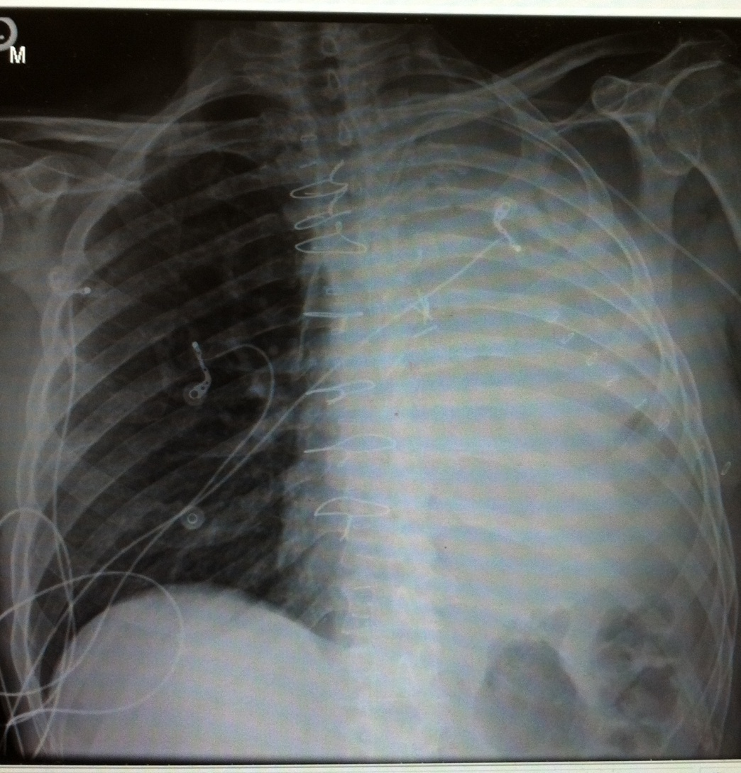
Discharge CXR

Slide 21
Cardiovascular Complications Following Thoracic Surgery
Occur in up to 30% of patients following noncardiac thoracic surgery
MI occurs in less than 5% of patients after lobectomy, pneumonectomy, or esophagectomy
Mortality rate after MI as high as 40% after pneumonectomy
Atrial fibrillation is the most common
  Low risk <5%
  Intermediate risk 5-15%
  High risk >15%
VTE occurs in about 5%. There is significant variability in VTE (1%–26%)
Cardiovascular Complications Following Thoracic Surgery, Hari B. Keshava MD, MS, Daniel J. Boffa. Thoracic Surgery Clinics, 2015-11-01, Volume 25, Issue 4, Pages 371-392

Slide 22

https://riskcalculator.facs.org/RiskCalculator/PatientInfo.jsp
Calculate this patient’s perioperative risk using the American College of Surgery Risk Calculator

Slide 23
Contraindications to Noncardiac Surgery
High-Risk Cardiac Conditions Considered Contraindications to Noncardiac Surgery
  Acute coronary syndrome
  Acute decompensated heart failure
  Tachyarrhythmias or bradyarrhythmias associated with hypotension or requiring urgent medical attention (eg, ventricular tachycardia or high-grade atrioventricular block)
  Symptomatic, severe aortic stenosis (mean gradient >40 mm Hg or peak velocity >4 m/s)
Perioperative Cardiovascular Risk Assessment and Management for Noncardiac Surgery A Review. Nathaniel R. Smilowitz, MD, MS; Jeffrey S. Berger, MD, MS. JAMA. 2020;324(3):279-290.

Slide 24
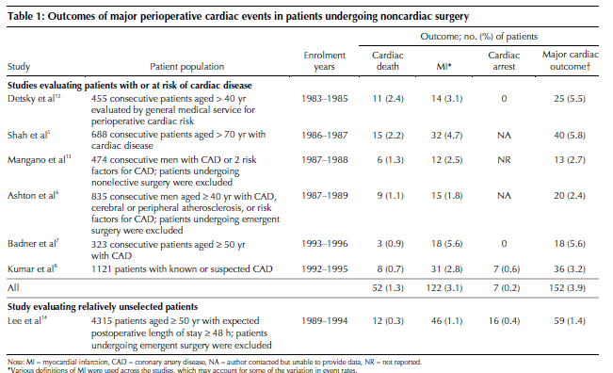
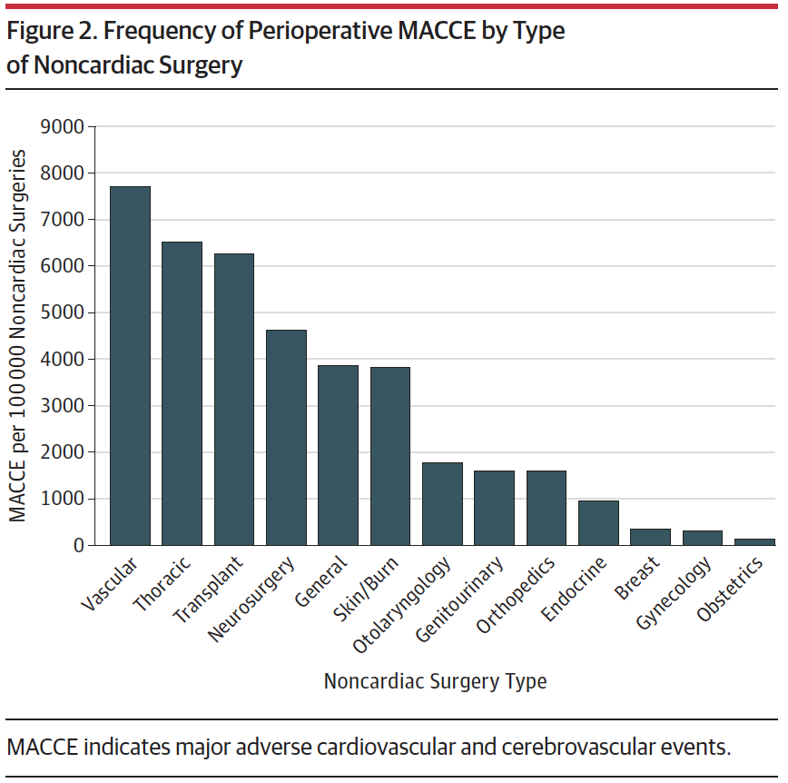
Perioperative Cardiac Events
PJ Devereaux et al: Peri-op cardiac events in patients undergoing non cardiac surgery: CMAJ/JAMC 2005; 173(6): 627- 34.
Perioperative Major Adverse Cardiovascular and Cerebrovascular Events Associated With Noncardiac Surgery. Smilowitz et al. JAMA Cardiol. 2017;2(2):181-187.

Slide 25
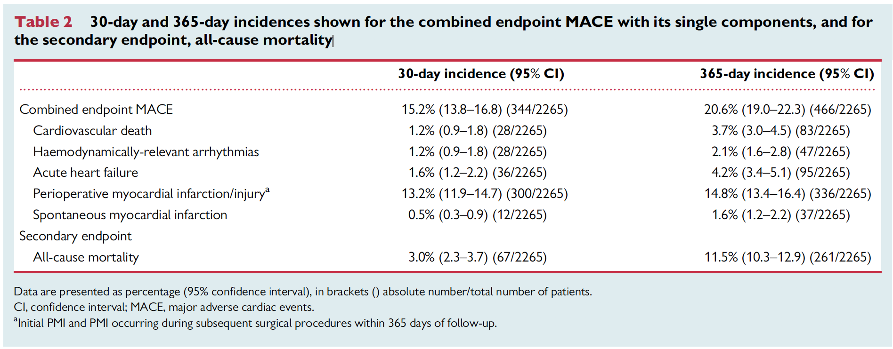
Incidence of major adverse cardiac events following non-cardiac surgery. Lorraine Sazgary et al. European Heart Journal: Acute Cardiovascular Care (2021) 10, 550–558

Slide 26
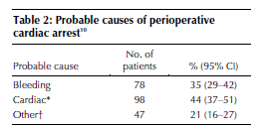
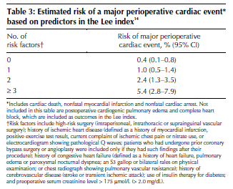
Perioperative Events
Lee Index is a cardiac risk calculator designed by Lee Goldman. 6 possible points.
High-risk surgery
History of ischemic heart disease
History of congestive heart failure
History of cerebrovascular disease
Preoperative treatment with insulin
Preoperative serum creatinine >2.0 mg/dl (>177 µmol/L).
PJ Devereaux et al: Peri-op cardiac events in patients undergoing non cardiac surgery: CMAJ/JAMC 2005; 173(6): 627- 34.

Slide 27
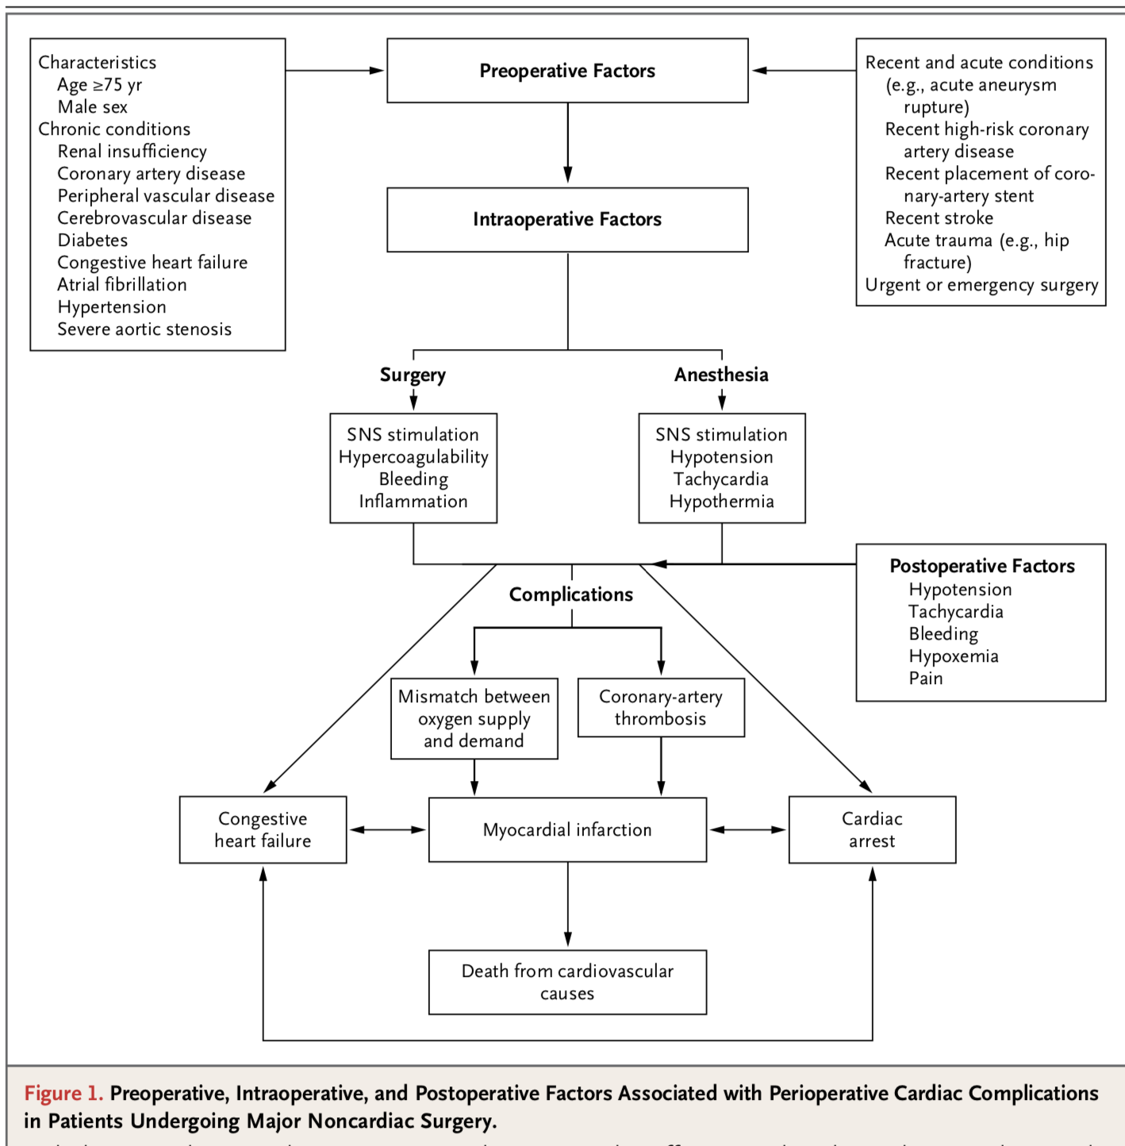
Factors Associated with Perioperative Cardiac Complications in Patients
Undergoing Major Noncardiac Surgery.
Cardiac Complications in Patients Undergoing Major Noncardiac Surgery. P.J. Devereaux, M.D., Ph.D., and Daniel I. Sessler N Engl J Med 2015;373:2258-69.

Slide 28
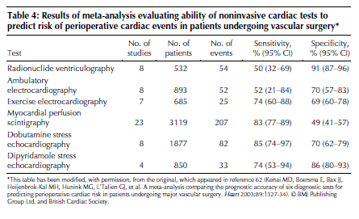
Perioperative Events
PJ Devereaux et al: Peri-op cardiac events in patients undergoing non cardiac surgery: :CMAJ/JAMC 2005; 173(6): 627- 34.

Slide 29
Learning Points
Cardiac complications of thoracic surgery not inconsequential
Pre op Index of Suspicion is important
Prognosis after major perioperative cardiac event is poor
Multiple factors contribute to peri-op cardiac M & M

