Slide 1
Thoracic Surgery General Management I
Updated by: Brian Mitzman, MD
University of Utah
Initial powerpoint by: Stephen Yang, MD
Johns Hopkins University

Slide 2
Learning Goals
The basic level concepts focused on:
General Knowledge
Basic Lung Anatomy
The advanced level concepts focused on:
Management and Advanced Lung Anatomy

Slide 3
Discussion Questions
Most common anomalies of the lung?
Encountered during bronchoscopy?
During lobectomy of individual lobes?

Slide 4
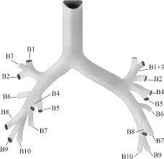
Standard Anatomy

Slide 5
Case #1
A 25 yo M sustains a bullet wound that enters the anterior right chest below the nipple and exits below the tip of the right scapula
What potential organs are injured?
What tests or procedures would be done to exclude injuries?

Slide 6
Discussion
Potential organs injured: lung, esophagus, diaphragm, liver, airway, heart, pericardium
Work up: FAST, CT chest/abdomen with oral and IV contrast, esophagram, endoscopy (bronchoscopy, esophagoscopy) – depending on situation and acuity

Slide 7
Case #2
A 68 yo F undergoes an uncomplicated VATS LLL lobectomy
She is on sips of liquids overnight
During the first POD1, the chest tube output was 350 cc and serosanguinous
On POD 2, you note that the chest tube output has increased to 750 cc during the 24 hrs before and looks turbid
1) What is the cause?
2) How do you work this up and the treatment?

Slide 8
Discussion
Differential: Lymphatic leak, chyle leak, esophageal leak
Workup: Send fluid for triglyceride, chylomicrons, amylase
Management: Make strict NPO vs chyle-leak diet

Slide 9
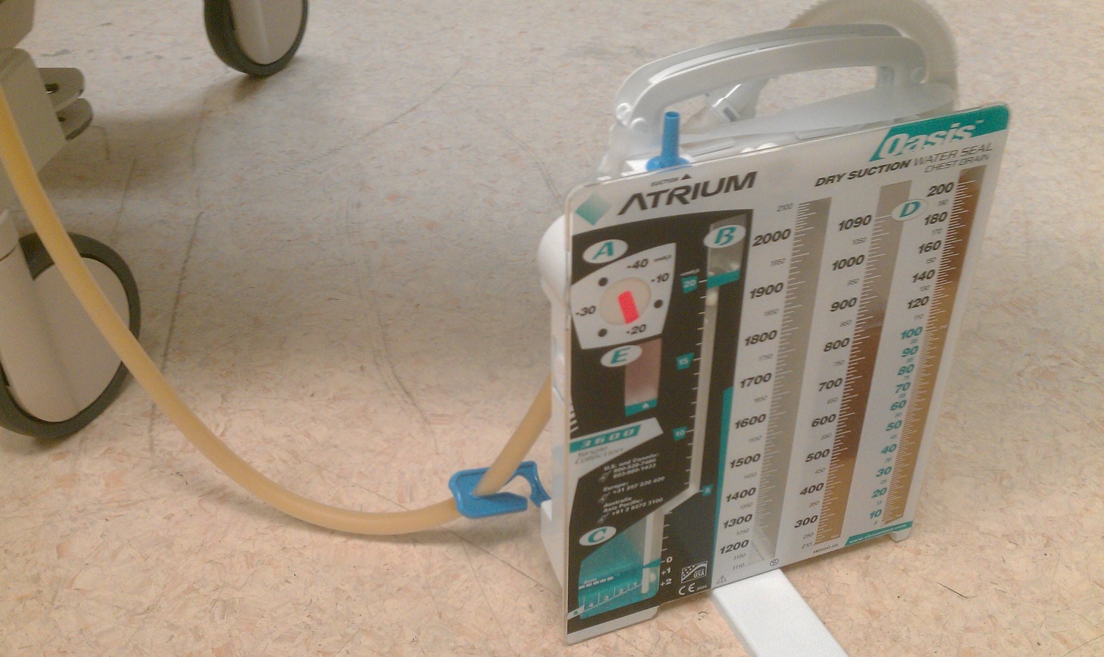
Case Outcome
TG 735 in the chest tube fluid
Pt made NPO – >700 cc/day for ensuing 4 days
Now what?

Slide 10
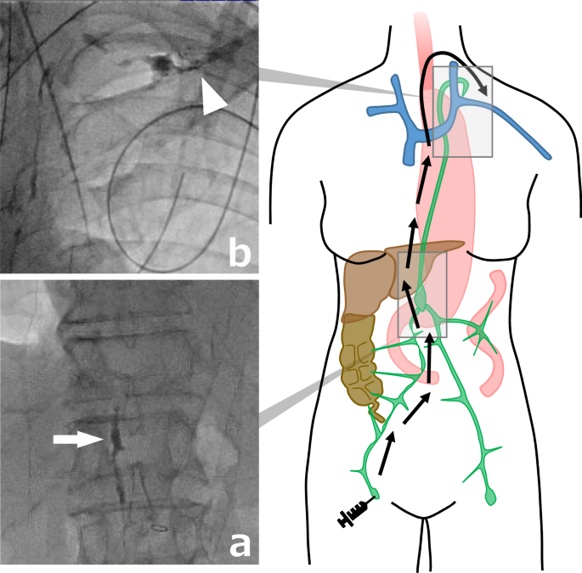
Case Outcome
Percutaneous lymphoscintigraphy showed normal anatomy and leak in subcarinal area
Output slowed after test to 200/day
Started on PO diet but output increased to 900 cc cloudy fluid
Now what?
Thoracic Duct Lymphangiogram
Notes:
Image from: Sato Y et al. Cliniclal Journal of Gastroenterology. 2021;14:969-74.

Slide 11
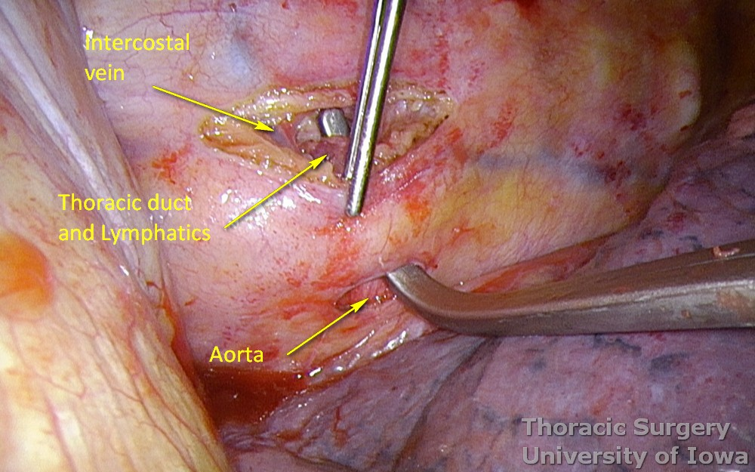
Case Outcome
Pt given regular diet, NPO after midnight
Right VATS thoracic duct ligation at T10 and T11 level
Can give intraoperative heavy cream to exacerbate leak for localization
Drainage stopped intraoperatively
Pt d/c home POD8
Notes:
Image courtesy of University of Iowa

Slide 12
Case #3
You are doing a lingulectomy for a small peripheral 1.5 cm NSCLC.
You have already divided the lingular PA and PV branches, and already stapled off the bronchus.
You reinflate the lung briefly to decide where to divide the lung parenchyma, but find that the lingula still inflates partially
Why is this so?

Slide 13
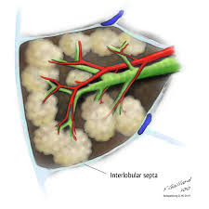
Pulmonary Collaterals: Pores of Kohn
Interalveolar connections, Canals of Lambert
Develop after birth
Account for:
Ventilation across segments and fissures
Failure of endobronchial valves
Local recurrence after wedge resection

Slide 14
Case #4
During a difficult left lower lobectomy dissection, you decide to open the pericardium to gain control of the PV
You find only one branch emanating from the LA
Now what?

Slide 15
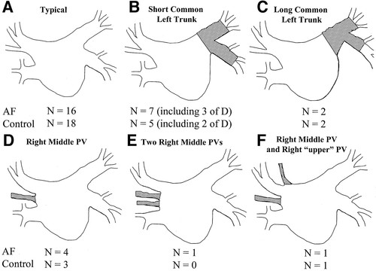
Common PV Trunk
L>R
Reported 14% cases
Always Identify both SPV and IPV
If accidentally divided, convert to open, reanastomose to LA (not completion pneumonectomy)
SPV
IPV
Notes:
Image from: Kato R et al. Circulation. 2003;107:2004-10.

Slide 16
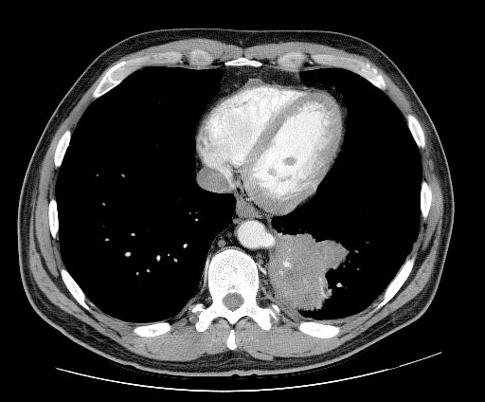
Case #5
A 30 year old woman presented with a history of two episodes of “pneumonia” and a three year history of streaky hemoptysis.
PMH is unremarkable and she is a non-smoker.
Bronchoscopy reveals erythema of the left lower lobe bronchus and cytologic specimens were negative for malignant cells.
A CT was obtained (shown).
What is the diagnosis and treatment?

Slide 17
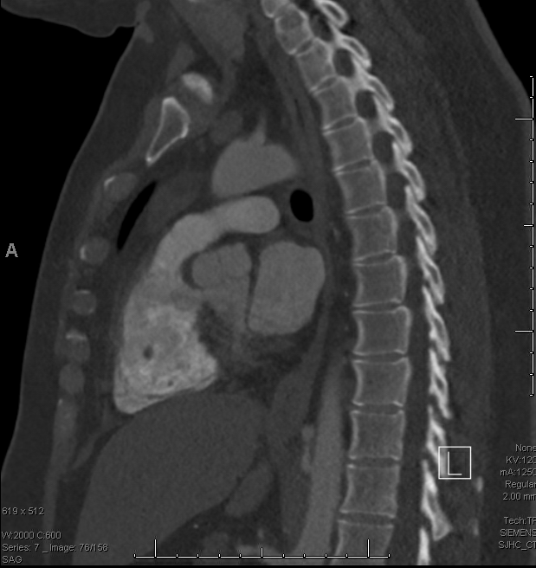
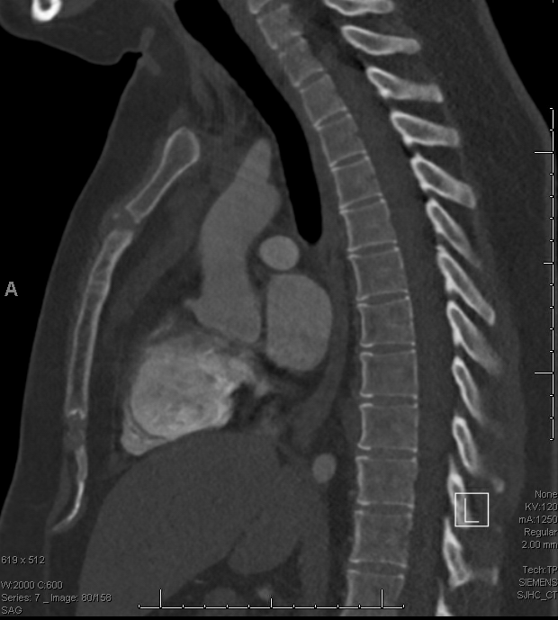
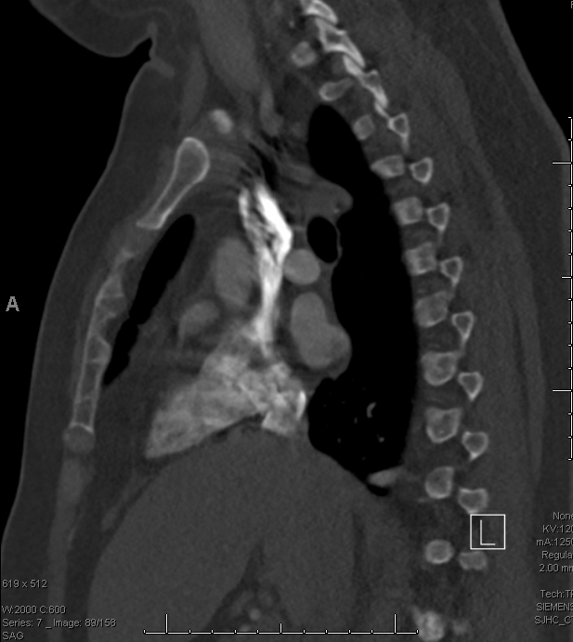
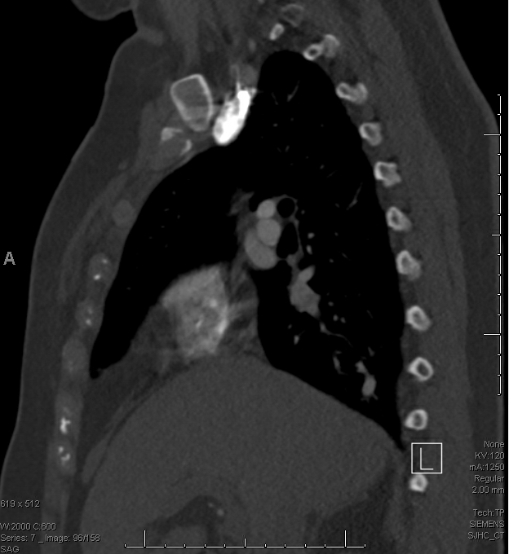
1.
2.
3.
4.

Slide 18
Case Outcome
Diagnosis of pulmonary sequestration (what type?)
Taken to OR for left VATS resection of sequestrated lung
Feeding aortic artery found in inferior pulmonary ligament
Discharged POD 4

Slide 19
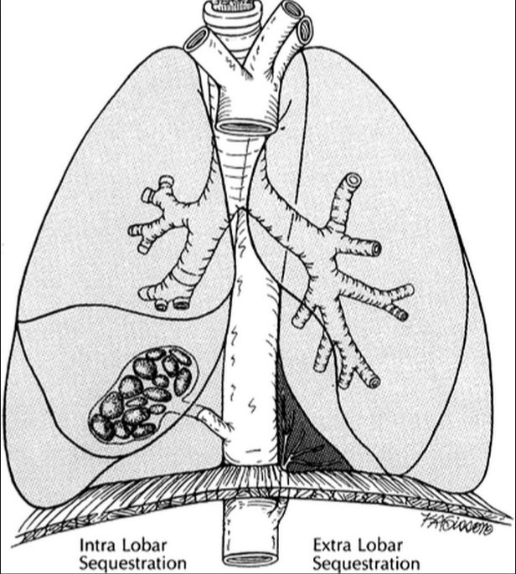

Slide 20
INTRALOBAR SEQUESTRATION | EXTRALOBAR SEQUESTRATION
Shares visceral pleura of normal lung | Locked up within own pleural membrane separate from normal lung
Pulmonary venous drainage | Congenital systemic venous drainage
Incidence 75% | Incidence 25%
Symptoms due to associated anomalies 11%; 85% are asymptomatic | 60% symptomatic 20% asymptomatic
Recurrent respiratory infection | Infections rare
Malformations with a portion of lung parenchyma separate from normal lobe. No normal communication with tracheobronchial tree and blood supply from systemic artery (aorta)
Congestive heart failure
Surgical resection for symptomatic lesions

Slide 21
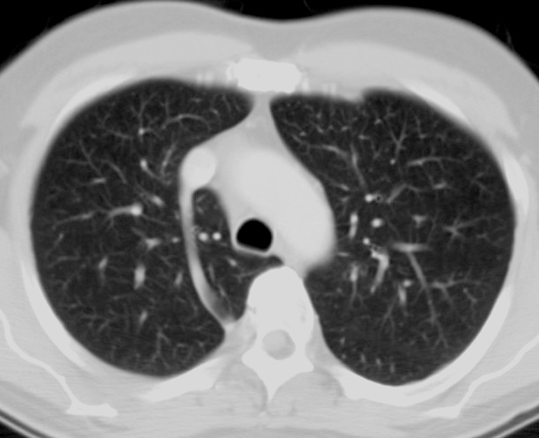
Case #6
What is seen here?
What is this anatomic anomaly?

Slide 22
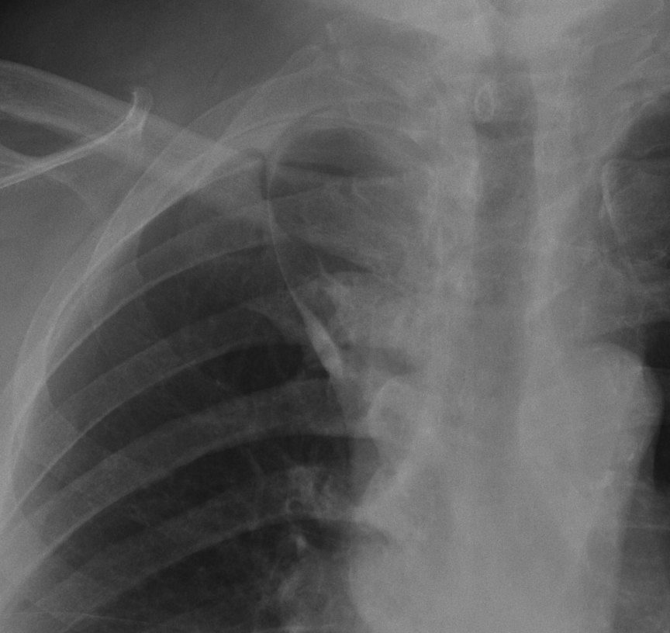
Azygous vein

Slide 23
Case #7
A 25 year old woman presented with a history of progressive SOB over 3 years. Inhalers do not help her diagnosis of asthma
CXR and CT are shown on the next slide.
Her past medical history is unremarkable and she is a non-smoker
What is the diagnosis and treatment?

Slide 24
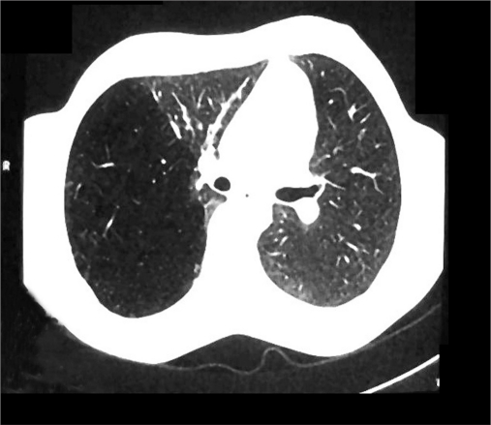
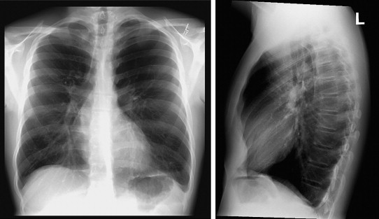
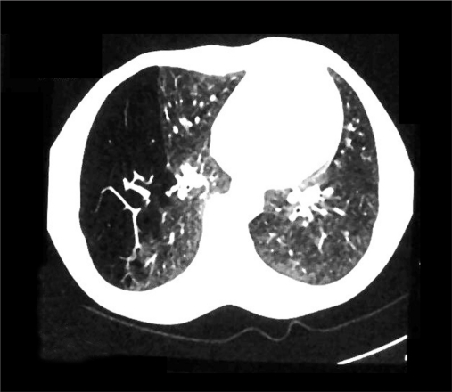
History

Slide 25
Case Outcome
Diagnosis of congenital lobar emphysema
FEV1 68% predicted, DLCO 86% predicted
Ventilation perfusion scan showed matched defect to RLL
Underwent right thoracotomy, RLL lobectomy
D/C on POD 4

Slide 26
Learning Points
Common anatomic pulmonary arterial anomalies most often in LUL, followed by unusual segmental abnormalities in the RUL post segment, superior segments and lingula
Lymphoscintigraphy can be therapeutic 50% in stopping chyle leaks
Pulmonary sequestrations are most common in the left side
Be aware of other congenital disorders: CAM

