Slide 1

Ischemic Mitral Regurgitation
Mitraclip
Author: JoAnna Ghobrial ,MD; Edward Verrier, M.D.
Institution: University of Washington
Date: May 2014
Learning Domain: Adult Cardiac Surgery
Learning Objective: Mitral Valve Disease
Coronary Artery Disease
Updated by: Kirsten Freeman MD, University of Florida, July 2022
Case Presentations
Adult Cardiac Surgery
TSC CV 13B
Milestone: 5

Slide 2
History of Present Illness
October 2012:
Increased nightime cough
September 2013 to January 2014:
“CHF exacerbations”
Feb 2014:
NYHA class III
73 y/o male markedly decreased exercise tolerance
Increased SOB
Notes:
1) 2V CXR: no abnormality, TTE was performed:
2) “CHF exacerbations”: Volume overload, pulmonary edema, titration of torsemide dose, addition of metolazone
3) Decreased exercise tolerance. He is able to walk ½ block then needs to stop to catch his breath, he can climb one small flight of stairs slowly without stopping.

Slide 3
PMH
Hypertension
Hyperlipidemia
Diabetes Mellitus Type 2 –diet controlled
CAD s/p Inferior MI, NSTEMI 2005
Carotid artery stenosis s/p R ICA stenting ‘06 c/b CVA without residual deficit
OSA on CPAP
Stage III CKD (Cr 1.4)
Severe COPD (FEV1 1.17L stable-f/b pulmonology) currently not on O2
Dysphagia with only mild Schatzki’s ring not requiring dilation, otherwise normal EGD.
Hiatal Hernia
L Thyroid Follicular neoplam – stable f/b Oncology

Slide 4
Medications
Lisinopril 10 mg daily
Metoprolol succinate 100 mg daily
Torsemide 40 mg BID
Metolazone 2.5 mg daily
Spirinolactone 25 mg daily
Nitroglycerin SL prn CP
Clopidogrel 75 mg daily (indication:CVA)
Atorvastatin 80 mg qhs
Advair 500/50 BID
Combivent inhaler
Flonase
Protonix

Slide 5
PMH
FH
SH
No FH of Heart disease that is known
Master Sergeant first class in army 20+ years
Worked as a janitor afterwards, retired in late 1980’s
No EtOH/Tobacco/Drug use

Slide 6
Physical Exam/Labs
PE
Labs
VS: P:90, BP: 100/60, RR:16, Sat 94% RA
Gen: younger than stated age
CV: no JVD. S1, S2, RRR. III/VI HSM LLSB radiating to apex.
CHEST: no rales or wheezing, CTA.
Ext: warm, 2+ pulses, 3+ LE edema
CBC: WBC 7, Hgb 11, Hct 34, PLT 173
Chemistry: Na 134, K 3.4, BUN 25, Cr 1.5 (eGFR 47 for AA)
Albumin 4
LFT’s WNL
ProBNP range in the past few months 4000->10,000
Lipid: 117/63/63/42

Slide 7
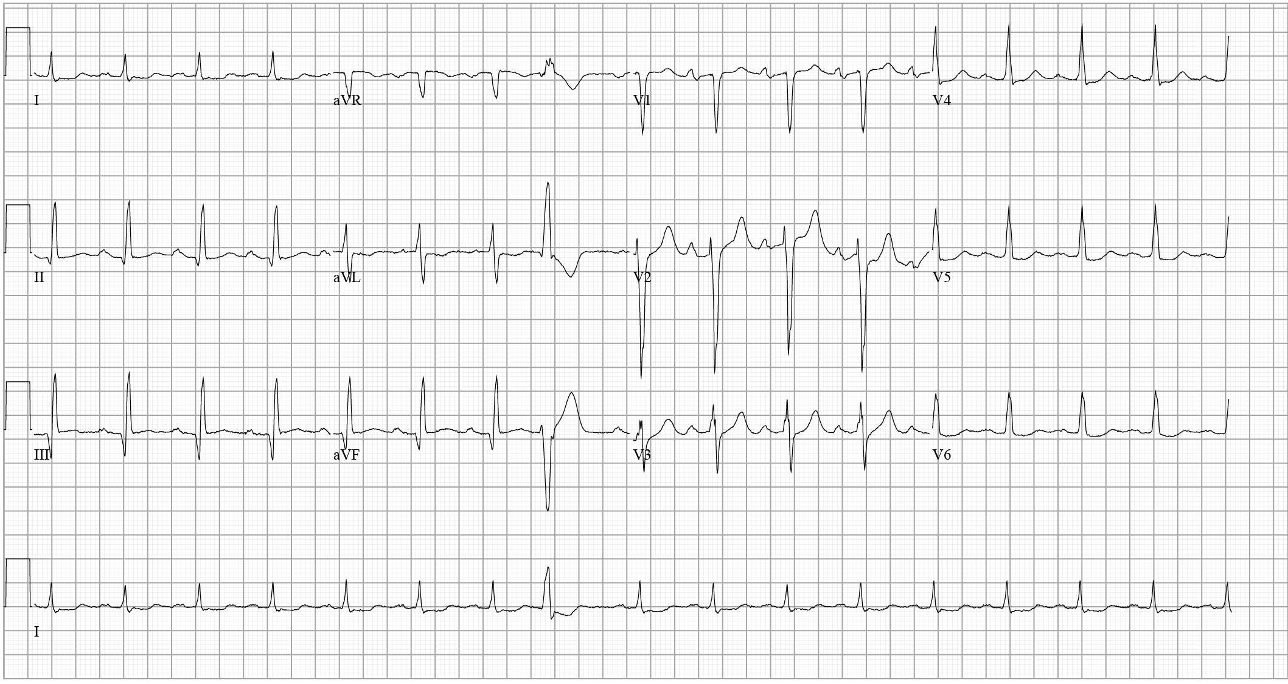
EKG
Notes:
HR 98
QRS 105
QTc 477
LA enlargement
IMI

Slide 8
OLD TTE 10/2012
Normal LV dimensions: EDD: 50 mm, ESD:36 mm
EF>65%
Diastolic dysfunction with decreased compliance and elevated filling pressures.
Severe anteriorly directed MR with posterior leaflet prolapse.
MR PISA 1.2 cm
RVSP 45-50 mmHg

Slide 9
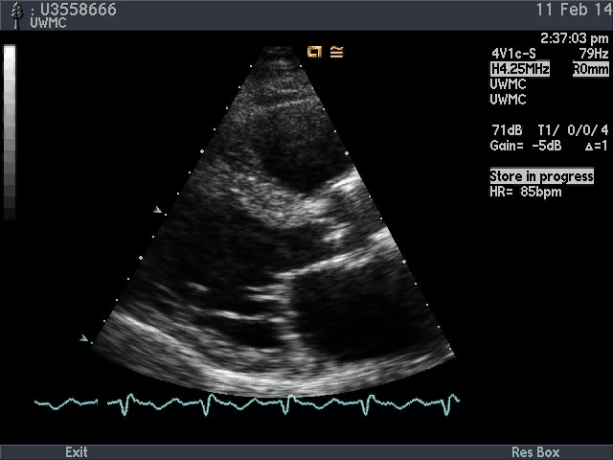
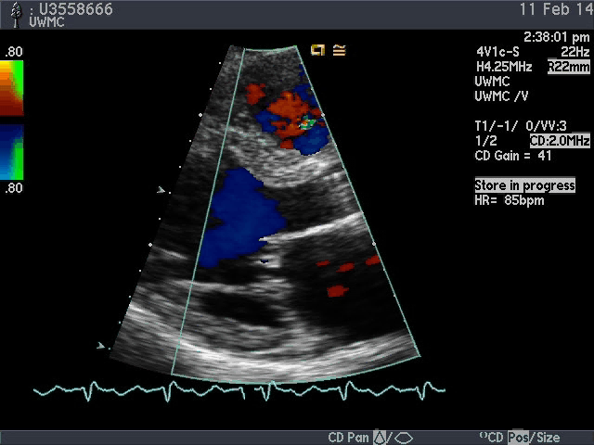
Current TTE Echocardiogram

Slide 10
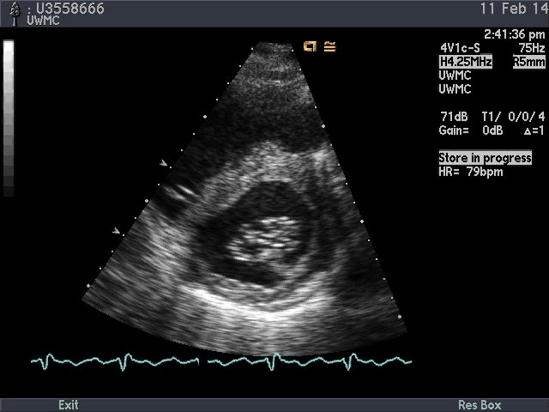
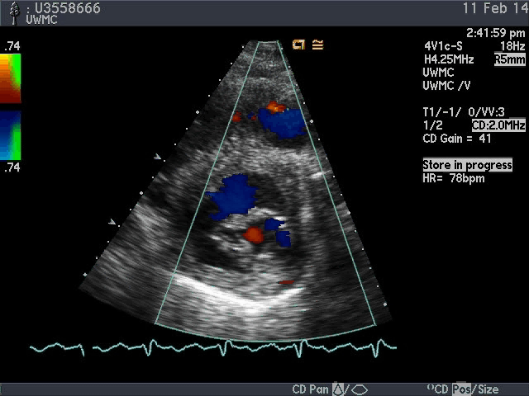
Current TTE Echocardiograms

Slide 11
Nuclear Stress Study
HR 82-> 93 bpm
BP 125/62
EF 43% with global HK more noted inferiorly.
Moderate to large area of mildly reversible ischemia in the inferior wall
Small area of mild reversible ischemia in the apical septum

Slide 12
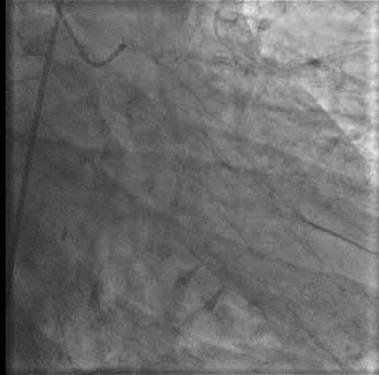
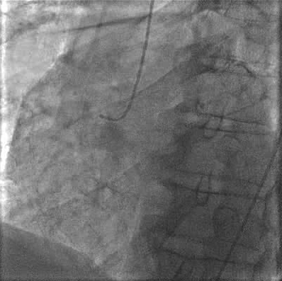
Coronary Arteriograms

Slide 13
Cath Hemodynamics
Chamber | Pressure
RA | 4 mmHg
PA | 54/14 (35) mmHg
PCWP | 19 mmHg (V wave 25 mmHg)
CO/CI | 5.1 L/min, 2.24 L/min/m2
LVEDP | 20 mmHg
Ao | 92/46 (66) mmHg

Slide 14
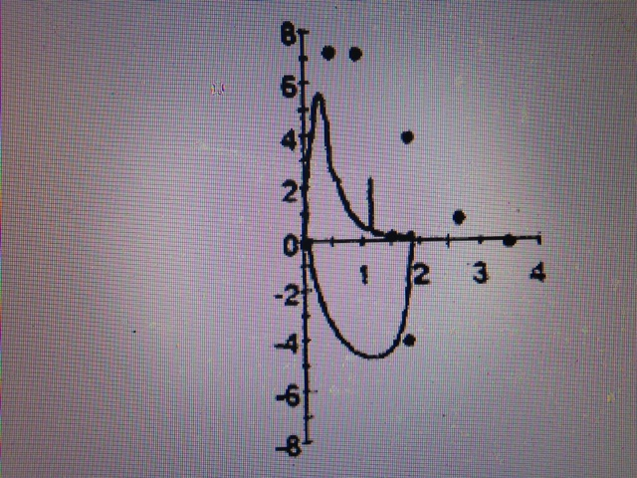
Pulmonary Function Tests
FVC 1.8/70%
FEV1 1.17/47%
Ratio ~60%
DLCO 45%

Slide 15
Discussion Points for Conference
Viable 73 y/o male with severe 3 vessel CAD
Severe mitral regurgitation / symptomatic
Pre-operatigve surgical risk?
Therapeutic goals?
Therapeutic options?
Valvular guidelines 2020

Slide 16
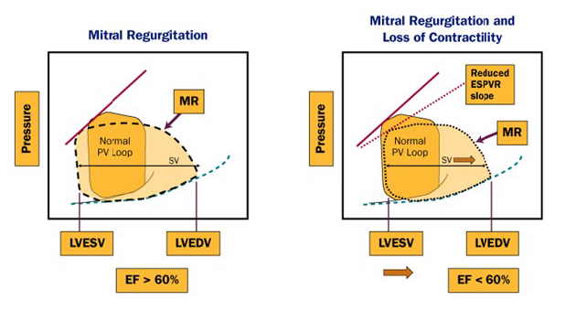
MR: Pathophysiology

Slide 17
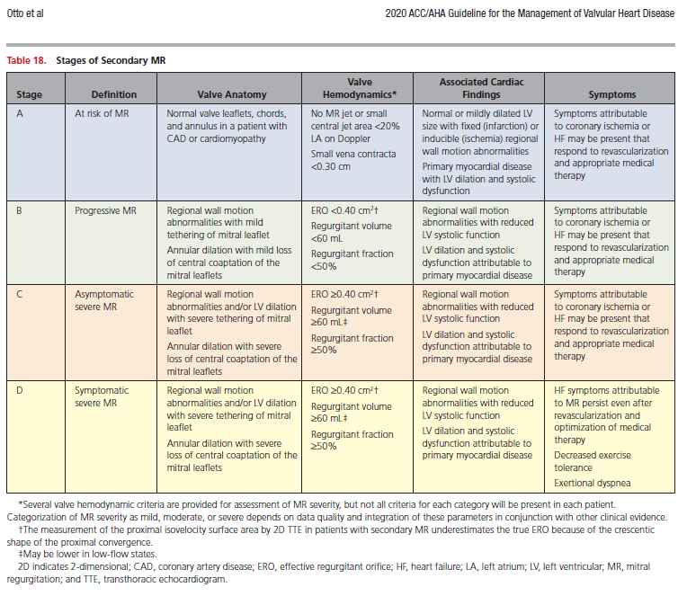
2020 ACC/AHA Valvular Heart Disease Guidelines

Slide 18
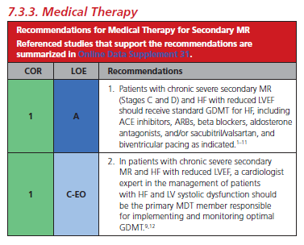
2020 ACC/AHA Valvular Heart Disease Guidelines

Slide 19
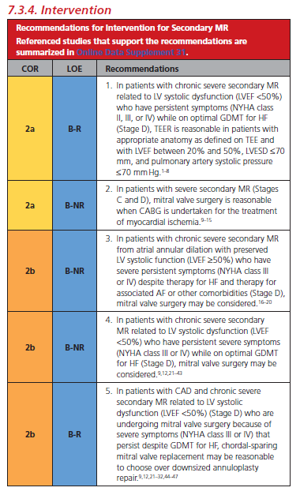
2020 ACC/AHA Valvular Heart Disease Guidelines

Slide 20
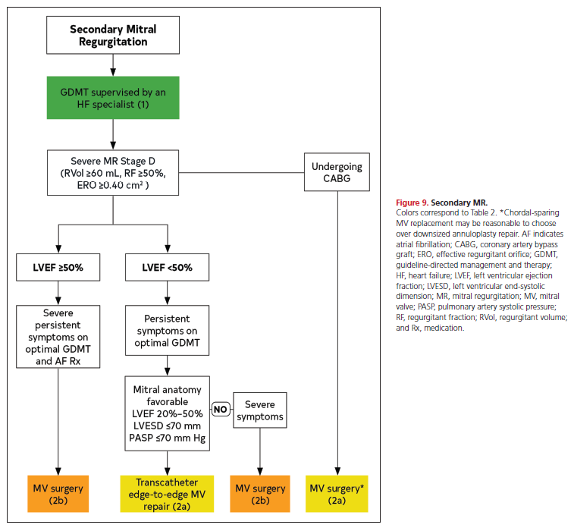

Slide 21
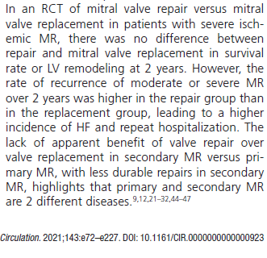

Slide 23
Outcome
High risk for surgical intervention
No easy revasculaization options
Multidisciplinary discussion
Mitral Valve :
  Mitraclip
  2 clips
Discharge POD #7
Symptomatically improved, still with mild-mod MR
Doing well at 6 months

Slide 24
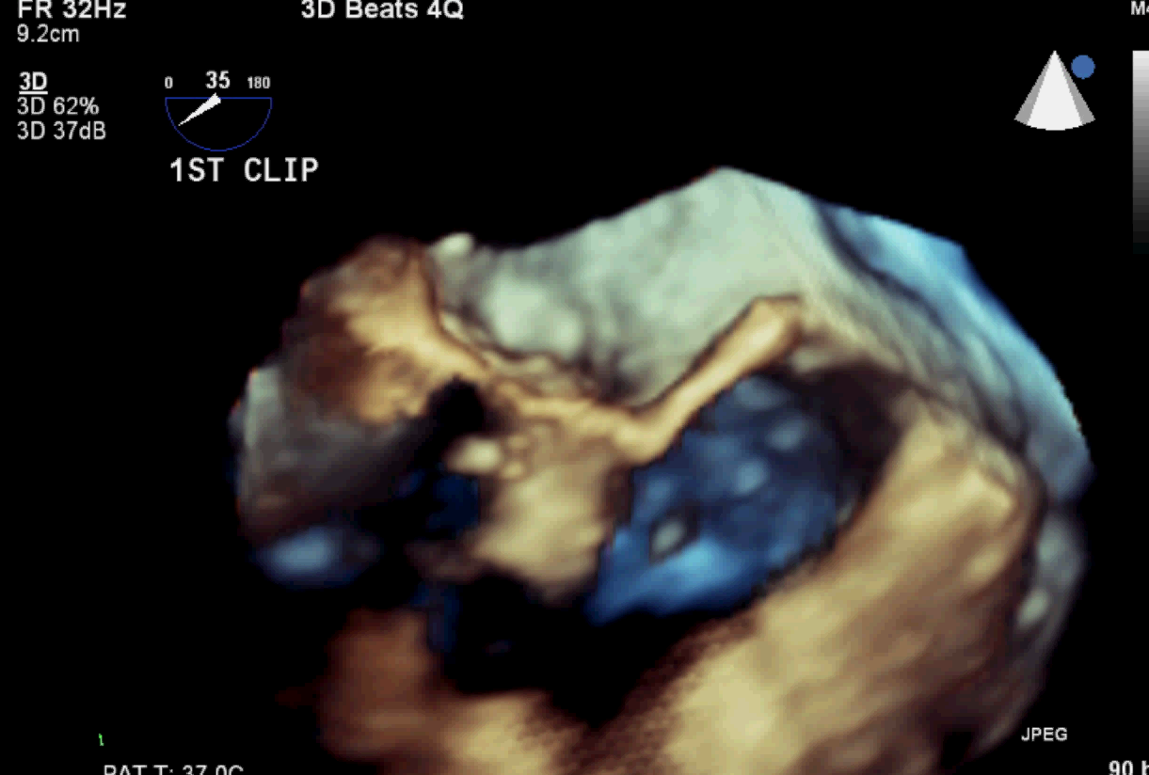
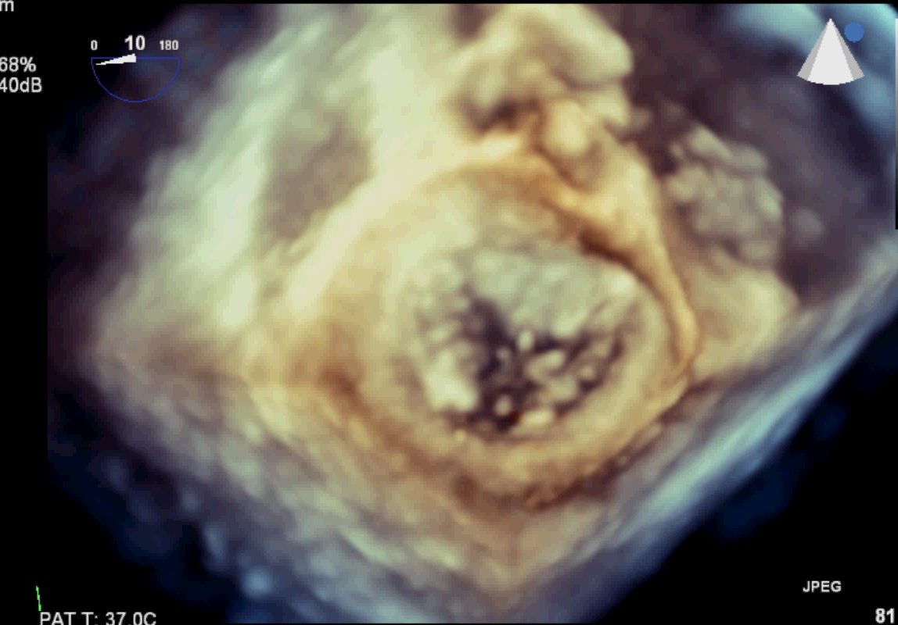
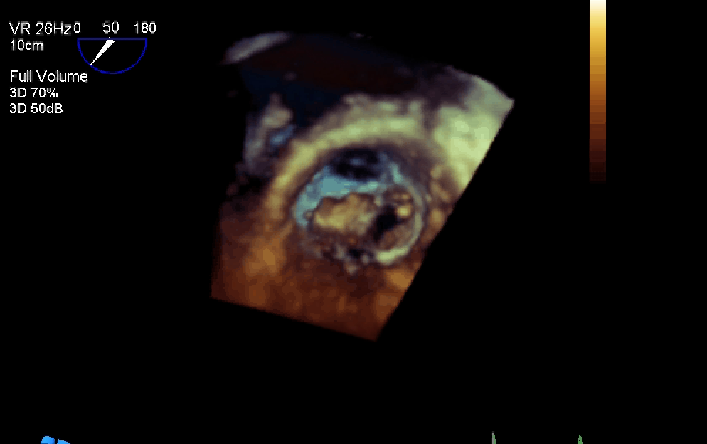
Intra op TEE
3-D after 1st Mitraclip
3-D Before Mitraclip
3-D after 2nd Mitraclip

Slide 25
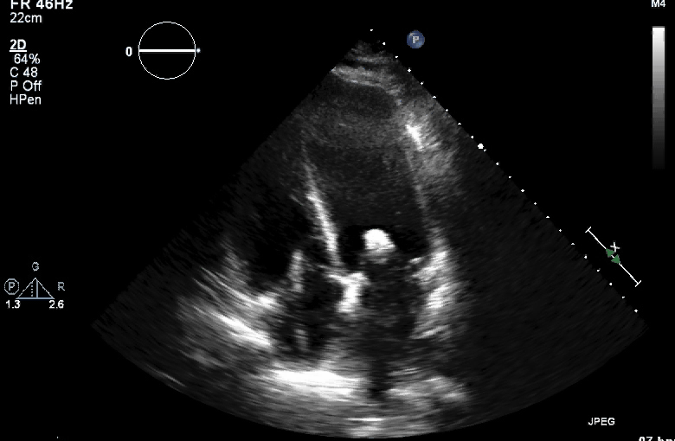
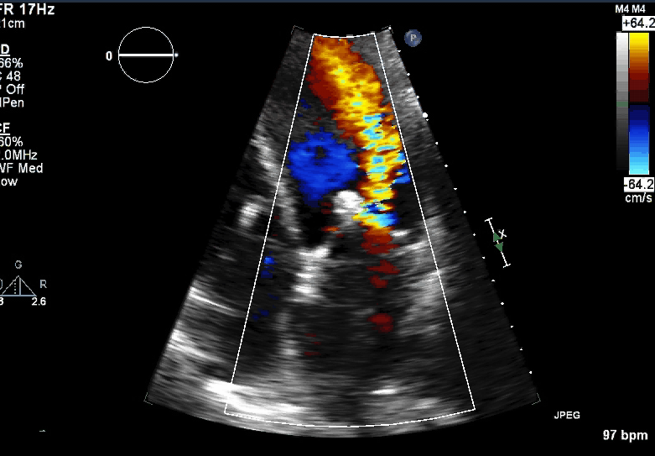
Intra-op Echocardiography
After first clip

Slide 26
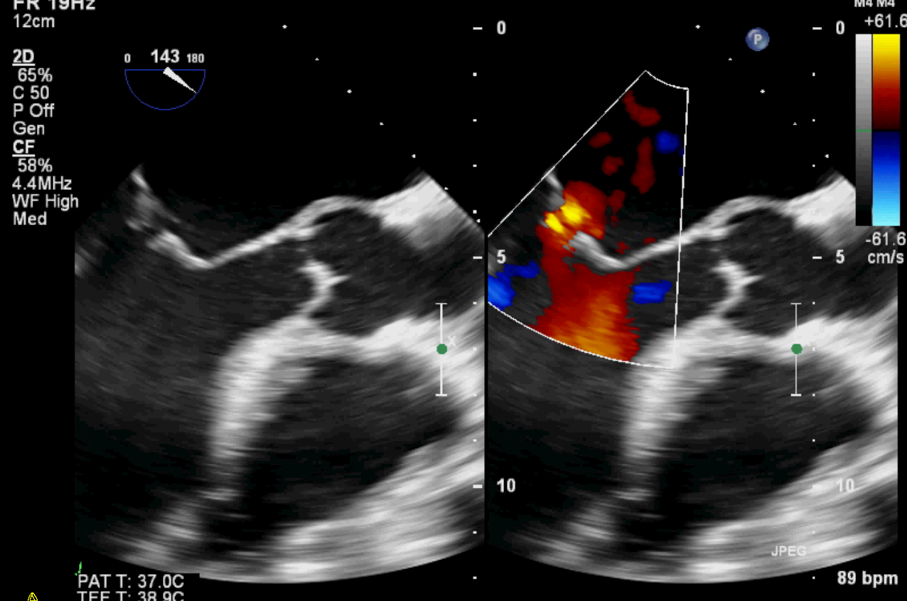
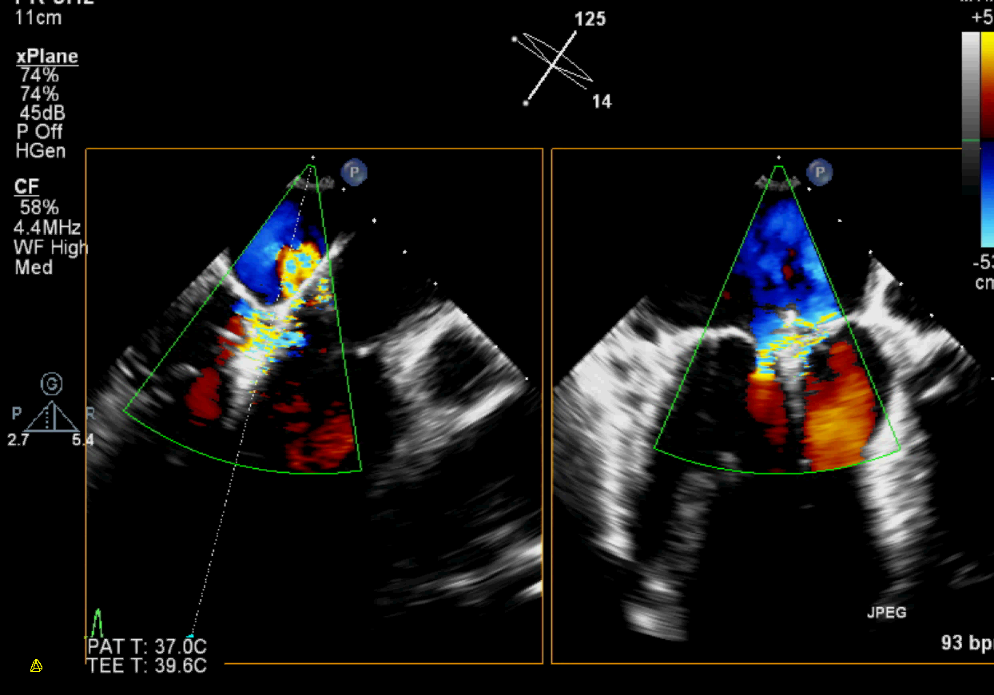
Intra – op Echocardiography
2-D X plane
After 1st clip

Slide 27
Intra-op Echocardiography
MVQ
Pre - clip
Post Clip

Slide 28
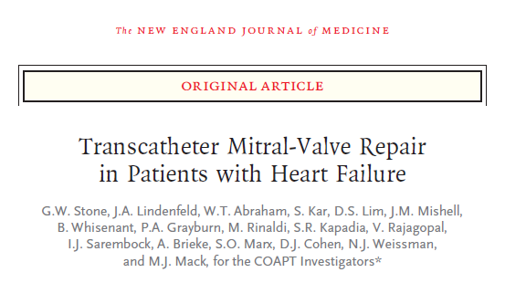
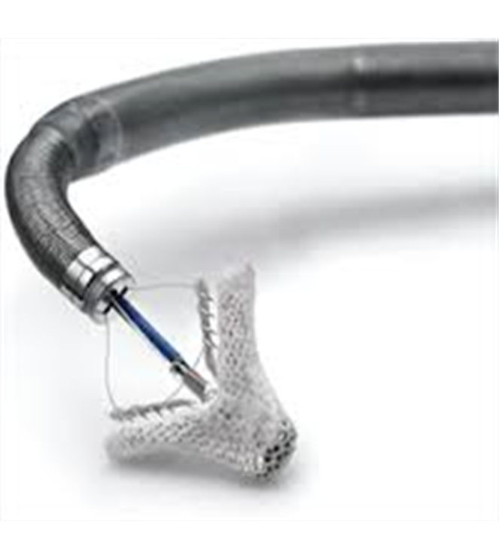
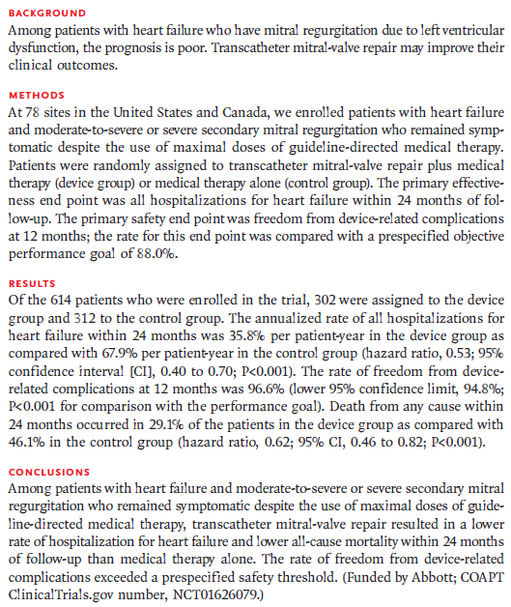
Notes:
ASA for 6 months
Plavix for a month
Heparin intraprocedure.

Slide 29
Notes:
ASA for 6 months
Plavix for a month
Heparin intraprocedure.

Slide 30
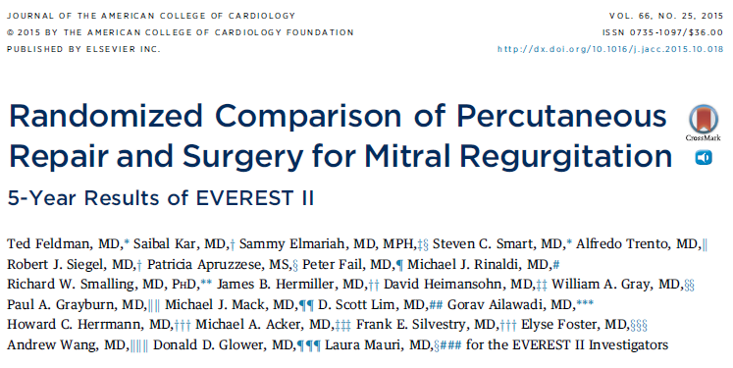
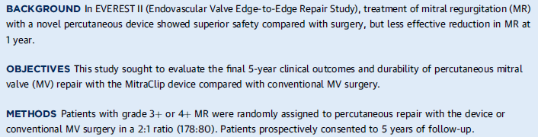
279 pts Grade 3+/4+ MR
184 pts: MClip
95 pts: Surgery
Notes:
-EVEREST II 2011:
-Exclusions:EF<25%, ESD>55 mm. If asymptomatic: decreased EF, ESD>40, afib, PHTN
-major adverse events at 30 days: MI, reoperation, stroke, renal failure, mech ventilation, GI complication, afib, septicemia, transfusion >2 units
-Results: rate of primary end point for efficacy were higher in the surgical group 73% vs 55% in MClip (death 6% both, MV surgery 20% vs 2%, same ~20% for 3-4+ MR).
-Major adverse events occurred in15% in Mclip, 48% in surgical.
-At 12 months both had improved LV size, improved NYHA and quality of life measures.
non-inferior for primary efficacy endpoint (freedom from death, MV surgery, >grade 2 MR), M-Clip had more MR vs surgical group, similar improvement in functional status after both therapies.
-Circ Cardiovasc Imaging 2013: Patients with LV dysfunction had reverse remodelling of their LV with improved LV EF after M-Clip
-JACC 2013 4 year follow-up: Patients treated with percutaneous repair of the mitral valve more commonly required surgery to treat residual MR; however, after the first year of follow-up, there were few surgeries required after either percutaneous or surgical treatment and no difference in the prevalence of moderate-severe and severe MR or mortality at 4 years.

Slide 31
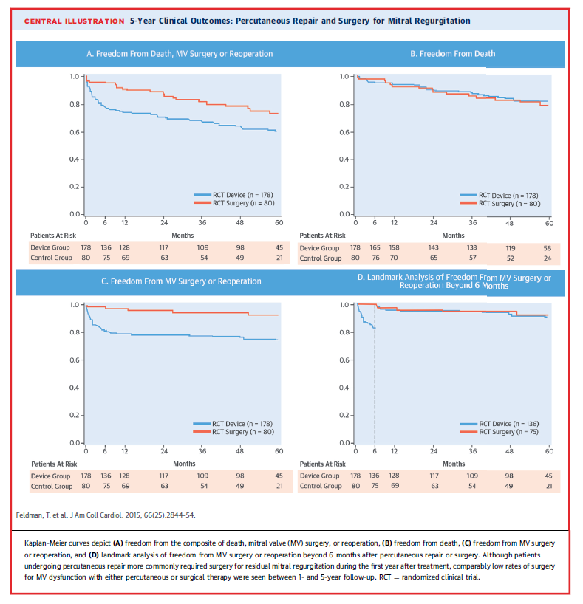
Notes:
-EVEREST II 2011:
-Exclusions:EF<25%, ESD>55 mm. If asymptomatic: decreased EF, ESD>40, afib, PHTN
-major adverse events at 30 days: MI, reoperation, stroke, renal failure, mech ventilation, GI complication, afib, septicemia, transfusion >2 units
-Results: rate of primary end point for efficacy were higher in the surgical group 73% vs 55% in MClip (death 6% both, MV surgery 20% vs 2%, same ~20% for 3-4+ MR).
-Major adverse events occurred in15% in Mclip, 48% in surgical.
-At 12 months both had improved LV size, improved NYHA and quality of life measures.
non-inferior for primary efficacy endpoint (freedom from death, MV surgery, >grade 2 MR), M-Clip had more MR vs surgical group, similar improvement in functional status after both therapies.
-Circ Cardiovasc Imaging 2013: Patients with LV dysfunction had reverse remodelling of their LV with improved LV EF after M-Clip
-JACC 2013 4 year follow-up: Patients treated with percutaneous repair of the mitral valve more commonly required surgery to treat residual MR; however, after the first year of follow-up, there were few surgeries required after either percutaneous or surgical treatment and no difference in the prevalence of moderate-severe and severe MR or mortality at 4 years.

Slide 32
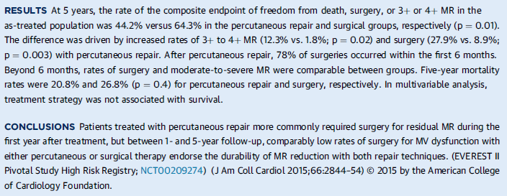
Notes:
-EVEREST II 2011:
-Exclusions:EF<25%, ESD>55 mm. If asymptomatic: decreased EF, ESD>40, afib, PHTN
-major adverse events at 30 days: MI, reoperation, stroke, renal failure, mech ventilation, GI complication, afib, septicemia, transfusion >2 units
-Results: rate of primary end point for efficacy were higher in the surgical group 73% vs 55% in MClip (death 6% both, MV surgery 20% vs 2%, same ~20% for 3-4+ MR).
-Major adverse events occurred in15% in Mclip, 48% in surgical.
-At 12 months both had improved LV size, improved NYHA and quality of life measures.
non-inferior for primary efficacy endpoint (freedom from death, MV surgery, >grade 2 MR), M-Clip had more MR vs surgical group, similar improvement in functional status after both therapies.
-Circ Cardiovasc Imaging 2013: Patients with LV dysfunction had reverse remodelling of their LV with improved LV EF after M-Clip
-JACC 2013 4 year follow-up: Patients treated with percutaneous repair of the mitral valve more commonly required surgery to treat residual MR; however, after the first year of follow-up, there were few surgeries required after either percutaneous or surgical treatment and no difference in the prevalence of moderate-severe and severe MR or mortality at 4 years.

Slide 33
Learning Points
Ischemic MR is multi-faceted dx
Multiple therapeutic options must be entertained
Role of Mitra-clip is changing, continued updates in the device and learning curve with implantation
Long term prognosis probably related to CAD

