Slide 1

Congenitally Bicuspid Aortic Valve
Author Elisa Zaragoza-Macias, M.D.
Institution: University of Washington Medical Center
Date: November 2013
Learning Domain: Adult Congenital Heart Disease
Learning Objective: Evaluation of and surgical decision making associated with Congenitally Bicuspid Aortic Valve Disease in 22 y/o
Case Presentations
Adult Cardiac Surgery
CV 12 CV 16

Slide 2
History
22 y/o F with bicuspid aortic valve (intracoronary cusp fusion) with progressive severe aortic stenosis
Bipolar disorder
Pseudoseizures
History of polysubstance abuse
Syncopal episode at age 16: mild AS by echo
2011: Moderate aortic stenosis (peak velocity 3.4 m/s, AVA 1.2 cm²), symptomatic during pregnancy

Slide 3
Recent History
2013: Severe aortic stenosis, dyspneic, activity intolerance & chest pain with most recent pregnancy → bedrest
Symptoms of chest pain & shortness of breath persisted after delivery with episodes of syncope

Slide 4
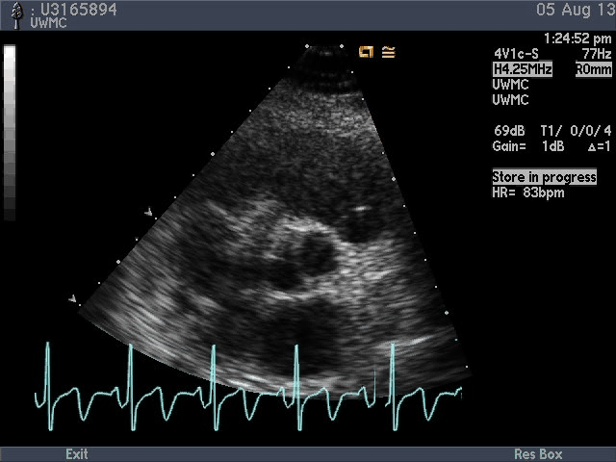
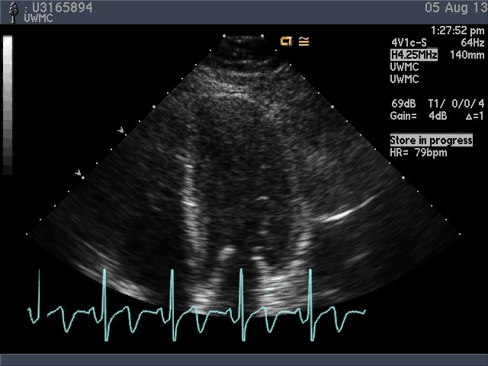
Echocardiograms

Slide 5
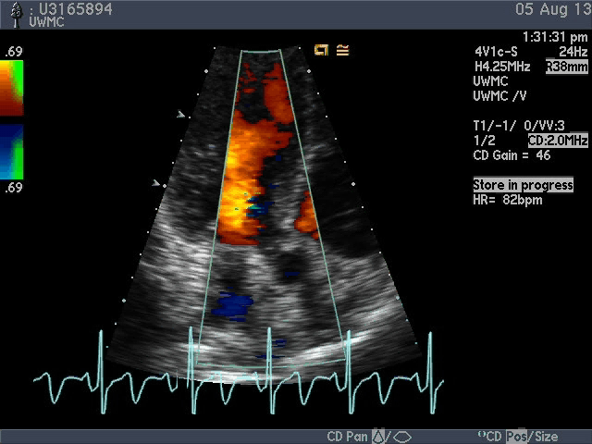
Echocardiogram

Slide 6
Echocardiogram
Bicuspid valve
AV velocity 4.3 m/s
AVA 0.9 cm2
Mean gradient 34 mmHg
LV EF 60-65%
Mild LVH
Normal aortic size (3.3 cm)

Slide 7
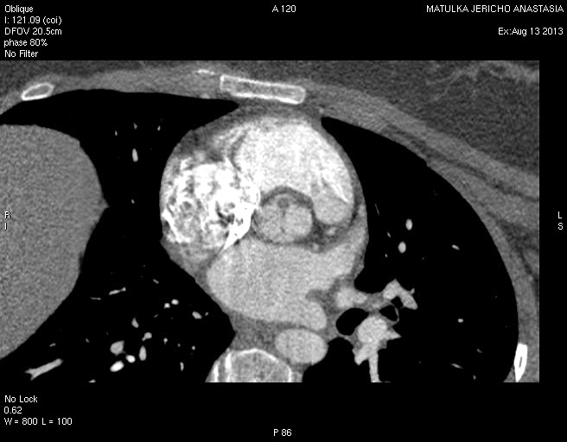
CT Angio
Anomalous right coronary artery originating from left
sinus of Valsalva with short intra-arterial course

Slide 8
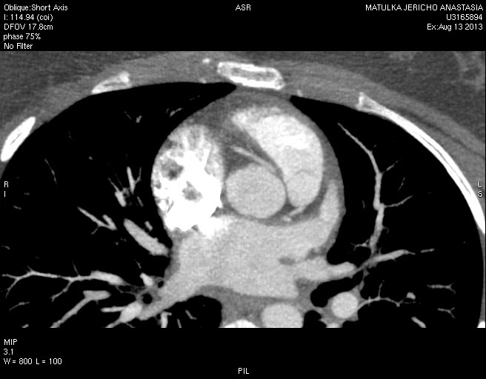
CT Angio
Bicuspid Aortic Valve
Ascending Aorta 3.2 CM

Slide 9
CT angiogram, 08/2013
Anomalous right coronary artery originating from the left sinus of Valsalva, with short intra-arterial course
Bicuspid aortic valve
Ascending aorta measured 3.5 cm

Slide 10
Discussion Points
22 year old with Congenital Bicuspid Aortic Valve
? Timing of Surgery
? Patient reliability / Pregnancy
? Valve Choice
? Role of Ross Procedure
? Deal with Anomalous Right Coronary Artery
? Deal with Ascending Aorta
  AVR
  Bentall
  Ross

Slide 11
Course
Patient referred for Aortic Root considerations
Pt decided to have Fallopian tubes tied
In drug rehab, improving family support
Wanted durable solution
AVR with 21 mm St Jude Regents mechanical prosthesis
Root explored with no compression of RCA, no intra-arterial un-roofing felt necessary
Bentall / Ross considered, not done

Slide 12
Learning Points
Gender and social implications of valve replacement
Need for consistent follow up to monitor progression of disease
Certain # of congenitally bicuspid valves will have root disease
In young adults other congenital anomalies can be present

