Slide 1
Bicuspid Aortic Valve Disease
(AS)
Author: Elisa Zaragoza-Macias, M.D.
Institution: University of Washington Medical Center
Date: November 2013
Updated by: Alison F. Ward, MD, Emory University, April 2023
Case Presentations
Adult Cardiac Surgery
CV 12 CV 16

Slide 2
History
55yo M presented to the emergency room with multiple falls
PMH:
  Seizure disorder
  Polysubstance abuse including alcoholism
  HTN
  Afib diagnosed in the past
  Testicular cancer
Poor historian but told he had a murmur
Able to walk several miles without SOB or CP
After strenuous activity feels light headed, multiple syncopal episodes
Head imaging, EEG, and labs were all unremarkable
TTE obtained

Slide 3
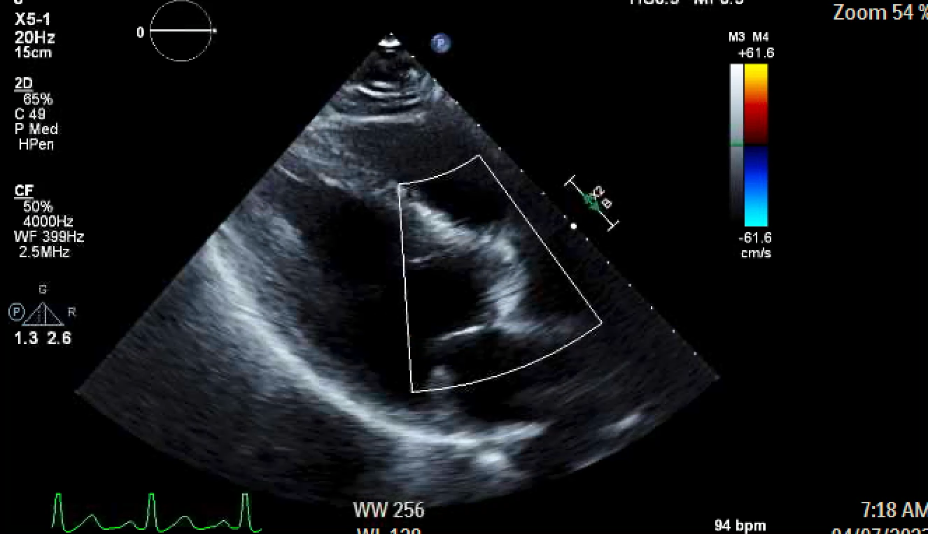
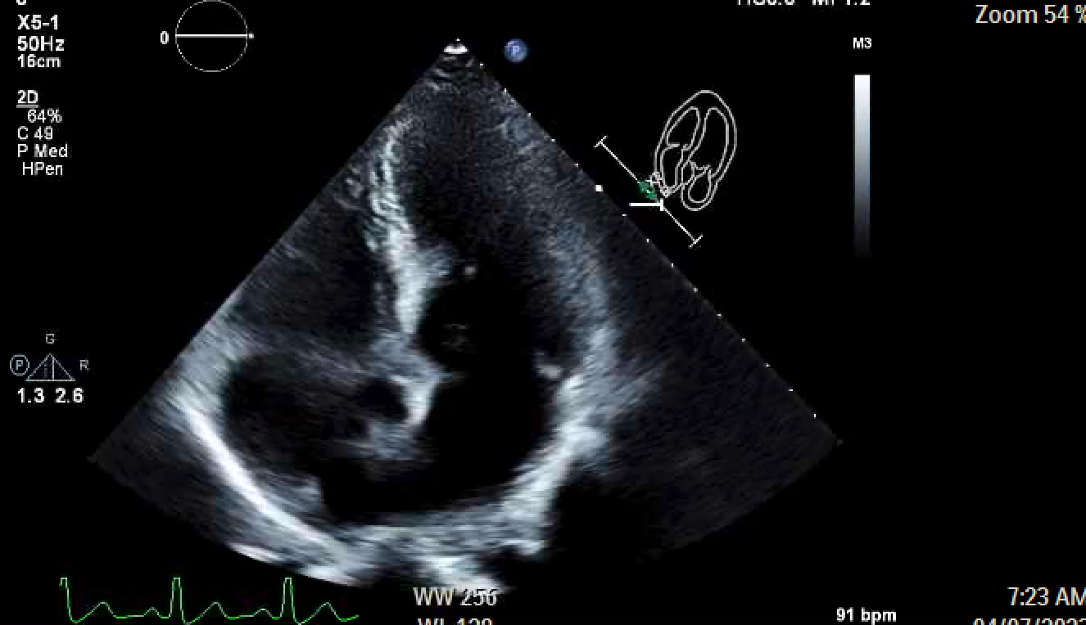
Echo
LV ejection Fraction = 55-60%.
An intracavitary gradient is present
Normal LV diastolic function
Nl RV function
Mean AV gradient 45 mmHg
Peak velocity 4m/s
Calculated AVA 0.9cm²
Trace aortic regurgitation

Slide 4
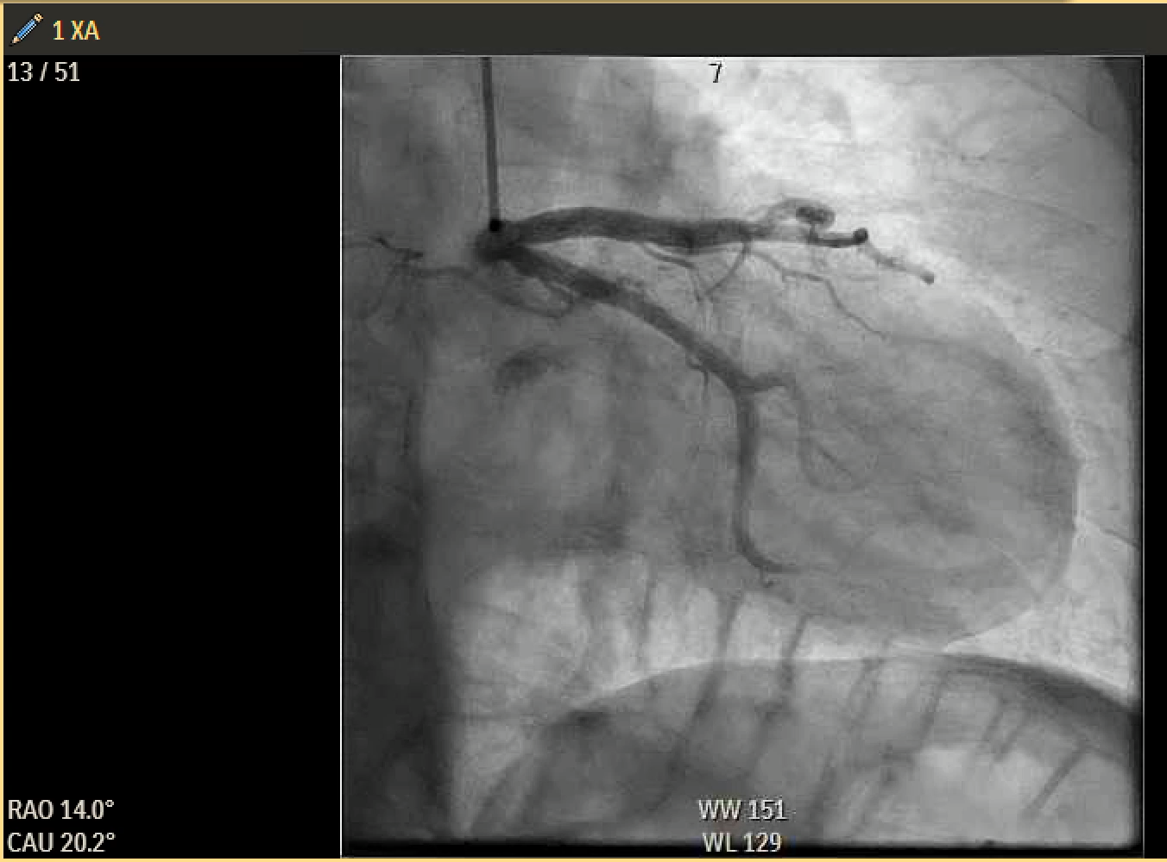
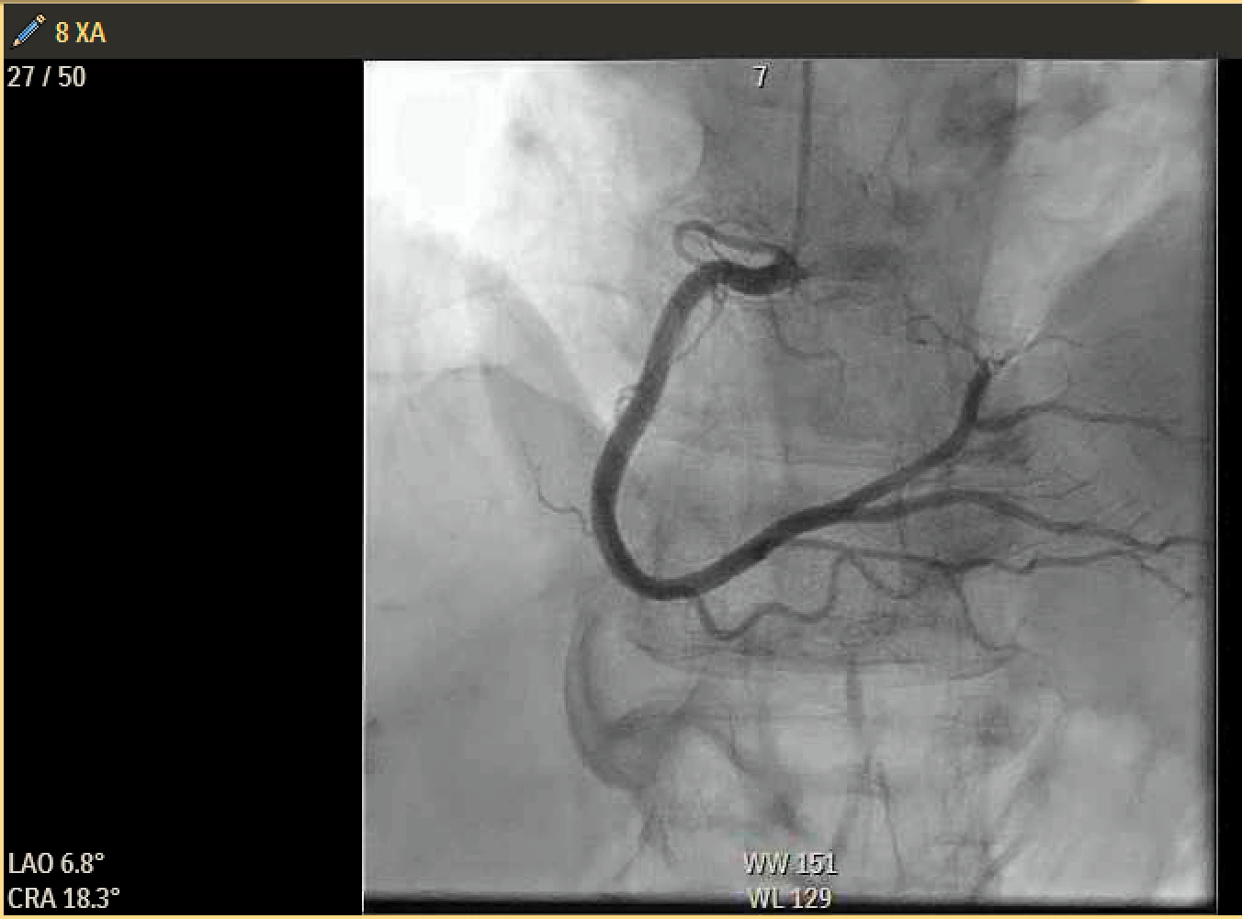
Left Heart Cath
Normal coronaries

Slide 5
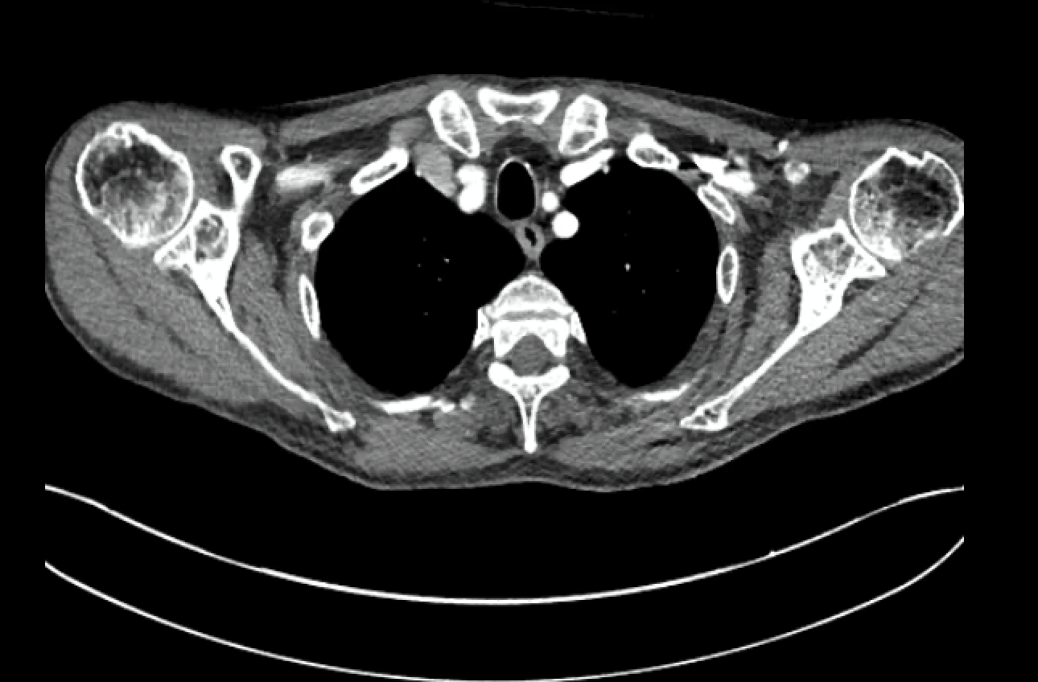
CT Angiography
4.2cm ascending aorta, bicuspid aortic valve

Slide 6
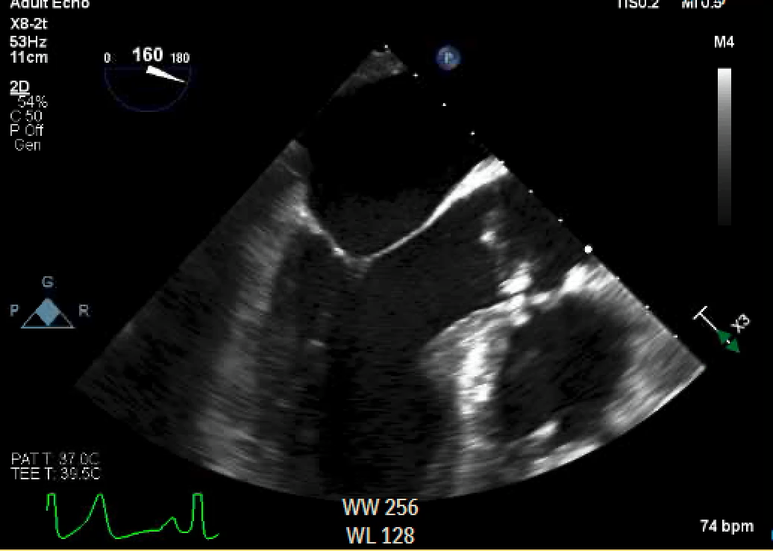
Pre-CPB TEE

Slide 7
Operative Course
Scheduled for AVR while inpatient
Valve selection discussed—due to polysubstance abuse and medical non-complicance bioprosthetic valve was selected
Intraoperative pre-CPB TEE demonstrated septal hypertrophy
Cannulation: ascending aorta, RAA, RSPV vent, antegrade cardioplegia
AV severely calcified and bicuspid
Operation: PVI and LAA clip placement, AVR with Edwards Inspiris valve, limited septal myectomy
Uneventful postoperative course—no arrhythmias

Slide 8
Learning Points
Important to consider valve selection based on age, social history, gender, and anatomy
Bicuspid AV patients should be screened for aortopathies
Need for consistent follow up to monitor progression of disease

