Slide 1

Vascular Ring in Adult
Author: Edward Verrier, M.D.
Institution: University of Washington
Date: March2014
Learning Domain: Adult Cardiac Surgery
Learning Objective: Vascular Ring
Tracheal / Esophageal Compression
Case Presentations
Adult Cardiac Surgery
TSC CV: 18, CD 09
Milestone: 9

Slide 2
Presentation
22 y/o with Increasing SOB /DOE
Decreased Exercise intolerance for 2 years
  Can’t keep up with Marine recruits
PMH:
  Palpitations
  Mild scoliosis

Slide 3
History and Exam
Pertinent Physical Exam
BP 126/81, Pulse 78, Temp 36.5, 77.6 kg
Lungs clear bilaterally
Heart rate regular with no M, G, H, T
Full pulses, no clubbing
Labs
  All Labs Normal
Medications
  No medications

Slide 4
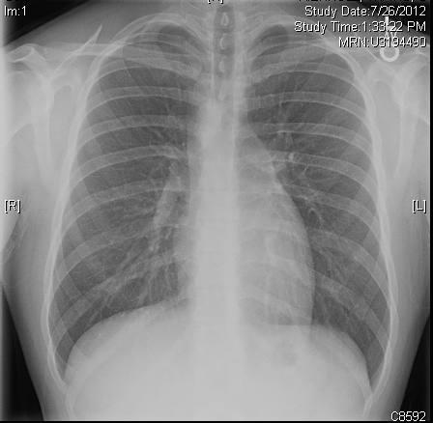
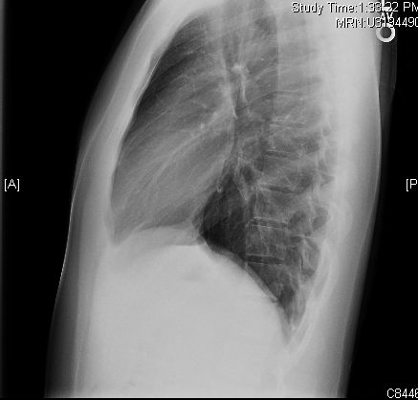
Chest X-Ray

Slide 5
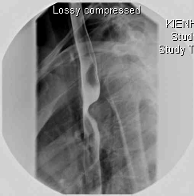
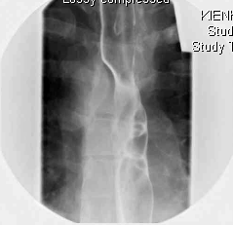
Esophagram

Slide 6
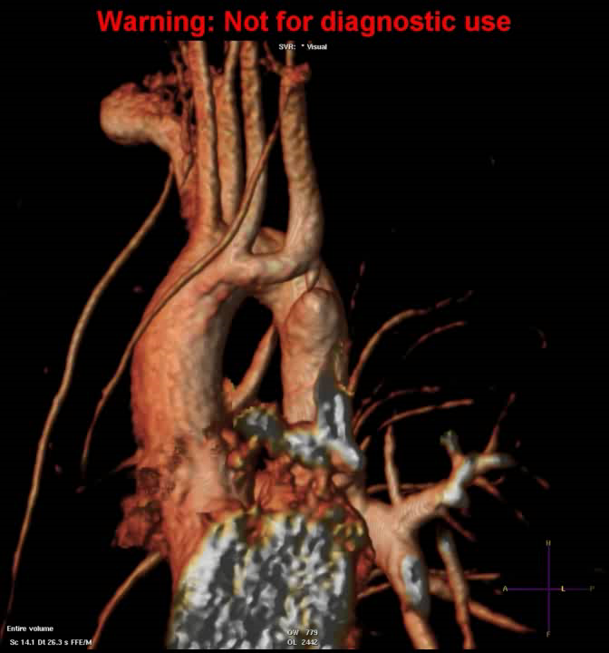
MRI

Slide 7
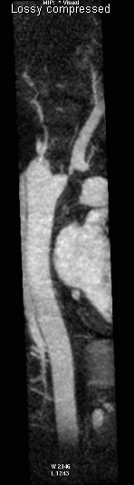
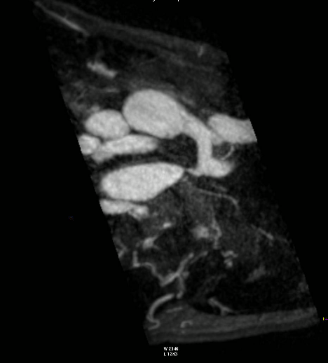
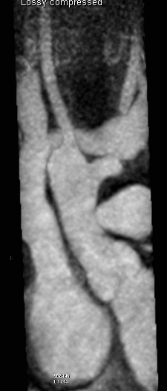
MRI

Slide 8
MRI Results
Abnormal double arch
Right-sided primary arch
Atretic left-sided arch
  gives off the left subclavian and left carotids.
Vascular ring with 2 diverticula,
  one coming off the right-sided aortic arch.
Thin band that appears to encircle the trachea and esophagus.
Smaller diverticulum on the carotid side.

Slide 9
Outcomes
Left thoracotomy,
  double lumen endotracheal tube
Resection of Ligamentum Arteriosus
Vascular stapling Left carotid aneurysm
Partial side clamp Aorta
Resection of Kommerall Diverticulum
Discharge POD 4
Asymptomatic at 1 year

Slide 10
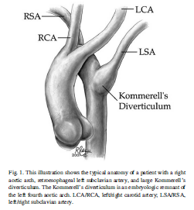
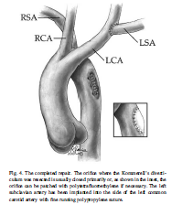
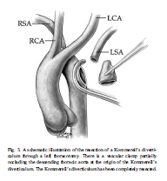
Literature
JA van Son et al: Burkhard Kommerell and Kommmerall’s Diverticulum Tex Heart Inst J 29: 2002
Backer CL et al: Resection of Kommerell’s Diverticulum and L subclavian artery transfer. EJCTS 22: 2002

Slide 11
Learning points
Abnormalities of the Aortic Arch are rare but can present in adults
Compression on trachea or esophagus is common
Simple transection of the ligamentum is often inadequate
Each case must be individualized in operative approach

