Slide 1

Sinus Of Valsalva Aneurysm
Author: Edward Verrier, M.D.
Institution: University of Washington
Date: March2014
Learning Domain: Adult Cardiac Surgery
Learning Objective: Sinus of Valsalva Aneurysm in Adult
Case Presentations
Adult Cardiac Surgery
TSC CV: 19; CD 11
Milestone: 8

Slide 2
Presentation
19 y/o with mild Increasing SOB /DOE
I year previous motorcycle accident
  Neuro injury, admitted for observation / concussion
  Heart murmur heard
PMH:
  Palpitations
  Mild scoliosis

Slide 3
Physical Exam & Labs
Pertinent Physical Exam
BP 116/60, Pulse 85, Temp 36.5, 90.6 kg
Lungs clear bilaterally
Continuous loud IV/VN murmur across entire precordium
No gallops, heaves, thrills, rubs
Full pulses, no clubbing
Labs
  Normal labs

Slide 4
Past History & Medications
Past History
  No alcohol, cigarettes, drugs
  Family hx premature CAD
Medications
  Flonase
  MVI
  Melatonin

Slide 5
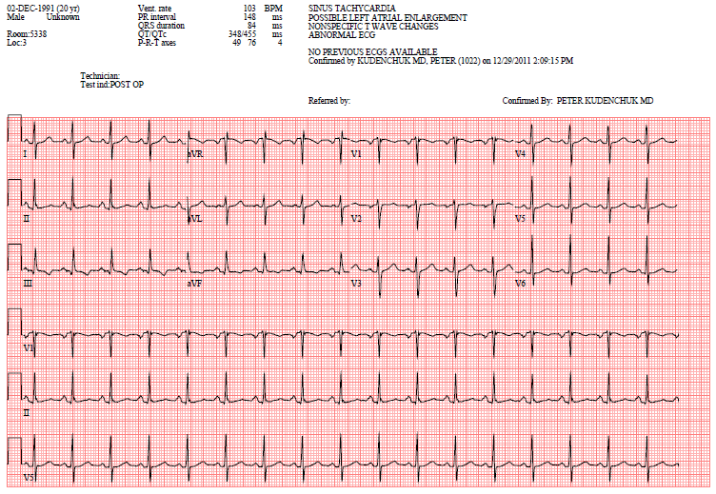
Electrocardiogram

Slide 6
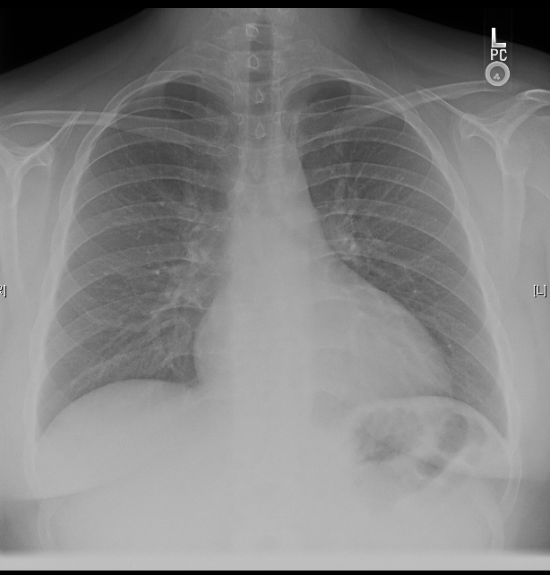
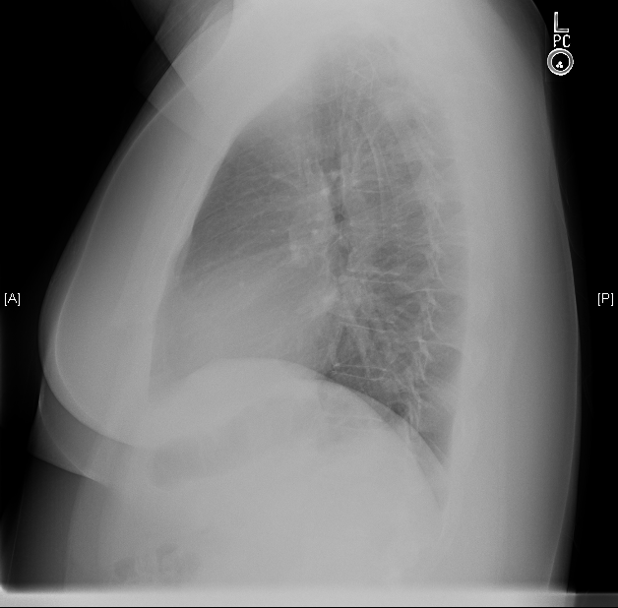
Chest X-Ray

Slide 7
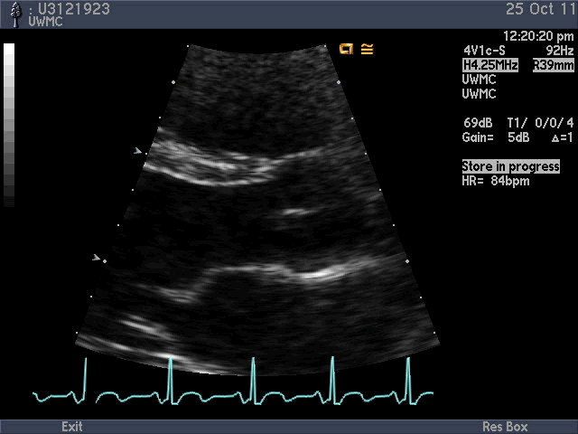
Parasternal long axis- no abnormality yet..
Sinuses of Valsalva
LVOT
Mitral valve
Aortic Valve
Left atrium

Slide 8
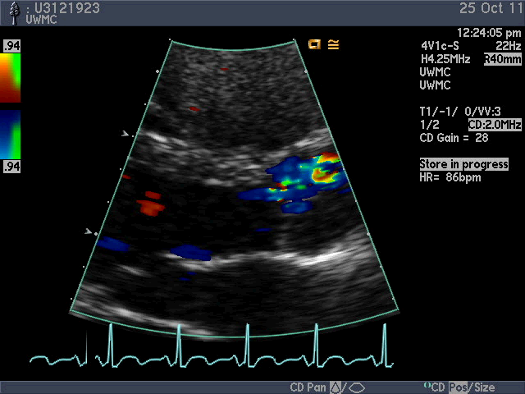
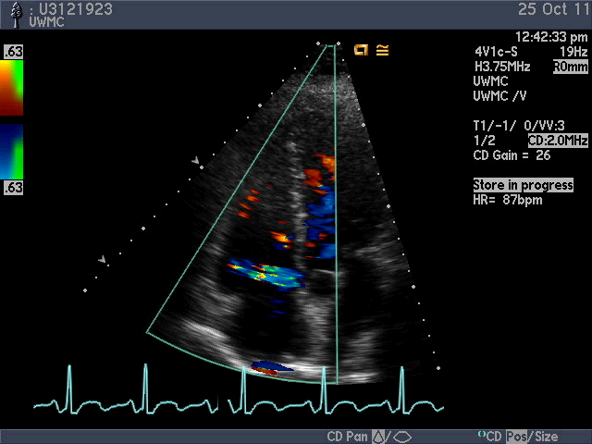
Ruptured coronary sinus aneurysm with left to right flow
Note that when color Doppler is turned on, abnormal flow is seen in the LVOT and ascending aorta and in the apical 4 chamber view, lateral flow from the ascending aorta to the right atrium is seen

Slide 9
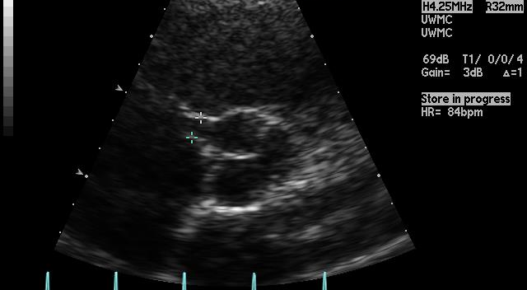
Note the 1cm ruptured communication
By 2 D echo, the relationship of the defect to the right coronary artery is ill defined

Slide 10
Discussion Points for Conference
Pathophysiology of Sinus of Valsalva Aneurysms
Natural History of SV Aneurysms
Any relationship to Trauma
Risk of Endocarditis
Surgical Approaches to repair?
Interventional Approaches in 2014?

Slide 11
Outcomes
Median Sternotomy
Antegrade & Retrograde Cardioplegia
Bicaval cannulation
1.5 x 1.0 cm oval pericardial patch
Non coronary sinus
Right atrium opened and entrance of windsock to RA closed with pledgeted stitch
D/C POD # 3
Well at 2 years

Slide 12
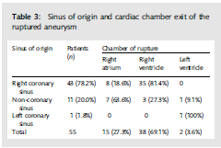
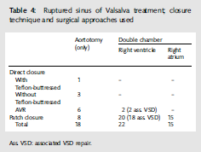
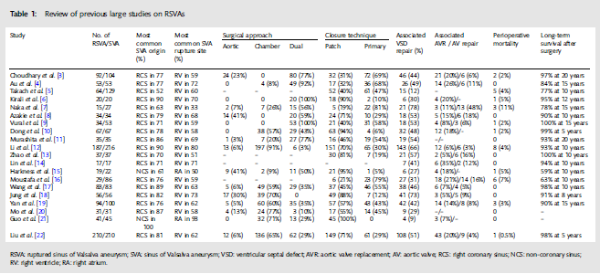
2012 Review article
Sarikaya et al: Surgery for Ruptured SVA: 25 Year Experience with 55 Patients. EJCTS (2012) 1-6.

Slide 13
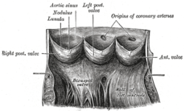
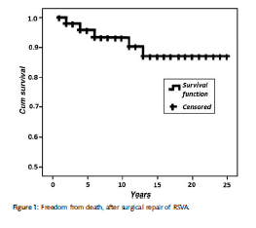
Anatomy of Sinuses of Valsalva
Outcomes
Sarikaya et al: Surgery for Ruptured SVA: 25 Year Experience with 55 Patients. EJCTS (2012) 1-6.

Slide 14
Learning points
Ruptured Sinus of Valsalva Aneurysm can rupture into other chambers of the heart
Right sinus > Noncoronary > Left sinus
Risk of Endocarditis
Multiple repair techniques possible

