Slide 1
Right Coronary Artery Aneurysm.
Author: Fawwaz Shaw, M.D.
Institution: University of Washington Medical Center
Date: January 8th, 2014
Learning Domain: Adult Cardiac Surgery
Learning Objective: Review the evaluation and management of coronary artery aneurysms.

Slide 2
History
54 year old gentleman with intermittent chest pain and palpitations for 18 months.
Diagnosed with an inferior MI in August 2012.
Pain characterized as non-exertional, sharp and localized to the left chest and substernal region.
Recently diagnosed with an acoustic neuroma and was undergoing his pre-operative work up for surgical removal.

Slide 3
History
PMHx: Inferior MI x18 months, Eczema, Acoustic neuroma, and Nephrolithiasis.
PSHX: None
Social Hx: Chemist; No tobacco or recreational drug use; occassional EtOH.
Medications: ASA 325 mg daily,
Atorvastatin 10 mg QHS, Nebivolol 2.5 mg daily
Family Hx: Father: MI at 47 y/o; deceased at 62 y.o.
Multiple paternal uncles with MI prior to 50 y.o.

Slide 4
Physical Exam
Vital signs: T 36.7F; HR: 58; 118/79; BMI 22.1
Neuro: No focal neurologic deficits
Heart: RRR, No murmurs, Normal S1 and S2. No JVD
Chest: Clear lung fields B/L
Abdomen: Soft, NT, ND, No organomegaly
Extremities: No edema
Vascular: No carotid bruits. Symmetric, palpable radial, femoral, DP and PT pulses. No carotid bruit

Slide 5
Labs
Hgb/Hct: 13.3/37
Creatinine: 0.97
Electrolytes: within normal ranges
INR: 1.2

Slide 6
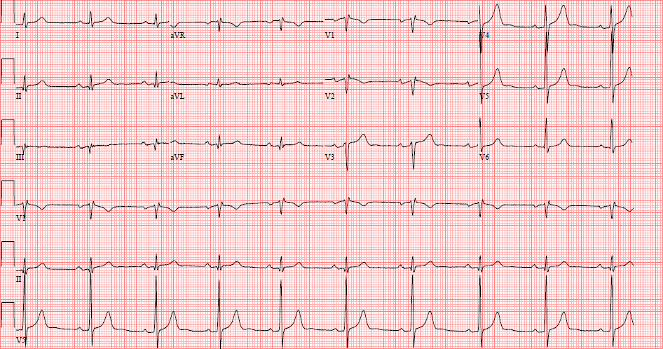
EKG

Slide 7
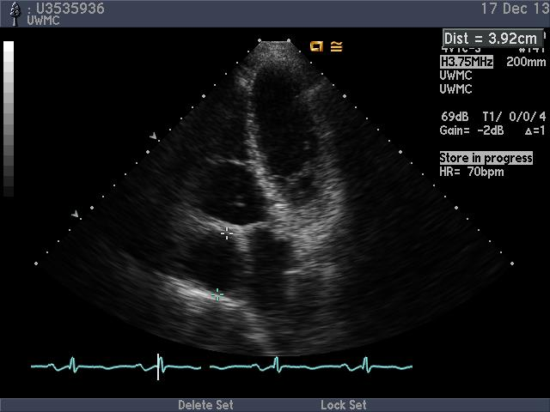
Echocardiogram
Notes:
Apical 4 chamber view

Slide 8
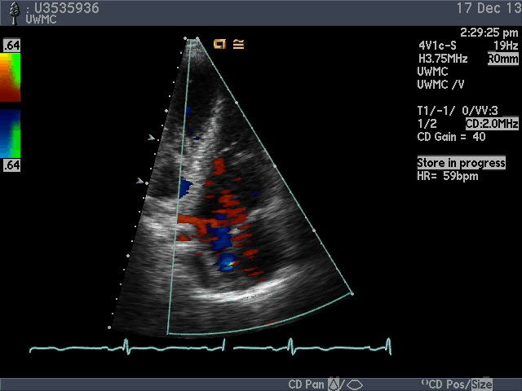
Echocardiogram

Slide 9
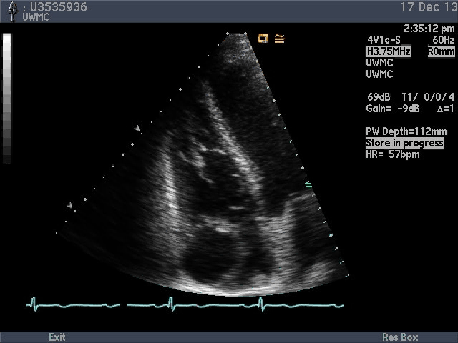
Echocardiogram
Notes:
Parasternal short axis

Slide 10
Echocardiogram findings
Large, round, echolucent space seen in the anterior AV groove.
Diameter of 4.6 cm.
Otherwise normal echocardiogram.

Slide 11
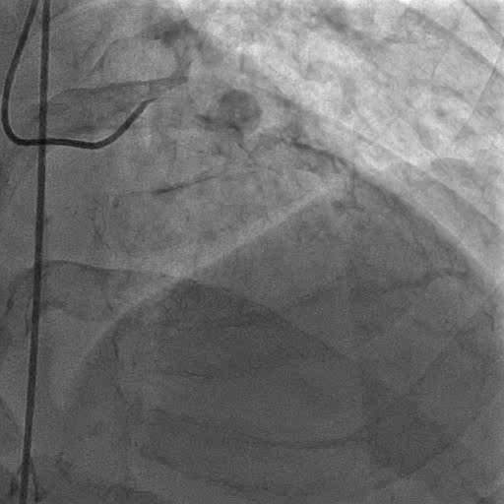
Cardiac Catheterization

Slide 12
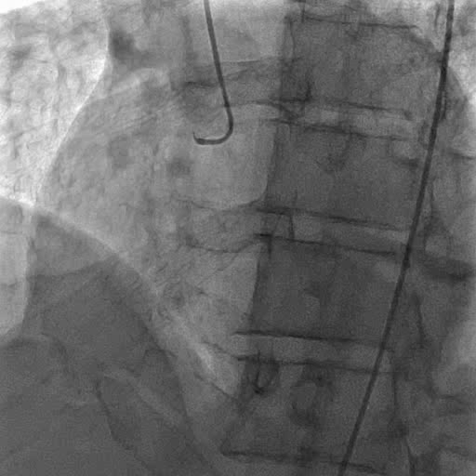
Cardiac Catheterization

Slide 13
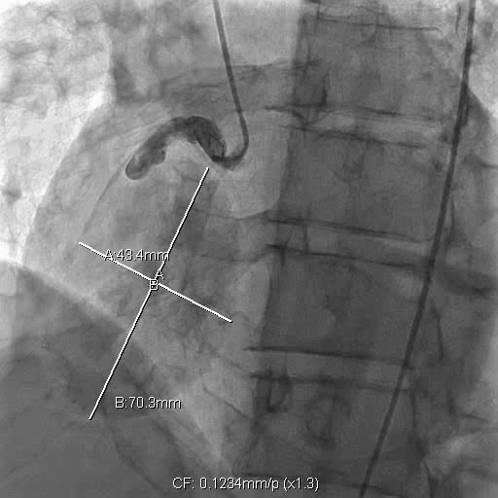
Cardiac Catheterization

Slide 14
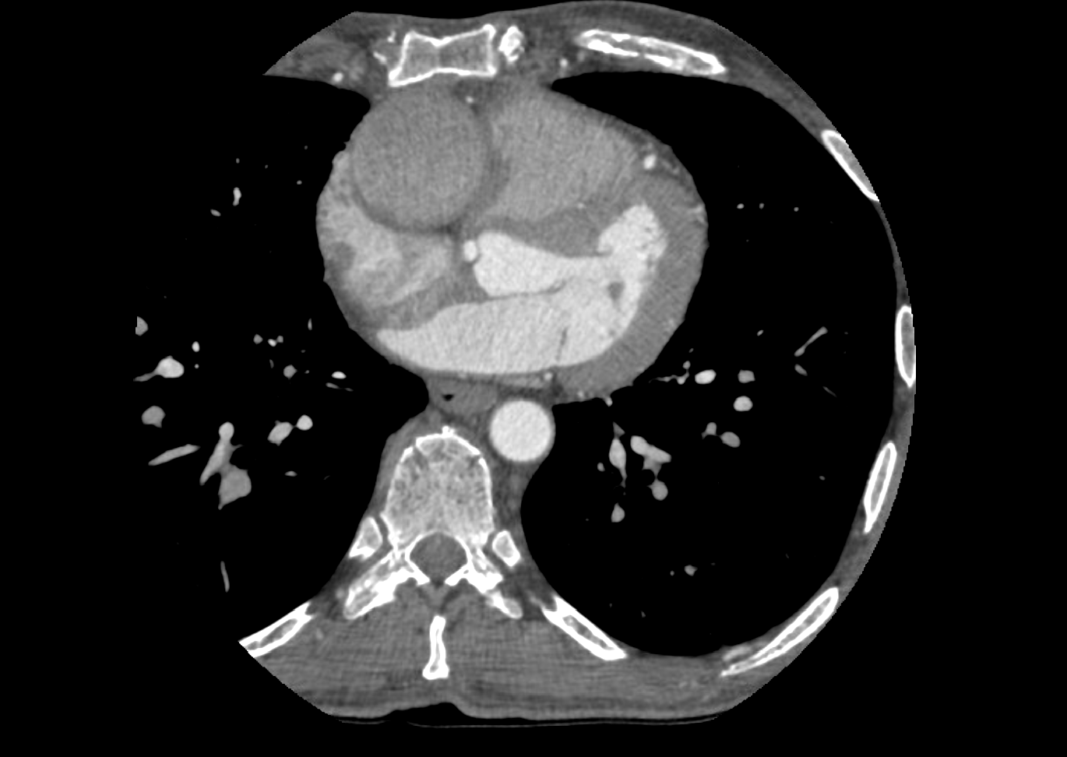
Coronary CTA

Slide 15
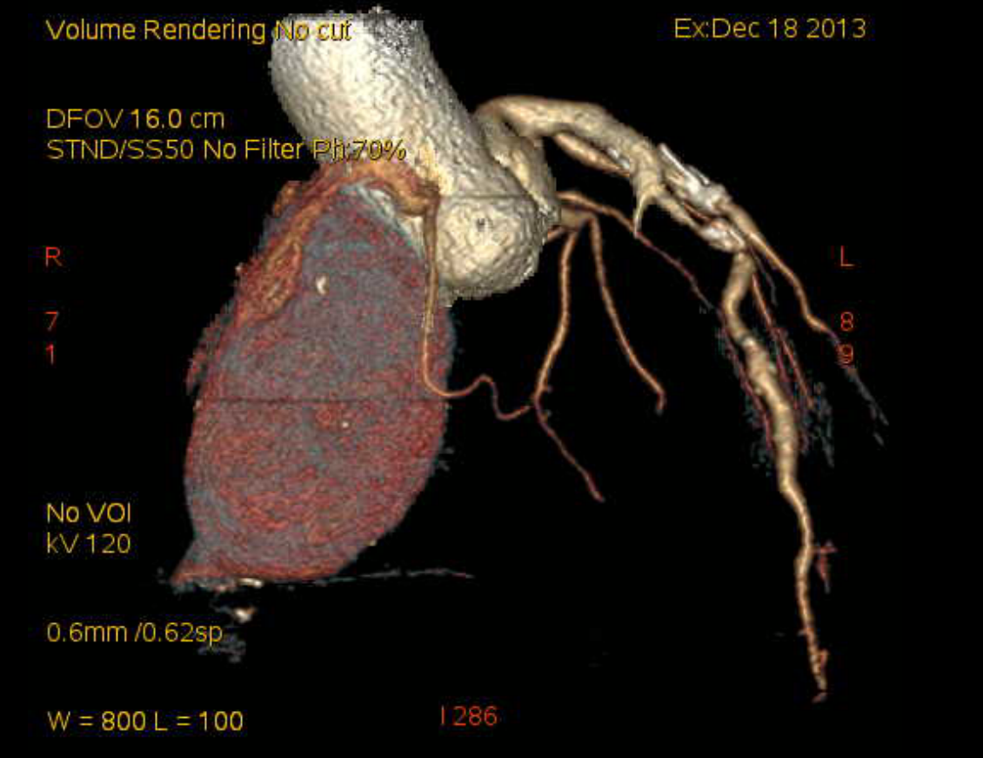
Coronary CTA

Slide 16
Coronary CTA findings
RCA: Partially thrombosed ostia measuring 7 mm. 2cm from the origin is a 7.5x4.4x4.7 cm aneurysm without the presence of thrombus
L main: 6mm caliber. No visible disease
LAD: Irregular, aneurysmal, 7.2 mm caliber with moderate/severe stenosis in the proximal LAD with focal atherosclerotic calcification
Circumflex: 5mm caliber. No visible disease

Slide 17
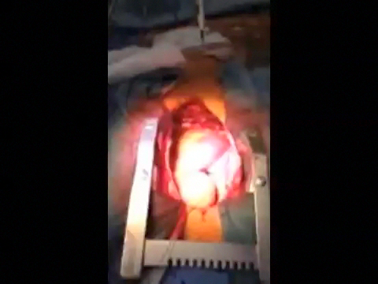
Intraoperative findings

Slide 18
Discussion Points
Natural History of CA Aneurysms?
What if this Pt did not have LAD disease?
Risk of RV Injury with Ligation
Open vessel or simply ligate both ends
Role of Intracoronary Intervention
What if Patient were in Japan?

Slide 19
Outcome
2 Vessel CABG (LIMA-LAD; SVG to RCA)
Biopsy of right coronary artery aneurysm
Proximal and distal ligation of aneurysmal RCA, over sew of RV branches
No myocardial injury
Subsequent discharge home

Slide 20
Pathology
Adventitial fibrosis and sparse chronic inflammation.
Atherosclerotic plaque.
Differential includes atherosclerotic disease vs. “burnt-out” phase of systemic arteritis.

Slide 21
Coronary artery aneurysms
Comprises mostly of case reports.
0.02-0.04% incidence (Surgical).
0.15%-4.9% incidence (Angiographic)
No clear consensus regarding natural history/sequelae.
Risks: rupture, compression, fistulization, embolization, thrombosis, myocardial infarction.
Individual characteristics often dictate treatment strategies.

Slide 22
Etiology
Varies geographically.
Europe and NA: > 50% associated with atherosclerotic disease.
Japan/China: Kawasaki’s disease most common.
Other etiologies include congenital, iatrogenic and infectious (mycotic).
55% associated with the RCA.

Slide 23
Learning Points
CAA: coronary dilation 1.5 times the diameter of the nearest normal adjacent segment or largest coronary vessel. (“Giant CAA” are defined as > 2cm.)
Principle of management is to exclude the aneurysmal segment and maintain coronary blood flow.

