Slide 1

Late Ischemic Ventricular Septal Defect
Apical Inferior Wall Aneurysm
Author: Edward Verrier, M.D.
Institution: University of Washington
Date: March2014
Learning Domain: Adult Cardiac Surgery
Learning Objective: Complication of Coronary Artery Disease
Acquired Ventricular Septal Defect
Case Presentations
Adult Cardiac Surgery
TSC CV: 10
Milestone: 2

Slide 2
Presentation
42 y/o with Increasing SOB /DOE
PMH:
  Inferior Wall MI 2 years previously
  Two RCA drug eluding stents 2010

Slide 3
Past Medical History and Medications
Pertinent Past Hx
  Hypothyroidism
  Gout
  Mild Obesity
  Remote smoker
  No alcohol / drugs
Medications
  Lovastatin
  Metoprolol
  Levothyroxine
  Fish Oil
  Losartan
  ASA
  Niacin
  Cholecalciferol

Slide 4
History and Exam
Pertinent Physical Exam
BP 120/84, Pulse 78, Temp 36.5, 90.6 kg
BMI 38
Lungs clear bilaterally
Heart rate regular , Loud Grade III/VI holosystolic M across precordium
Full pulses, no clubbing
Labs
  All labsNormal

Slide 5
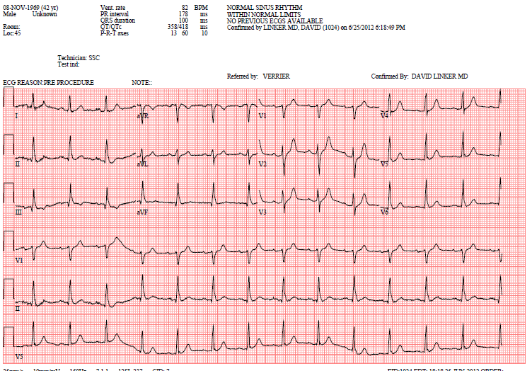
Electrocardiogram

Slide 6
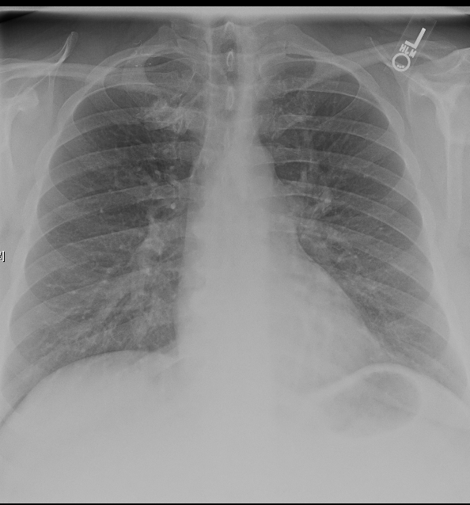
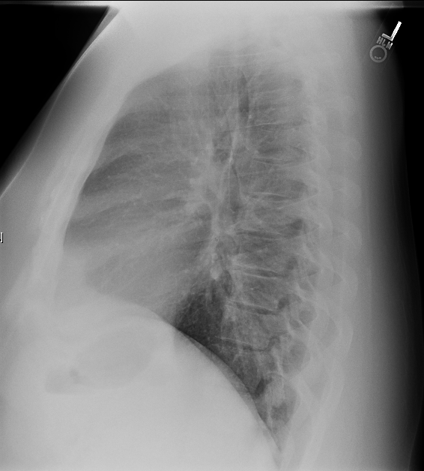
Chest X-Ray

Slide 7
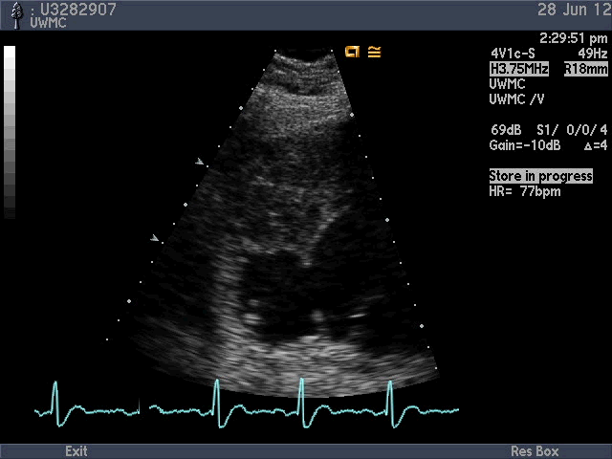
In an off axis LV short axis view…
Defect
Aneurysm
Septum
LV
Mitral valve leaflet
Once a defect is seen, often off axis sweeps or 3D echo may be needed to fully characterize location, dimensions and abnormal connections

Slide 8
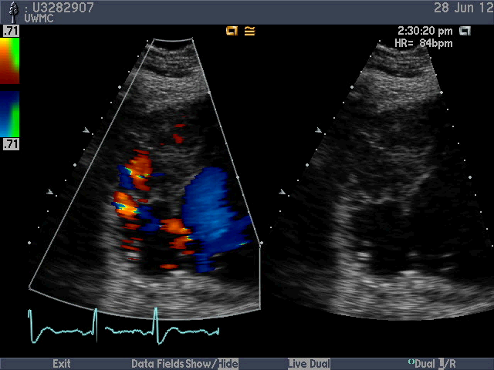
With color Doppler assessment..
Right ventricle
Left ventricle
Left to right shunt seen through a communicating small restrictive VSD

Slide 9
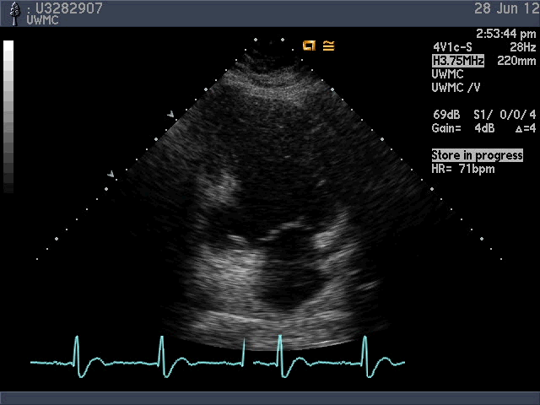
In a normal apical 2 chamber view..
Inferior wall
Anterior wall
Inferoseptal aneurysm
LA
The echocardiographer determines size and location from standard views as well. In the A2C view, we clearly see the defect involves the basal inferior wall

Slide 10
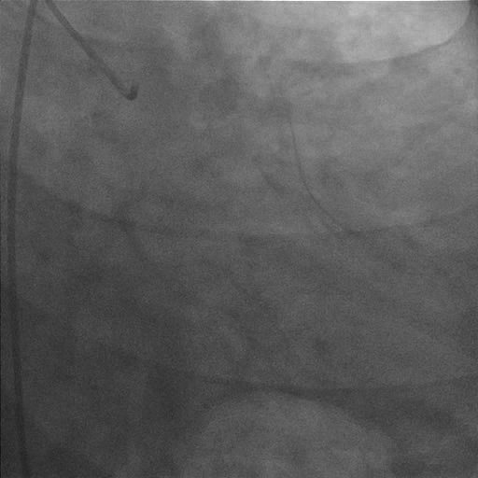
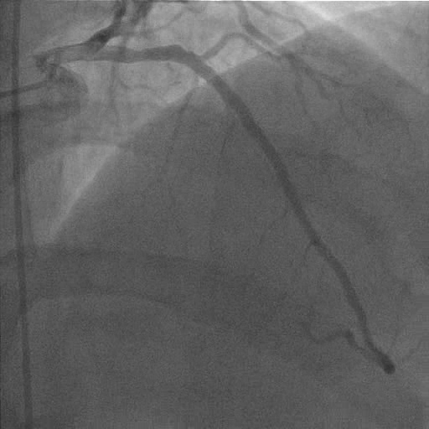
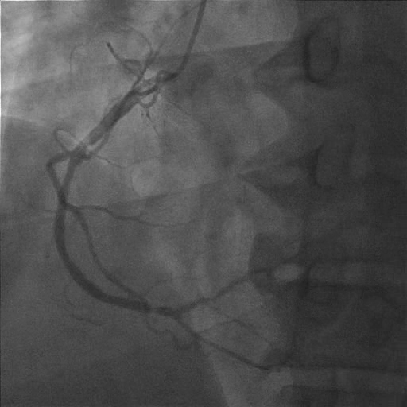
Coronary Angiograms

Slide 11
Discussion Points for Conference
Is this a post infarction VSD?
What is the natural history of post infarction VSD?
What is the usual mortality from surgical repair of post MI Ventricular Septal defect
Should repair of this Aneurysm / VSD have the same M & M as an acute Repair? Why?
How would you surgically approach this patient?

Slide 12
Operative Repair
Bicaval to Ascending Aorta CPB
Open RV, RA, Ao
Gor-tex patch with interrupted with pledgets around edge of Aneurysm / VSD
RSVG to Obtuse marginal coronary
No External Patch of RV required
Pt D / C’d on POD # 6
Well 2 years later

Slide 13
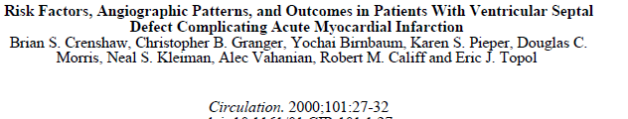
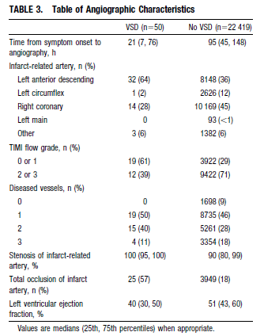
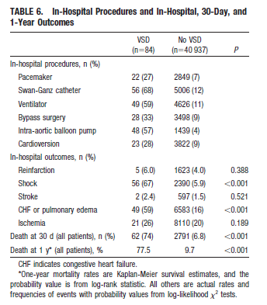
Gusto trial 2000

Slide 14
Learning points
Mortality and Morbidity of acute VSD after MI
  Very high
If pt survives early, late repair has significantly better prognosis
  Self selection
  Easier VSD repair with mature edges to sew into

