Slide 1

Cardiopulmonary Bypass
Crisis Scenarios:
Thinking Yourself Out of a Box
Author: Nahush Mokadam, MD; Craig Vocelka, Edward Verrier, M.D.
Institution: University of Washington
Date: October 2014
Learning Domain: Adult Cardiac Surgery
Learning Objective: Management of Cardiopulmonary Bypass
Case Presentations
Adult Cardiac Surgery
TSC CV 05
Milestone: 3

Slide 2
Cardiopulmonary Bypass
One of the few procedures we perform during which we have the opportunity to have a fatal event at every step…

Slide 3


Slide 4



Slide 5
Opportunities for Success…
Cannulation
Commencement of Cardiopulmonary Bypass
Crossclamp
Maintenance of Cardiopulmonary Bypass
Weaning Cardiopulmonary Bypass
Finishing Up

Slide 6
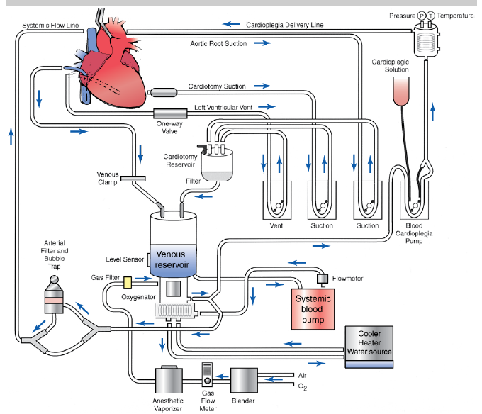
Know Your Pump

Slide 7
Case Study Part 1
(I’ve heard of this happening at other centers…)
40 y/o male with Marfan’s, aortic root aneurysm, and trace aortic insufficiency for planned David procedure. The patient undergoes aortic cannulation in the proximal aortic arch. When you ask the perfusionist to test the line, she reports that the line pressure is 350 mmHg and the aorta looks like this:

Slide 8
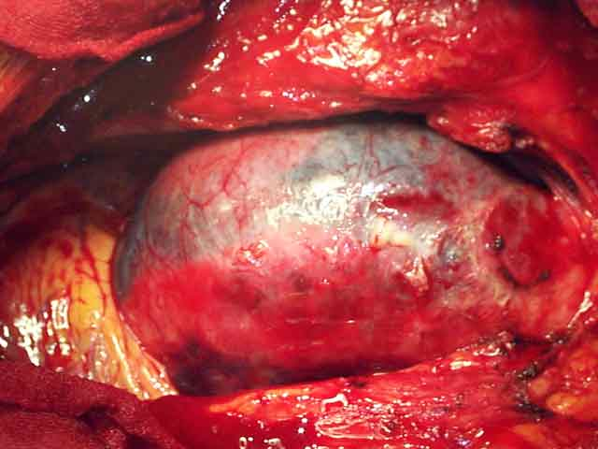
Case Study Part 1

Slide 9
Intra-operative Aortic Dissection
Etiology
Diagnosis
Hypertension
Connective tissue disorder
Calcification
Iatrogenic
  Cannulation
  Crossclamp
  Proximals
  Aortotomy
  Vent
Color change
Decrease in MAP
Decrease in venous return
Increase in arterial line pressure
Flap on TEE
Change in cerebral perfusion
Discordant A-line pressures

Slide 10
Intra-op Aortic Dissection Management
Team Approach
Call for help
Continue CPB as able
Start cooling
Femoral cannulation to complete cooling
Crossclamp low when fibrillating
DHCA
Resect cannulation site
Replace aorta – hemiarch
Rewarm
Finish your initial operation

Slide 11
Case Study Part 2
(this may have happened to one of my partners once…)
After uneventful cannulation, you commence CPB. The perfusionist immediately tells you that she cannot flow at all…

Slide 12
“I Can’t Flow”
Work Your Way Through It
Venous – Is the reservoir empty or full?
Arterial
Clamp on venous cannula
Kink in venous line
Air lock
Clamp on aortic cannula
Kink in arterial line
Aortic dissection
Pump
Thrombus in system
  Filter
  Oxygenator
  Between Reservoirs

Slide 13
Case Study Part 3
(this is pretty common…)
The perfusionist now tells you that she can start bypass, but is only able to achieve 2 liter per minute of flow…you examine the heart and note that it is relatively full of blood.

Slide 14
“I Can Only Flow 2 Liters”
(Heart is Full)
Venous cannula mal-positioned
  Right ventricle
  Coronary Sinus
  Hepatic Vein
Venous cannula too small
Venous line kink
Partial Airlock
Inadequate gravity drainage
Anomalous venous return (LSVC) with bicaval cannulation

Slide 15
Case Study Part 4
(this happens all the time…)
You have finally achieved full flow with a cardiac index of > 2.4 l/m². You look at the arterial line and notice BP 110/56. What is the cause?

Slide 16
“I’m at Full Flow (CI > 2.4 l/m²)”
(Heart is Full)
Aortic insufficiency
PDA
Aortopulmonary Window
Anomalous venous return (LSVC) with bicaval cannulation
Large VSD
Aortopulmonary Collaterals
  Bronchial Sequestration
  Thebesian Blood Flow
  Bronchial Arterial Circulation

Slide 17
Case Study Part 5
(remember not to panic…)
You place the aortic crossclamp on a low flow state. After starting standard antegrade cardioplegia, you notice that there is no change in the ECG, and the heart does not arrest in a timely fashion…

Slide 18
“The Heart Won’t Arrest”
Is your cardioplegia clamped?
  By its clip or kinked?
  By the crossclamp?
Is your crossclamp entirely across the aorta?
Is there too much aortic insufficiency to deliver antegrade?
Is there K+ in cardioplegia?
Is the coronary sinus catheter in the right position
If there is an IMA graft, did you occlude it?
Is there severe CAD (need retrograde)?
Is the heart being warmed by something (PDA, LSVC, etc)?
All of these apply to a heart that won’t stay arrested as well…

Slide 19
Other Issues During Crossclamp
Aortic dissection
Partial crossclamp of arterial line
Injury to pulmonary artery

Slide 20
Case Study Part 6
(this is really quite rare but disastrous…)
The perfusionist tells you that she saw an unexplained bolus of air in the arterial line and she is concerned air was pumped to the patient before it was recognized….

Slide 21
Etiology of Massive Air Embolism
Empty venous reservoir
Bridge clamp came off
Excessive vaccuum assisted drainage
Air in cardioplegia cannula
Detachment of critical component (oxygenator)

Slide 22
“There is Air in the Line!”
Team Approach
PUMP OFF and CLAMP THE LINES
  Arterial line proximal to luer lock
  Open luer lock to passively de-air
Head down, right side up
Call for help
Retrograde cerebral perfusion
  Via SVC cannula or place separate SVC cannula
  1-2 lpm for 1 min
  Monitor CVP
Resume Full CPB, Cool, Rewarm
Permissive HTN

Slide 23
Case Study Part 7
(this just really happened…)
60 minutes into the operation, the heart is arrested and you are making progress. The perfusionist says, “I can’t flow forward!” “My venous reservoir is empty!” “My cardiotomy reservoir is overflowing!” “I CAN’T FLOW FORWARD!!!!”

Slide 24
Find the Problem…

Slide 25
Intraoperative Management
Thrombus located between cardiotomy reservoir and venous reservior
Unable to manually remove clot from reservoir
Exchanged reservoir, transferred contents from clotted cardiotomy reservoir to new reservoir
Resumed flow
Low flow – 9 minutes
Warm circulatory arrest time – 4 minutes

Slide 26
Case Study Part 8
(this really happened too…)
60 minutes into the operation, the heart is arrested and you are working on the annular sutures. There is (constant) construction going on, and power in the operating room goes out. The only remaining power is miraculously attached to your headlight…

Slide 27
Power Outage on CPB
Internal Battery for CPB
Hand Crank
Extension Cords
This is largely an analogue system ☺
JUST KEEP OPERATING

Slide 28
Maintenance of CPB
Heart won’t stay arrested
Heart keeps filling
Hypo or Hypertension

Slide 29
Case Study Part 9
(this has never happened to me…)
You’ve completed your operation. After appropriate de-airing maneuvers, the aortic crossclamp is removed. The heart beats twice, then goes into ventricular fibrillation. You defibrillate with internal paddles up to 30J and after several attempts, the heart remains in VF…

Slide 30
Etiology and Treatment of Ventricular Fibrillation
Air
Air
Air
Change your defib axis
Forgot to remove retrograde
Needs more reperfusion time
Problem with coronary ostium
Problem with graft
Circumflex caught in MV sutures
RCA caught in TV sutures
Myocardial protection

Slide 31
Case Study Part 10
(just this week…)
So you’ve defibrillated, and begin weaning bypass. You notice that the right ventricle is hypokinetic and distended. Every time you wean bypass less than 2 lpm, the mean pressure drops to 40mmHg…

Slide 32
Etiology and Treatment of Right Ventricular Failure
Ventilating?
Volume Overloaded?
RCA occlusion by AVR?
Cx injury during MVR?
Myocardial Protection?
RCA graft issue?
Optimize metabolic state
  Acidosis
  Hyperglycemia
Consider IABP
Treat LV failure
Nitric Oxide
Go back on!
RVAD...

Slide 33
Case Study Part 11
(seriously, #%^*&@!!)
The RV looks great! You are able to wean successfully from bypass. After about 10 minutes, the blood pressure drops to 60s, the LV appears distended on echo, and the patient begins to develop ventricular ectopy…

Slide 34
Etiology and Treatment of
Left Ventricular Failure
Myocardial Protection
Graft issue
Paravalvular Leak
AI after MVR
SAM
MR
Optimize metabolic state
  Acidosis
  Hyperglycemia
Consider IABP
Treat LV failure
Address valves and grafts
Go back on!
LVAD…

Slide 35
Case Study Part 12
(all bleeding stops eventually…)
You’re off! Biventricular function is excellent. Surgical sites are intact. You are getting ready for protamine, and notice dark blood welling up from the field…

Slide 36

Common Injuries
Pulmonary artery from crossclamp
Coronary sinus from catheter
IVC at RA junction
Atrioventricular disruption
Go back on CPB and repair them…

Slide 37
Case Study Part 13
(We All Breathe the Same Air…)
You’ve completed your operation and all is generally well. After 2-3 minutes off CPB, you hear the sound of a declining pulse oximeter…

Slide 38
Etiology and Treatment of
Hypoxia/Lung Injury
Ventilator on?
PEEP?
New findings on Echo?
  MR?
  Right to Left Shunt?
Lungs coming up?
Pneumothorax?
Optimize Ventilator
Nitric Oxide for V/Q matching
Repair Echo findings
Bronchoscopy
Go back on!
ECMO…

Slide 39
Case Study Part 14
(It’s a fish story…)
The case is done. The ventricles are working. Oxygenation is adequate. Your surgical reconstruction is complete. You’ve asked for the standard dose of protamine (BTW, what is that?). At ¼ dose, you note dropping blood pressure…

Slide 40
Protamine Reaction
Team Approach
Moderate Systemic Hypotension
  Slow rate of protamine infusion, give peripherally, or direct aortic
  Volume responsive
Anaphyllaxis
  Volume, Epinephrine, Steroids
Pulmonary Hypertension, RV Failure
  GIVE HEPARIN
  GO BACK ON!

Slide 41


Slide 42
Learning Points
Cardiopulmonary Bypass is has many potential opportunites for success
Don’t Panic – Everyone is looking to you for leadership
Developing a systematic approach to common problems is valuable
Developing a practiced team approach may align expectations to rare disasters

