Slide 1

Cardiac Anatomy for the Surgeon
Author: Kathleen Berfield ,MD; Edward Verrier, M.D.
Institution: University of Washington
Date: July 2014
Learning Domain: Adult Cardiac Surgery
Learning Objective: Cardiac anatomy
Core curriculum
Case Presentations
Adult Cardiac Surgery
TSC CV 01
Milestone:

Slide 2
Basic cardiothoracic anatomy from case start to finish from the cardiac surgeons perspective…

Slide 3
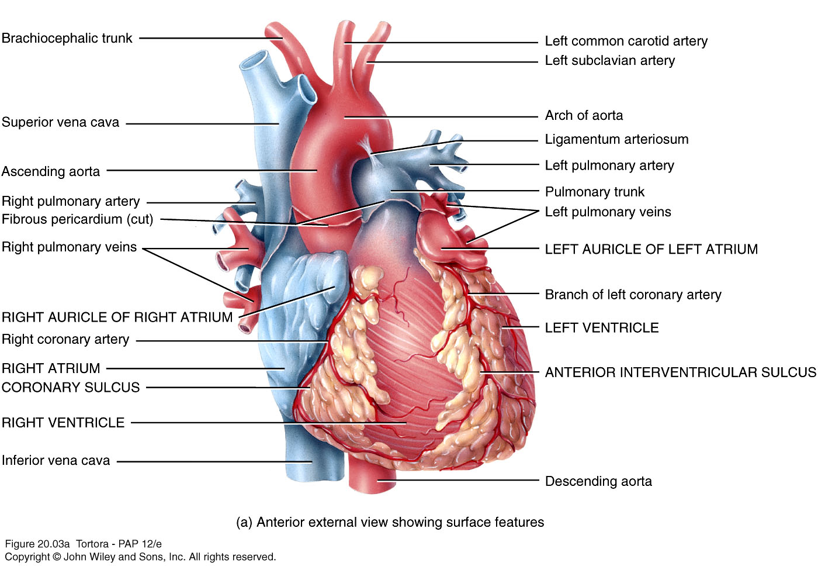
Cardiac Anatomy

Slide 4
Case
25 yo F with a bicuspid aortic valve with aortic stenosis and Class III NYHA symptoms.
PMH: none
PSH: none
Medications: none
Family: no CAD, no congenital heart disease
Social history: No tobacco, moderate EtOH, no illicit drugs.

Slide 5
Echo
AVA 0.7 cm2, peak gradient 67mm Hg, mean gradient 41 mmHg, Velocity 4.2 m/s2.
Aorta at the Sinus of Valsalva 25mm
Aorta at the Sino Tubular Junction 21mm

Slide 6
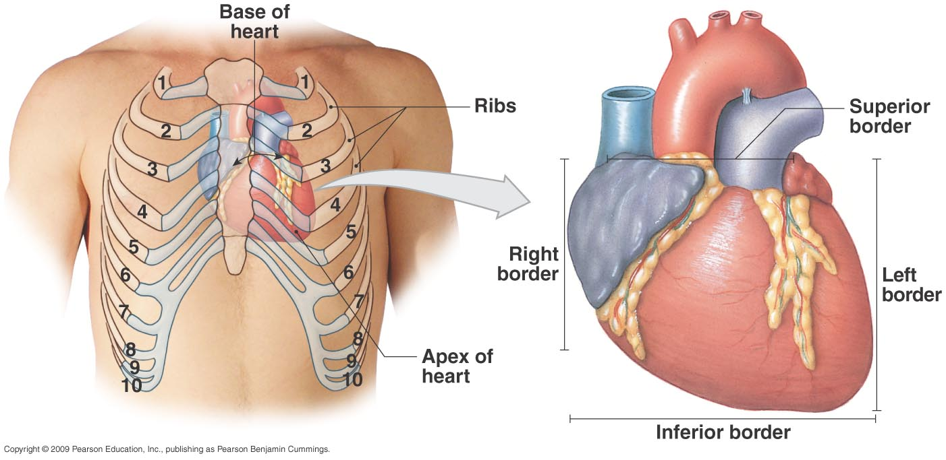
External Anterior Chest Wall Anatomy
? Incisions for: Median sternotomy,
Minimally invasive AVR, Transapical AVR, PDA,
Coarctation repair, Minimally invasive ASD, Pericardial window, Pericardiocentesis
Robotic MVR, Right anterolateral thoracotomy for MVR
Notes:
Located in the mediastinum – anatomical region extending from the sternum to the vertebral column, the first rib and between the lungs
Apex at tip of left ventricle
Base is posterior surface
Anterior surface deep to sternum and ribs
Inferior surface between apex and right border
Right border faces right lung
Left border (pulmonary border) faces left lung

Slide 7
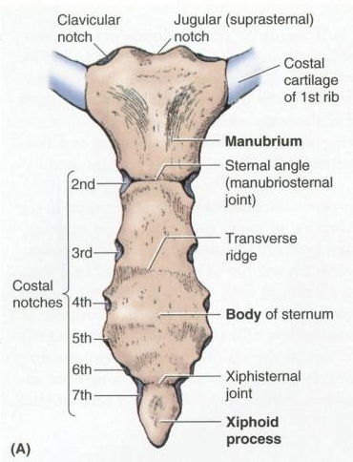
The Sternum
Manubrium
Body
Xiphoid
How to split sternum in midline?
Landmarks for sternotomy?
Minimally invasive incisions?

Slide 8
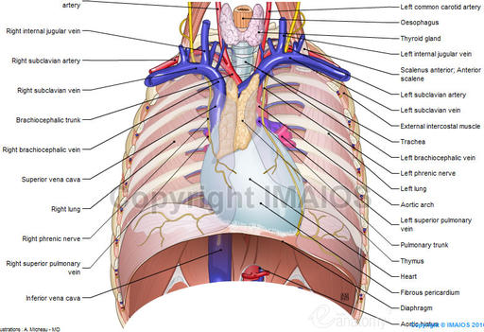
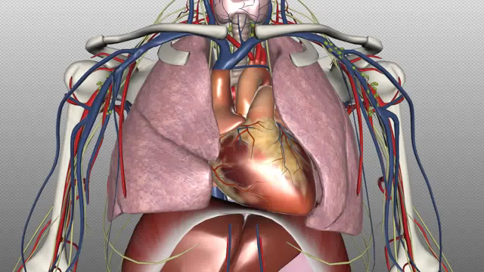
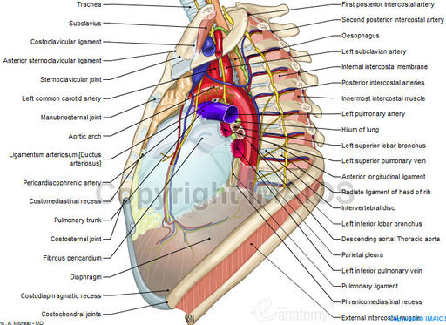
Anterior Mediastinum
How to Identify Thymus vs Fat?
When to remove anterior mediastinal fat
during routine sternotomy?
Where are phrenic nerves vulnerable to
bovie injury?
How to identify innominate vein?

Slide 9
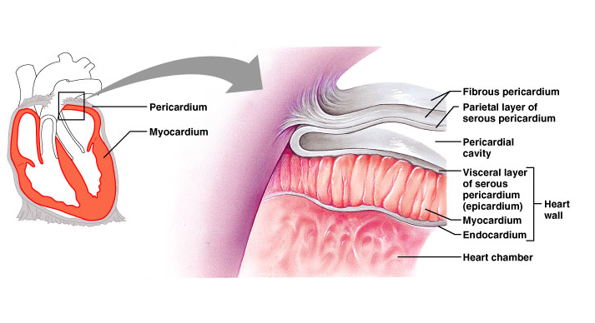
The Pericardium
How much pericardium to excise for pericardial window?
How much to excise for complete pericardiectomy?
Safest spot to open normal pericardium?
How do you identify phrenic nerves from front?
Notes:
Membrane surrounding and protecting the heart
Confines while still allowing free movement
2 main parts
Fibrous pericardium – tough, inelastic, dense irregular connective tissue – prevents overstretching, protection, anchorage
Serous pericardium – thinner, more delicate membrane – double layer (parietal layer fused to fibrous pericardium, visceral layer also called epicardium)
Pericardial fluid reduces friction – secreted into pericardial cavity 15-150cc fluid

Slide 10
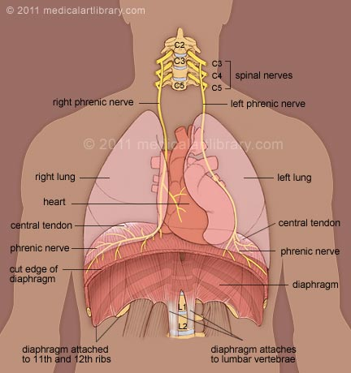
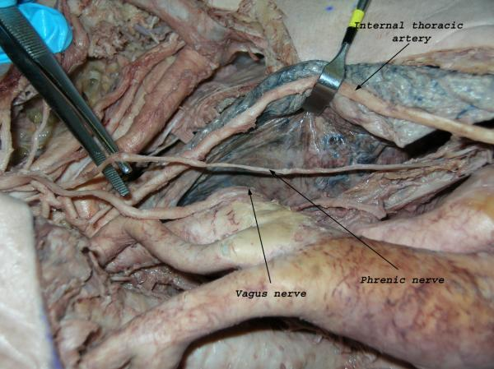
Phrenic nerves
Relationship of left phrenic nerve and vagus nerve? Recurrent laryngeal nerve?
Where can phrenic nerve be injured during LIMA takedown?
How to identify left phrenic in redo pulmonary valve replacement?
How far lateral to go in Radial Pericardiectomy?

Slide 11
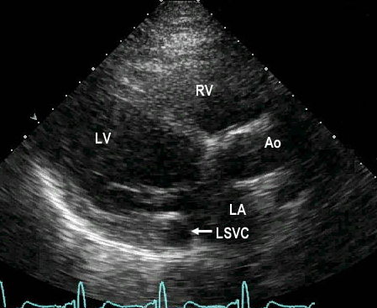
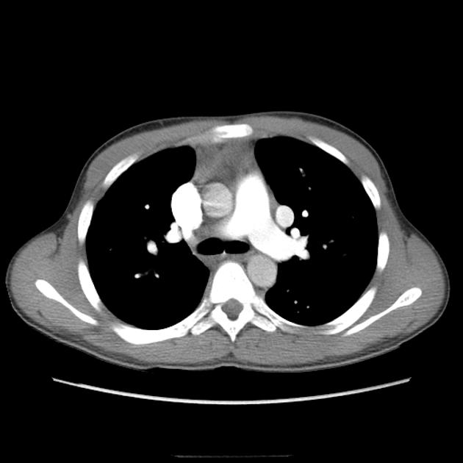
Persistent Left sided SVC?
0.3-0.5% patients
Suspect if…
Small or absent innominate vein
Large coronary sinus
Small or absent right SVC
How would you find the left sided vena cava?
Implications for cannulation strategies?
Implications for cardioplegia strategies?
Notes:
0.3-0.5% of normal population
3-10% of those w congenital heart disease
Drainge of left head/upper extremity into the subclavian- LSVC- Coronary sinus
Enlarged coronary sinus
Diagnosis:

Slide 12
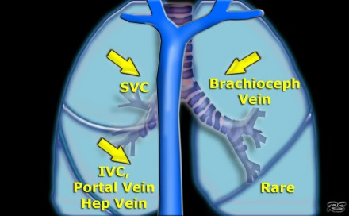
Partial Anomalous Pulmonary Venous Drainage into Mediastinum
Which PAPVR is associated with
Sinus Venosus ASD?
Which PAPVR is often called
Scimitar Syndrome? Why?
Which PASPVR is associated with
pulmonary hypoplasia?
What do you think of when you open pericardium and notice
enlarged right heart and reddish right atrium?

Slide 13
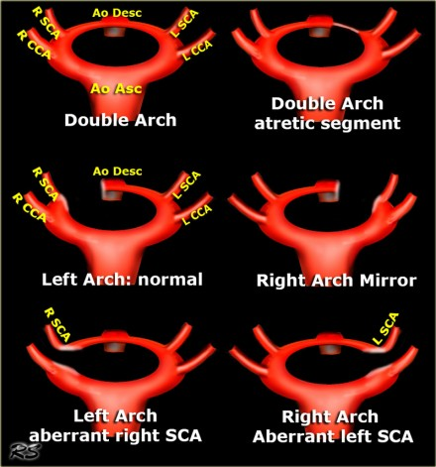
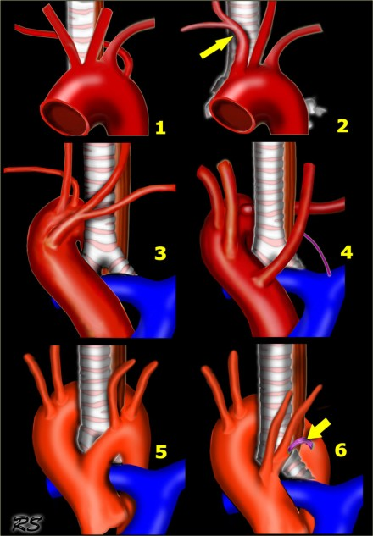
Aortic Arch Abnormalities
Embrology
Anatomy
6
5
3
1
4
How common is right sided aortic arch?
Which lesions are commonly obstructing

Slide 14
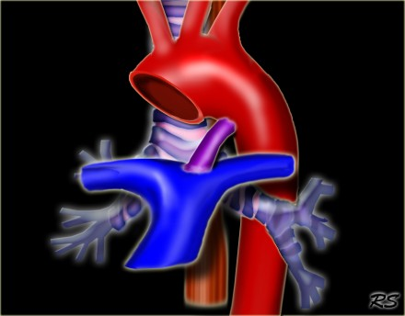
Patent Ductus Arteriosus from Front

Slide 15
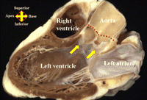
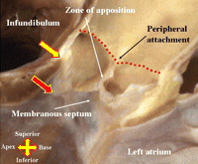
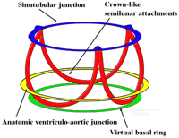
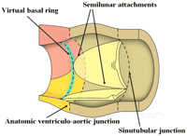
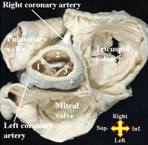
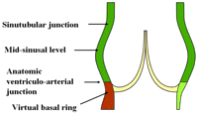
Aortic Root Anatomy
Anderson RTH: The surgical anatomy of the Aortic Root MMCTS 2007 (0219)

Slide 16
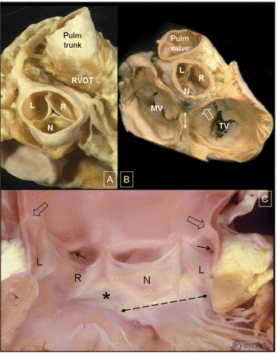
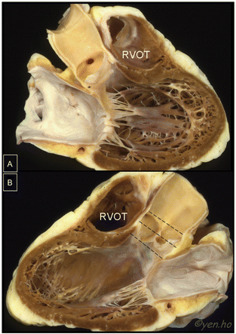
Aortic Valve and Aortic Root Anatomy
How to identify right coronary artery during AVR?
Where would aortic root incision go for Manougian operation ?
Where aortic root would incision go for Konno operation?
How to dissect out aortic root for David operation?

Slide 17
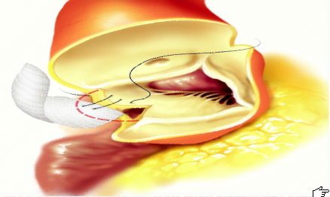
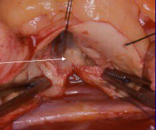
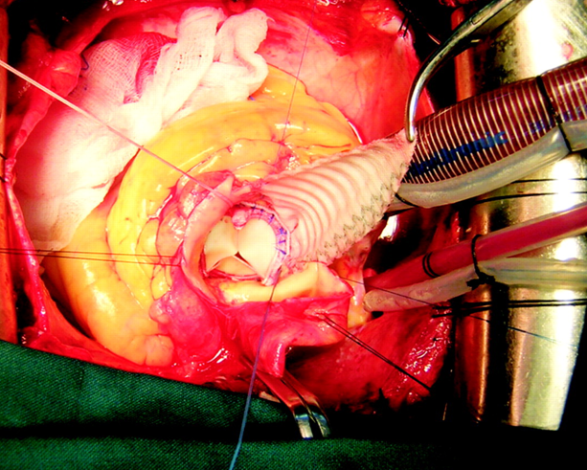
Manougian

Slide 18
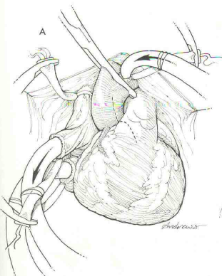
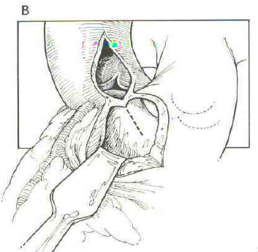
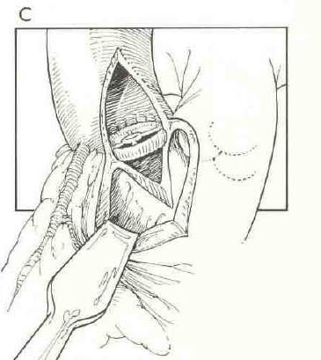
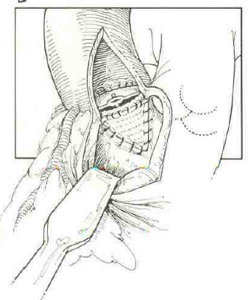
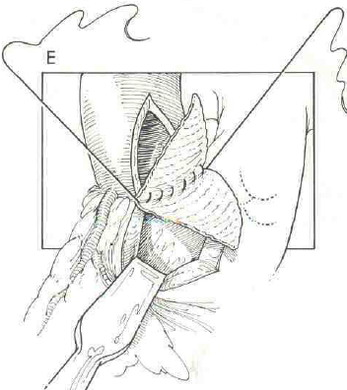
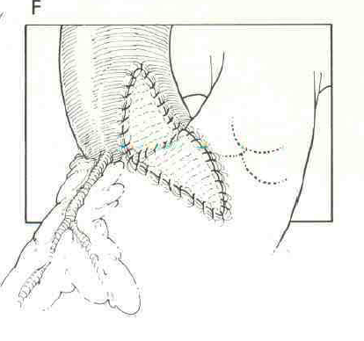
Konno

Slide 19
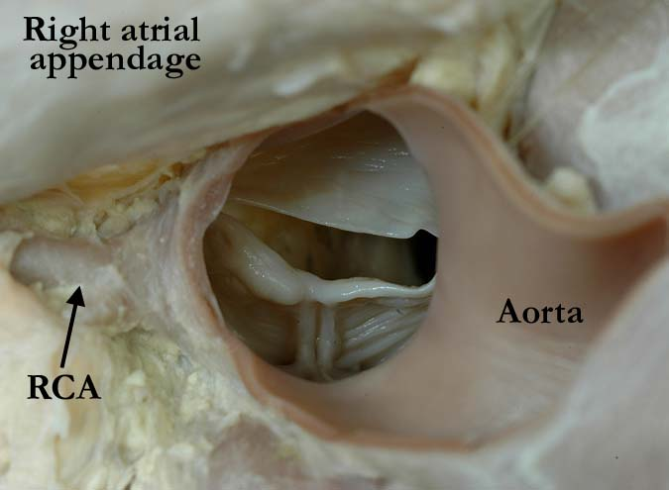
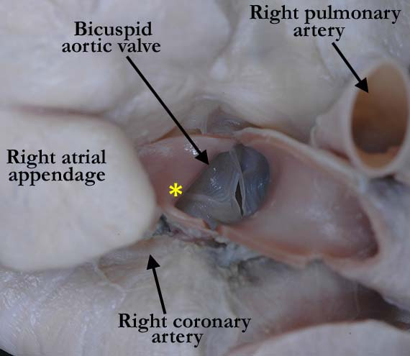
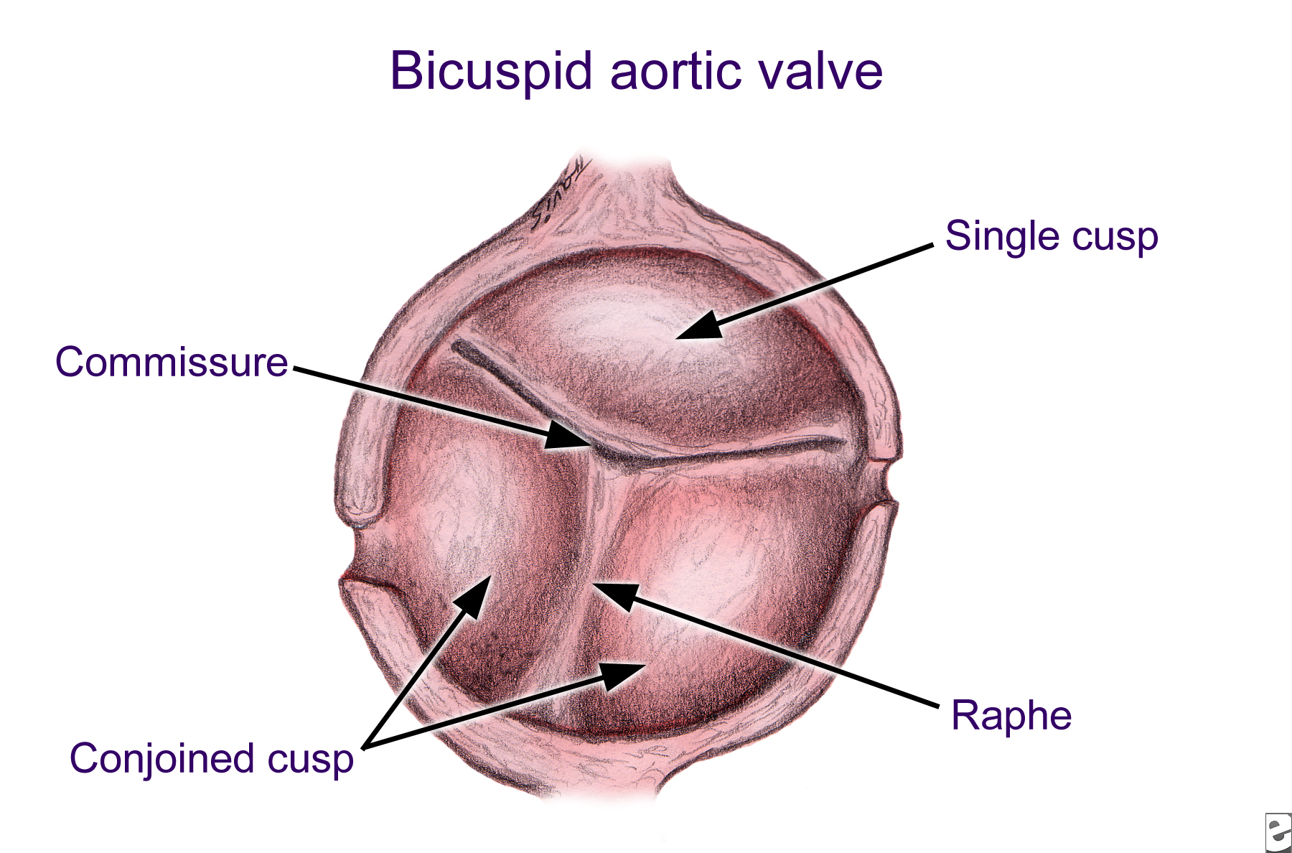
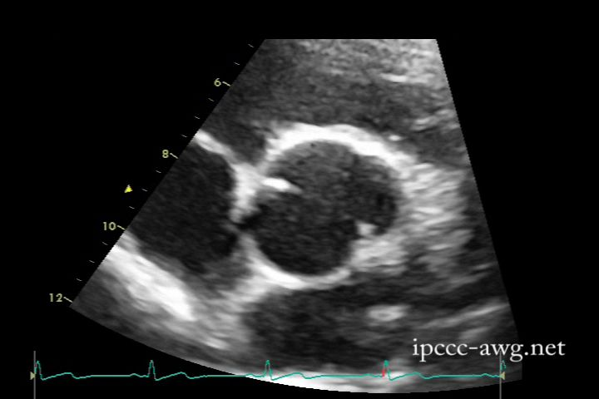
Aortic Valve Anatomy Bicuspid Aortic Valve

Slide 20
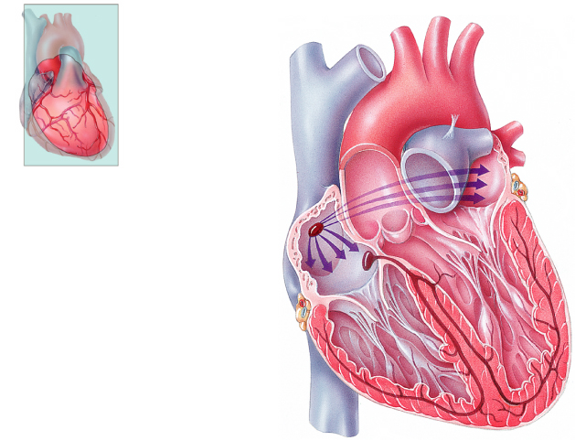
Conduction system
Frontal plane
Left atrium
Right atrium
1
SINOATRIAL (SA) NODE
2
ATRIOVENTRICULAR
(AV) NODE
3
ATRIOVENTRICULAR (AV)
BUNDLE (BUNDLE OF HIS)
4
RIGHT AND LEFT
BUNDLE BRANCHES
Left ventricle
Right ventricle
5
PURKINJE FIBERS
Anterior view of frontal section
Notes:
SA node ( SA nodal artery RCA)
Anterior, middle, posterior internodal tracts in the R and L atrium- bachmann’s bundle
AV node - Triangle of Koch, Tendon of todaro, Coronary sinus, septal leaflet of tricuspid valve
Bundle of His- penetrates the membranous septum just underneath the R and non-coronary cusps of the Aortic valve
Bundle Branches-
Purkinje fibres

Slide 21
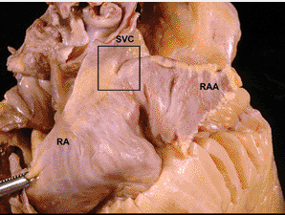
Sino-atrial Node
? Injury to Sino-atrial node:
- Cannulation of SVC
- Repair of PAPVR
- Girandon incision for Mitral

Slide 22
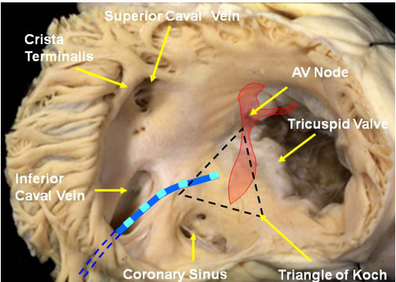
Atrio -ventricular node
In jury location?
Perimembranous VSD
Tricuspid valve replacement
Mitral valve replacement
Aortic valve replacement
Ostium primum ASD Repair
Unroofed CS ASD
LV Myomectomy
Konno

Slide 23
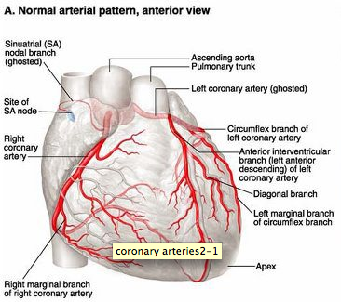
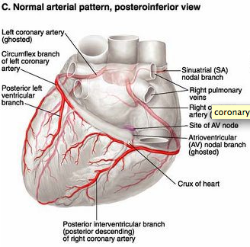
Coronary Artery Anatomy
Notes:
Right dominante 80-85%
Left dominant 10-15%
Codominant 5%

Slide 24
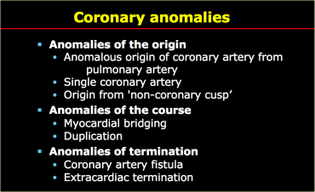
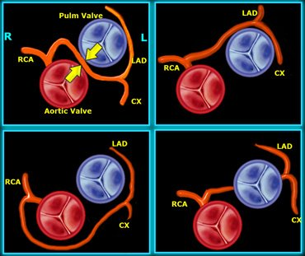
Coronary Artery Anomalies
What is most common coronary
anomaly in Tetralogy of Fallot?llot
Most common congenital coronary anomaly:
Anomalous LCA form Right Sinus Valsalva

Slide 25
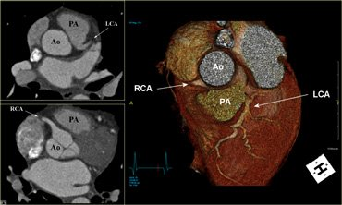
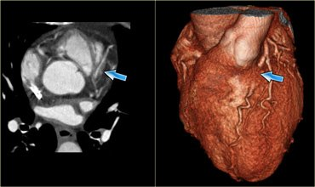
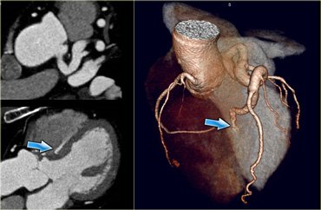
CORONARY ANOMALIES
Anomalous Coronary from
Pulmonary Artery (ALCAPA)
Myocardial Bridge
Coronary Artery Fistula

Slide 26
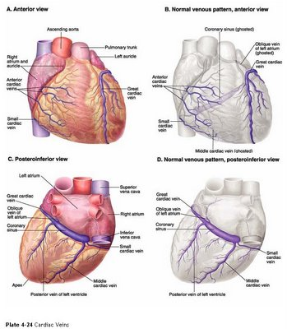
Cardiac Vein Anatomy
Where does coronary sinus injury
commonly occur with cardioplegia?
Anatomy of markedly enlarged
coronary sinus?
Importance of great cardiac vein
during cardioplegia?
How to distinguish coronary artery
from coronary vein during CABG?

Slide 27
Learning Points
Understanding normal Mediastinal Anatomy is essential to …
Design and execute most cardiac operations
Avoid complications
Understanding Anomalous Mediastinal Anatomy is the etiology of many cardiac operations

