Slide 1
Combined Coronary and Carotid Disease
Pey-Jen Yu, MD
Northwell Health

Slide 2
Background
71 y/o F PMH HTN p/w increasing SOB over the past month. Patient denies chest pain, dizziness, headache.
Meds: Carvedilol, amlodipine
PE:
  HR 77 BP 180/70
  Neuro: intact
  Lungs: clear
  Grade III/VI holosystolic murmur
  3+ B/L LE edema
Labs
  13.5
  6.78 )-----------( 345
  42.9
  140 | 99 | 21
  ----------------------------< 134
  3.3 | 26 | 1.03
  TPro 7.3 / Alb 4.0 / TBili 1.2 / AST 46/ ALT 38/ AlkPhos 103
  High sensitivity trop 418 ng/L ->233 ng/L
  BNP >25K

Slide 3
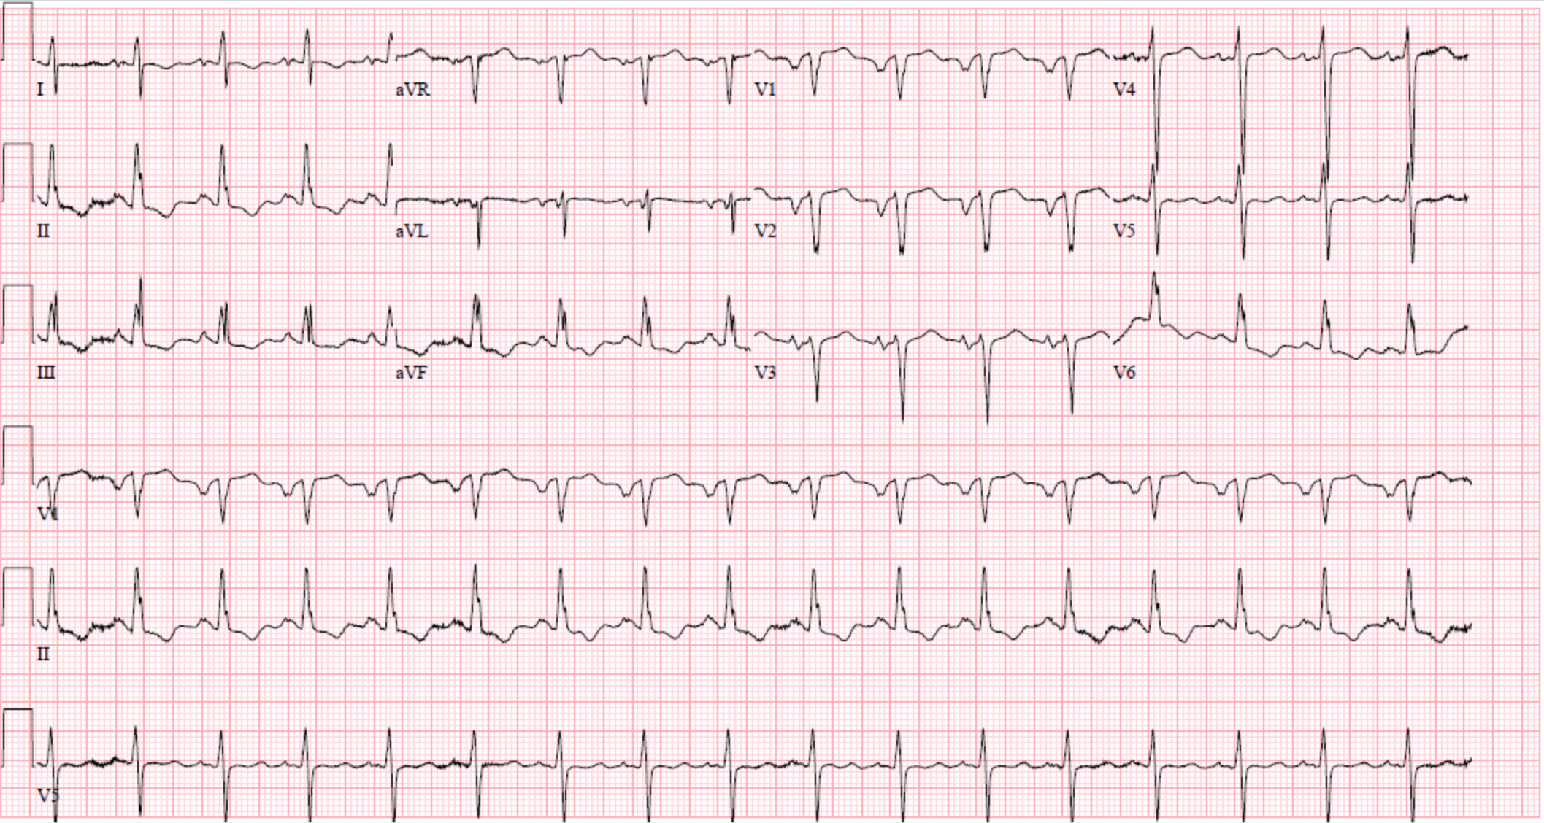
Electrocardiogram

Slide 4
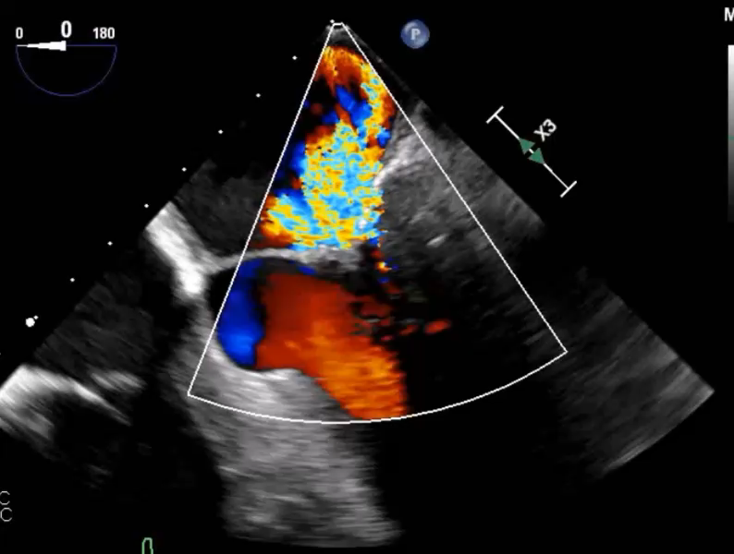
Echocardiogram
Severe MR
Normal LVEF
Normal RV size with decreased function
Mild- moderate TR

Slide 5
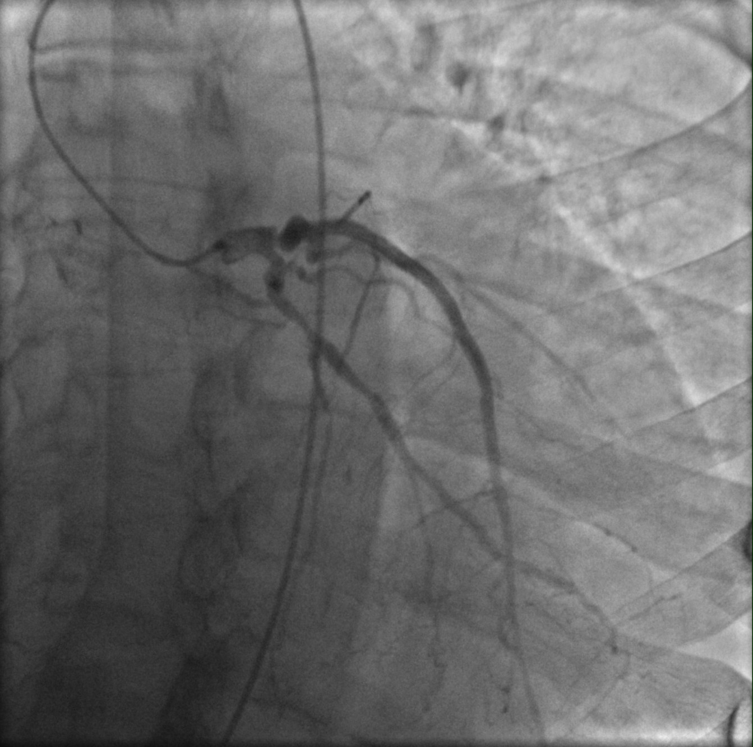
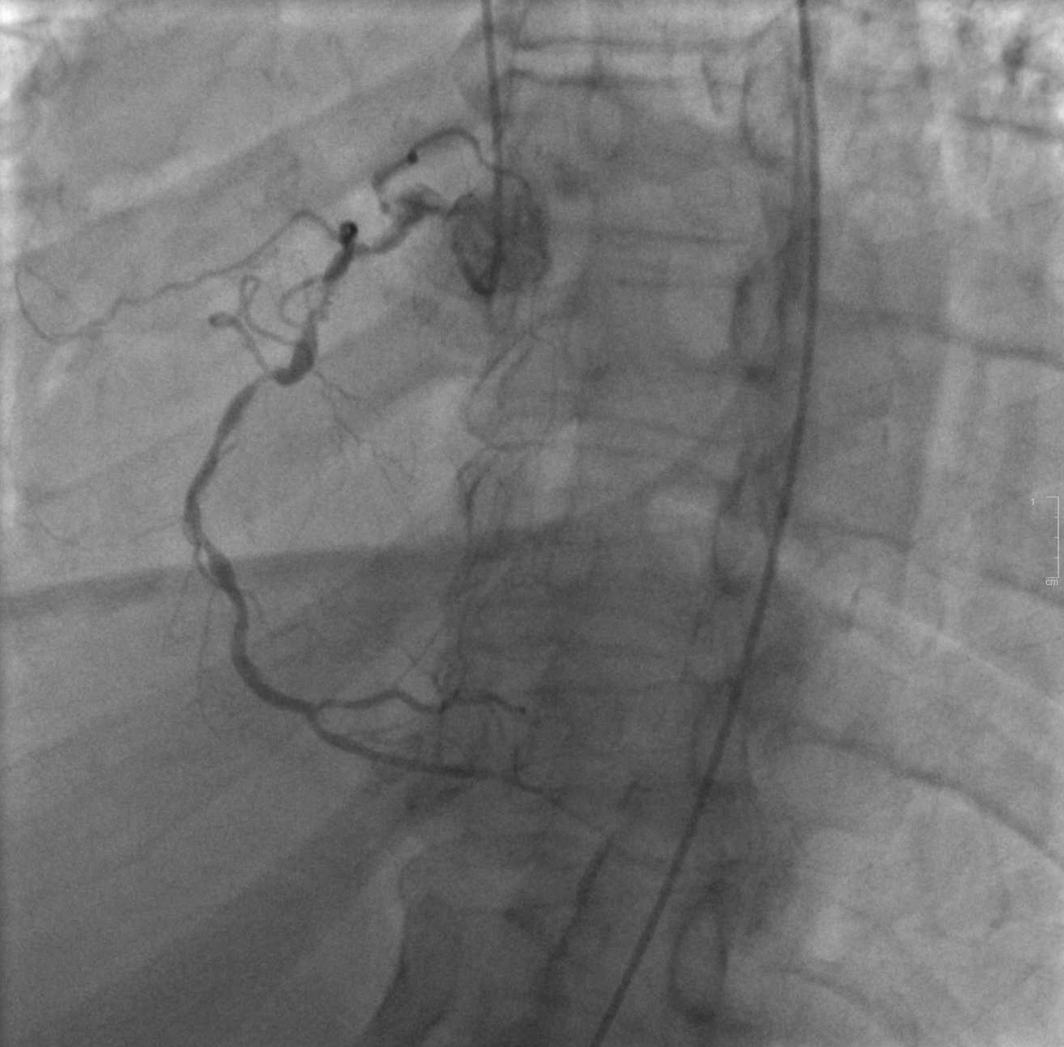
Coronary Angiogram

Slide 6
Carotid Workup
Carotid Duplex
RIGHT:
PROX CCA = 69 cm/s; DIST CCA = 130 cm/s
PROX ICA = 237 cm/s; DIST ICA = 94 cm/s
ECA = 223 cm/s
LEFT:
PROX CCA = 104 cm/s; DIST CCA = 120 cm/s
PROX ICA = 464 cm/s; DIST ICA = 152 cm/s
ECA = 293 cm/s
IMPRESSION:
Over 70% stenosis of the internal carotid arteries.
Bilateral external carotid artery stenosis
CT Angiogram of the Head and Neck
Head CT:
Mild parenchymal volume loss and mild chronic microvascular ischemic changes.
Head and Neck CTA:
Calcified and noncalcified plaque causes moderate stenoses of the
bilateral common carotid arteries.
Atelectatic changes resulting in approximately 70% stenoses of the proximal right internal carotid artery.
Approximately 80% stenosis of the proximal and distal left cervical internal carotid artery.

Slide 7
Pre-operative course
Had episode of transient mild expressive aphasia in the hospital on the day of the head and neck angiogram, evaluated by neurology and vascular surgery

Slide 8
Surgery
Left carotid artery endarterectomy with patch angioplasty using left external jugular vein
Sternotomy
SVG to PDA
Placement of left atrial appendage occluder
LIMA to LAD
Mitral valve replacement
Closure of sternum and median sternotomy incision
Closure of left neck incision

Slide 9
Learning Points
Combined coronary artery disease, mitral valve disease, and carotid disease
Indications for mitral valve, coronary, and carotid surgery
Timing for mitral valve, coronary, and carotid surgery
  Impact of the patient’s neurological event on timing of surgery
Sequence of surgery

