Slide 1
STEMI with Triple Vessel Disease
Pey-Jen Yu, MD
Northwell Health

Slide 2
Background
Labs
14.09 )-----------( 447
42.2
132 | 97 | 6
--------------------------< 121
4.3 | 28 | 0.78
TPro 7.5 / Alb 3.9 / TBili 0.6 / AST 70 / ALT 29 / AlkPhos 46
PT 11.0 / INR 0.93 / PTT: 32.2
HS Trop I: 3226 ng/L / CK 1628 / CKMB 317
65 y/o M with no PMH presents with worsening epigastric and substernal chest pain with radiation to his arms and back for 4 hours.
Meds: None
PE: HR 73 BP 121/61 Sat 100% RA
  Lungs: Clear
  Heart: RRR, no murmur

Slide 3
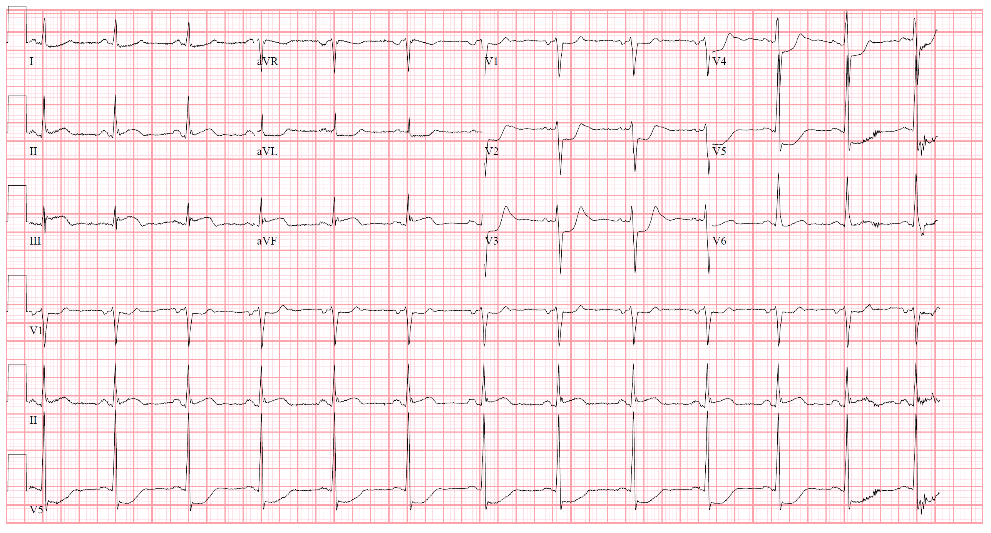
Electrocardiogram

Slide 4
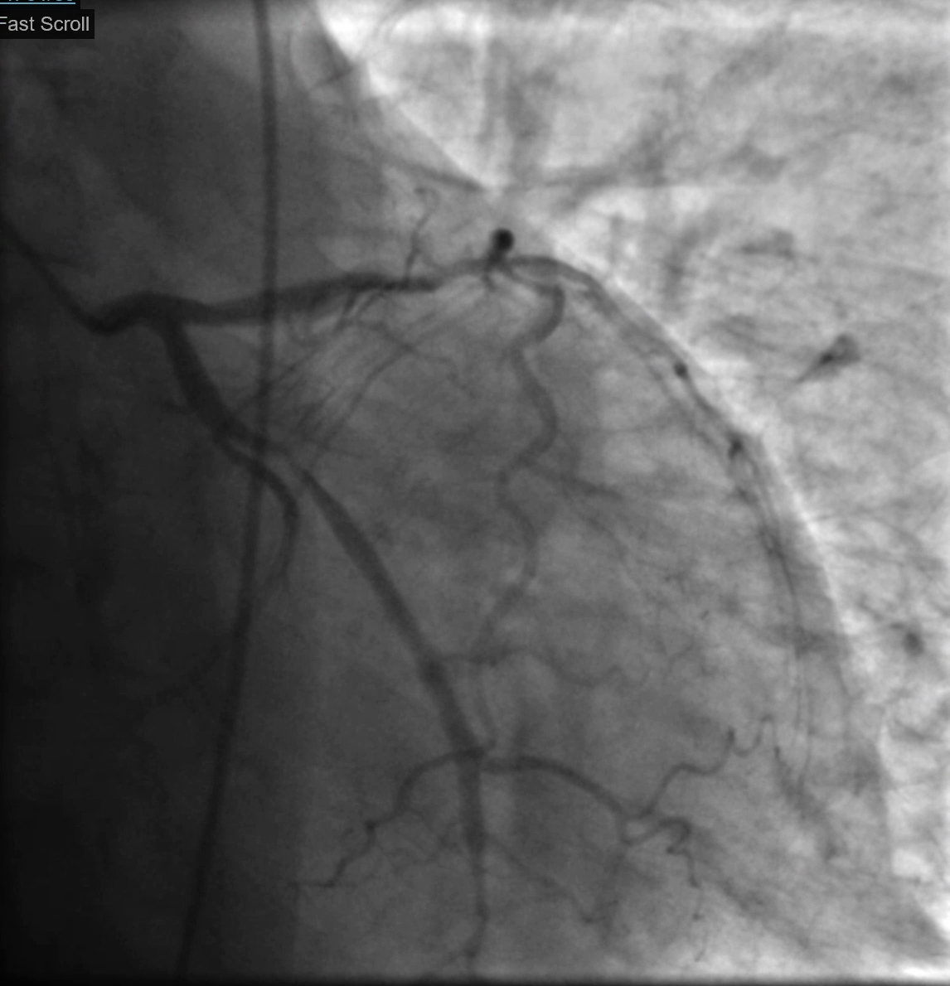
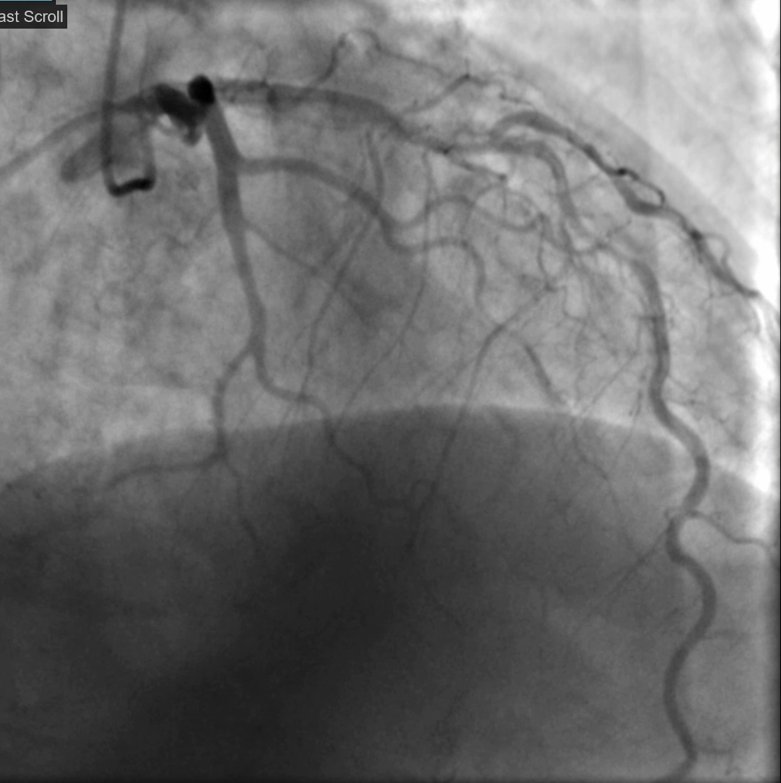
Left Coronary Angiogram

Slide 5
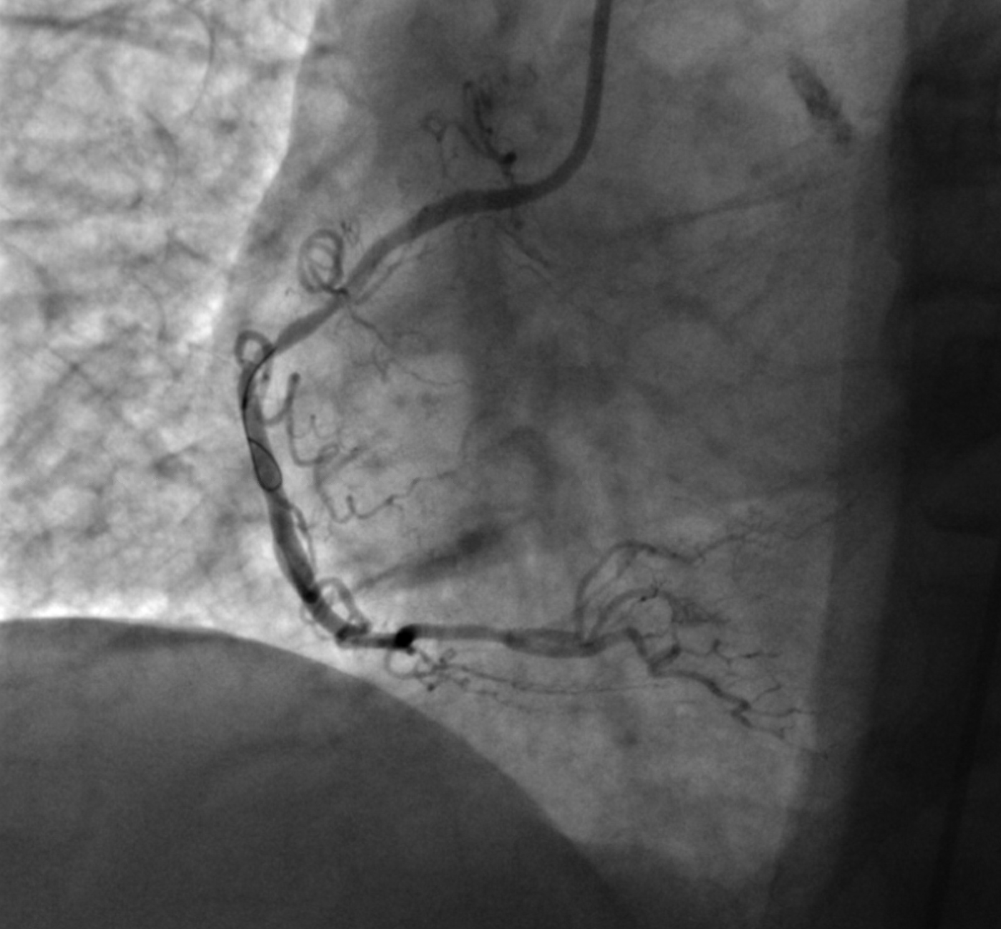
Right Coronary Angiogram

Slide 6
Discussion
Management of STEMI in the setting of severe TVD
  PCI versus CABG
  Timing of interventions

Slide 7
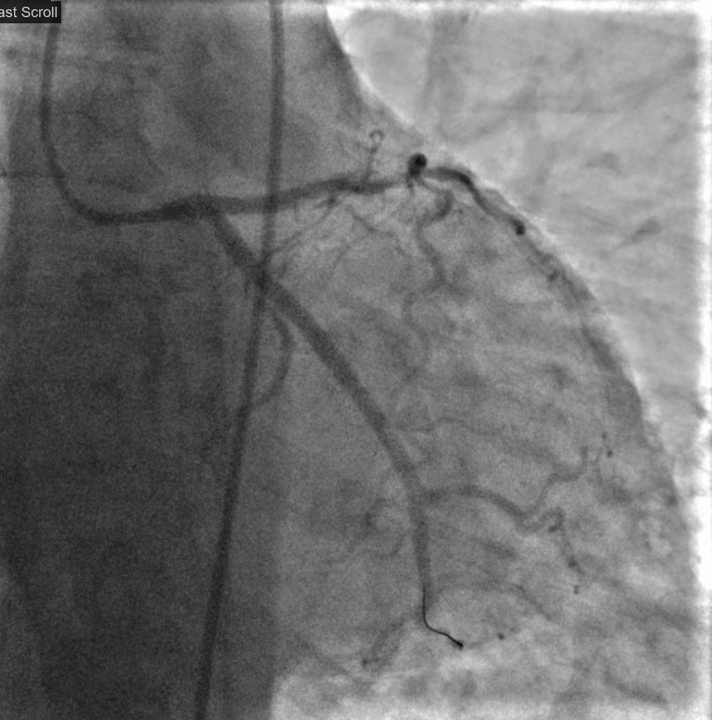
DES to OM1

Slide 8
Post PCI Hospital Course
Transthoracic echocardiogram
  tethered mitral valve leaflets with minimal mitral regurgitation
  Mid segmental left ventricular systolic dysfunction. Ejection Fraction 45%. The inferior lateral wall is akinetic. The basal inferior and the basal to mid anterior lateral walls are hypokinetic. Stage II diastolic dysfunction. Normal right ventricular size and function
CT Surgery evaluation - followup as outpatient
Discharged on ASA/ticagrelor hospital day #1

Slide 9
Elective CABG
Pt returns for elective CABG 4 months later for uncomplicated LIMA to the LAD, L radial artery to the PDA

Slide 10
Learning Points
Indication for revascularization in STEMI
Type of revascularization (PCI/ CABG/ Hybrid)
Timing of revascularization

