Slide 1

Acute Myocardial Infarction
Ventricular Septal Defect
Interventional Approach
Author: Aneet Patel, MD Edward Verrier, MD
Institution: University of Washington Medical Center
Date: March 2014
Learning Domain: Adult Cardiac Surgery
Learning Objectives: Management Strategies for Complications
of Acute Myocardial Infarction
Case Presentations
Adult Cardiac Disease
TSC: CV 10
Milestone: 2

Slide 2
Presenting History
83 y/o male who developed abdominal pain x 3 days prior to seeking medical attention.
Epigastric, non radiating
No relief with Pepto Bismol for 3 days
Son was concerned enough to bring him to the ER @ outside hospital
Found to have a troponin of 19.4, Cr 2.35 K 4.7, and ST elevations

Slide 3
Initial Electrocardiogram
ST elevations in II, III, AvF and reciprocal changes V2-V5

Slide 4
Past Medical History
Hernia repair at age 12
L sciatic nerve pain at age 65
Last saw a physician in 1995 and made it to 83
No history of known HTN, DM, CAD, CA

Slide 5
The other histories
Social History
Smoked until 1945 then quit
Family History
Mother lived until she was 101
Medications
No medications prior to STEMI
Allergies
NKDA
Father was a smoker, but no early CAD
Lived with his wife until she passed 3 years ago.
Lives with his son.
No Illicits

Slide 6
Outside hospital course
Day 1
Cardiac cath 100% RCA 40% LM, LAD open, 70-80% OM
2 DES placed to his right. Echo shows VSD and infarcted inferior wall.
Day 2-7
Continued epigastric pain, got a CT abdomen and due to azy GB, got a perc drain placed.
Started to become hypotensive, developed afib
Day 8-9
Placed on cef/flagyl for presumed cholecystitis
14mcg dopamine, 5mcg dobutamine
CT surg consulted, waiting for tissue to heal, non-op
Persistant hypotension, increasing AKI, UW contacted for assistance

Slide 7
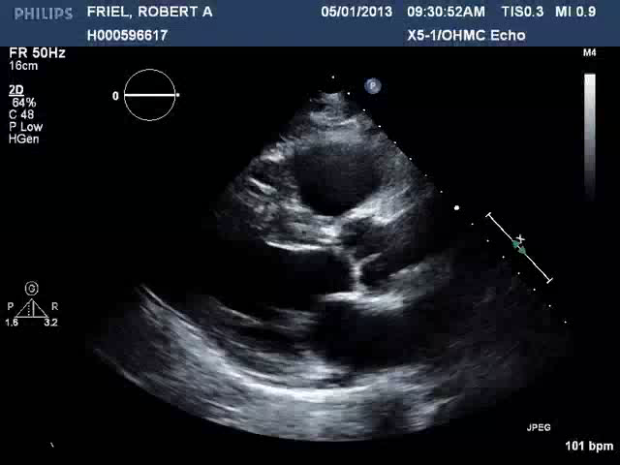
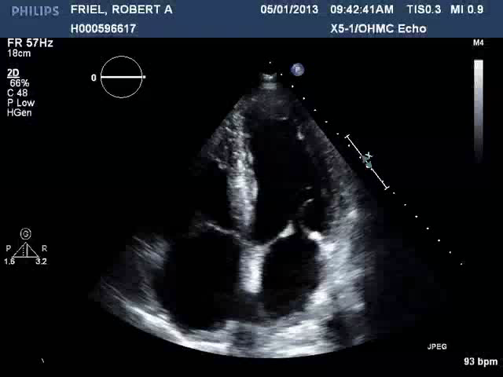
Initial Echocardiogram ~3days
PLAX & A4C
Notes:
PLAX
A4C

Slide 8
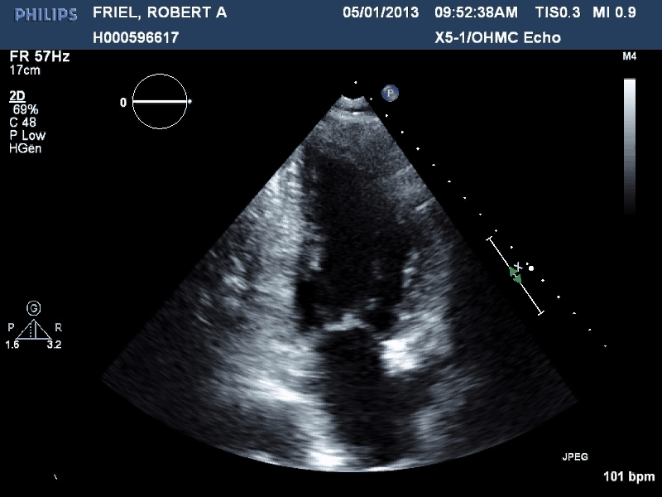
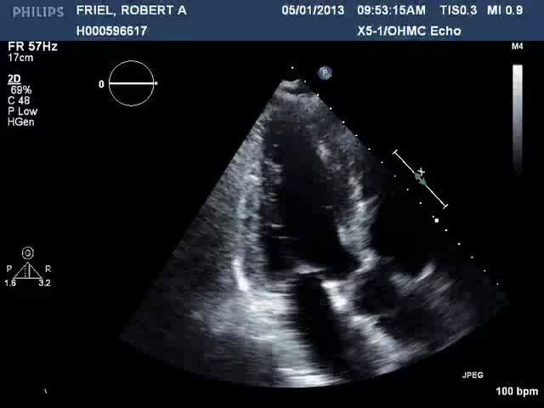
Initial Echocardiogram
A2C & ALAX

Slide 9
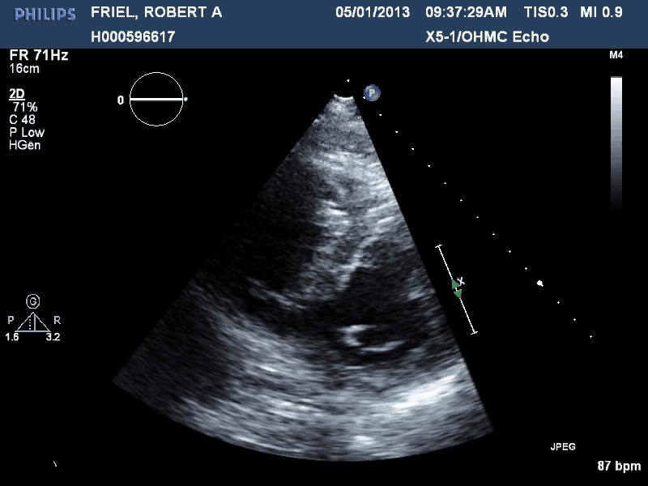
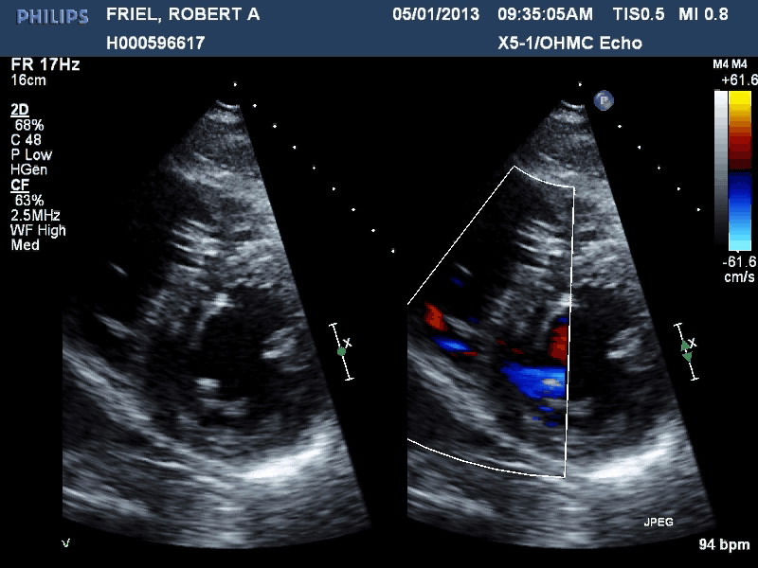
Initial Echocardiogram
SAX & Off SAX color compare

Slide 10
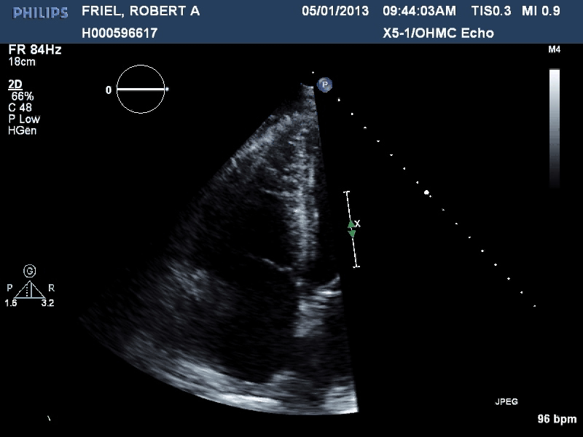
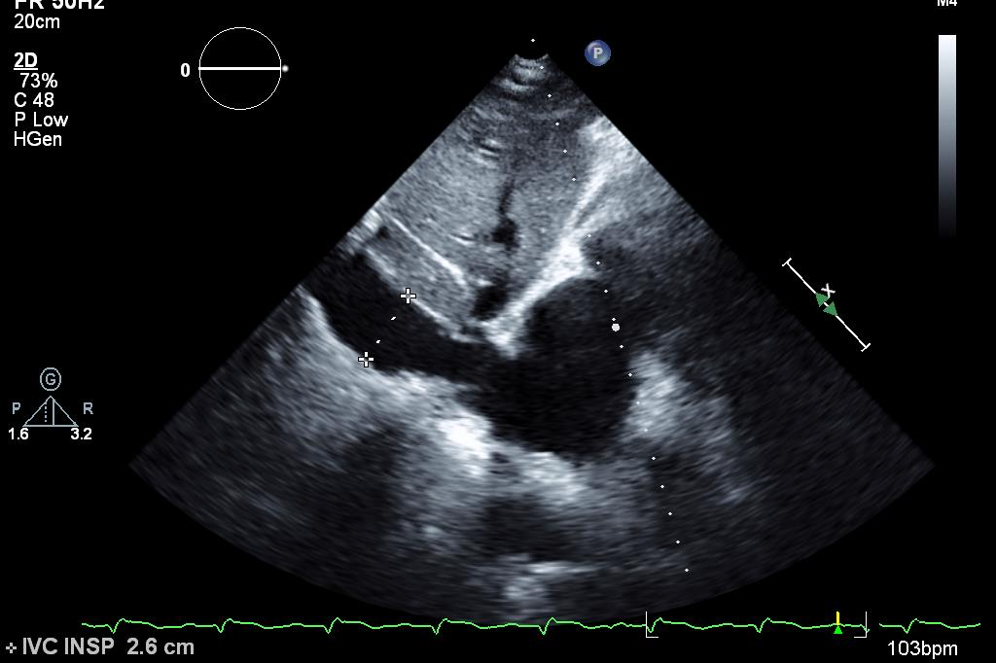
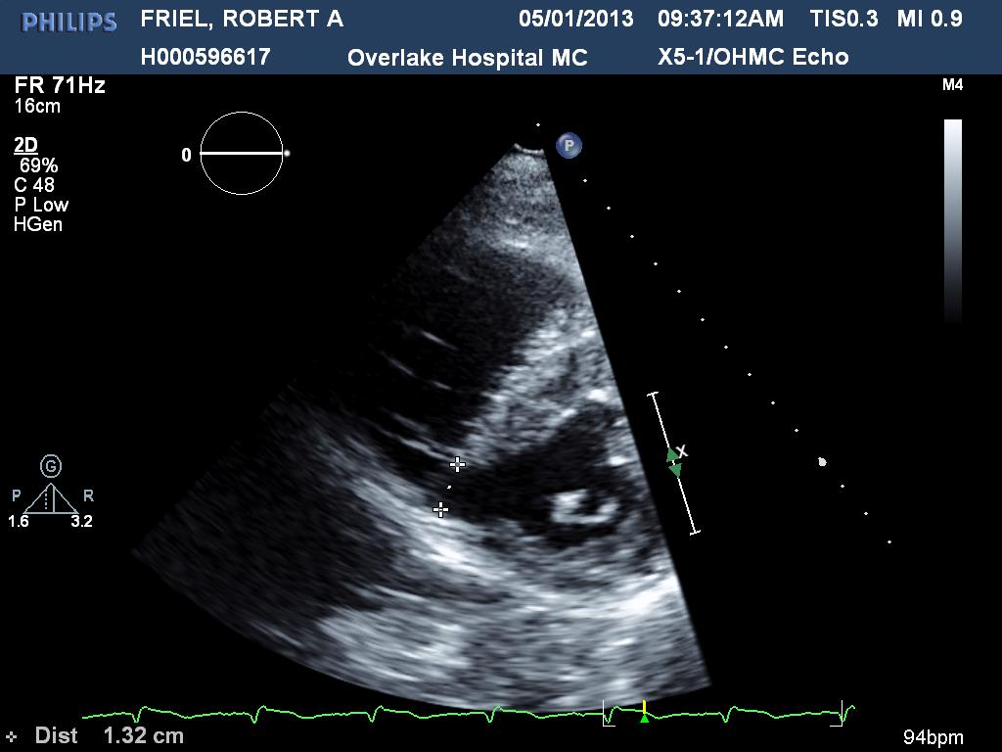
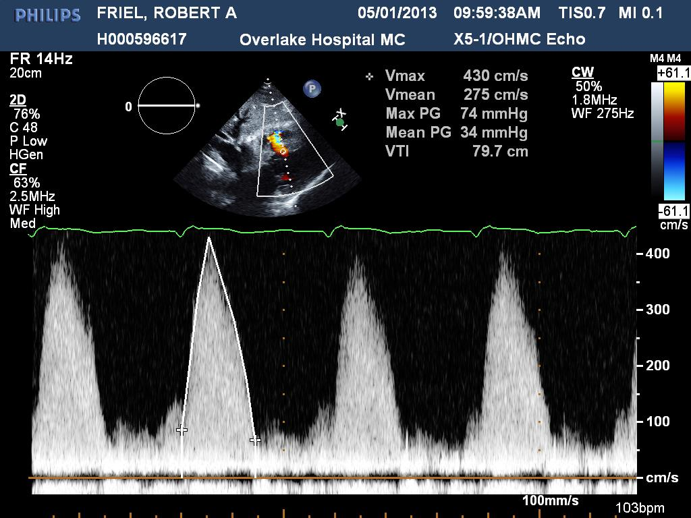
Initial Echocardiogram
Context clues
Notes:
Inspiratory IVC 2.6 cm
VSD measurement 1.32cm

Slide 11
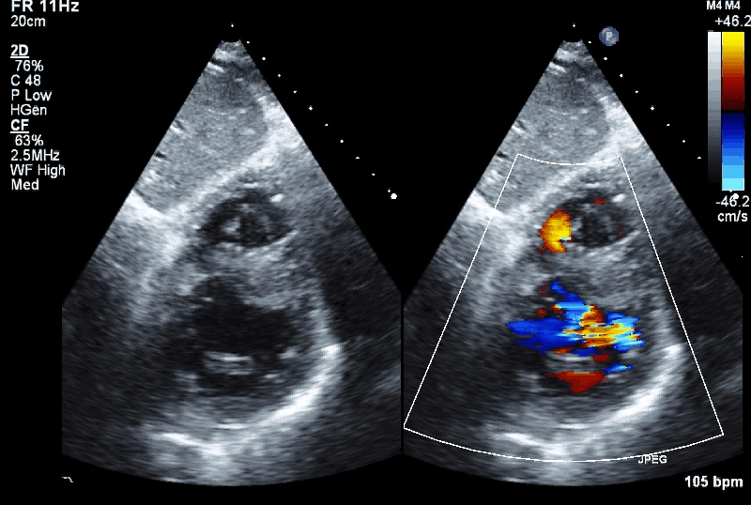
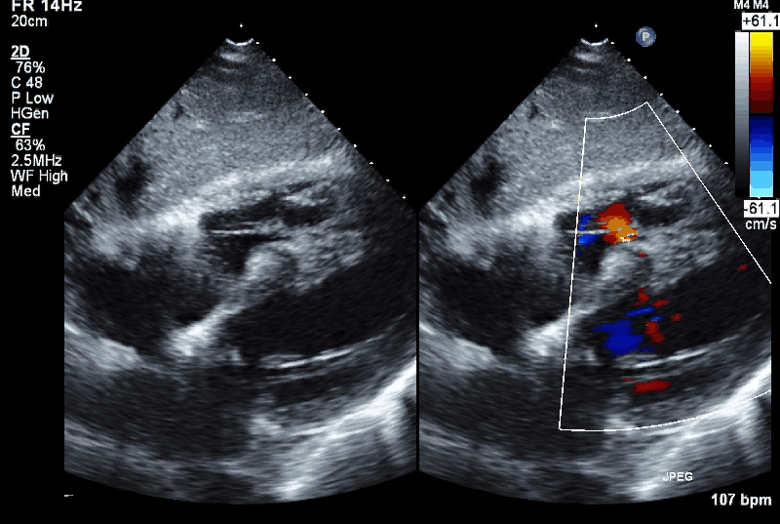
Initial echocardiogram
Subcostal SAX & 4C Color Compare

Slide 12
Physical Examination upon Transfer:
36.8⁰, HR 99, BP 82/49, RR 22, SpO2 95% 2L
Gen: elderly male, alert, in bed, slightly lethargic and diaphoretic
Eyes: no icterus, no conjunctival irritation, PERRLA, EOMI
Cor: regular, blowing pansystolic murmur, no JVD, non displaced PMI
Res: Crackles bilaterally
Abd: soft, not tender, normal bowel tones, percutaneous drain with green bile. Insertion site C/D/I
Neu: non focal exam, did not sit up for full exam
Ext: 2-3+ bilateral edema, slightly mottled and peripherally cool

Slide 13
Electrocardiogram upon Transfer

Slide 14
Laboratory
124 94 93
146
12k
221
4.4 17 4.48
32
1.4
Cr from 1.85→ 4.48: 9 days
Troponin from 19 to 2.15
CK 69
BNP 2547
AST 18 ALT 33 Bili 0.8

Slide 15
Discussion Point for Conference
Presentation / Timing / Natural History
  Complications of Acute MI
Initial hemodynamic management strategies
Use of Intra-aortic Balloon Counterpulsation
Therapeutic Options ?
Role of Interventional Approaches
  ? Bridge to Surgery
  ? Definitive Therapy

Slide 16
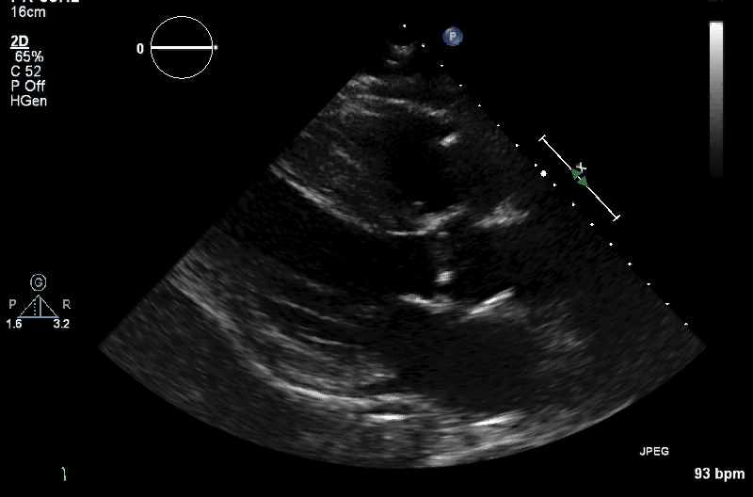
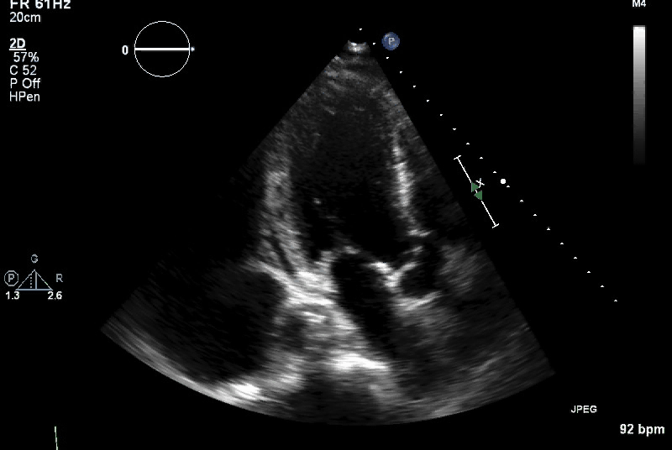
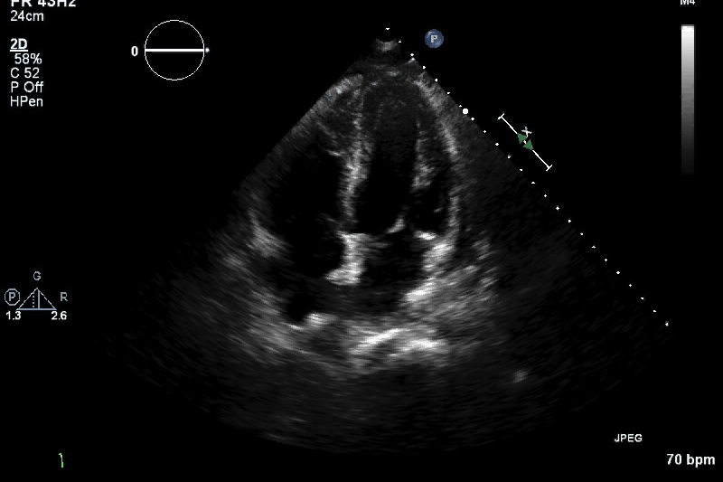
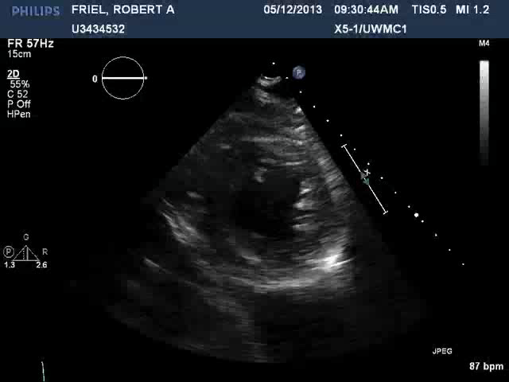
Follow up echo @ UWMC
PLAX
ALAX
A4C
SAX

Slide 17
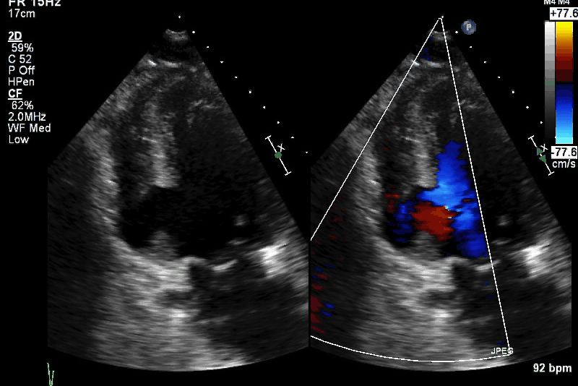
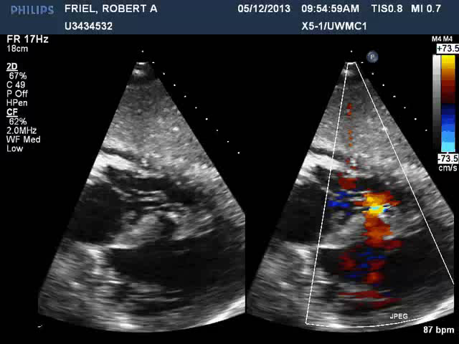
Follow up echo @ UWMC
Off axis A2C & Sub Costal 4C

Slide 18
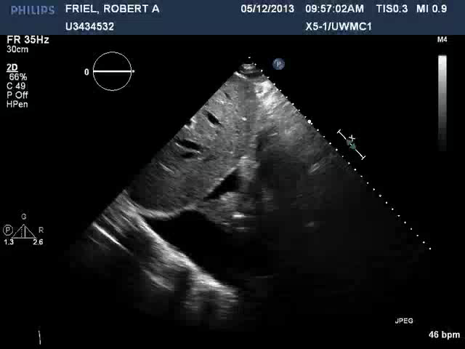
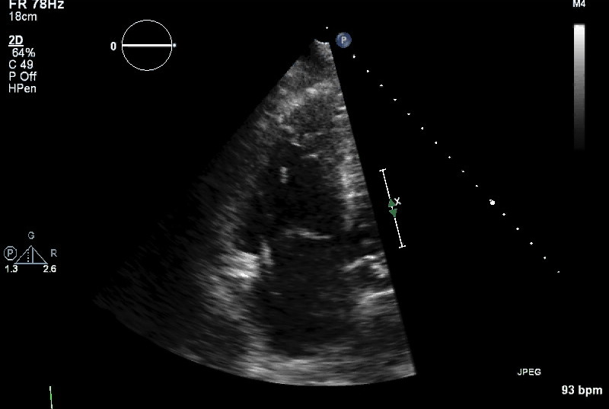
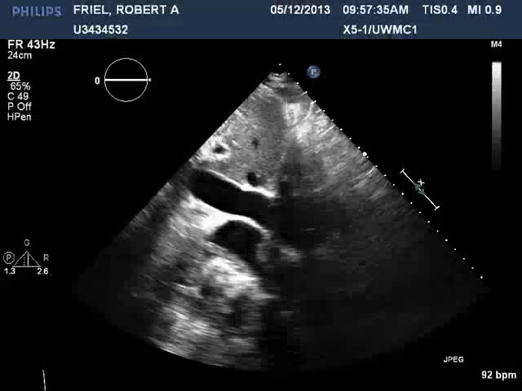
Follow up echo @ UWMC
Context Clues

Slide 19
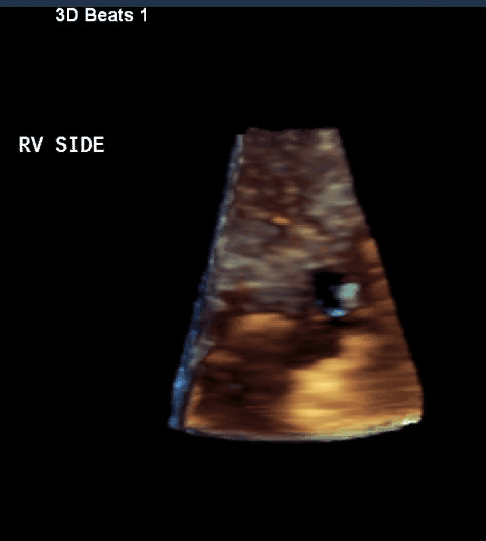
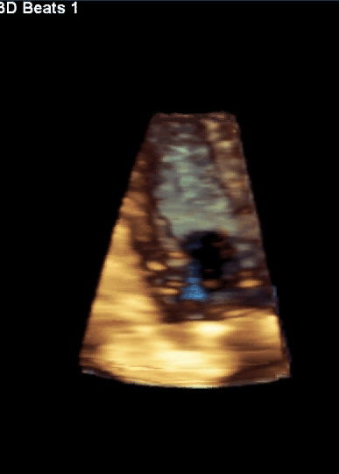
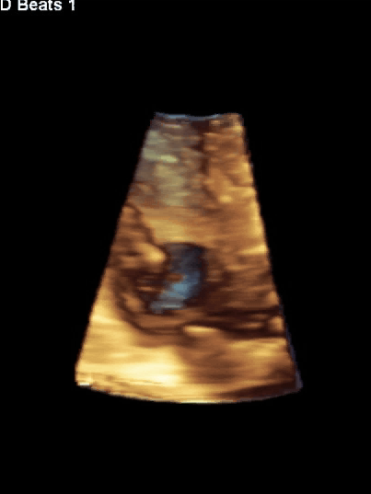
Follow up echo @ UWMC
Full Volumes

Slide 20
Hospital course
HD 1
Found to be in oliguric cardiogenic shock. Cold and Wet.
Immediate family conference.
Day 2-3
Discussion with family regarding percutaneous device as a bridge to surgery
Care coordination and multidisciplinary case conference regarding approach
HD 4
Percutaneous device placement, 13 days post dx of MI, likely 16 days since the event.
Swan and IABP placed
Pt stabilized and comfortable with reduced pressor requirment

Slide 21
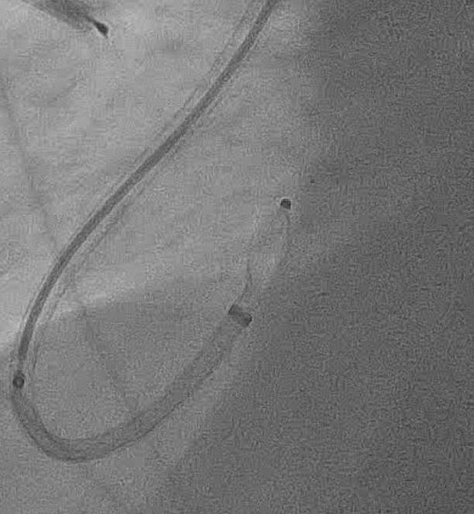
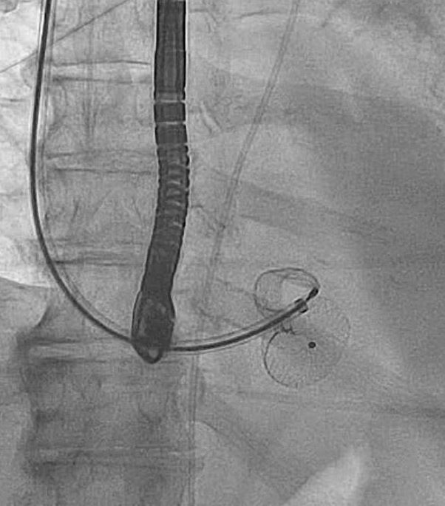
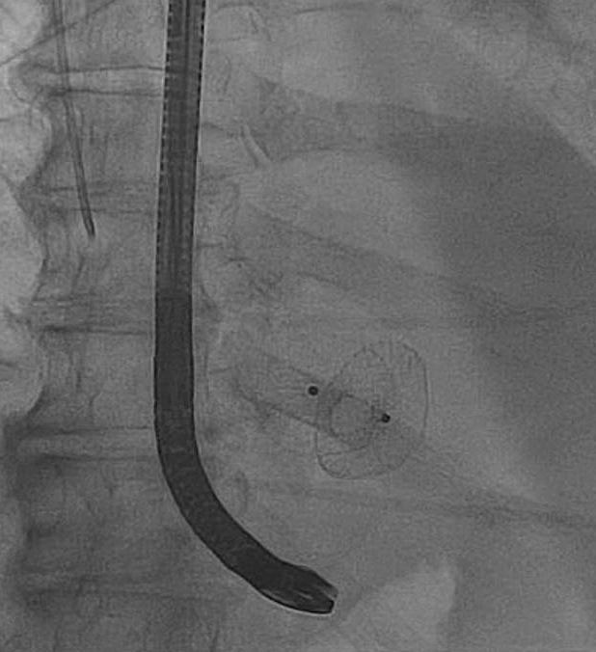
Percutaneous VSO placement
Notes:
LAO
Caudal RAO
RAO

Slide 22
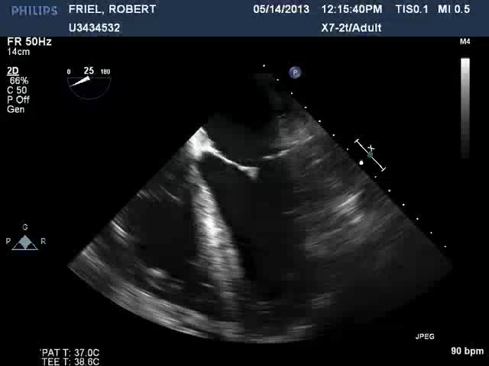
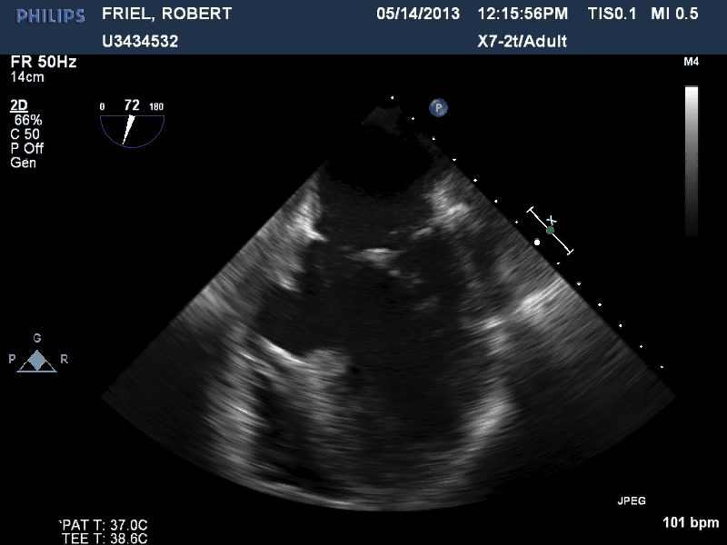
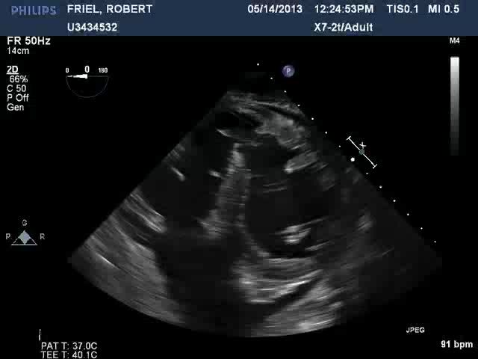
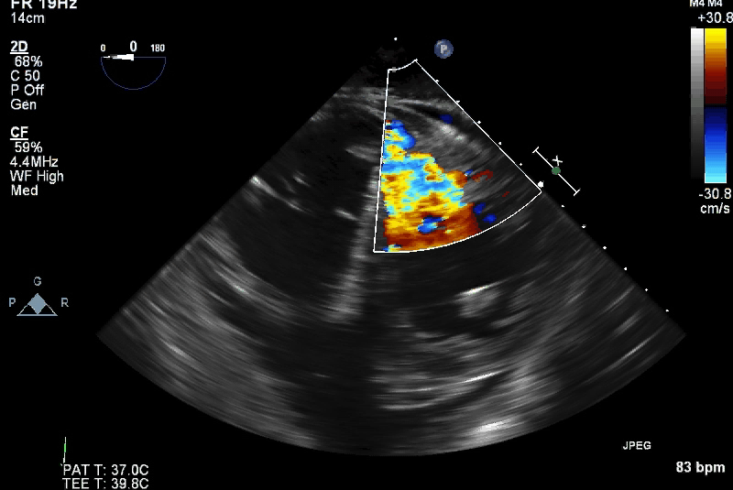
TEE intraop echo; Hosp day 4
ME 4C, 2c and TG SAX

Slide 23
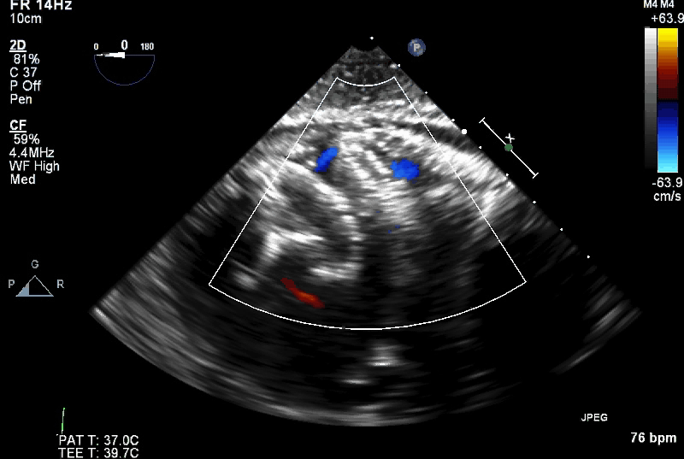
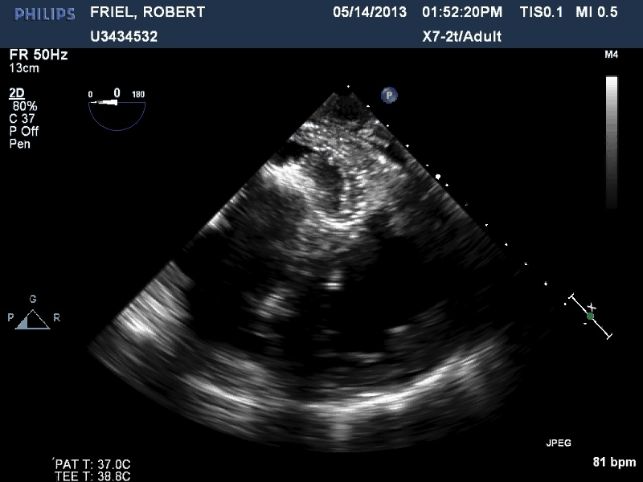
TEE intraop echo
Device deployment 5.14.13
 | Pre device | Post device
RA | 75% | 75%
PA | 96% | 96%
RV | 95% | 95%

Slide 24
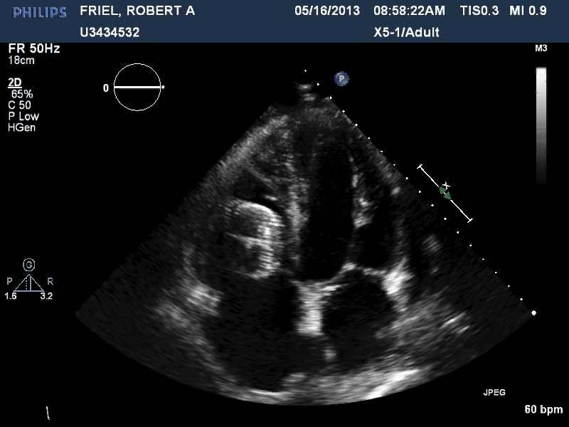
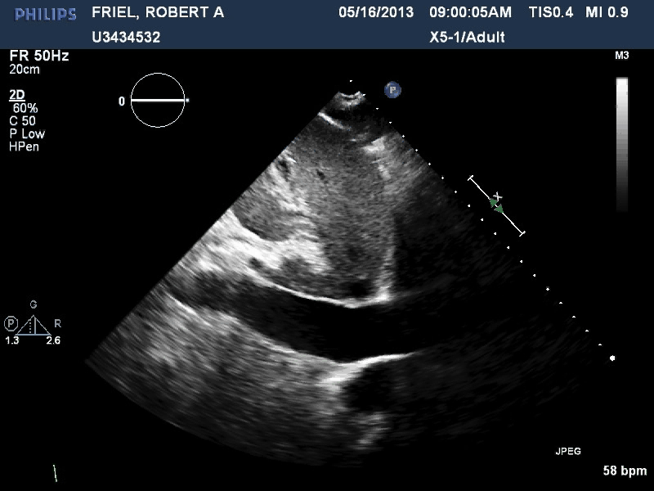
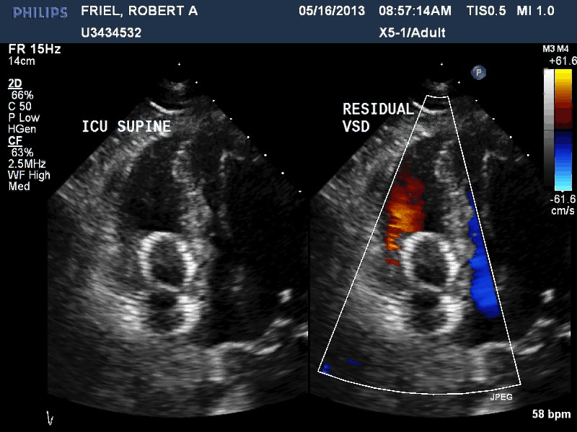
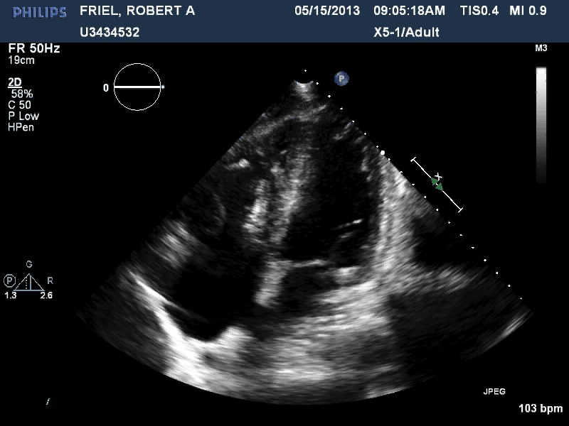
TTE HD 5
A4C, Off axis A4C and IVC
Notes:
BP from 80s to 110 systolic

Slide 25
Case Outcome
Continued high vasoactive agent requirement
Family at the bedside and life prolonging medications were weaned, patient and family grateful for care and attempt.
Autopsy performed:

Slide 26
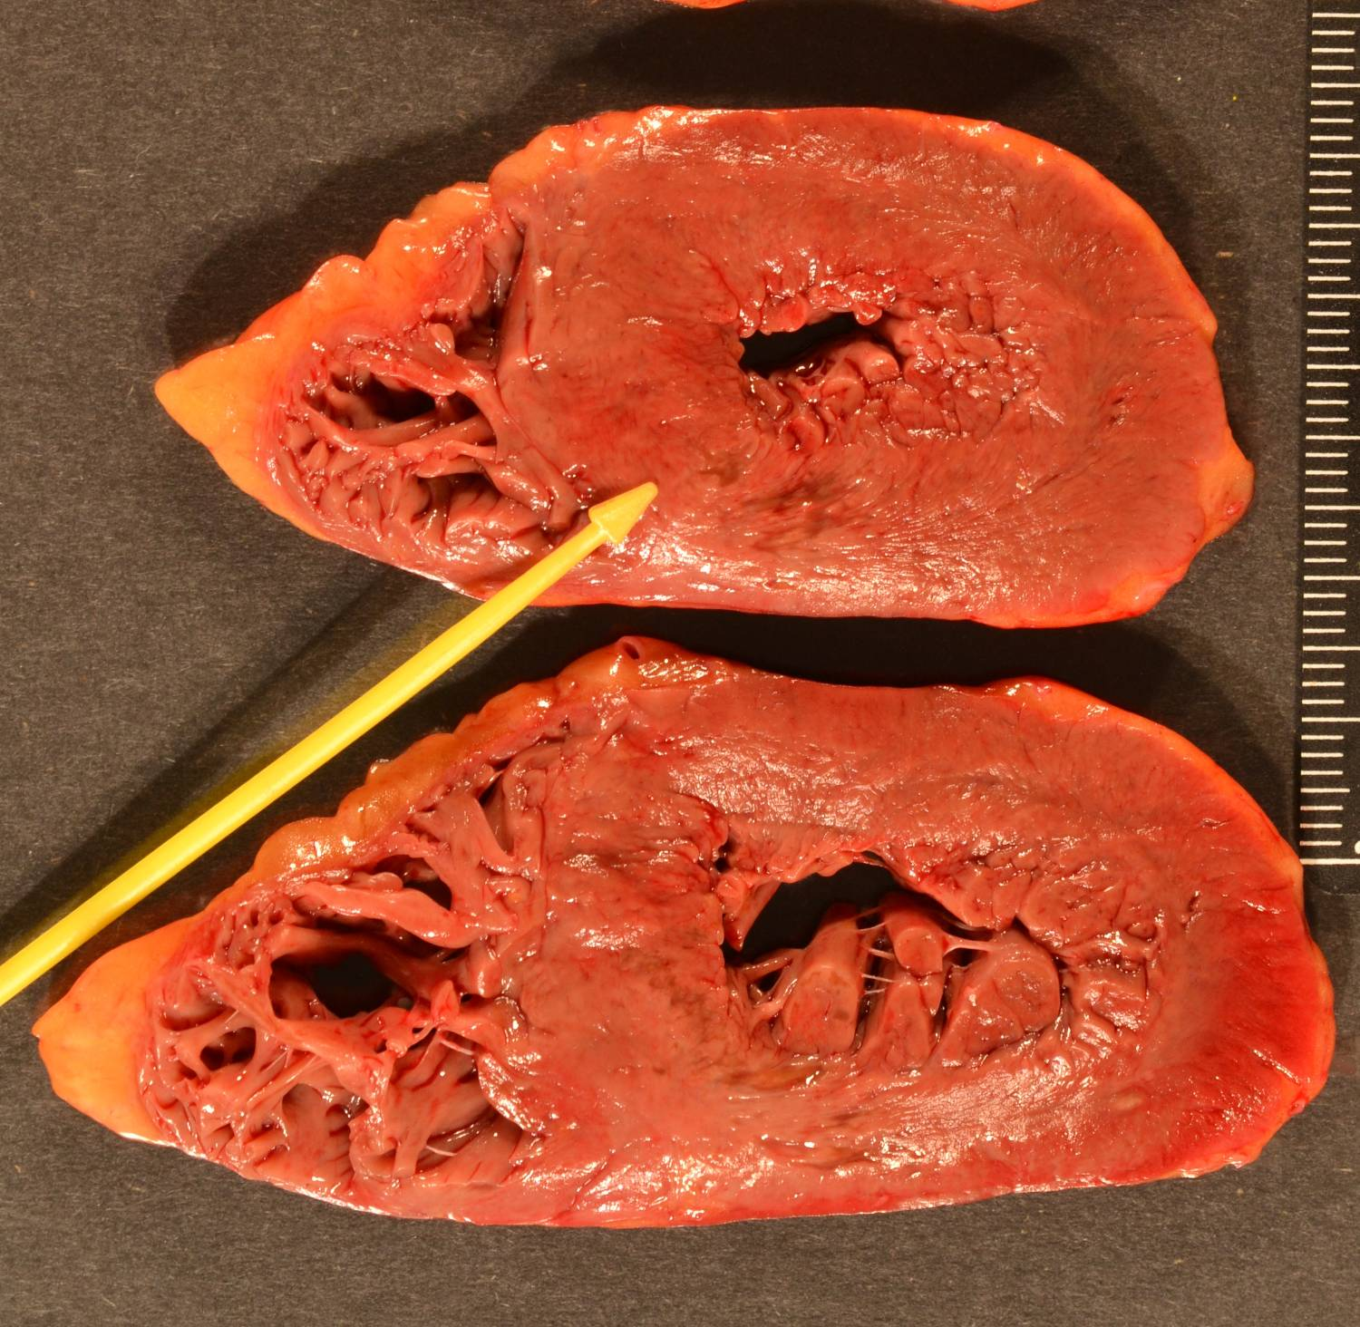
Recent (healing) MI

Slide 27
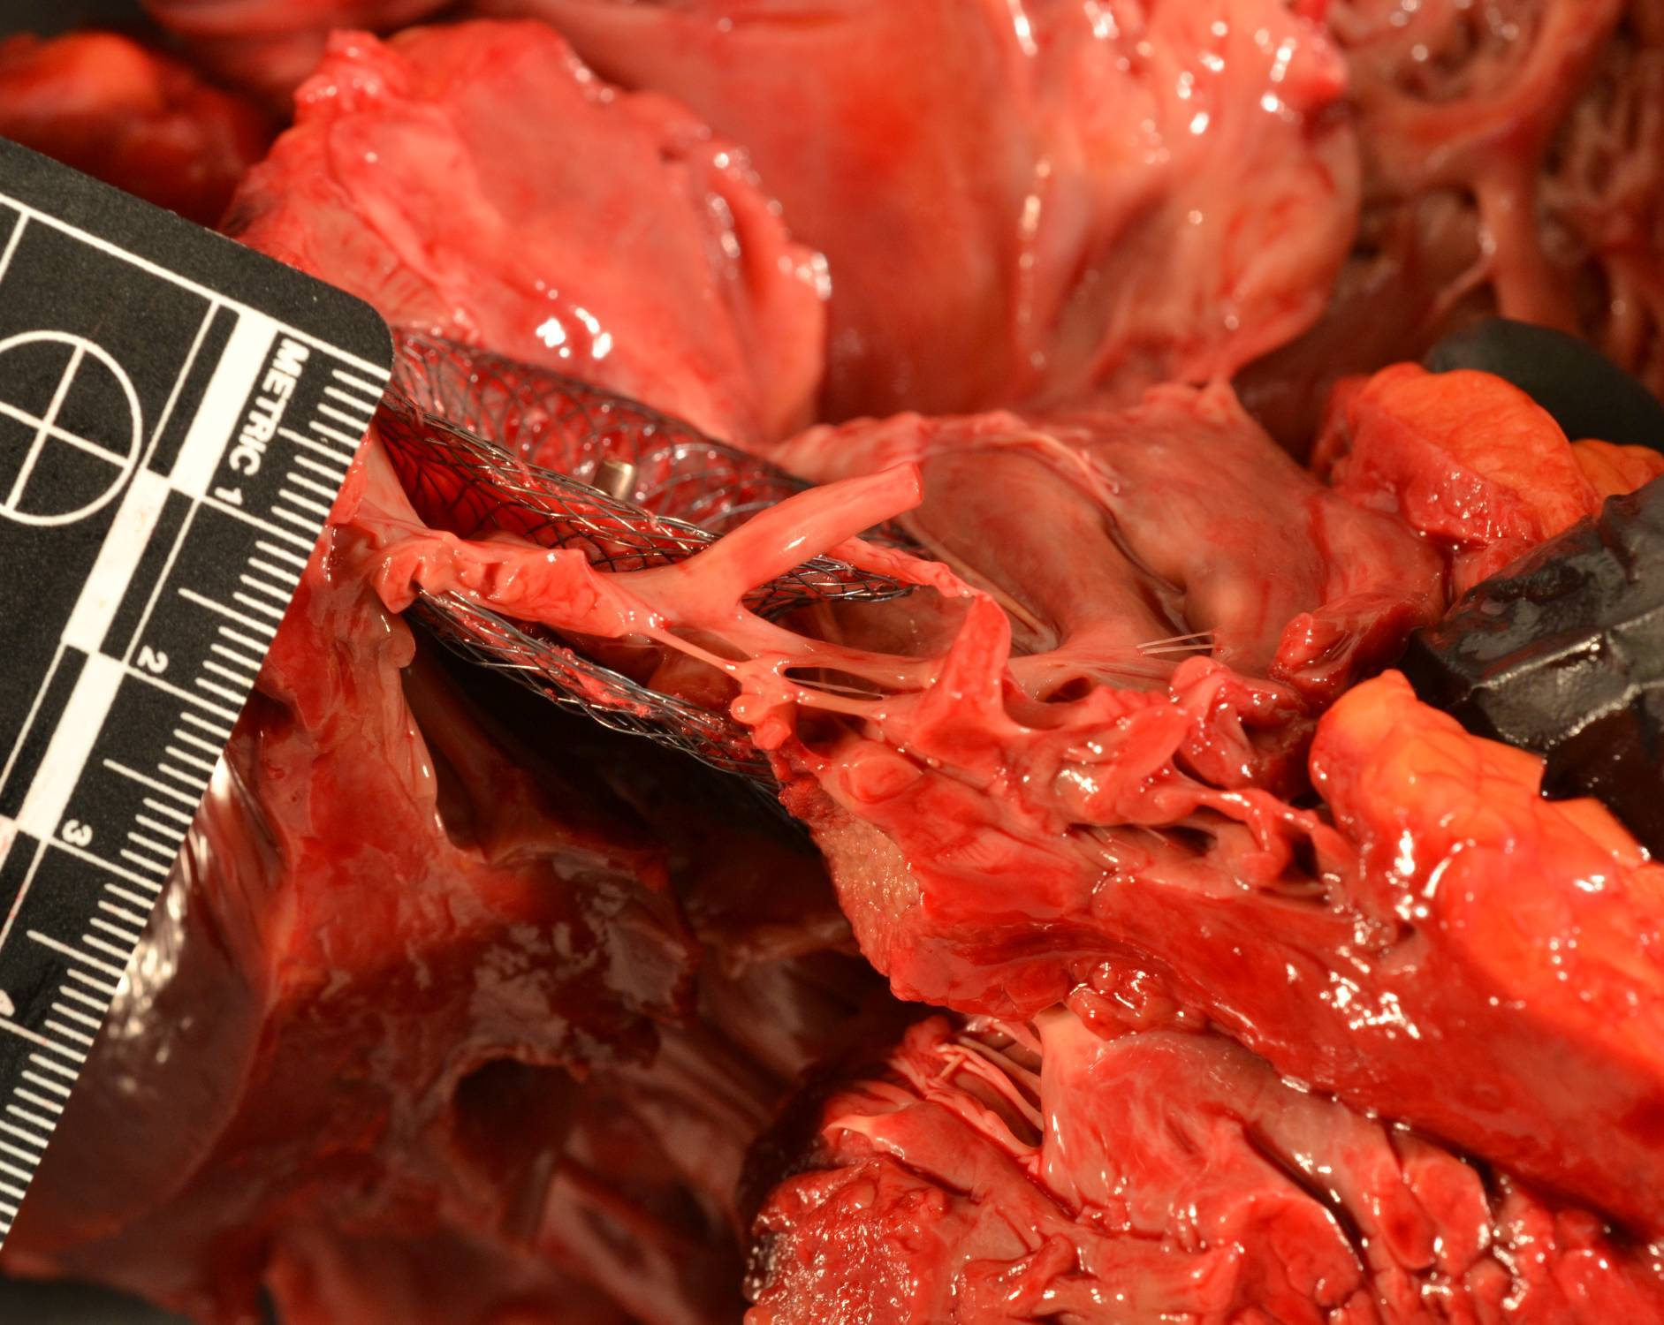
Amplatzer in situ over VSD

Slide 28
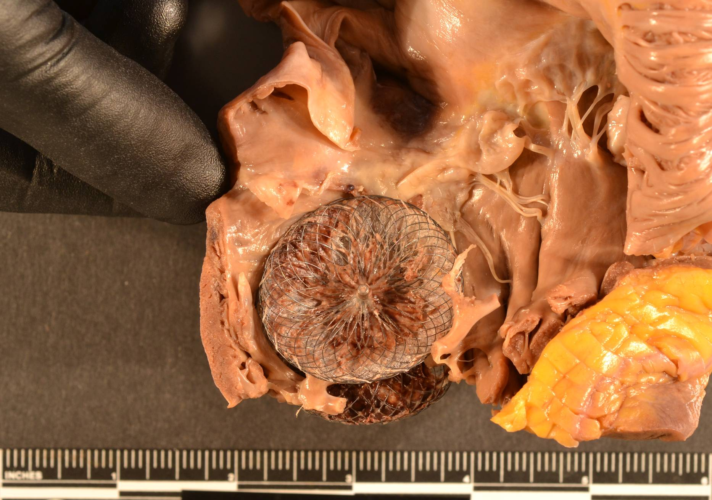

Slide 29
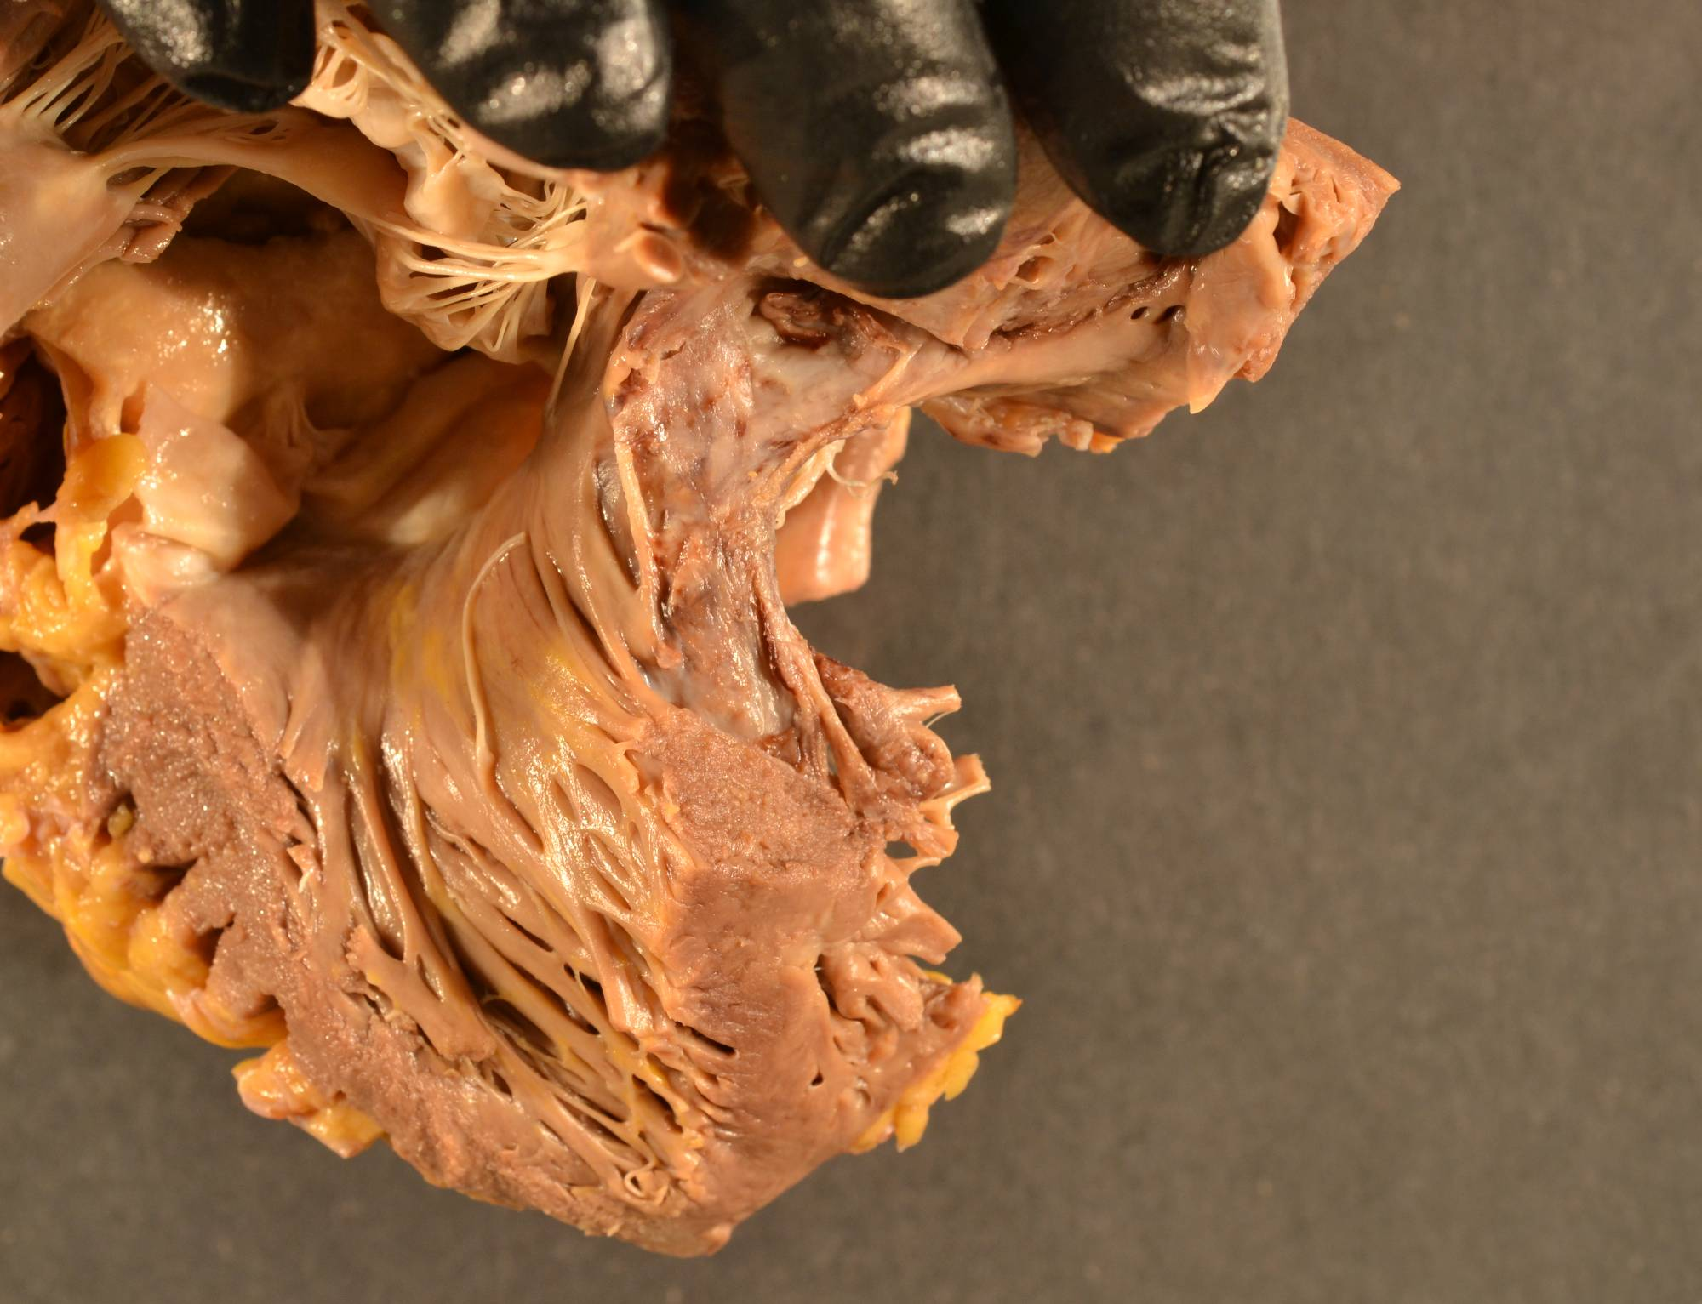
VSD
VSD Amplatzer Removed

Slide 30
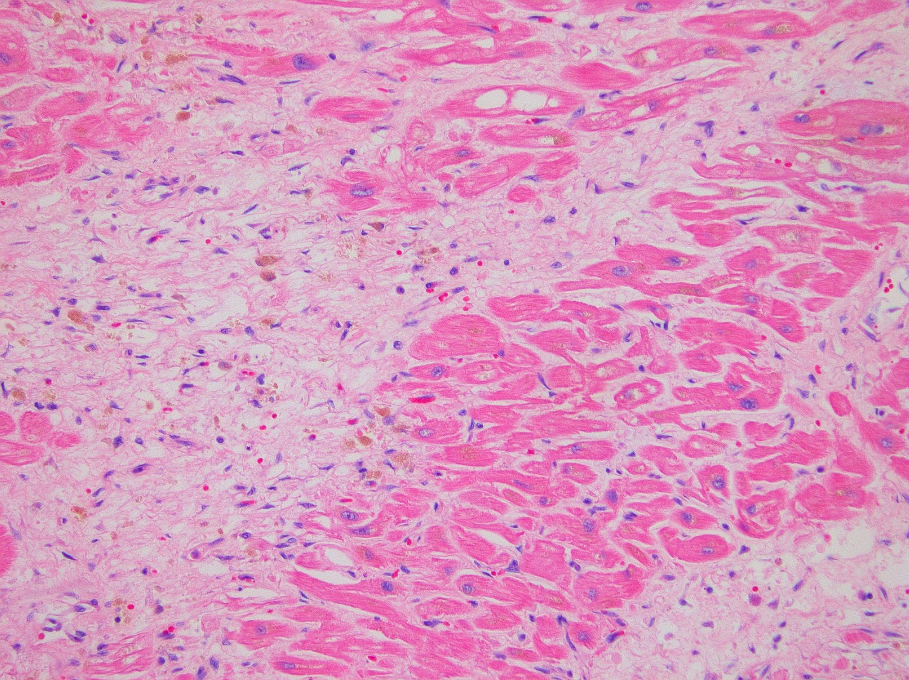
Recent (healing)
Infarct (weeks)

Slide 31
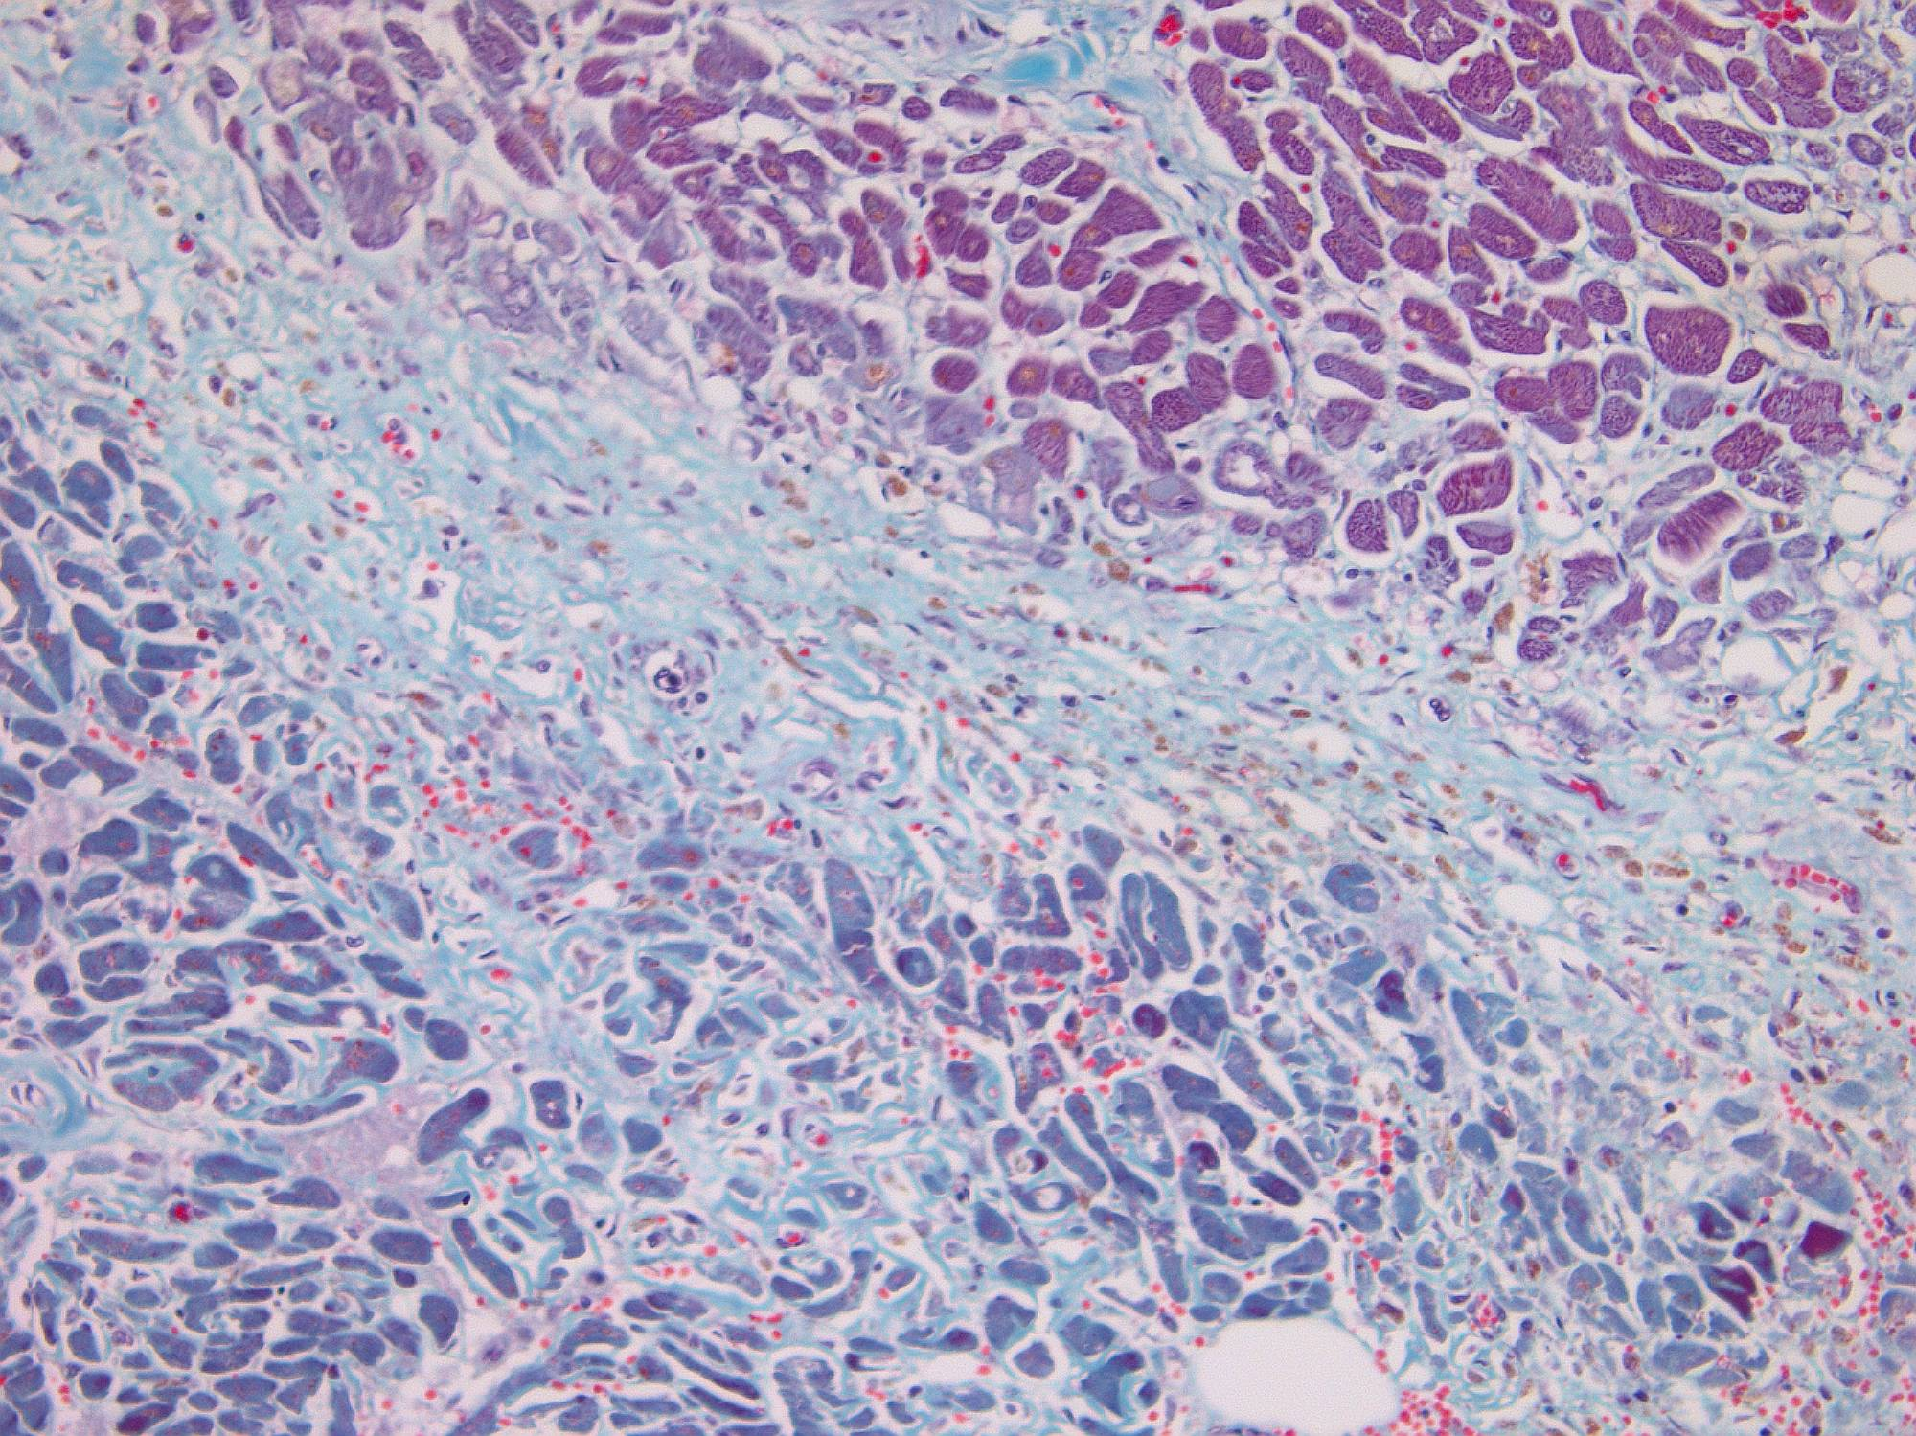
Recent Infarct (weeks) - GT

Slide 32
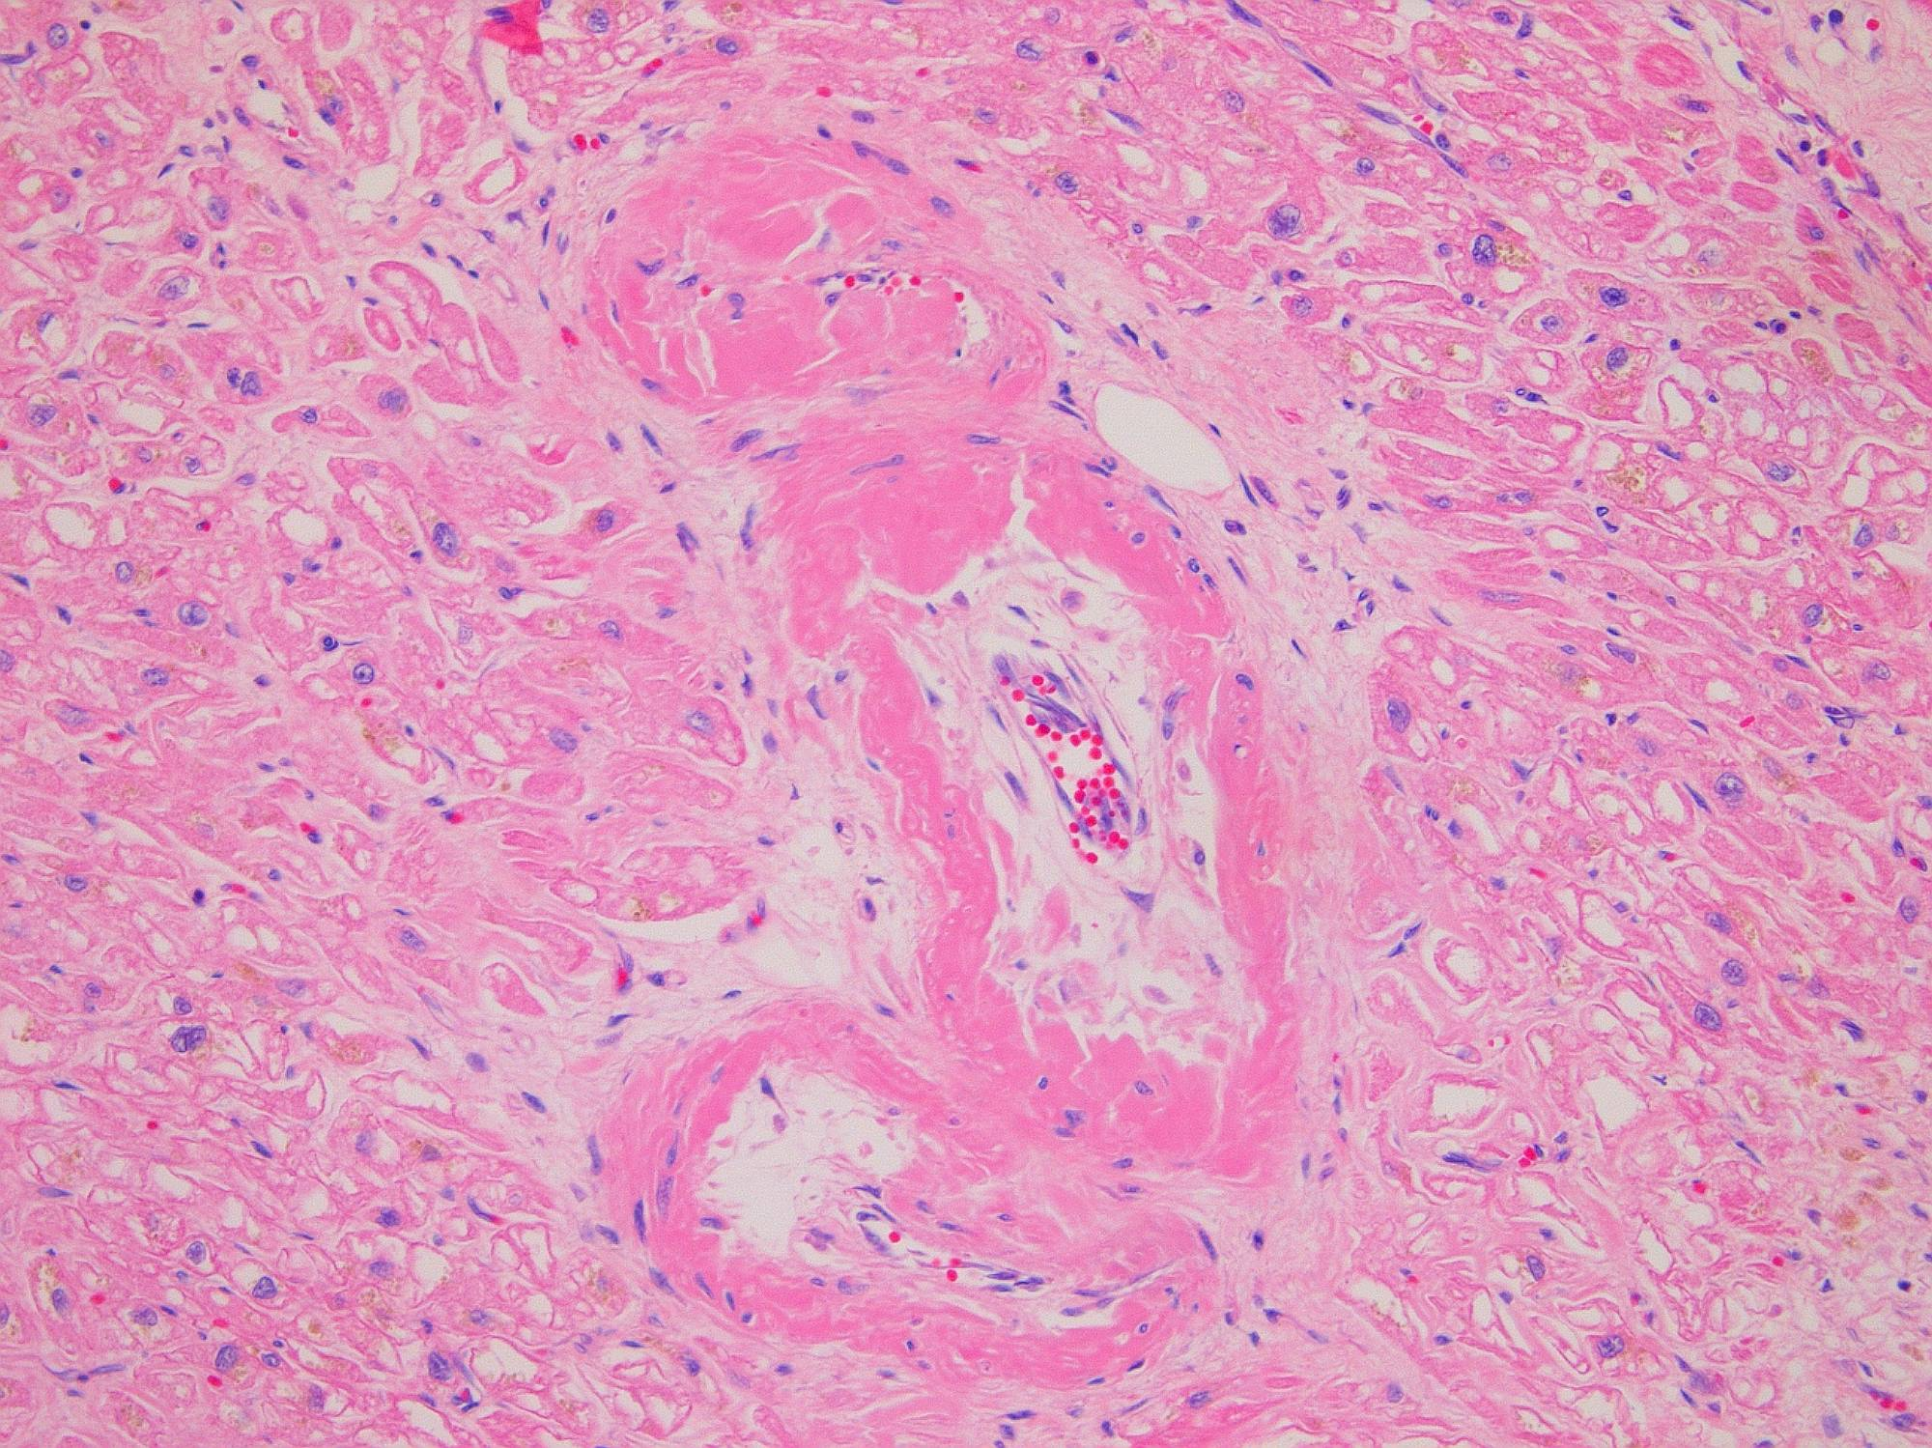
Amyloid

Slide 33
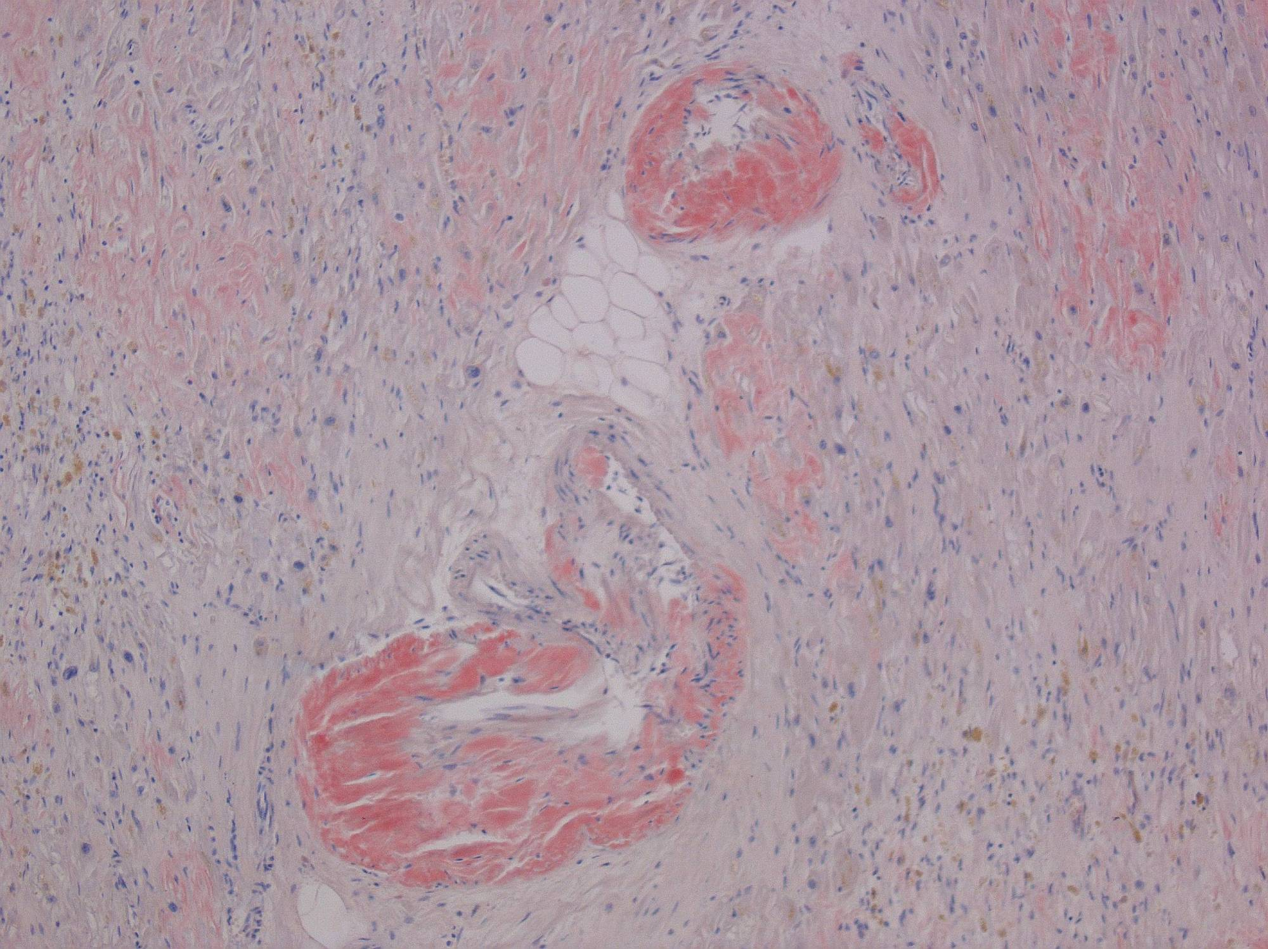
Amyloid
Congo Red—interstitial and intravascular

Slide 34
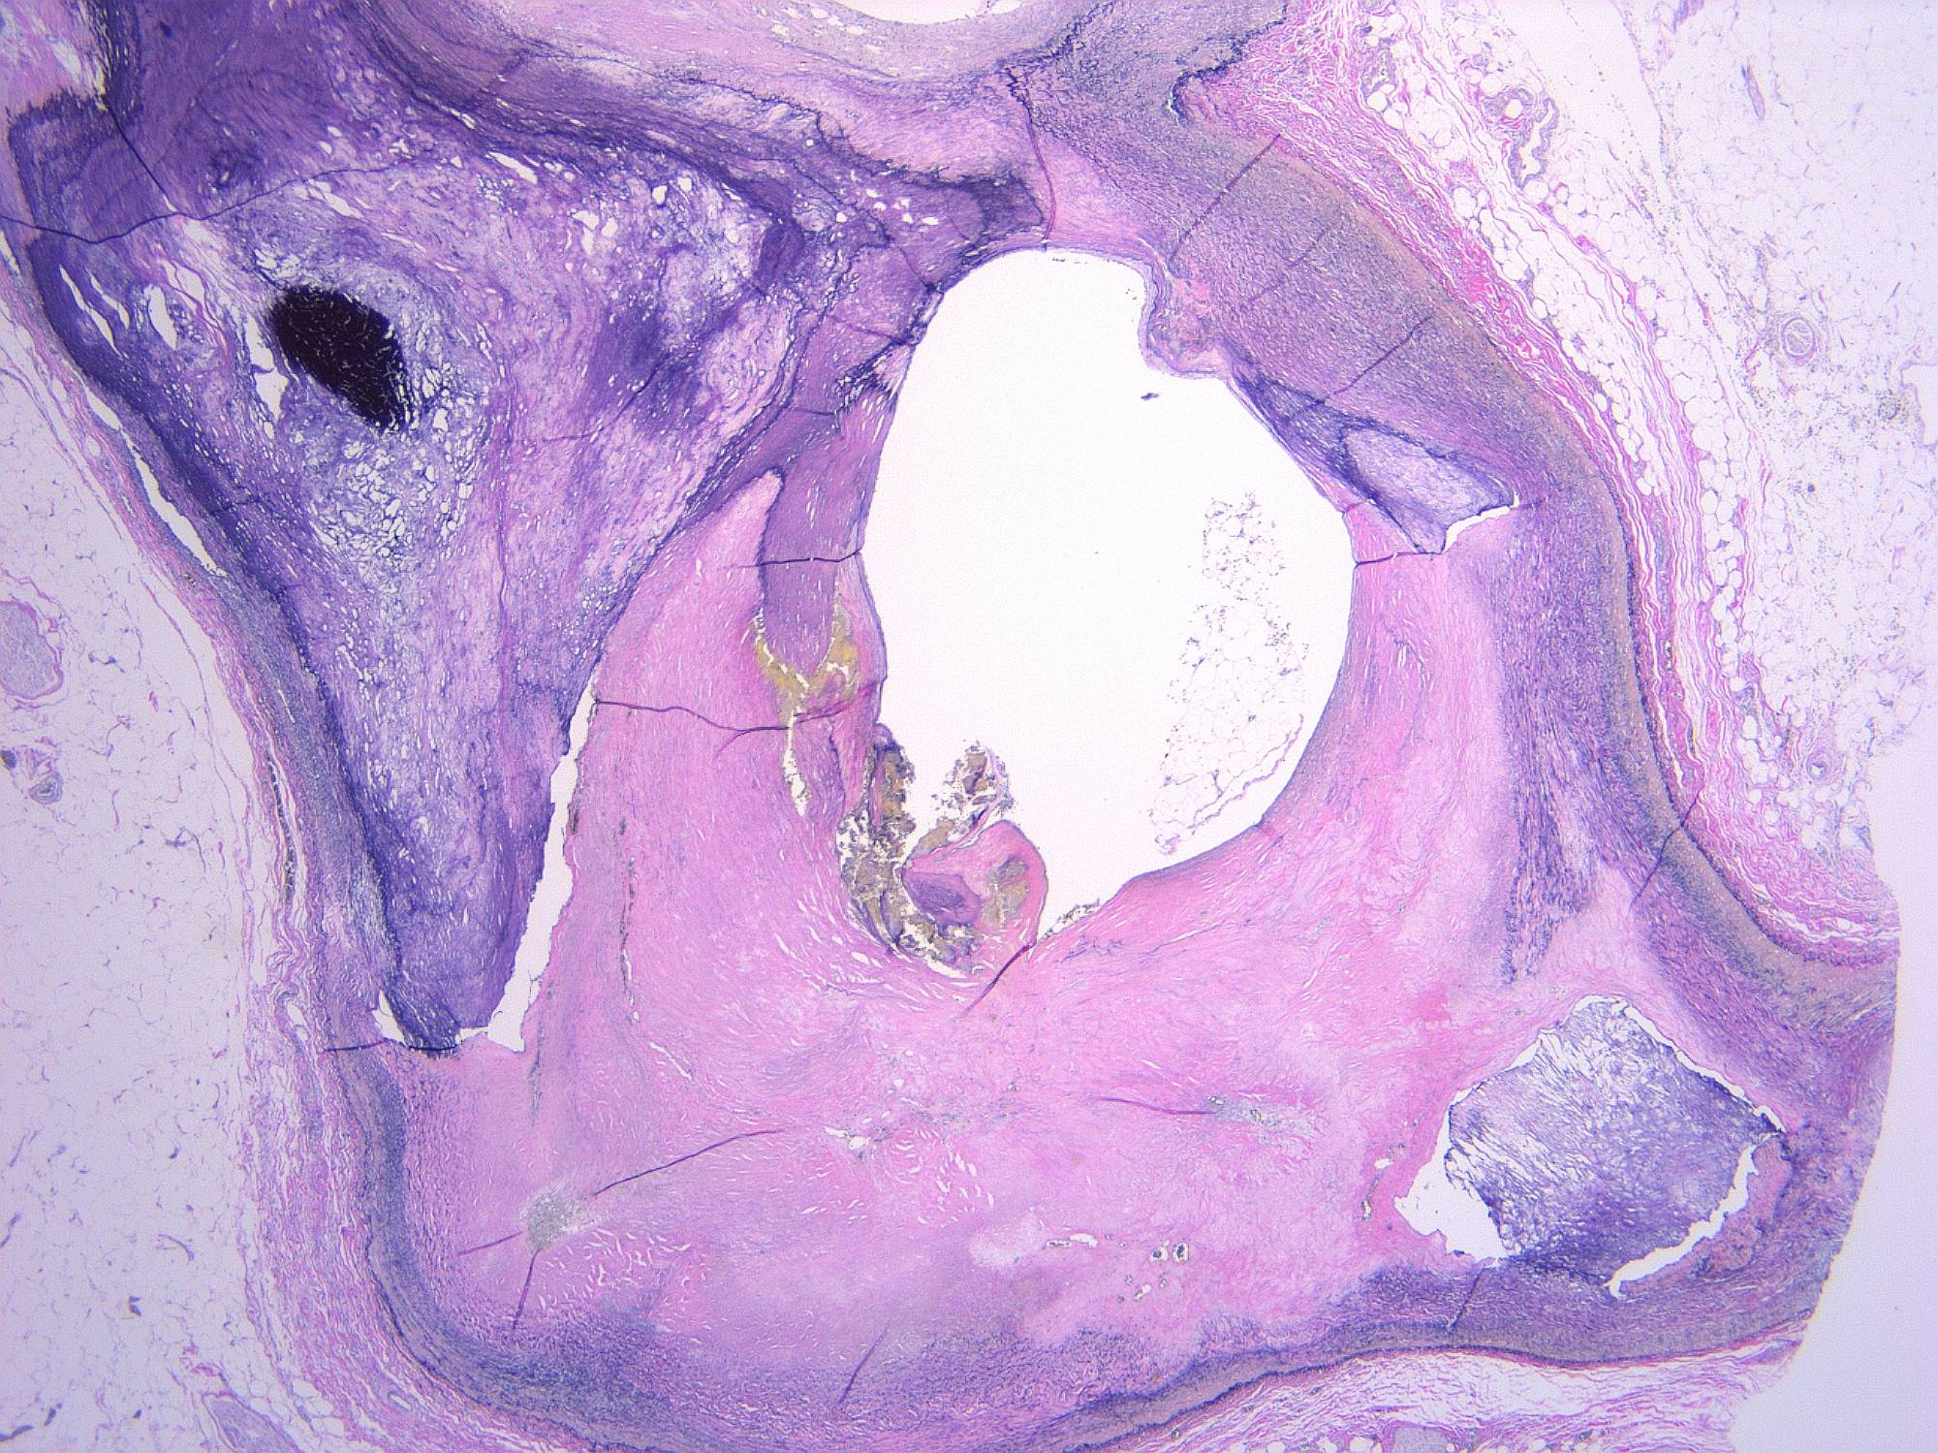
Coronary Artery

Slide 35
Autopsy Findings
Cardiomegaly (537 grams)
Recent (healing) myocardial infarct (weeks).
  Posterior-septal distribution (RCA).
  RCA stents in place.
  Variable atherosclerotic stenosis of coronary arteries.
Acquired ventricular septal defect (VSD) due to ruptured myocardial infarct.
  Amplatzer in place; entrapped tricuspid valve leaflet.
Cardiac amyloidosis.
Myxomatous degeneration of posterior mitral valve leaflet; mild annular calcification of mitral valve

Slide 36
Learning Points
Post Myocardial Infarctions complications rare
Acute VSD has high mortality (~50%)
Acute medical management must be optimized first
Surgery probably better than Medical management in selected cases (>90%)
Role of Interventional (VSD occluders) approaches unclear
Infarct / VSD exclusion (David) approach probably preferred surgical approach

