Slide 1
Aortic Valve Stenosis
Mitral Valve Regurgitation
Author: Shalin Patel, MD; Edward Verrier, M.D.
Institution: University of Washington Date: 8/2014
Revised 9/2022 by Alison F. Ward, MD; Emory University
Updated 9/2022 by Alison F. Ward, MD; Emory University

Slide 2
November 2021
CC: “ I can’t do what I used to be able to”
History of present illness
  Mr. B is a 80 year old man who was very active until November 2021. He was avid biker with daily 5-10 mile rides
  He presents to ED with several days of fatigue and dyspnea with minimal exertion
  He does not report chest pain / pressure, nausea or diaphoresis, palpitations, or syncope

Slide 3
Past Medical History
  Moderate aortic stenosis
    Peak velocity of 3 m/s, mean gradient of 21 mmHg
  Paroxysmal atrial fibrillation
  Sick sinus syndrome requiring pacemaker
  Hypertension
  Dyslipidemia
  CKD Stage 3
  Polymyalgia rheumatica

Slide 4
Past Medical History Continued
Medications: Simvastatin, metoprolol, coumadin
Social History: Retired accountant. Lives with his son. No smoking history. Social alcohol use
Family History: Two sons with valvular problems

Slide 5
November 2021
  Physical Exam
  Tc: 99.2 Pulse:72 BP:124/72 RR:12 O2:98%RA
  General: Well appearing male in no acute distress
  Lungs: Clear to auscultation bilaterally. No crackles or wheezing noted.
  Heart: RRR. 3/6 holosystolic murmur best heard at the apex. JVP ~ 10 cm. No edema.
Diagnostic Studies
  ECG: NSR. NA. NI. No regional ST-T changes.
  Labs: Normal CBC, Chem 7 and cardiac enzymes
  CXR: Bilateral moderate pleural effusions
  Cardiac Cath: One vessel CAD (70% mid RCA lesion)

Slide 6
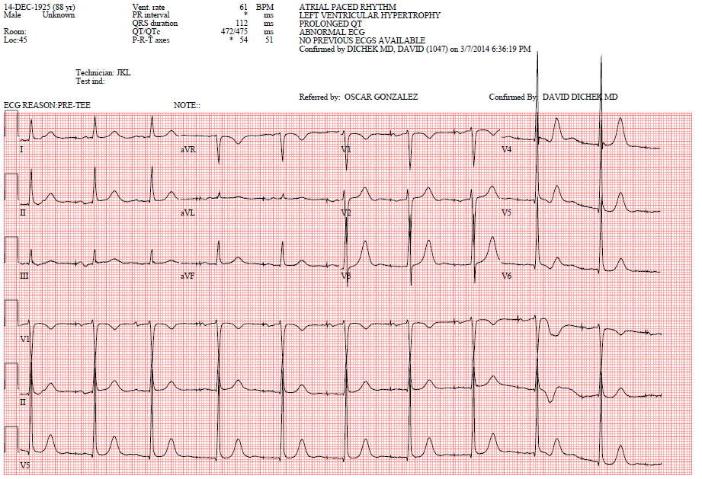
Electrocardiogram

Slide 7
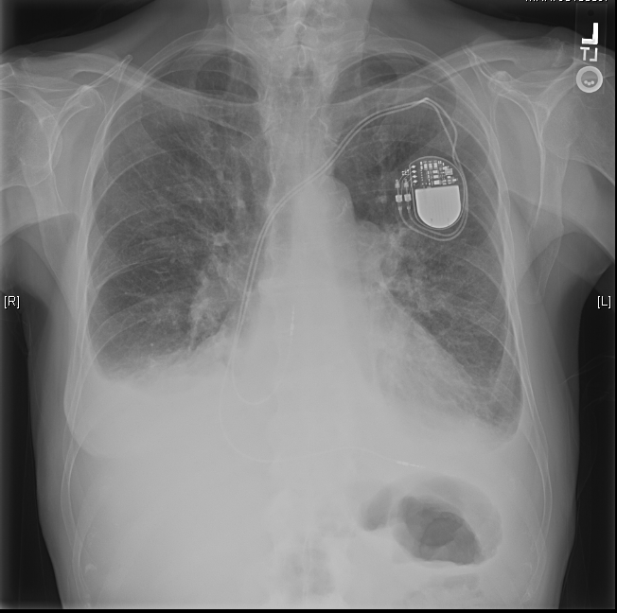
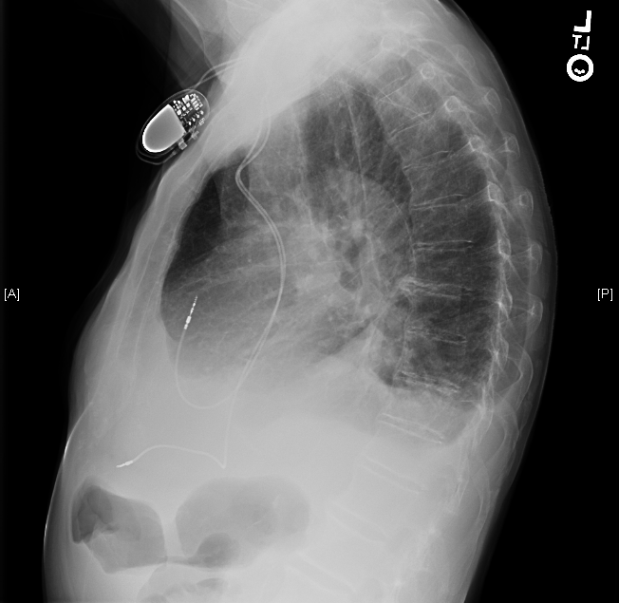
Chest X-Ray

Slide 8
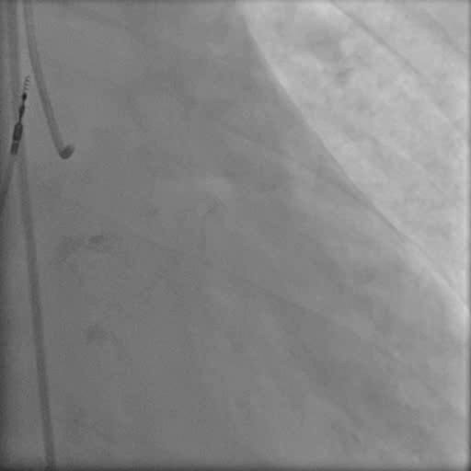
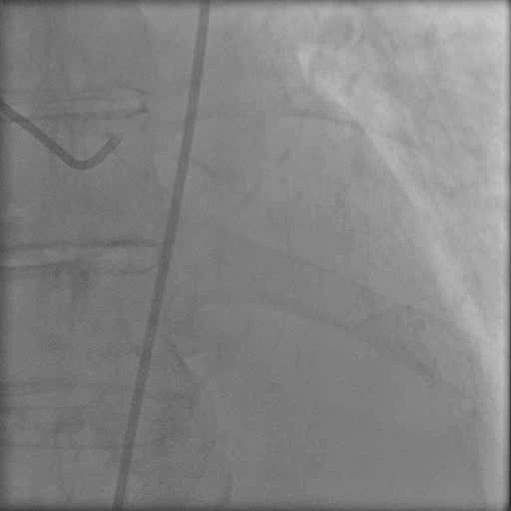
Coronary Angiogram

Slide 9
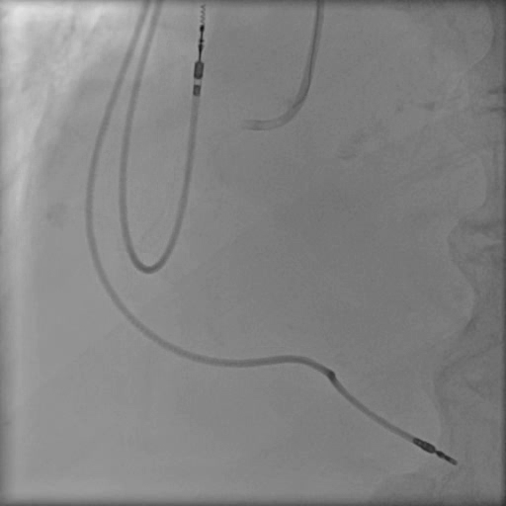
Coronary Angiogram

Slide 10
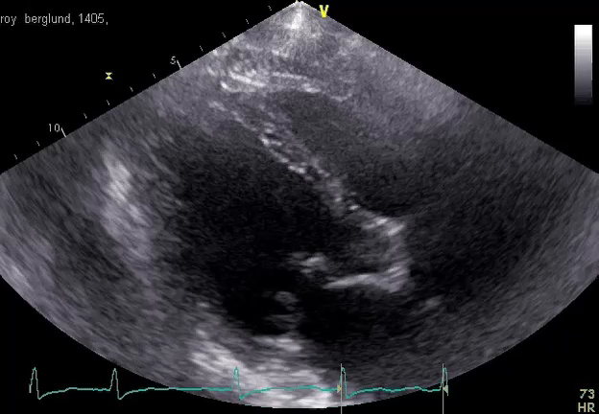
Transthoracic Echocardiogram

Slide 11
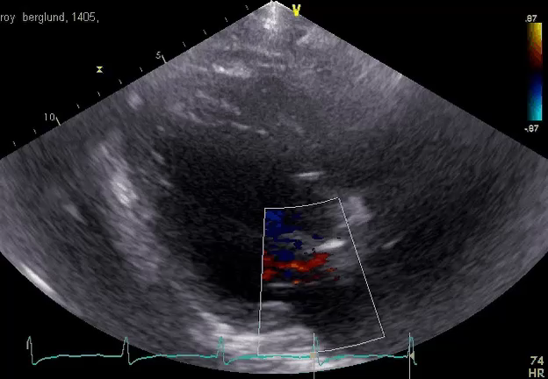
Transthoracic Echocardiogram

Slide 12
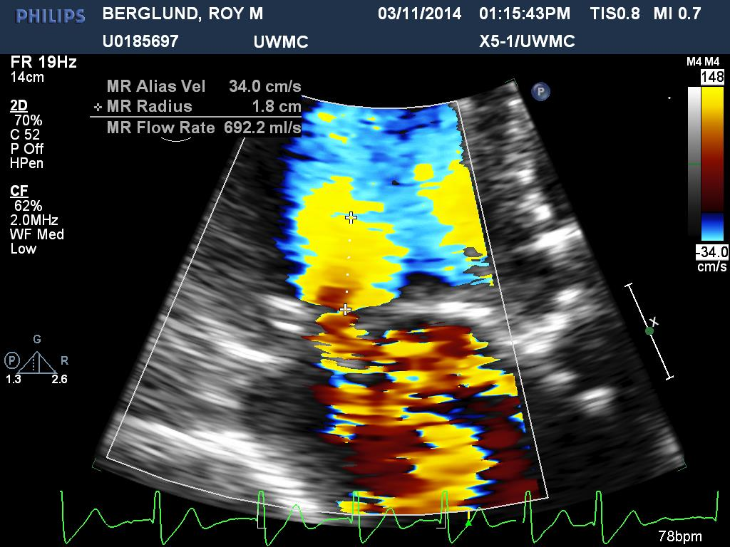
Transthoracic Echocardiogram

Slide 13
Discussion Points for Conference
80 y/o with two valve disease + CAD
Risk stratification
Heart team discussion
  Continued medical management
  TAVR +PCI + staged Mitraclip
  Open surgery: double valve replacement, single vessel bypass

Slide 14
Winter 2021
Opted for Continued Medical Management
Four admissions to the hospital for acute on chronic heart failure requiring IV diuresis.
Left heart catheterization showed one vessel coronary artery disease with 70% proximal right coronary artery disease.
Presented to ED in 02/2014 with confusion and found to be cardiogenic shock with altered mental status and acute kidney injury.
Discharged to rehab in 03/2014 after significant diuresis.
Referred to quaternary hospital for further advanced therapies

Slide 15
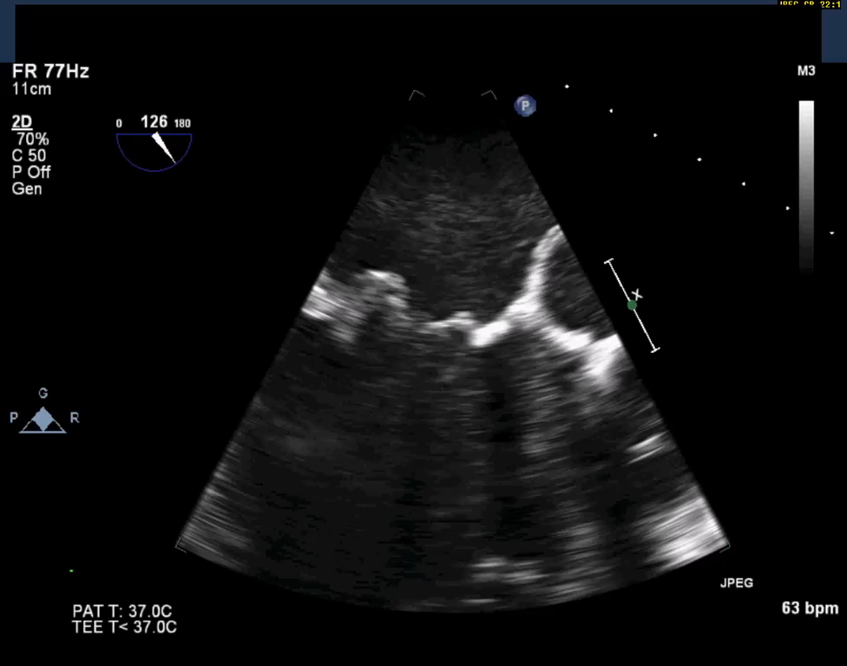
3-D Transesophageal Echocardiogram

Slide 16
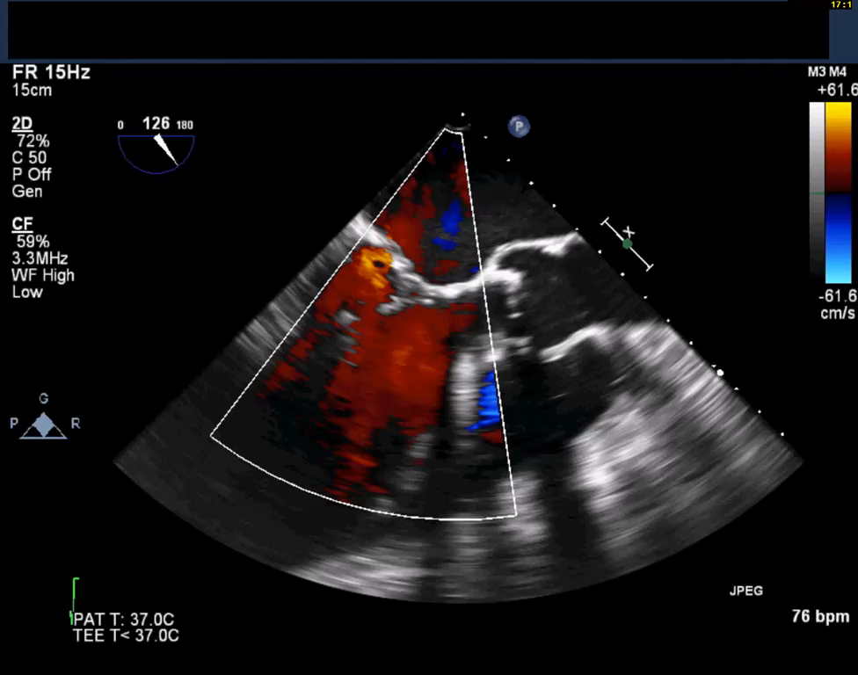
3-D Transesophageal Echocardiogram

Slide 17
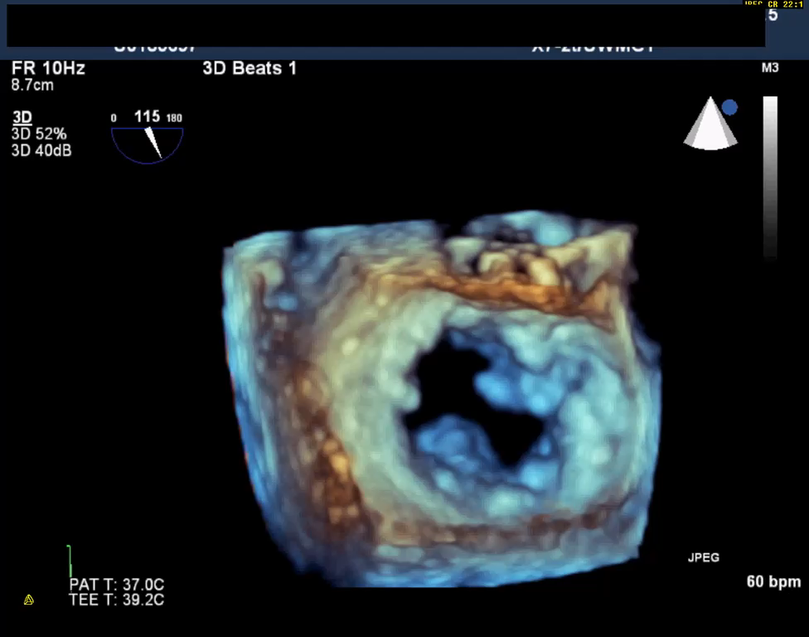
3D Transesophageal Echocardiogram

Slide 18
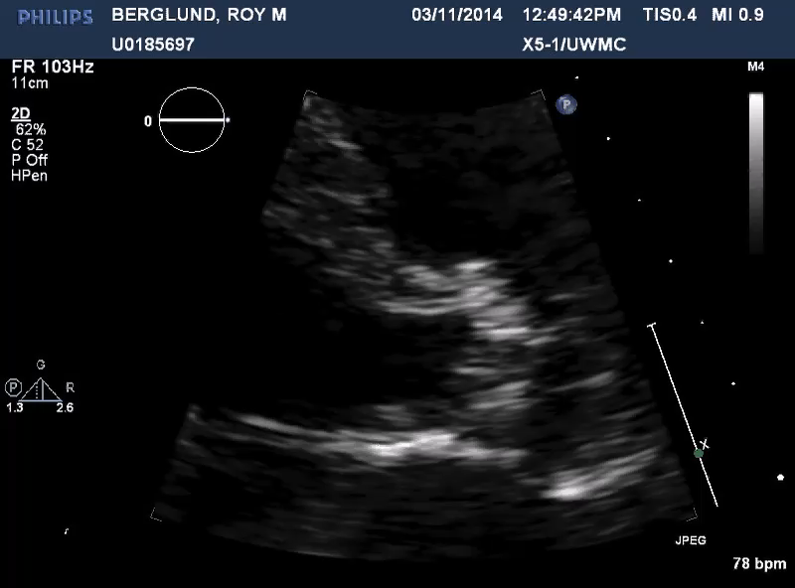
Transthoracic Echocardiogram

Slide 19
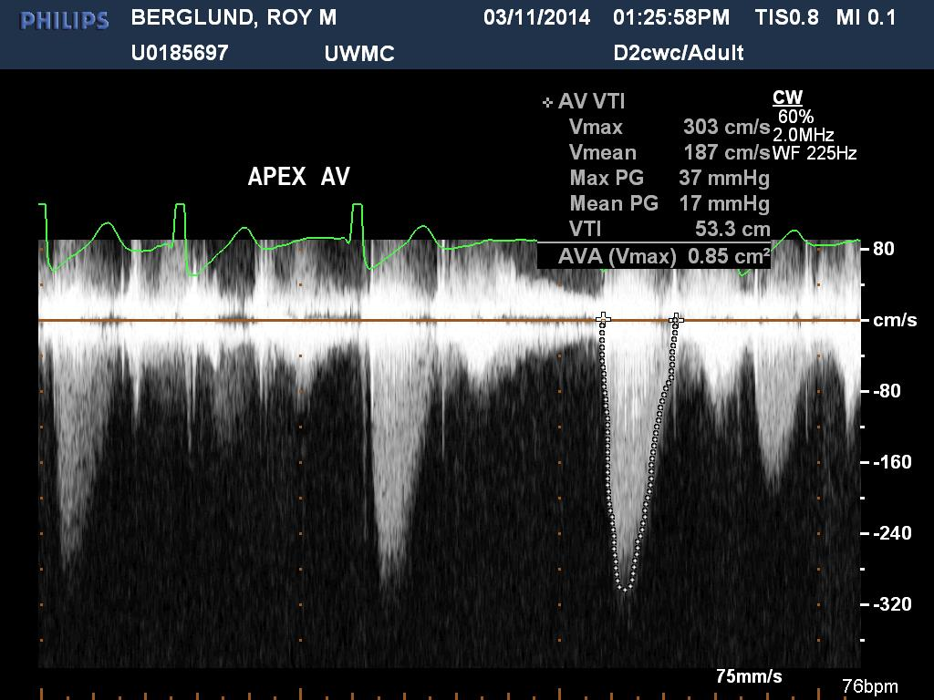
Transthoracic Echocardiogram

Slide 20
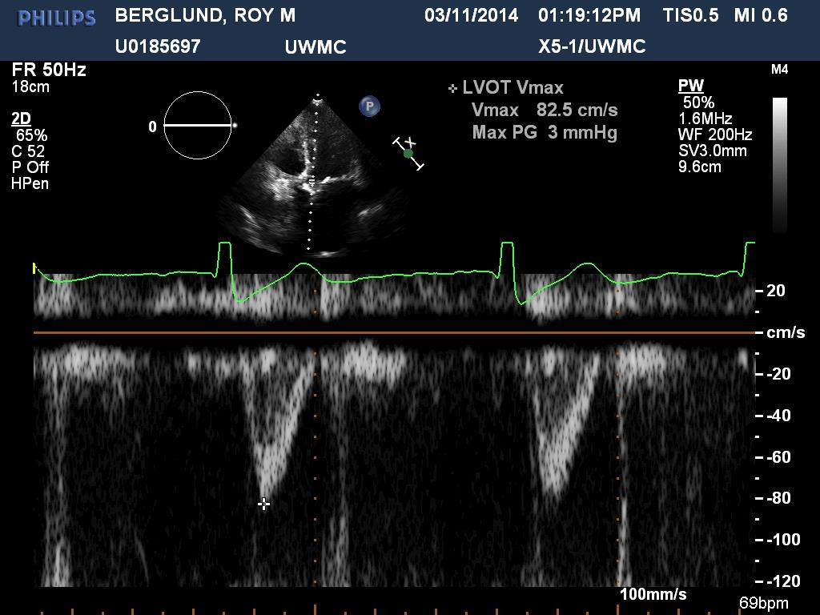
Transthoracic Echocardiogram

Slide 21

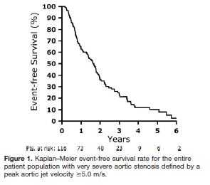
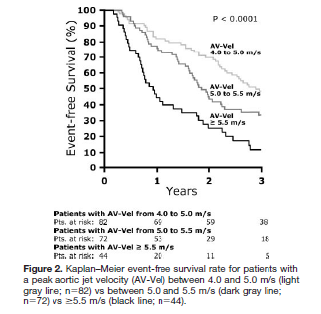

Slide 24
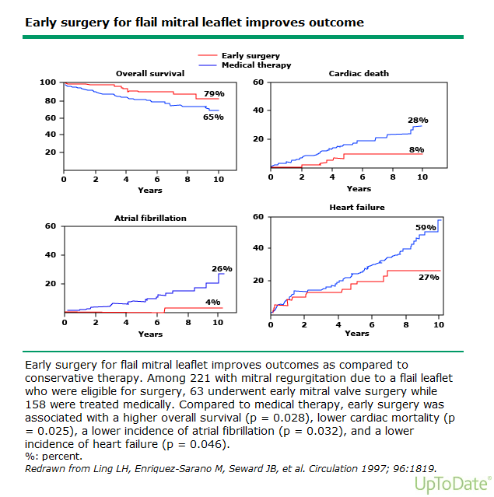
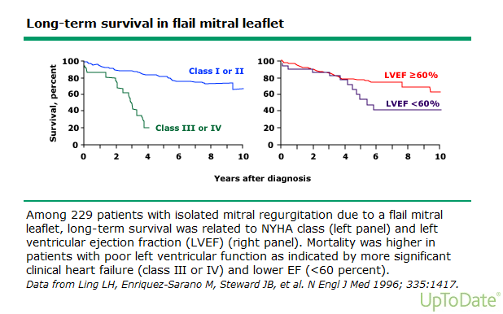
NEJM 1996;335(19):1417

Slide 27
Risk Stratification for AS/MR Intervention

Slide 28
Postoperative Course
The patient underwent AVR, MVR with bioprosthetic valves and SVG-RCA
Early extubation and mobilization postoperatively
No significant perioperative complications
Discharged POD # 11 to SNF
Discharged to home at one month
Doing well 3 months later

Slide 29
Learning points
Decision making in patients with complex valvular heart disease should involve a heart team approach, with decision making tailored to the patient
  SAVR vs TAVR
  MVR vs MVr vs TEER
  CABG vs PCI
  Staged approach
Surgery can still be successful in well selected patients
Elderly patients undergoing complex operations should be mobilized quickly to avoid perioperative complications

