Slide 1

Coronary Ischemia after Mitral Valve Repair
Author: Raghav Murthy MD, Derek Williams MD, David Graham MD, Brian Bethea MD.
Institution: University of Texas Southwestern /Dallas
Date: March 2014
Learning Domain: Adult Cardiac Surgery
Learning Objective: Mitral Valve Disease
Coronary Artery Disease
Case Presentations
Adult Cardiac Surgery
TSC CV 04 / 13 B
Milestone: 5, 17

Slide 2
History
32 yo male, mild developmental delay diagnosed with mitral valve prolapse 2000
Sx for scoliosis 1999
Home meds:
metoprolol

Slide 3
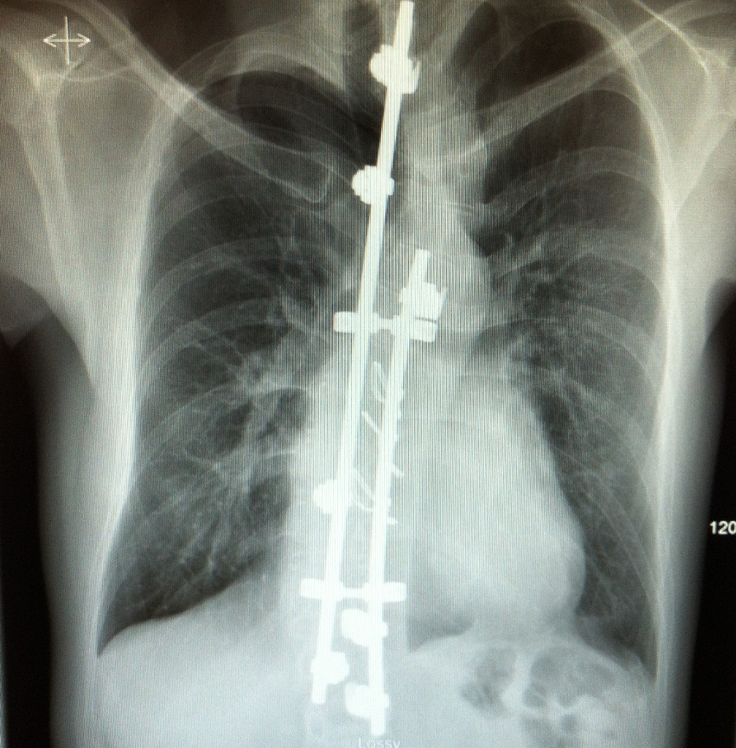
Pre op Chest X-Ray

Slide 4
ECHO
Severe MR, bi-leaflet prolapse post > ant
EF 50%
LVEDD: 40 mm

Slide 5
Surgery
Minimally invasive: right thoracotomy
Mitral valve repair, 5 neo cords, 40 mm Physio-2 ring
Pectus + scoliosis difficult exposure
CPB 242 mins, AXC 180 mins
No difficulty separating from CPB
Post op TEE: trace MR ? post WMA

Slide 6
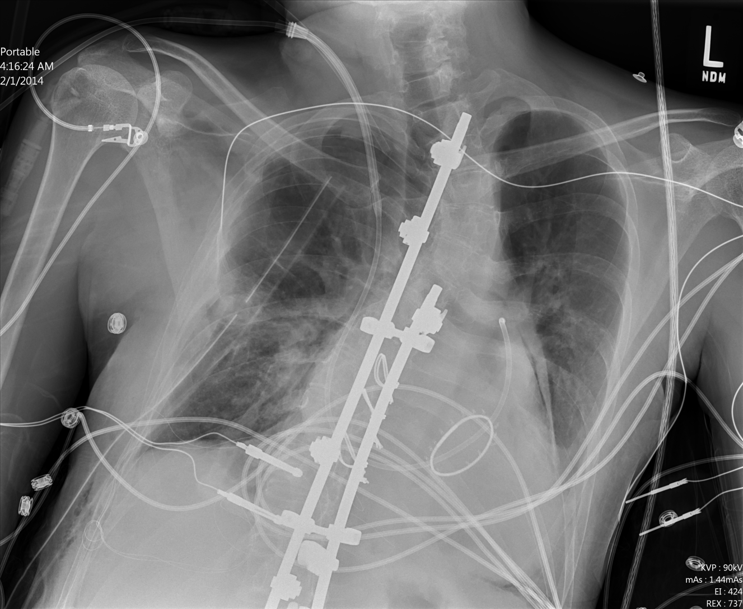
Post-op Chest X-Ray

Slide 7
Discussion Points for Conference
When to suspect coronary injury during valve surgery
Tricuspid valve / Aortic Valve / Mitral valve
Anatomic features leading to injury
How to make diagnosis
Clinical “Index of Suspicion”
Intra op / post op EKG
Troponin
Regional wall motion abnormalities
Difference between air vs mechanical injury
Reliability of testing in early post op period
Therapeutic options

Slide 8
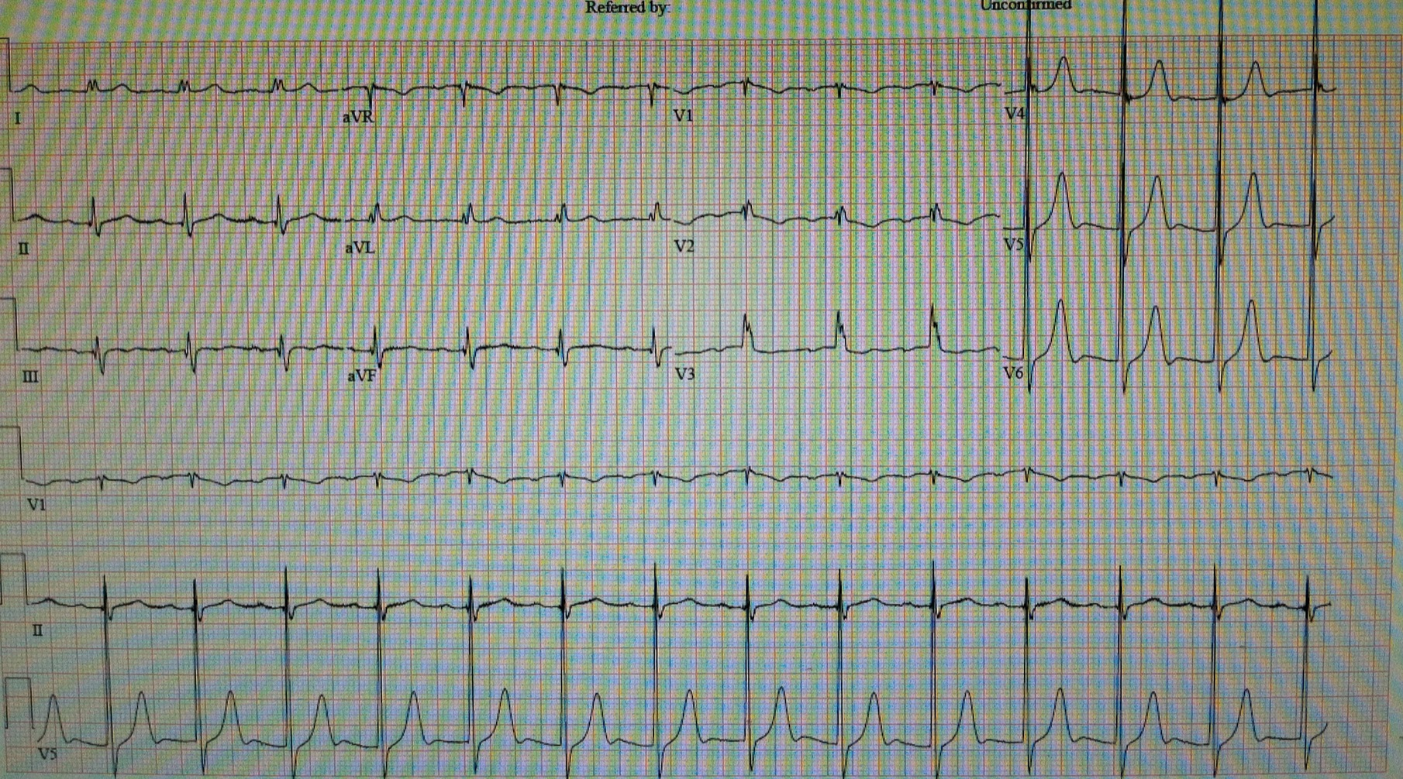
Post-op EKG

Slide 9
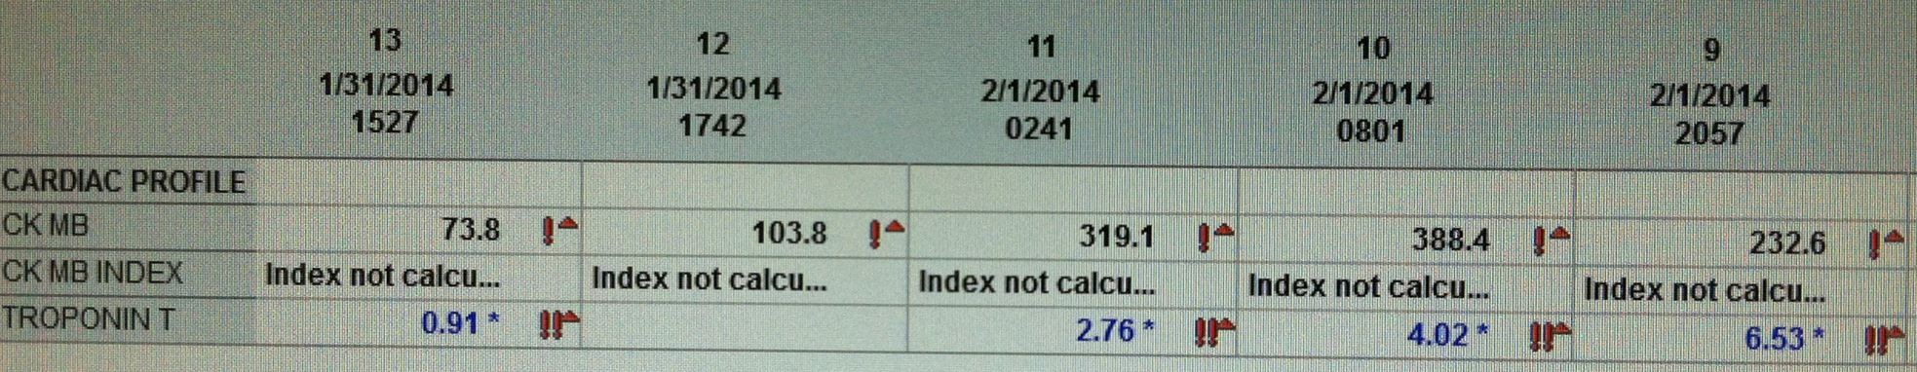
Cardiac profile

Slide 10
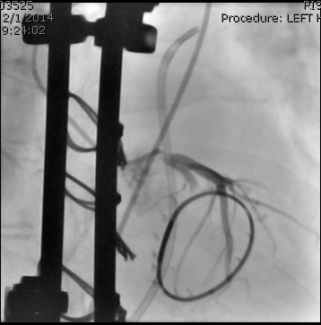
Left Coronary Injection
Mid circumflex Coronary Occlusion

Slide 11
Cath lab
POD # 1
99% mid Cx stenosis
Predilated with a 2.0 x 12 mm, 2.5 x 15, and 3.0 x 20 mm Sprinter balloon to 14 atm. 3.0 x 26 Resolute Integrity stent to 14 atm.

Slide 12
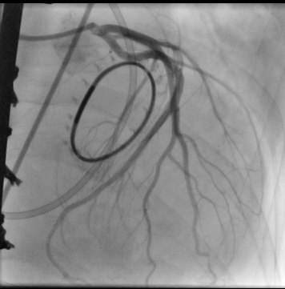
Left coronary angiogram post PCI / Stent
Left Circumflex Coronary open

Slide 13
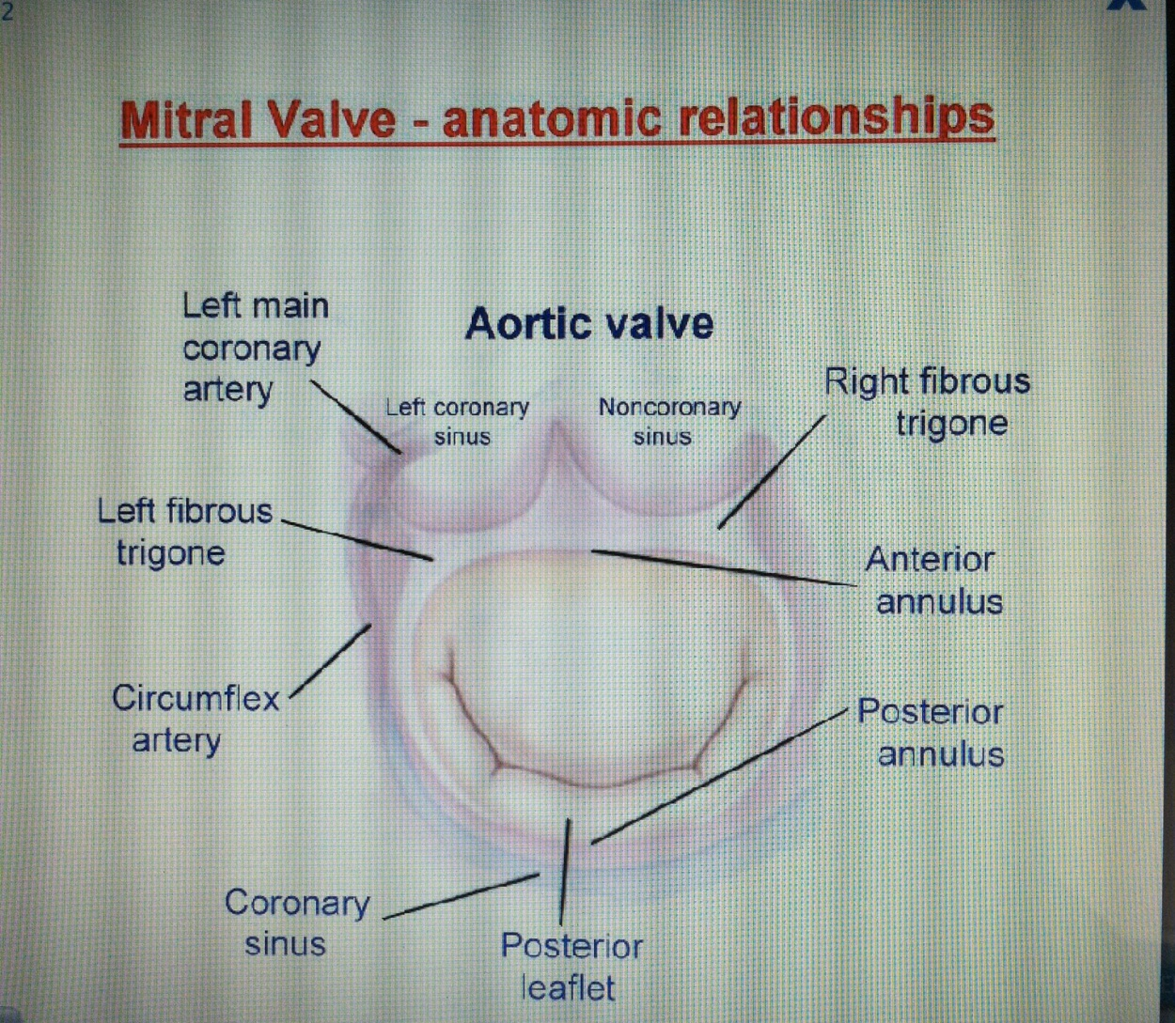
Right dominant hearts showed that the shortest distance between the annulus and the coronary arteries occurred at the level of the anterior commissure, where the circumflex artery was distant to the annulus 3.99 ± 1.86 mm (varying from 1.01 to 11.80 mm) while the longest distance was at the posterior commissure, measuring 7.78 ± 2.61 mm.
Pessa C.J.N., Gomes W.J., Catani R., Prates J.C., Buffolo E.
Anatomical relationship between the posterior mitral valve annulus and the coronary arteries. Implications to operative treatment. Rev Bras Cir Cardiovasc 2004;19:372-377.

Slide 14
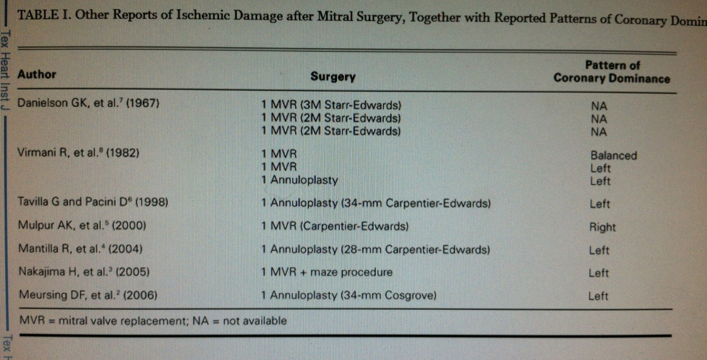

Slide 15
Mechanism of injury
Fixation suture that completely encircles and occludes the artery
Suture that passes through and completely obliterates the artery
Vascular distortion or a large quadrangular resection that causes dynamic or fixed occlusion
Laceration of the artery that results in localized hemorrhage, subintimal hematoma, coronary spasm or thrombotic occlusion due to laceration of the endothelium.
Grande AM, Fiore A, Massetti M, Viganò M. Iatrogenic circumflex coronary lesion in mitral valve surgery: case report and review of the literature. Tex Heart Inst J. 2008;35(2):179-83. Review.

Slide 16
Follow up
Discharged home POD 5 on ASA and plavix
Pre discharge echo with no regional wall motion abnormality
Patient doing well at 3 month post discharge

Slide 17
Learning Points
Intraoperative coronary injury must be suspected to be diagnosed
Can occur with almost any valve replacement
More common in reoperations
Diagnostic criteria can be challenging for surgeon when focused on primary operation
Early diagnosis and intervention leads to best outcomes

